Slide 1
802.11 WG September 2025 Session Report
Date: 2025-09-17
Authors:

Slide 2
Abstract
This document is a digest of the closing reports of all 802.11 sub-groups for presentation at the September 2025 closing plenary meeting. Liaison reports (including liaison reports from the opening plenary) are also included.

Slide 3
Editors Meeting
No report

Slide 4
ANA
No report

Slide 5
AIML SC (AI and ML)
No report

Slide 6
ARC SC (Architecture)
No report

Slide 7
Coex SC (Coexistence)
No report

Slide 8
PAR Review SC
No report

Slide 9
WNG SC (Wireless Next Generation)
No report

Slide 10
JTC1 802 SC
No report

Slide 11
TGmf (Maintenance)
No report

Slide 12
TGbi (Enhanced Data Privacy)
No report

Slide 13
TGbn (Ultra High Reliability)
No report

Slide 14
TGbp (Ambient Power)
No report

Slide 15
TGbq (Integrated mmWave)
No report

Slide 16
TGbr (Enhanced Light Communications)
No report

Slide 17
TGbt (Post Quantum Cryptography)
No report

Slide 18
AUTO TIG (Automotive)
No report

Slide 19
UCM TIG (Automotive)
No report

Slide 20
WFA liaison
No report

Slide 21
IEEE 802.11-IETF Liaison Report
Date: 2025-09-17
Authors:

Slide 22
Abstract
This presentation contains the IEEE 802.11 – IETF liaison report for September 2025.

Slide 23
IETF Meetings
Upcoming Meetings:
November 1-7, 2025 – Montreal, QC, CA
March 14-20, 2026 – Shenzhen, CN
IETF meeting fee waivers
http://www.ietf.org
Newcomer training: https://www.ietf.org/about/participate/get-started/
April 2016: Wireless Tutorial (Donald Eastlake), 802.11 & 802.15 tutorials (Dorothy Stanley, Charlie Perkins), see 11-16/500, September 2016: Pat Thaler & Juan Carlos – 802.1E (Privacy Considerations) and 802c (Local MAC address usage) https://datatracker.ietf.org/group/edu/materials/

Slide 24
IETF- IEEE 802 Liaison Activity
Joint meetings, agenda and presentations
http://www.iab.org/activities/joint-activities/iab-ieee-coordination/
Proceedings: https://datatracker.ietf.org/iabasg/ietfieee/meetings/
Coordination topics include: Layer 2/Layer 3 Interaction for Time-Sensitive Traffic, Development of YANG models in the IEEE 802, Capability Discovery, MADINAS
IETF-IEEE 802 coordination teleconferences: June 26, 2025 (next Oct. 2025)
Joint in-person leadership meeting: July 26, 2025
DETNET-TSN Workshop: July 26, 2025

Slide 25
IETF protocol use with 802.11 technology
Nothing recently

Slide 26
BOFs at IETF 124 November 1-7, 2025
See https://datatracker.ietf.org/wg/bofs/
webbotauth | Web Bot Auth
expat | TLS Exported Attestation
fantel | Fast Notification for Traffic Engineering and Load Balancing
ptth | Protocol for Transposed Transactions over HTTP

Slide 27
IETF/IRTF groups being (re-)chartered
See https://datatracker.ietf.org/group/chartering/
ccamp | Common Control and Measurement Plane
ccwg | Congestion Control Working Group
cose | CBOR Object Signing and Encryption
dconn | Domain Connect
dnsop | Domain Name System Operations
httpbis | HTTP
quic | QUIC
seal | Secure Evidence and Attestation Layer
settle | SEcure access To Tls Local rEsources

Slide 28
YANG Model Catalog
YANG catalog development
A YANG model catalog and registry that allows users to find models relevant to their use cases from the large and growing number of YANG modules being published.
YANG Catalog was developed through a collaboration between the IETF and the Broadband Forum, and contains many data models, including from other Standards Development Organizations (SDOs) such as the IEEE, as well as some vendor-specific data models. Interest and participation from other SDOs, equipment vendors, open-source projects and network operators is encouraged.
Newly created: IEEE 802 YANG Standing Committee
Scott Mansfield is the chair
See https://yangcatalog.org/ and https://1.ieee802.org/yangsters/

Slide 29
IoT-related work
6LO
Working Group website: https://datatracker.ietf.org/wg/6lo/
Focus: IPv6 over Networks of Resource-constrained Nodes
Updates
Waiting for write-up: Generic Address Assignment Option for 6LowPAN Neighbor Discovery: https://datatracker.ietf.org/doc/draft-ietf-6lo-nd-gaao/ (September 2025)
Revised: Path-Aware Semantic Addressing (PASA) for Low power and Lossy Networks: https://datatracker.ietf.org/doc/draft-ietf-6lo-path-aware-semantic-addressing/ (August 2025)
RFC Editor’s queue: IPv6 Neighbor Discovery Prefix Registration: https://datatracker.ietf.org/doc/draft-ietf-6lo-prefix-registration/ (August 2025)

Slide 30
IoT-related work (cont.)
ROLL: Working Group website: https://datatracker.ietf.org/wg/roll/
Focus: Routing over Low Power and Lossy Networks
CORE: (Constrained RESTful Environments) Working Group website: http://datatracker.ietf.org/wg/core/
Focus: framework for resource-oriented applications intended to run on constrained IP networks.
IoT Directorate:
Reviews IETF drafts that are IoT related
See: https://datatracker.ietf.org/group/iotdir/about/

Slide 31
EAP Method Update (EMU)
See https://datatracker.ietf.org/wg/emu/
This working group has been chartered to provide updates to some commonly used Extensible Authentication Protocol methods including of EAP-TLS, EAP-AKA, EAP-AKA’ (for 5G), EAP-SIM, etc.
The group should document any recently gained new knowledge on vulnerabilities or the possible implications of pervasive surveillance or other new concerns.
Updates
IESG Evaluation with1 DISCUSS: The eap.arpa domain and EAP provisioning: https://datatracker.ietf.org/doc/draft-ietf-emu-eap-arpa/ (September 2025)
In IESG Evaluation with 3 DISCUSS: Bootstrapped TLS Authentication with Proof of Knowledge (TLS-POK): https://datatracker.ietf.org/doc/draft-ietf-emu-bootstrapped-tls/ (September 2025)
Waiting for Write-up: Using the Extensible Authentication Protocol (EAP) with Ephemeral Diffie-Hellman over COSE (EDHOC): https://datatracker.ietf.org/doc/draft-ietf-emu-eap-edhoc/ (June 2025)
Back in RFC Editor’s queue: Tunnel Extensible Authentication Protocol (TEAP) Version 1: https://datatracker.ietf.org/doc/draft-ietf-emu-rfc7170bis/ (May 2025)

Slide 32
Operations Area Working Group
https://datatracker.ietf.org/wg/opsawg/
Updates
Waiting for write-up: PCAP Capture File Format: https://datatracker.ietf.org/doc/draft-ietf-opsawg-pcap/ (September 2025) [Historic]
AD Evaluation: Link-Layer Types for PCAP-related Capture File Formats: https://datatracker.ietf.org/doc/draft-ietf-opsawg-pcaplinktype/ (August 2025)
Revised: PCAP Now Generic (pcapng) Capture File Format: https://datatracker.ietf.org/doc/draft-ietf-opsawg-pcapng/ (August 2025)
Background
Of interest: RFC 6632, An Overview of the IETF Network Management Protocols, see https://tools.ietf.org/html/rfc6632
Automated network management, including YANG data models, see https://www.ietf.org/topics/netmgmt/

Slide 33
Internet Area Working Group
https://datatracker.ietf.org/wg/intarea/
Updates
Revised: The Multicast Application Port: https://datatracker.ietf.org/doc/draft-ietf-intarea-multicast-application-port/ (September 2025)

Slide 34
Transport Layer Security (TLS)
See: https://datatracker.ietf.org/wg/tls/
Updates
RFC Editor’s queue: The Transport Layer Security (TLS) Protocol Version 1.3: https://datatracker.ietf.org/doc/draft-ietf-tls-rfc8446bis/ (September 2025)
Approved for publication: Hybrid key exchange in TLS 1.3: https://datatracker.ietf.org/doc/draft-ietf-tls-hybrid-design/ (September 2025)
RFC Editor’s queue: TLS 1.3 Extension for Using Certificates with an External Pre-Shared Key: https://datatracker.ietf.org/doc/draft-ietf-tls-8773bis/ (September 2025)
New: A Password Authenticated Key Exchange Extension for TLS 1.3: https://datatracker.ietf.org/doc/draft-ietf-tls-pake/ (September 2025)

Slide 35
Deterministic Networking (DETNET)
DETNET: https://datatracker.ietf.org/wg/detnet/
The Deterministic Networking (DetNet) Working Group focuses on deterministic data paths that operate over Layer 2 bridged and Layer 3 routed segments, where such paths can provide bounds on latency, loss, and packet delay variation (jitter), and high reliability.
The IEEE 802.11be activities seem like they may fit in with DetNet and there was a joint IEEE-IETF DetNet discussion in Bangkok (November 2018).
Addresses Layer 3 aspects in support of applications requiring deterministic networking.
The Working Group collaborates with IEEE 802.1 Time Sensitive Networking (TSN), which is responsible for Layer 2 operations, to define a common architecture for both Layer 2 and Layer 3.
Example applications for deterministic networks include professional and home audio/video, multimedia in transportation, engine control systems, and other general industrial and vehicular applications being considered by the IEEE 802.1 TSN Task Group.
Updates:
RFC Editor’s queue: Reliable and Available Wireless Architecture: https://datatracker.ietf.org/doc/draft-ietf-raw-architecture/ (July 2025)
In RFC Editor’s queue (missing reference): Reliable and Available Wireless Technologies: https://datatracker.ietf.org/doc/draft-ietf-raw-technologies/ (April 2025)

Slide 36
Autonomic Networking Integrated Model and Approach (ANIMA)
ANIMA: https://datatracker.ietf.org/group/anima/
ANIMA designs protocols to allow network operations (e.g., on-boarding) to be carried out without requiring low-level management of individual devices
Updates:
RFC Editor queue: BRSKI Cloud Registrar: https://datatracker.ietf.org/doc/draft-ietf-anima-brski-cloud/ (September 2025) [Missing reference]
Revised: BRSKI discovery and variations: https://datatracker.ietf.org/doc/draft-ietf-anima-brski-discovery/: (July 2025)

Slide 37
References
RFC 7241, “The IEEE 802/IETF Relationship” (RFC 4441 update)
https://datatracker.ietf.org/doc/rfc7241/
IEEE 802 Liaisons list is available
http://ieee-sa.centraldesktop.com/802liaisondb/FrontPage

Slide 38
Wireless Broadband Alliance (WBA) Liaison Report – September 2025
Date: 2025-09-17
Authors:
Name | Company | Address | Phone | Email
Necati Canpolat | Intel |  |  | necati.canpolat@intel.com

Slide 39






WBA ORGANIZATION
WBA IS A NONPROFIT ASSOCIATION WITH THE VISION TO ACCELERATE THE DEVELOPMENT OF
“SEAMLESS AND INTEROPERABLE WI-FI SERVICES”
Seamless, Secure and Interoperable Wi-Fi
Convergence and Coexistence of Wireless Technologies
Accelerate Next Generation Wi-Fi Networks
Established
in 2003
+200 MEMBERSHIP
COMMUNITY
PROJECTS &
PROGRAMS
3 ANNUAL
EVENTS
PROMOTION AND
GO-TO-MARKET
THOUGHT LEADERSHIP &
MARKET RESEARCH

Slide 40
Wireless Broadband Alliance (WBA)
Drives seamless & interoperable Wi-Fi services
Addresses business and technical issues, as well as opportunities in the industry
IEEE 802.11 (std dev) WFA (cert) WBA (enablement)

Slide 41
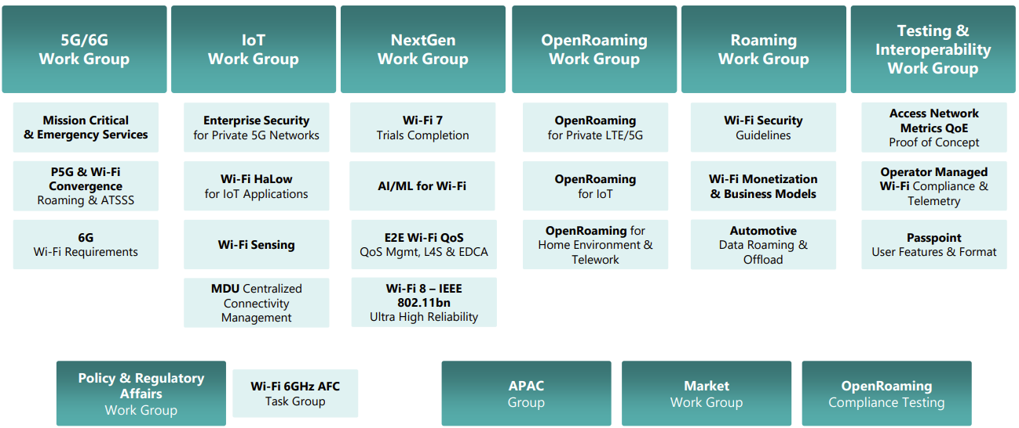
WBA Technical Activities & Roadmap for 2025
https://wballiance.com/wba-program-overview-2025/
https://wballiancec.com/proejcts-details

Slide 42

Access Network Metrics
This report defines how service providers, network operators, and technology vendors can collect, standardize, and transmit key Wi-Fi performance metrics.
https://wballiance.com/wp-content/uploads/2025/05/Access-Network-Metrics-Phase-2-Whitepaper-V1.0.0-Public-.pdf

Slide 43

Wi-Fi 7 Trial Report for Residential Settings by LG U+ and Intel
https://wballiance.com/wp-content/uploads/2025/03/WBA-Wi-Fi-7-Trials-Report-2025-LG-U-Plus-and-Intel-_FINAL-V1.0.0-1.pdf

Slide 44

Wi-Fi 7 Trials for Enterprise Scenarios by AT&T, CommScope and Intel
https://wballiance.com/wp-content/uploads/2025/05/WBA-Wi-Fi-7-Trials-Report-2025-ATT-CommScope-Intel-V1.0.0-1.pdf

Slide 45
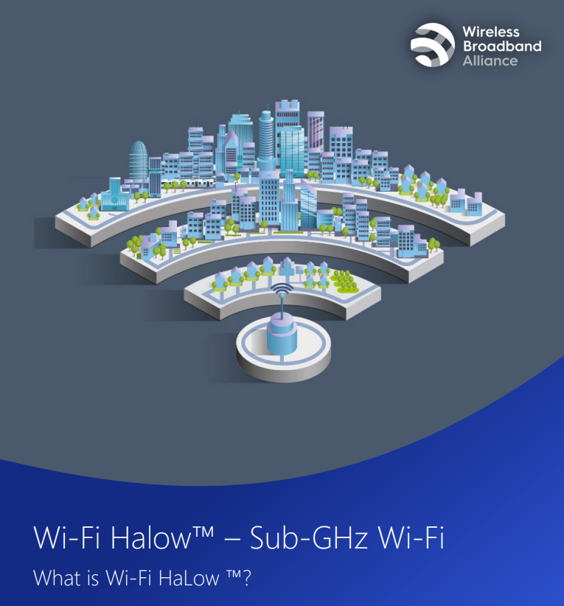
Wi-Fi Hallow
https://wballiance.com/wp-content/uploads/2025/07/What-is-Wi-Fi-HaLow.pdf
Wi-Fi HaLow, based on the IEEE 802.11ah standard, is a breakthrough low-power, long-range Wi-Fi technology purpose-built for the Internet of Things (IoT).

Slide 46
6G Wi-Fi Requirements Project
Launched in June’25
This project addresses challenges in network convergence, spectrum allocation, and interoperability, aiming to enhance network efficiency and ensure seamless connectivity across public and private networks, including indoor and outdoor spaces. By reducing network management complexity, it will create a more efficient, reliable, and cost effective infrastructure, promoting smoother handovers and better performance. Ultimately, the project seeks to improve user experiences and drive the adoption of converged networks across industries.

Slide 47
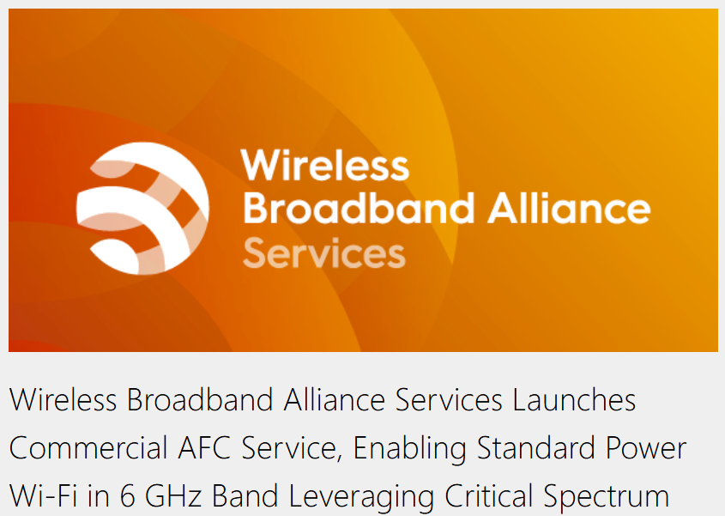
WBA AFC Services

Slide 48

Wireless Global Congress & Members Meetings
https://www.wirelessglobalcongress.com/

Slide 49
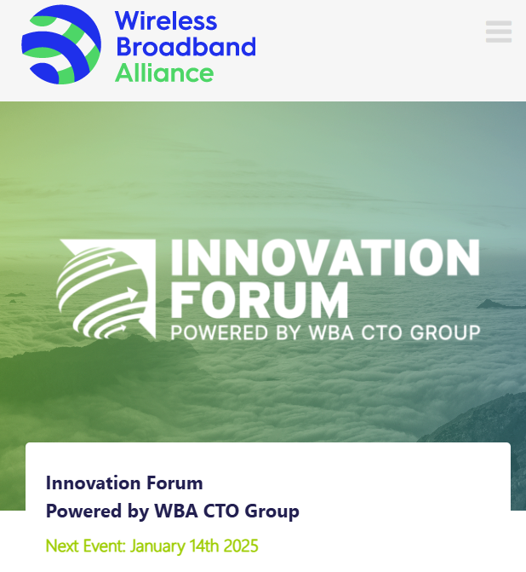
WBA Innovation Forum September
https://wballiance.com/innovation-forum/
Focus on key themes sharing perspectives that will shape the future of connectivity for the next decade and beyond

Slide 50
Further information
WBA information at https://wballiance.com/
Current work areas https://wballiance.com/wba-program-overview-2025/
WBA resource center https://wballiance.com/resource/
WBA events https://wballiance.com/events-awards/
WBA memberships: https://wballiance.com/membership/

Slide 51
Backup

Slide 52


WBA Focus Areas
WBA MEMBERS SOLVE
REAL BUSINESS ISSUES
Fosters success for its members
WBA’s mission is to enable collaboration between service providers, technology companies and organizations to drive positive change and enable opportunities for growth.
Standards & Specifications - Setting the scene, requirements and creating specifications
Testing & Interoperability - Creating test plans to showcase the technology capabilities
End-to-End Trials - Running field trials/ proof of concept on real-world environment
Guidelines & Best Practices – Accelerate deployments of services and technologies
Certification & Plug Fests - Addressing gaps and helping the industry to maximizing biz opportunities
Think Thank & Advocacy – Industry leaders roundtables and targeted verticals analysis

Slide 53
WAA liaison
No report

Slide 54
802.19 WG September 2025 Liaison Report
Date: 2025-9-17
Authors:

Slide 55
IEEE 802.19 Overview
IEEE 802.19 group reviews coexistence assessment documents (CAD) produced by working groups developing new wireless standards for unlicensed devices.
IEEE 802.19 develops standards for coexistence between wireless standards of unlicensed devices.
Monday PM3 and Thursday PM3 (6:30 PM).
Position | Person
Working Group Chair | Tuncer Baykas (Kadir Has Uni.)
Working Group Vice Chair | Steve Shellhammer (Qualcomm)
Work Group Secretary | Yukimasa Nagai (Mitsubishi Electric)
Task Group 3a Chair | Ben Rolfe (Blind Creek Associates)
Liaison To/From 802.11 | Tuncer Baykas (Self)

Slide 56
Coexistence Assessment Document Letter Ballots
IEEE P802.11bn Coexistence Assessment Document letter ballot will end on 28th of September.
If you are an 802.19 voter you can vote via: https://mentor.ieee.org/802.19/polls

Slide 57
802.19.3a Task Group
Scope of the project: This amendment updates and expands coexistence recommendations to address new market requirements, increasing data traffic, greater device density of devices, and increased potential for congestion based on both IEEE Std 802.11-2020 and IEEE Std 802.15.4 sub-1 GHz standards.
This amendment includes recommendations with respect to new devices, as well as compatibility with deployed legacy devices.
Draft proposal is in 802.19 Private area.

Slide 58
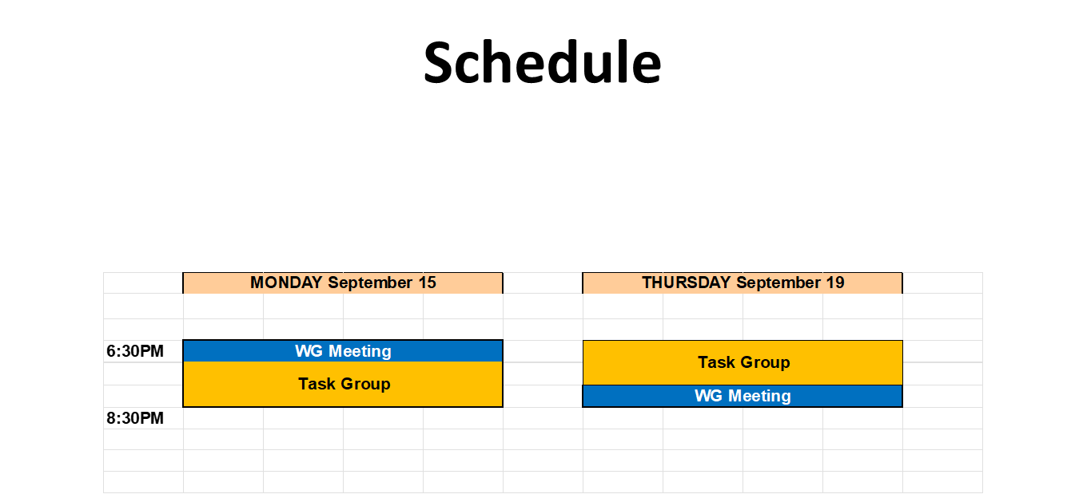

Slide 59
802.15 liaison
No report

Slide 60
802.18 Liaison Report – September 2025
Date: 17 September 2025
Author:
Name | Company | Address | Phone | Email
Edward Au | Huawei Technologies |  |  | edward.ks.au@gmail.com

Slide 61
RR-TAG at a glance
Membership as of 1 August 2025
71 voters (including 10 on LMSC)
7 nearly voters
11 aspirants
Officers
Chair: Edward Au (Huawei Technologies)
Co-Vice Chair: Gaurav Patwardhan (Hewlett Packard Enterprise)
Co-Vice Chair: Al Petrick (Jones-Petrick Associates)
Secretary: Chenhe Ji (Huawei Technologies)
IEEE SA Program Manager: Jodi Haasz (IEEE SA)

Slide 62
Progress since the 2025 July plenary
Reviewed the latest ongoing consultations
Approved the following IEEE 802 LMSC submissions:
EC RSPG: Draft RSPG Opinion on Long-term vision for the upper 6 GHz band
Nigeria NCC: Regulatory Guidelines for the use of the lower part of the 6 GHz (5925 – 6425) MHz band in Nigeria
CEPT ECC PT1 #82: A submission related to the upper 6 GHz band studies - protection of WAS/RLAN
Discussed the latest topics related to spectrum and regulation in Europe, North America, and Asia Pacific.

Slide 63
Objectives this week
Reviewed the following consultation:
Belgium BIPT: Consultation on the draft decision radio interfaces related to short-range devices
Japan MIC: Frequency Reorganization Action Plan (2025 Edition) (Draft)
Discussed the latest topics related to spectrum and regulation in Europe, North America, and Asia Pacific

Slide 64
802.24 liaison
No report

Slide 65
802c status
No report

