Slide 1
802.15 Liaison Report – July 2025
Date: 2025-07-10
Authors:

Slide 2
Abstract
Overview of current activities in WG15.

Slide 3
Working Group 15 November Agenda
Agenda:
https://mentor.ieee.org/802.15/dcn/25/15-25-0289-05-0000-july-2025-802-15-agenda.xlsx
WG opening report:
https://mentor.ieee.org/802.15/dcn/25/15-25-0290-05-0000-july-2025-802-15-opening-report.pptx

Slide 4
Subgroup Closing Reports
Title | URL
TG15.6ma Closing Report for | https://mentor.ieee.org/802.15/dcn/25/15-25-0389-03-006a-tg15-6ma-closing-report-for-july-2025.pptx
SCM Agenda, Opening and Closing Report | https://mentor.ieee.org/802.15/dcn/25/15-25-0315-01-0mag-scm-agenda-opening-and-closing-report-july-2025.pptx
TG4ab May Closing Report | https://mentor.ieee.org/802.15/dcn/25/15-25-0401-01-04ab-tg4ab-closing-report.pptx
TG4ac May Opening and Closing Report | https://mentor.ieee.org/802.15/dcn/25/15-25-0320-01-04ac-july-opening-and-closing.pptx
TG4ad Agenda, Opening and Closing Report | https://mentor.ieee.org/802.15/dcn/25/15-25-0316-01-04ad-tg4ad-agenda-opening-and-closing-report-july-2025.pptx
TG4ae (ASCON) Opening and Closing | https://mentor.ieee.org/802.15/dcn/25/15-25-0318-01-04ae-july-opening-and-closing.pptx
IG Access agenda opening and closing report and Minutes | https://mentor.ieee.org/802.15/dcn/25/15-25-0346-01-acss-ig-access-july-2025-agenda-and-presentation.pptx
TG9A Opening and Closing report | https://mentor.ieee.org/802.15/dcn/25/15-25-0319-01-009a-july-opening-and-closing.pptx
TG16me Revision to 802.16-2017 report | https://mentor.ieee.org/802.15/dcn/25/15-25-0397-00-16me-tg16me-july-2025-closing-report.pptx
IEEE 802.15 IG NG-OWC Closing Report | https://mentor.ieee.org/802.15/dcn/25/15-25-0399-00-07ma-ieee-802-15-ig-ng-owc-closing-report-july-2025.pptx

Slide 5
Subgroup Closing Reports
Title | URL
TG16me closing report | https://mentor.ieee.org/802.15/dcn/25/15-25-0397-00-16me-tg16me-july-2025-closing-report.pptx
IG NG-OWC Closing Report | https://mentor.ieee.org/802.15/dcn/25/15-25-0399-00-07ma-ieee-802-15-ig-ng-owc-closing-report-july-2025.pptx

Slide 6
802.15 Overview
Wireless Specialty Networks Active standards:
802.15.3 - no active projects but a bunch of really cool stuff
802.15.4 - many current projects (see next slide)
802.15.6a Body Area Networks: WG ballot recirculations
802.15.7a Higher Rate, Longer Range Optical, in publication
802.15.9a KMP Transport, extensions to key management: Working group ballot
802.16t Extension to 802.16 for specific bands: approved (DONE!)
802.16.me Revision of 802.16-2017 – first TG meeting
Interest Group Access: Several technical concepts to be developed into potential new projects
Interest Group NG-OWC: the next generation for optical wireless communication
SC THz: discussing future THz communications with Terabit/second data rates

Slide 7
Standing Committee, Maintenance
Maintains internal support documents such as WG Operations manual, editor’s guide, motion templates, checklists and supporting material
Maintains “bug list” for each standard as input to the revision projects
Reviews PARs and provides comments for other WGs
Considers and responds to comments received on 802.15 PARs

Slide 8
802.15.4 Projects
802.15.4ab Next Generation UWB: First WG recirculation
802.15.4ac Enhanced Privacy: Initial WG ballot
802.15.4ad Next Generation SUN PHYs: Pre-draft, technical contributions and proposals
802.15.4ae ASCON light weight encryption extension for 802.15.4: draft in progress

Slide 9
802.15.4ab Next generation UWB: Amendment to IEEE Std 802.15.4-2024 (rev E)
Recirculation comment resolution in progress
Closing report:
  https://mentor.ieee.org/802.15/dcn/25/15-25-0401-01-04ab-tg4ab-closing-report.pptx
Current status: in WG ballot comment resolution
 | Current Schedule
First recirculation | March 2025
Recirculation comment resolution | March-Aug 2025
Second recirculation | Aug 2025
Recirculation comment resolution | Sept 2025
First SA-Ballot | Oct 2025…
SA-Ballot comment resolution | After that

Slide 10
802.15.4ac Enhanced Privacy
This amendment specifies modifications to the IEEE Std 802.15.4 medium access control (MAC) specification to specify mechanisms that address and improve user privacy. These mechanisms include randomized addresses, and exchanges that support session continuity. This amendment maintains backward compatibility with the base standard.
State: WG Recirculation, conditionally ready for SA ballot (1 more recirc)
Opening and closing report: https://mentor.ieee.org/802.15/dcn/25/15-25-0320-01-04ac-july-opening-and-closing.pptx

Slide 11
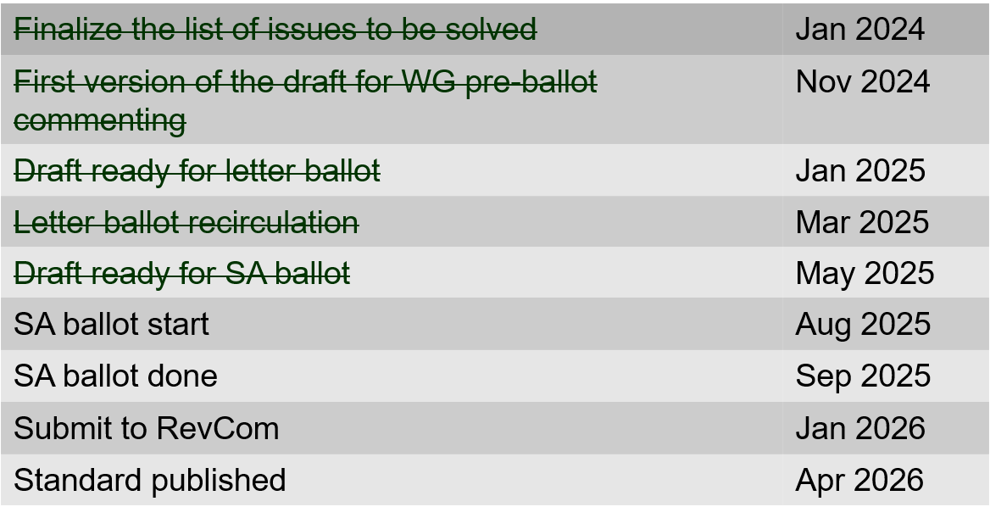
802.15.4ac Enhanced Privacy Timeline

Slide 12
802.15.4ad Next Generation SUN PHYs
Developing enhancements to the 802.15.4 SUN PHYs (FSK, OFDM)
State: pre-draft development
Meeting goals:
  Approval of minutes
  Presentations (see next page)
Closing report: https://mentor.ieee.org/802.15/dcn/25/15-25-0219-00-04ad-tg4ad-agenda-opening-and-closing-report-may-2025.pptx

Slide 13
802.15.4ad Timeline
2024
November: Approve Technical Guidance Document
Call for proposals issued
2025
January: Hear initial proposals
March: Hear updated proposals
March to May – 2 conference calls
  Simulation results of remaining proposals not yet provided
  Prepare table of proposals for analysing against technical guidance document
May: Hear final proposals
May to July – 2 conference calls
  Simulation results and proposal categorisation.
July: Heard final proposals. Categorized and summarized proposals
July – September: Merging proposals
September: Finish merging and start drafting the standard

Slide 14
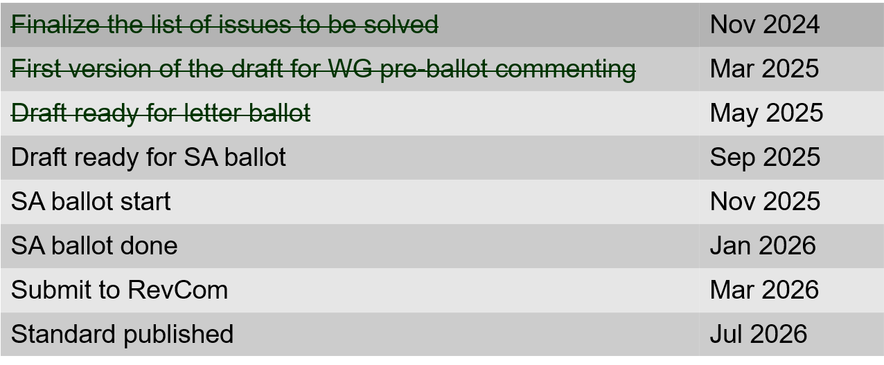
802.15.4ae (ASCON)
ASCON light weight encryption extension for 802.15.4
Meeting achievements
Resolve letter ballot comments
Prepare draft ready for letter ballot recirculation
Start letter ballot recirculation after the session
Closing report: https://mentor.ieee.org/802.15/dcn/25/15-25-0318-01-04ae-july-opening-and-closing.pptx

Slide 15
802.15.6ma
Completed WG balloting (recirc with no new comments)
Ready for SA ballot
Completed 4 WG Ballots and completed with 100 % approval rate (D06)
  The TG has resolved 113 comments received on drafts P802.15.6ma/D03
  The TG has resolved 265 comments received on drafts P802.15.6ma/D04
  The TG has resolved 127 comments received on drafts P802.15.6ma/D05
  The TG did not receive any comments for P802.15.6ma/D06
Closing report: https://mentor.ieee.org/802.15/dcn/25/15-25-0389-02-006a-tg15-6ma-closing-report-for-july-2025.pptx

Slide 16
TG 6ma Timeline(expected)
Final SB recirculation, if required. Submission to RevCom
Jan 2026
Tech Req Doc July 2022
Presentation of proposals
May 2023
Comment Resolutionfor LB210
Nov. 2024
Comment Resolutionfor LB212
March 2025
Comment Resolutionfor LB217
May
2025
Comment Resolution for LB217
July
2025
SA Ballot
Sept
2025
WG PreBallot submission for Draft2.5 August 2024
Revcom Approve
March 2026
SA recirculation if required
Oct 2025
^{Draft V1,18 Com}
May. 2024
Recirculation (LB212)
Jan. 2025
RevcomSubmission
Feb. 2026
TRD,CMD
Call Proposals Sept 2022
Std. Draf V1.9 Proposals
Nov. 2023
Comment Resolution fo Draft v2.3 on WG for PreBallot July 2024
1st Letter Ballot(LB210)
Sept. 2024
2nd Recirculation (LB217)
April 2025
3rd Recirculation (LB)
June 2025
Unconditional approval for Standard Association Ballot (SA)
July 2025
Request EC approval for SA Ballot
Nov. 2026
Comment Resolution for SA Ballot
Oct. 2025

Slide 17
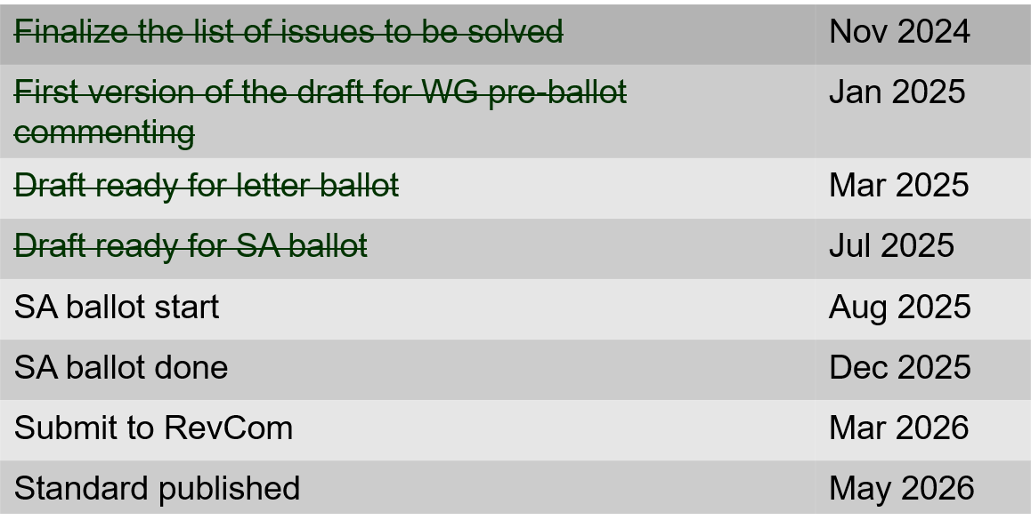
802.15.9a KMP Transport
Extensions to key management: extending to support EDHOC
State: Completed initial WG ballot
Session objectives
  Resolve comments
  Initiate recirculation ballot
  Conditional approval to start SA ballot
Opening and closing report: https://mentor.ieee.org/802.15/dcn/25/15-25-0319-02-009a-july-opening-and-closing.pptx

Slide 18
IG Access
Agenda, closing report and minutes: https://mentor.ieee.org/802.15/dcn/25/15-25-0346-01-acss-ig-access-july-2025-agenda-and-presentation.pptx
Presentations: “CCA Modes and Adaptive ED Threshold in suspendable CSMA-CA” Doc: 15-25-0353-02
Discussion

Slide 19
TG16me Revision of 802.16-2017
Revision to 802.16
  Includes rollup of 16t
Roll-up preparation underway
Heard technical contributions
Closing report: https://mentor.ieee.org/802.15/dcn/25/15-25-0397-00-16me-tg16me-july-2025-closing-report.pptx

Slide 20
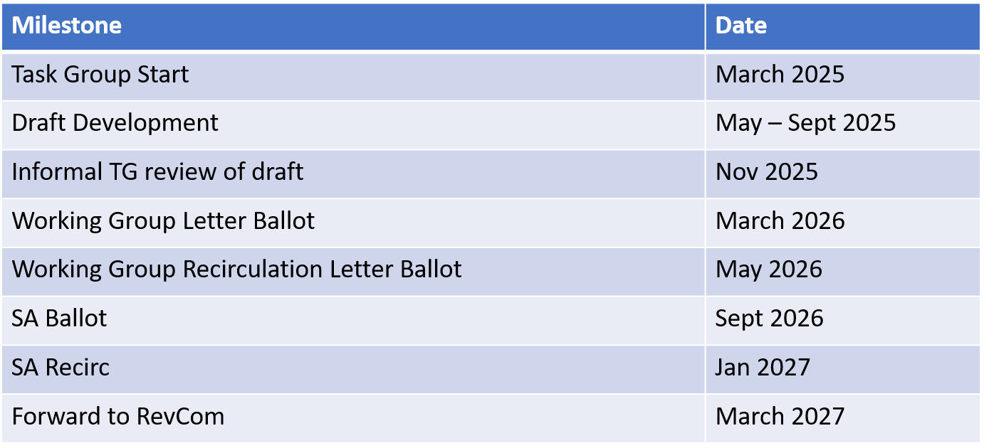
TG16me Revision Project Timeline

Slide 21
Interest Group Next Generation Optical Wireless Communication (NG-OWC)
IG NG-OWC Closing Report: https://mentor.ieee.org/802.15/dcn/25/15-25-0399-00-07ma-ieee-802-15-ig-ng-owc-closing-report-july-2025.pptx
Session objectives:
Hear contributions related to the future of next generation OWC(OCC, FSO) technology
Prepared extended Call for Applications on NG OWC
For September Session:
Invite contributors from companies
IEEE 802.15 IG NG OWC (OCC or FSO) Extended Call For Applications https://mentor.ieee.org/802.15/dcn/25/15-25-0162-02-07ma-ieee-802-15-ig-ng-owc-call-for-applications.doc

