Slide 1
Proposal of TIG on Unified Channel Model
Date: 2025-07-30
Authors:

Slide 2
Abstract
It is proposed to form a Topic Interest Group (TIG) for discussing use cases and requirements, developing a Unified Channel Model (UCM) and enable fair performance comparison of proposals for multilink operation (MLO) across sub‑7 GHz / mm-wave / optical bands.
The goals of the UCM TIG are to deliver a multi-band channel model,
which is spatially consistent across sub-7 GHz / mm-wave / optical bands,
builds on already available & verified models,
can be implemented using open software,
is well documented and,
may be used by ongoing and future task groups.

Slide 3
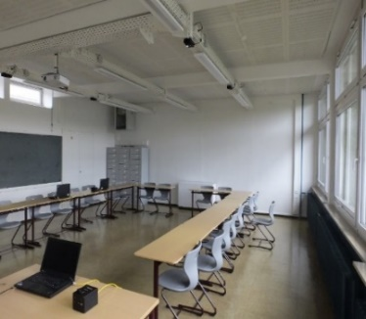
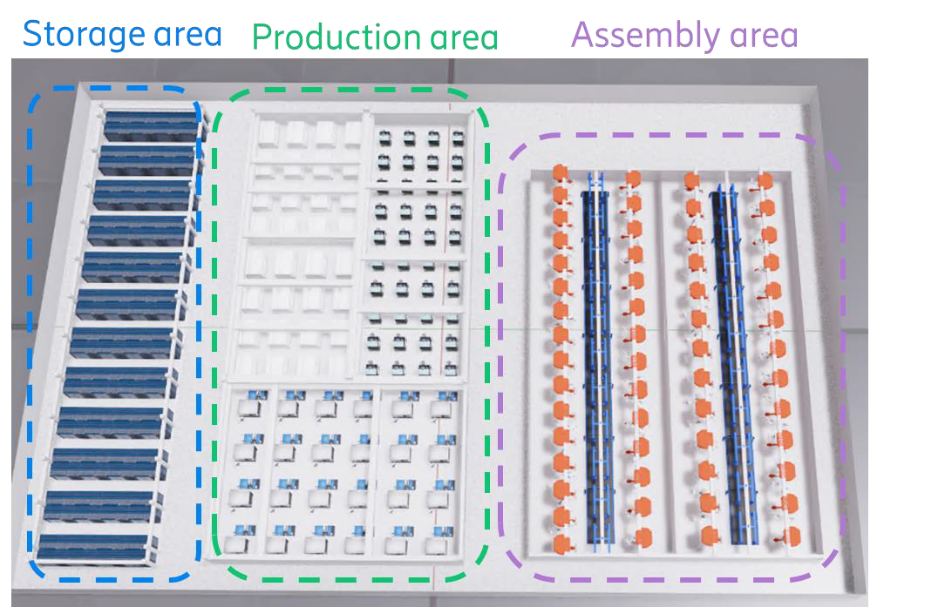
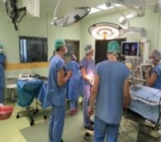
Extended MLO: Exemplary Applications
Hotspot scenarios…
  conference-/classrooms
  dual 5/mm-wave coverage in industry [12]
  hospital (4K video from endoscope to screen)
…can be addressed by network densification
  below-7 GHz APs (every 10-20 m)
  additional mm-wave/optical APs (every room)
      Extend MLO into mm-wave / optical bands
      mm-wave: 42-71 GHz mm-wave
      optical: 800-1000, 400-600 and 1200-1600 nm
Extended Multilink Operation
Multilink Operation
Sub7GHz BB
Sub7GHz
BB
Sub7GHz
BB
Sub7GHz
BB
Sub7GHz
BB
Sub7GHz
BB
Sub7GHz
BB
Sub7GHz
BB
2.4 GHz front-end
2.4 GHz front-end
5 GHz
front-end
5 GHz
front-end
6 GHz front-end
mm-wave front-end
ELC
front-end
6 GHz front-end

Slide 4
Exemplary work on channel modeling in 802.11
sub-7 GHz:
        TGbe Channel model doc. 11-19/0719r1
        TGax Channel model doc. 11-14/0882r4
        TGah Channel model doc. 11-11/0968r4
        TGn Channel models doc. 11-03/0940r4
mm-wave:
  TGbf Channel models for WLAN sensing 11-21/0782r5
  TGay Channel models 11-15/1150r4
optical:
  Channel model for ELC 11-25/1202r1
  TGbb Channel models 11-18/1582r4, 11-18/1237r2

Slide 5
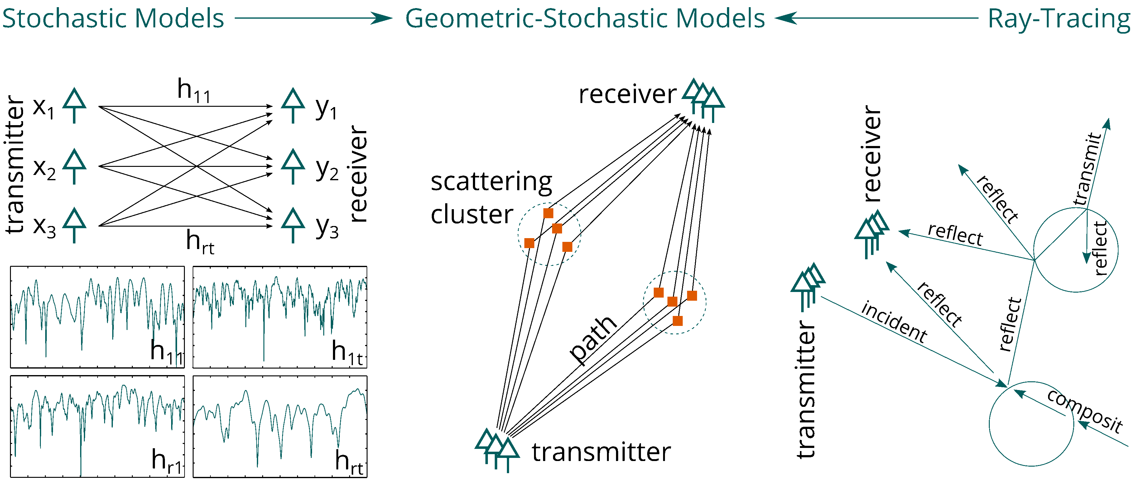
Problem: Different TGs use different channel models
TGn/ac/ax
TGad/ay
TGbb/bf

Slide 6
Limitations of existing channel models
Lack on integration of features
  tapped-delay line model (TGn) vs. accurate space-time characteristics (TGay, TGbb)
Multi-band operation is not foreseen
  different models for different bands
  use cases/scenarios cannot be easily combined
TGn/ac/ax models do not natively support system-level simulations
  has to be agreed upon/added on top of the model
Models are not spatially consistent
  not suitable for site-specific simulations (e.g., for multi-AP operation)
  do not reflect correlations between different bands
  do not correctly model the MIMO correlation for different user positions

Slide 7
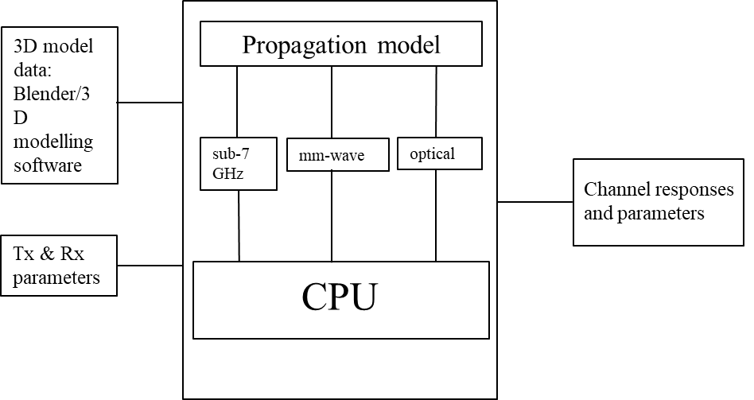
Unified Channel Model
Update the 802.11 channel model so that it
can be used in below-7GHz, mm-wave and optical bands
  support multi-link operation between an arbitrary choice of bands
  correctly model polarization in- and outdoors
is spatially consistent, i.e.,
  site-specific (e.g. for multi-AP operation)
  correctly reflects correlations between different bands
  correctly models MIMO correlations at different user positions

Slide 8
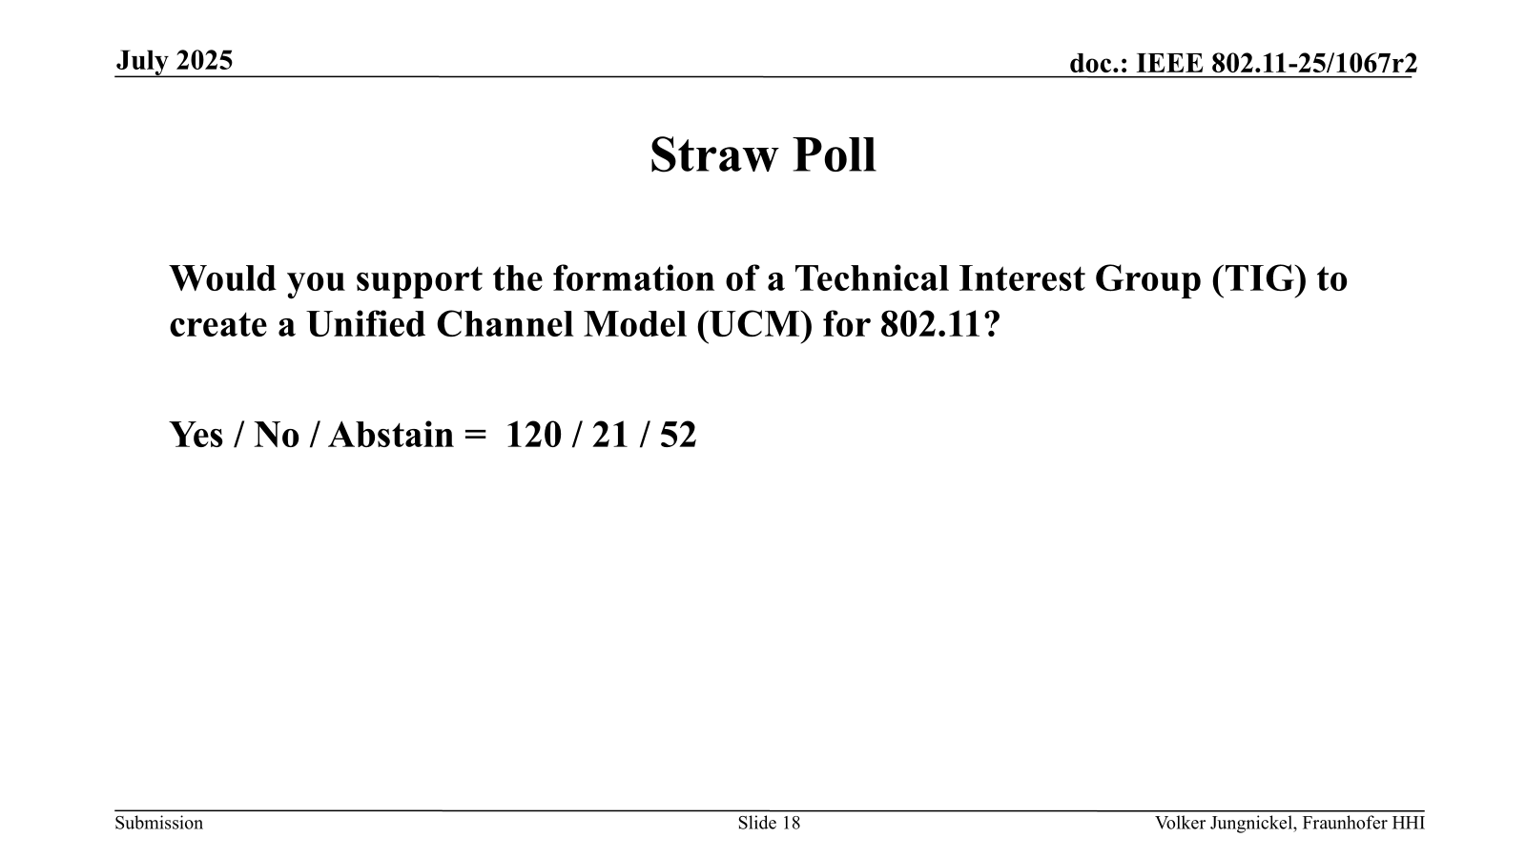
Proposal to form UCM TIG
Thanks for the support to form a UCM TIG in WNG on TUES, July 29, AM1!
Please, let the authors know
if you are interested to support or contribute to the UCM TIG
if there is any concern to be addressed
We plan to run a Motion at the Closing Plenary on Friday.

