Slide 1
Proposed PAR for an 802.19 project similar to 802.19.3a to address coexistence in 6 GHz
Date: 2025-07-27
Authors:

Slide 2
Abstract
An idea for improving coexistence through standardization: Developing a standard (standard, recommended practice or guide) to provide practical means to achieve and/or improve coexistence between 802.11 and 802.15.4 based systems operating in the 5GHz and 6GHz frequency bands

Slide 3
Overview
What is 802.19
What is IEEE Std 802.19.3
What is P802.19.3a
What is coexistence (a very brief introduction)
What is within the scope of the IEEE 802 LMSC
What a standard project might look like

Slide 4
Overview of 802.19
Wireless Coexistence Working Group
https://grouper.ieee.org/groups/802/19/
Develops standards for coexistence between wireless standards of unlicensed devices
Reviews coexistence assessment documents
Supports wireless working groups in coexistence consideration
  E.g. IEEE 802 Frequency and Wavelength Ranges Table, https://mentor.ieee.org/802-ec/dcn/22/ec-22-0266-00-WCSG-ieee-802-s-wireless-standards-table-of-frequency-ranges.xlsx
Might be a good place to develop coexistence methods, strategies and recommendations!

Slide 5
What is IEEE Std 802.19.3 and P802.19.3a
802.19.3: IEEE Recommended Practice for Local and Metropolitan Area Networks— Part 19: Coexistence Methods for IEEE 802.11 and IEEE 802.15.4 Based Systems Operating in the Sub - 1 GHz Frequency Bands
P802.19.3a – Amendment to update and expand recommendations based on changes in 802.11 and 802.15.4 standards, regional regulations, application needs and to apply what has been learned by experience
Specifically addressing sub-1 GHz bands
  There is a LOT of 802.15.4 devices around the world operating in sub-1 GHz bands
  There is a growing use of 802.11 S1G (802.11ah) based devise

Slide 6
What does it contain?
Background information that provides context for recommendations
Specific recommendations that are scenario based and trade-off (optimization) based:
  Recommendations based on usage scenarios
  Recommendations based on RF environment
  Recommendations describe ways to use features of each standard to achieve a goal based on performance trade-off objectives, e.g. trade-offs between packet delivery success rate and delivery latency
Useful information on the impacts of various configuration and use choices

Slide 7
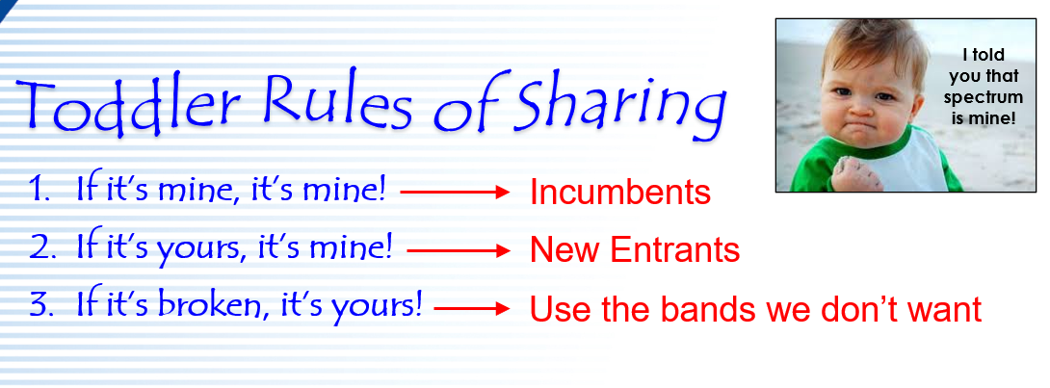
What is coexistence (a very brief introduction)

Slide 8
Traditional Sharing Models
Exclusive access (it’s mine and you can’t play with it, ever)
Opportunistic: it’s mine but if I’m not using it I guess you can use it
Mutual avoidance (of various degrees of mutual)
Coordinated or non-coordinated
  We can talk and/or are managed
  We don’t talk but we can recognize each other and could talk (e.g. I see your network but don’t have the keys to be part of it)
  We don’t talk and may or may not be able to sense the presence of the other
The eye of the beholder: “Fair coexistence” is when I get what I want
  Clearly this depends on point of view ;-)

Slide 9
Another view of coexistence
Diversity of use adds value
“Fair” means we learn to work and play well with others
Experience teaches us
  Some things work some of the time
  Some thins work none of the time
  Nothing works all the time
What we’ve always done is not all that we can do

Slide 10
How to move forward
Become ruler of the world and simply mandate that you’re use is the only important use
  Nice if you can swing it but….
  Does not lead to maximum use of scarce spectrum
  Usually only sustainable in our imagination!
Plan B: work with others to develop methods and strategies that enable mutual coexistence and diversity of uses in the spectrum
  Pool expertise and knowledge
  Recognize that different tricks will work in different situations
  Document what has been learned and validated (e.g. in a standard document)

Slide 11
What can we do:
What is within the scope of the IEEE 802 LMSC
Most basic limitations:
We are not governments or regulators
We have no enforcement capability
Use of our standards is always voluntary
Making sense is always better than not
So if we can’t control what people do, what? We influence:
Provide useful knowledge
Provide the tools to do the right things (802.11, 802.15.4, …)
Provide guidance on how to use those tools (802.19)

Slide 12
What a standard project might look like
A recommended practice for coexistence in mid-band spectrum between 802.11 (wideband) and 802.15.4 (narrow band)
  5 GHz and 6 GHz bands
  802.11ax and be OFDM
  802.15.4 O-QPSK
Scenario and trade-off based
  Focus on specific use cases and contexts in which a lot of both is expected
  Application of the features of each standard to optimize system performance
Recommended practice, guide or standard?
  Standard vs RP: really doesn’t matter, it’s all recommendations anyway?
  RP may “fit” better as the goal is to provide guidance and best practices
  Who actually knows what a guide is anyway?

Slide 13
What’s next:
We have a Working Group called “Wireless Coexistence”
Seems a likely place to develop standards for coexistence
Worked well for sub-1 GHz
We need participation from 802.11 and 802.15.4 experts
802.19 is not about enforcement
  It is not “mother”
  It is like the family room: , the place we can to work together
Develop a PAR

