Slide 1
Considerations on NPCA during AP PUO
Date: 2025-09-12
Authors:

Slide 2
Introduction
In TGbn [1], NPCA has been under discussion.
  NPCA operation is introduced to enhance reliability under dense OBSS environments.
Also, in TGbn [2], the AP PUO mode is also being discussed.
  AP PUO mode enables an AP to inform its associated non‑AP STAs of its periodic unavailability.
  An AP entered its PUO period may be unable to detect WLAN signals.
Assuming both AP PUO and NPCA are permitted within a BSS, there may be a problem.
  Even if an NPCA non‑AP STA satisfies the NPCA switch conditions and switches to the NPCA primary channel (NPCA PCH), the AP is likely to remain on the BSS PCH due to the AP PUO condition.
This contribution examines the issues arising from the coexistence of AP PUO and NPCA and proposes a possible solution.

Slide 3
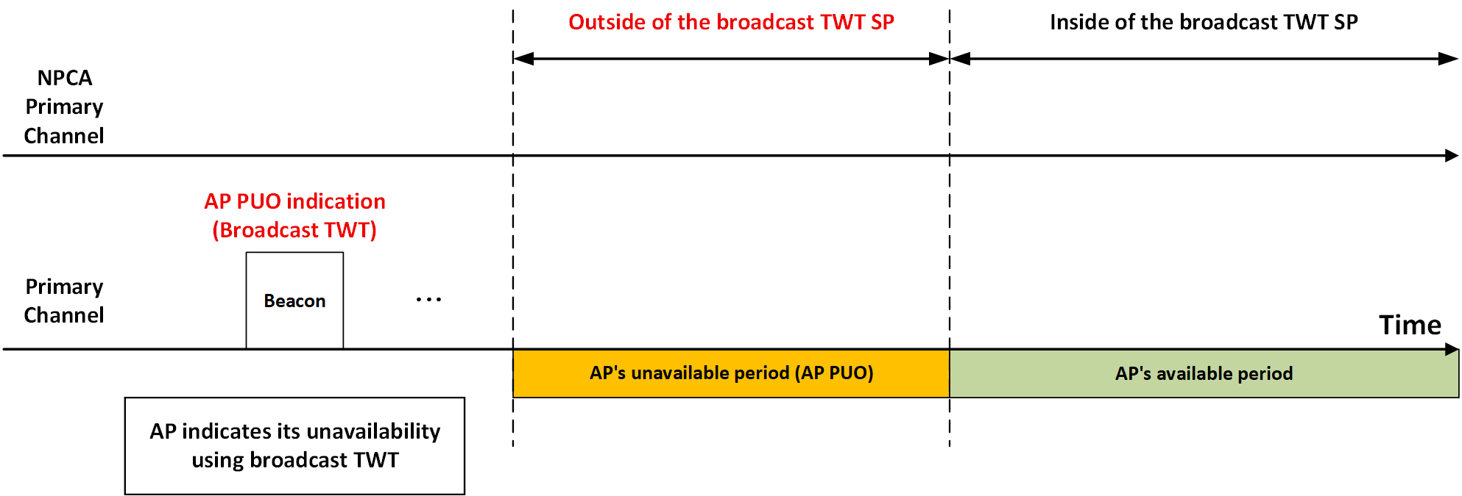
Problem Statement
In AP PUO mode, an AP can configure a broadcast TWT Service Period (SP) and indicate that it will be unavailable outside of the TWT SP.
  During the unavailable period of AP (AP PUO period), the AP likely be unable to transmit or receive WLAN signals.

Slide 4
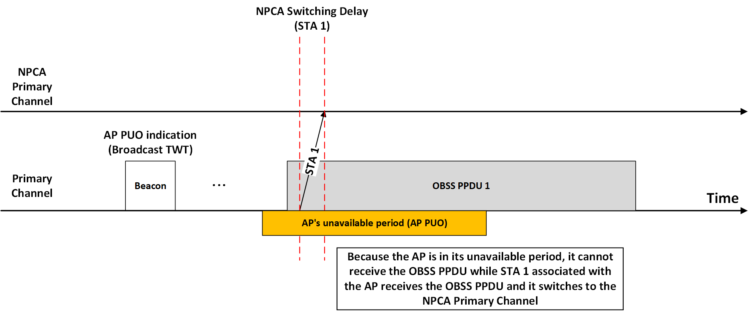
Problem Statement (cont’d)
During the AP PUO period, OBSS may occupy the BSS PCH and transmit a PPDU.
An NPCA STA in the BSS(e.g., STA 1) may receive the OBSS PPDU and switches to the NPCA PCH.
The AP may not be available to receive the OBSS PPDU due to the AP PUO condition, so the AP remains on the BSS PCH.

Slide 5
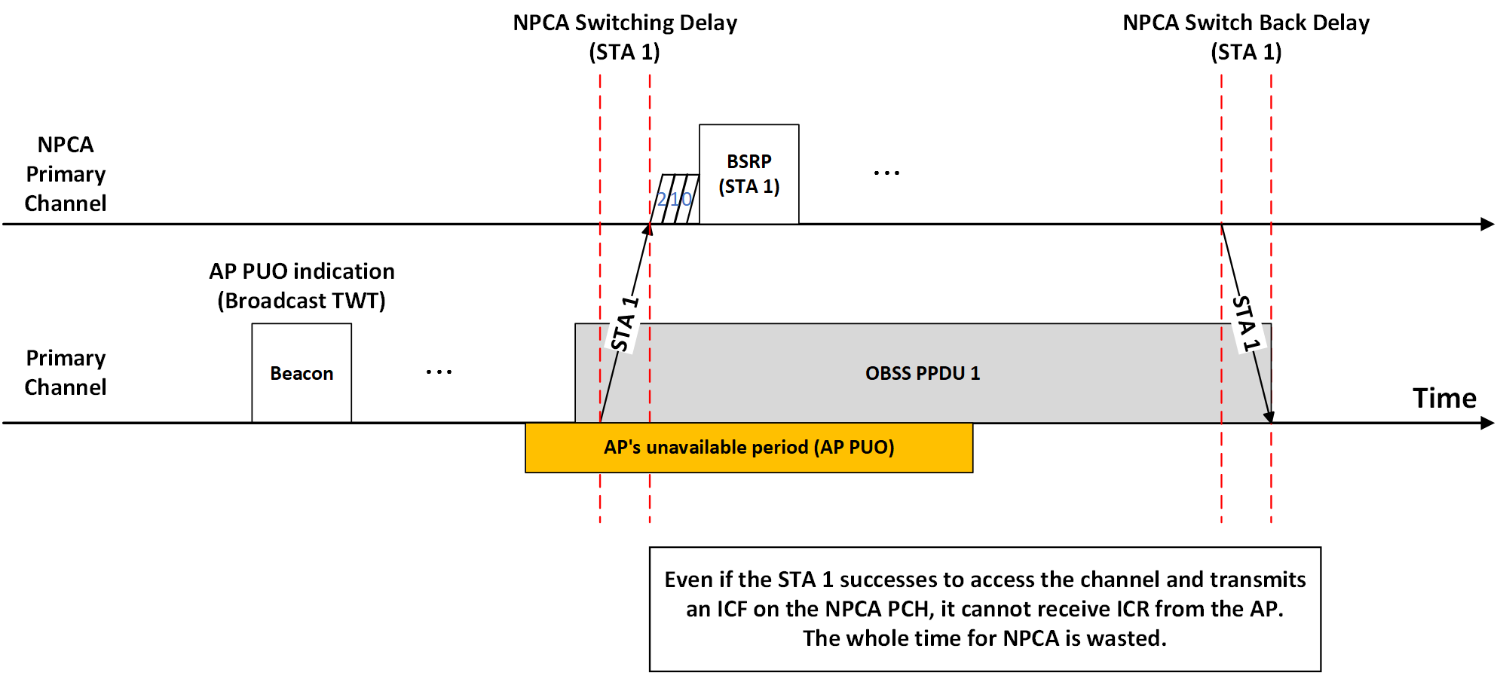
Problem Statement (cont’d)
Under this mismatch situation, even if an NPCA non-AP STA (STA 1) transmits a frame(e.g., ICF) to the AP on the NPCA PCH, it cannot receive any response from the AP.
As a result, the entire time for NPCA operation could be wasted.

Slide 6
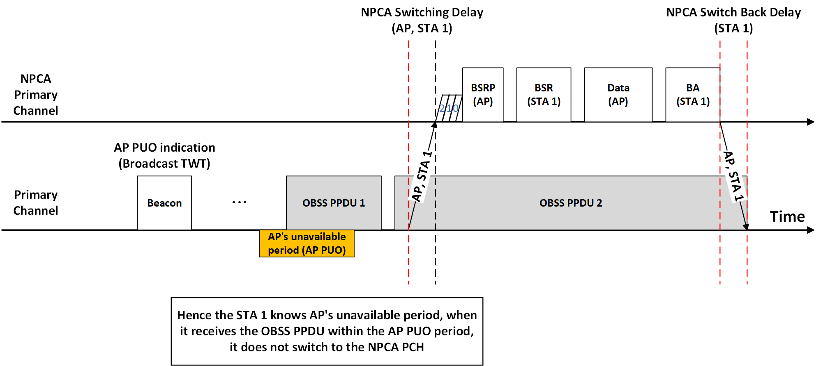
Possible Approach
To solve the mismatch issue, an NPCA non-AP STA aware of the AP PUO period shall not to switch to the NPCA PCH during the AP PUO period, even when the NPCA conditions are met.
  This approach is simple and powerful.

Slide 7
Conclusion
During the AP PUO period, the AP is likely unable to transmit or receive WLAN signals, implying that even if NPCA conditions are met, the AP will remain on the BSS PCH.
  Consequently, any transmissions on the NPCA PCH by NPCA non-AP STAs may fail.
To solve the issue, NPCA non-AP STAs shall not switch to the NPCA PCH during the AP PUO period.
With this approach, NPCA non-AP STAs can avoid unnecessary channel switches and reduce transmission failure.

Slide 8
References
[1] 11-25-0936-09-00bn-pdt-cr-mac-npca-cc50
[2] Draft P802.11bn_D0.3 (37.17.4 AP PUO mode)

Slide 9
Straw Poll
SP: Do you agree to include the following text into the 11bn SFD?
  Even if NPCA switch conditions are met during advertised AP’s unavailability period in AP PUO mode, an NPCA non-AP STAs associated with the AP shall not switch to the NPCA primary channel.
Y / N / A

