Slide 1
A proposal for light communication with short-wave infrared spectrum
Jul 2025
Date: 2024-07-28
Authors:
Name | Affiliations | Address | Phone | email
Cheng Chen | pureLiFi |  |  | Cheng.Chen@purelifi.com
Mohamed Islim | pureLiFi |  |  | Mohamed.Islim@purelifi.com
Mostafa Afgani | pureLiFi |  |  | Mostafa.Afgani@purelifi.com

Slide 2
Abstract
Jul 2025
This presentation provides a rational behind the support of light communication (LC) with short-wave infrared (SWIR) wavelength spectrum between 1200nm and 1600nm in TG802.11br

Slide 3
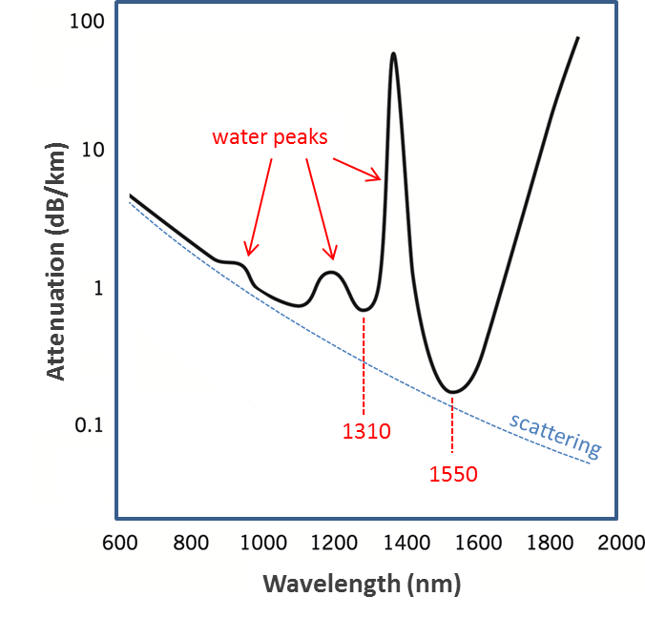
Why 1310nm and 1550nm OFEs?
Jul 2025
In optical fibre communications, choice of wavelength determines attenuations due to scattering and absorption by fibre glass.
Lower attenuation means the longer maximum optical fibre communication range.
1550nm exhibits the global lowest attenuation in the near-infrared region
1310nm exhibits the second lowest attenuation but with cheaper device costs.

Slide 4
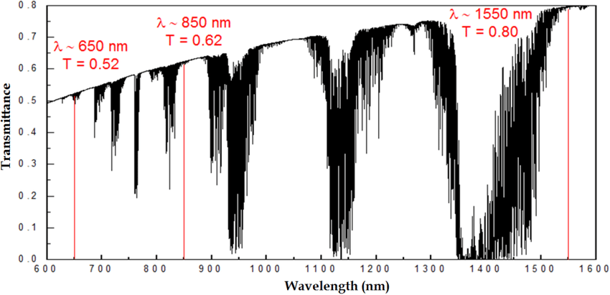
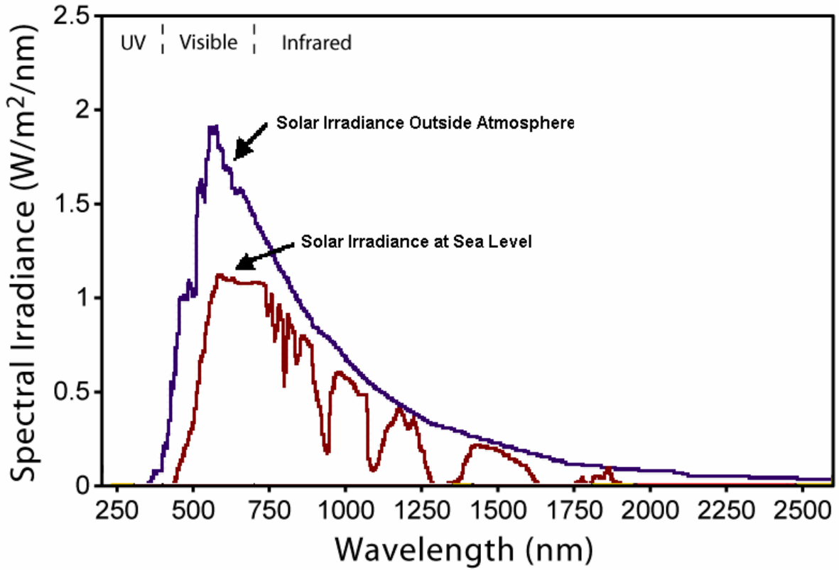
Better propagation characteristics in free-space
Jul 2025
1310nm
1310nm and 1550nm infrared light have higher transmittance in free-space.
The solar spectral irradiance in 1200nm - 1600nm is lower, which leads to less background noise.
These factors make light communication with 1200nm to 1600nm advantages for outdoor applications.

Slide 5
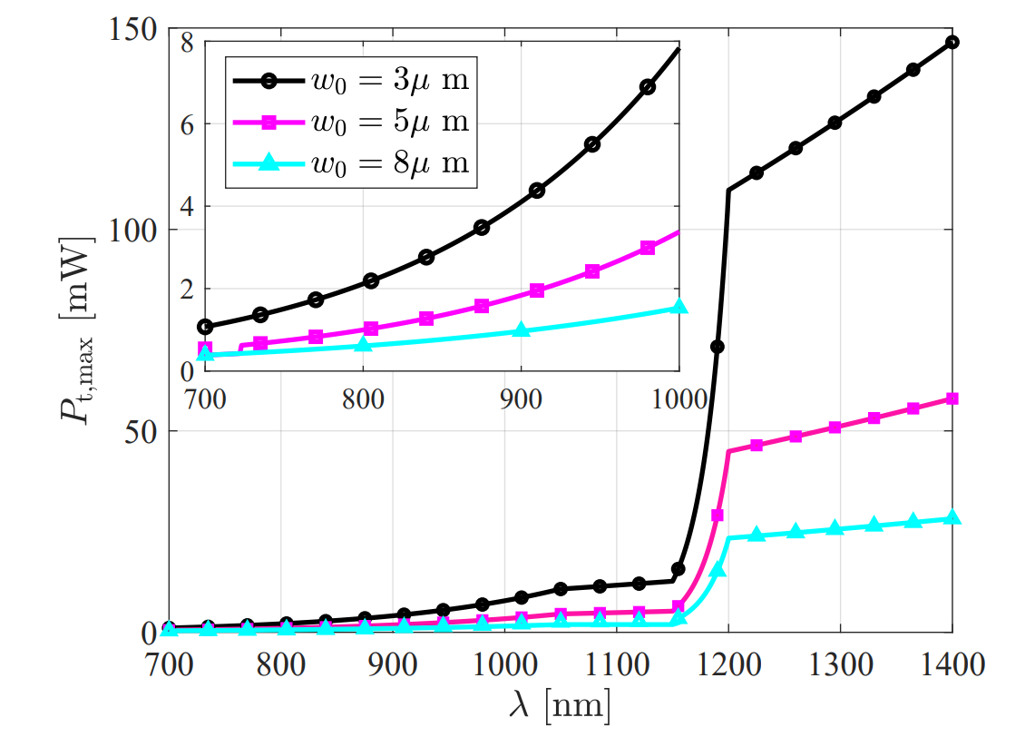
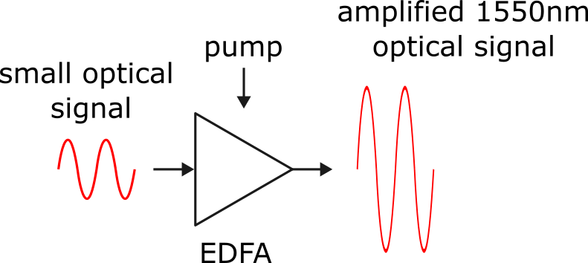
Relaxed eye-safety constraints and EDFA support
Jul 2025
Human eye absorbs >1,400 nm strongly in cornea/lens, preventing the beam from reaching the retina.
Infrared light emitters operating at wavelength above 1200nm allows much higher allowed optical power (nearly x10)
An Erbium-Doped Fiber Amplifier (EDFA) can significantly boost the optical signal at 1550nm wavelength.

Slide 6
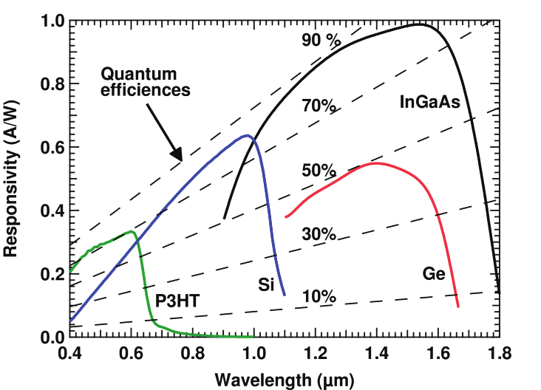
Improved detector sensitivity
Jul 2025
At 100% quantum efficiency, detector responsivity increases linearly with wavelength.
InGaAs’s narrower bandgap allows efficient absorption of low-energy photons (high quantum efficiency at 1000nm – 1600nm)

Slide 7
Better thermal stability
Jul 2025
The nominal operating voltage to reach a certain gain will vary as a function of temperature at different rates for different material thicknesses.
InGaAs active material is thinner, which leads to a higher temperature stability than silicon.
InGaAs detectors typically exhibits lower temperature coefficient than silicon detectors.
Some online information shows 1550nm VCSEL may have better thermal stability, but this is not likely to be widely acknowledged.

Slide 8
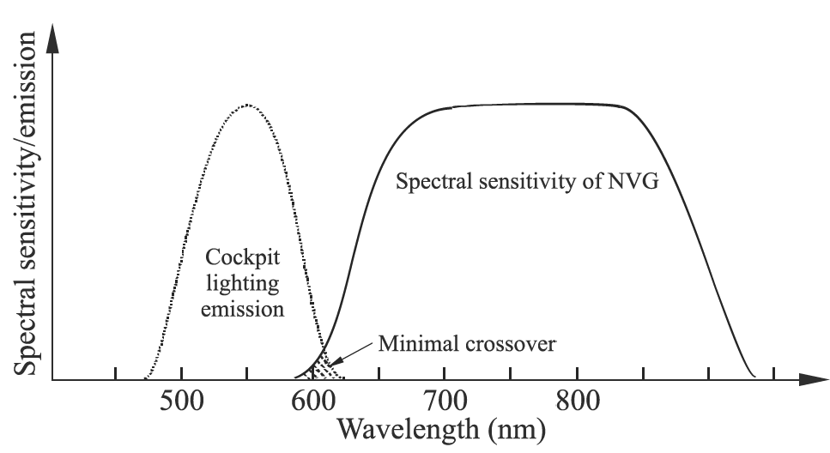
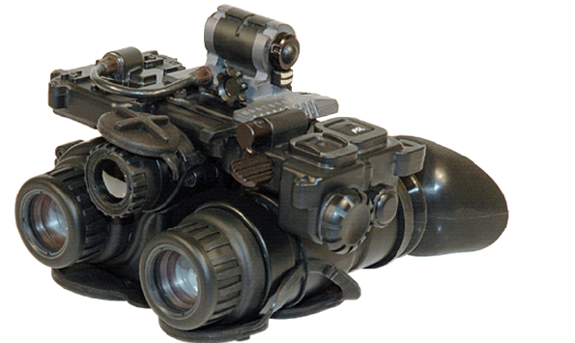
Advantages for defence applications
Jul 2025
Most night vision devices are sensitive to optical signals below 1000nm and cannot detect 1310nm/1550nm optical signals [9], which improves the low probability of intercept/detection (LPI/LPD) of light communication (LC) at these wavelengths.
1550nm optical signalling support use of EDFA [10] and allow much higher maximum emission power than optical signals below 1000nm. These conditions make it feasible to develop high power LC systems for long range or wide coverage defence applications.

Slide 9
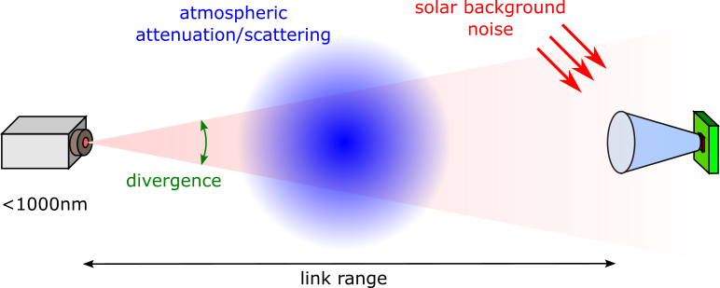
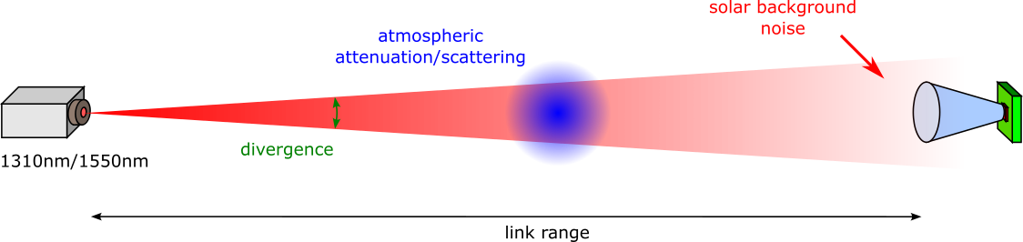
Advantages for defence applications
Jul 2025
1550nm LC systems can achieve longer range and are more robust against fog or haze weather conditions than <1000nm LC systems due to the following factors [11]:
  Higher maximum allowed emission power
  Lower attenuation/scattering in free-space
  Lower solar background noise
1550nm/1310nm LC systems can achieve more collimated beams for the same aperture size compared to <1000nm LC systems [12], which further improves LPI/LPD.

Slide 10
Summary
Sept 2024
LC with SWIR suffers less loss in atmospheric propagation.
LC with SWIR can transmit with a higher optical power.
LC with SWIR has improved detector sensitivity and thermal stability.
LC with SWIR for defence application can achieve improved LPI/LPD and robustness against fog or haze weather conditions.

Slide 11
References
Jul 2025
[1] slide 3, image from Choice of Wavelength for RF over Fibre – 1310nm vs 1550nm URL: https://www.vialite.com/resources/guides/choice-of-wavelength-for-rf-over-fiber-1310nm-vs-1550nm/
[2] slide 4, left image from Carrasco-Casado, Alberto, Verónica Fernández, and Natalia Denisenko. "Free-space quantum key distribution." Optical Wireless Communications: An Emerging Technology (2016): 589-607.
[3] slide 4, right image from M. Bozzetti, G. de Candia, M. Gallo, O. Losito, L. Mescia and F. Prudenzano, "Analysis and design of a solar rectenna," 2010 IEEE International Symposium on Industrial Electronics, Bari, Italy, 2010, pp. 2001-2004, doi: 10.1109/ISIE.2010.5637486.
[4] slide 5, top image from M. Dehghani Soltani et al., "Safety Analysis for Laser-Based Optical Wireless Communications: A Tutorial," in Proceedings of the IEEE, vol. 110, no. 8, pp. 1045-1072, Aug. 2022, doi: 10.1109/JPROC.2022.3181968.
[5] slide 6, image from Zvanovec, Stanislav, et al. "Visible light communications towards 5G." Radioengineering (2015).
[6] Al-Janabi, Samaher, Ihab Al-Janabi, and Noora Al-Janabi. "Analysis the structural, electronic and effect of light on PIN photodiode achievement through SILVACO software: a case study." Data Science for Genomics. Academic Press, 2023. 165-178.
[7] Huang, Jack Jia-Sheng, et al. "Temperature dependence study of mesa‐type InGaAs/InAlAs avalanche photodiode characteristics." Advances in OptoElectronics 2017.1 (2017): 2084621.
[8] ‘Choosing the Right APD Material for Laser Range Finding’, Laser Components, URL: https://22356006.fs1.hubspotusercontent-na1.net/hubfs/22356006/Laser%20Components%20APD%20PLD%20Selection%20Guide.pdf
[9] slide 8, images from Chrzanowski, Krzysztof. "Review of night vision technology." Opto-electronics review 21.2 (2013): 153-181.
[10] A. Grimes, B. Zhu, C. Jin and J. W. Nicholson, "10 Gbps Transmission from a High Power EDFA for Free Space Communications," 2024 IEEE Photonics Society Summer Topicals Meeting Series (SUM), Bridgetown, Barbados, 2024, pp. 1-4.
[11] Ijaz, Muhammad & Rajbhandari, Sujan & Le Minh, Hoa & Perez, Joaquin & Gholami, Asghar. (2012). Comparison of 830 nm and 1550 nm based Free Space Optical Communications link under Controlled Fog Conditions. 10.1109/CSNDSP.2012.6292739.
[12] Amr S. El-Wakeel, Nazmi A. Mohammed, and Moustafa H. Aly, "Free space optical communications system performance under atmospheric scattering and turbulence for 850 and 1550 nm operation," Appl. Opt. 55, 7276-7286 (2016)

