Slide 1
Lightly licensed mmWave bands for TGbq
Date: 2025-07-28
Authors:
Name | Affiliations | Address | Phone | E-mail
Thomas Handte | Sony Group Corporation |  |  | Thomas.Handte@sony.com
Yusuke Tanaka |  |  |  | Yusuke.YT.Tanaka@sony.com
Dana Ciochina
Daniel Verenzuela
Ryuichi Hirata
Kosuke Aio
Alfred Lin

Slide 2
Introduction
TGbq aims [1,2] to …
  … combine mmWave and sub-7 GHz via MLO framework
  … reuse sub-7GHz OFDM waveform for application in mmWave
mmWave is defined as unlicensed bands between 42 GHz and 71 GHz [3]
  The 60 GHz band is most versatile offering at least a few channels in many countries
  A 60 GHz radio is challenging in multiple aspects
    A lower frequency band would simplify implementation particularly for cost sensitive consumer devices
Worldwide Regulators are opening the 26 GHz band as a lightly licensed band
  The band ranges from approx. 24 to 29 GHz depending on country
  Some bandwidth can be leased in a specific area for privileged access i.e., interference-free spectrum
  Those bands are envisioned for 5G but are technology neutral
This submission highlights the benefits of extending TGbq’s mmWave band to include 26 GHz lightly licensed bands

Slide 3
Challenges of a 60 GHz mmWave link
A 60 GHz mmWave link has its challenges
  Channel has high pathloss; often dominated by LOS
  High phase noise
  Low output power of CMOS amplifiers, low power efficiency [4]
  Antenna architecture requires analog beamforming technology incl. phase shifters
    omni transmission is difficult
  Mechanism for precise beamforming training and tracking needed
The 60 GHz band can be considered as interference-free and non-congested, but its properties make the link brittle
  TGbq’s intention to integrate 60 GHz band in MLO framework will help, but the brittleness and weak coverage makes it impractical for some applications e.g., industrial use case [5]

Slide 4
Lightly licensed mmWave bands in 26 GHz band
Country | Spectrum [GHz] | Bandwidth [MHz]
Australia | 24.25-27.5 27.5-29.5 | Nx50 (N≥1)
Austria* | 24.3-24.9 | 600
Brazil⁺ | 27.5-27.9 | TBD
Denmark | 24.25-24.65 | 400
Finland | 24.25-25.1 | 850
Germany | 24.5-27.5 | 800
Greece⁺ | 26.5-27.5 | TBD
Hong Kong | 27.95-28.35 | 400
Israel* | 24.25-27.5 | TBD
Japan | 28.2-28.3 28.3-29.1 | 100 or 800
Norway* | 24.25-25.1 | 850
Republic of Korea | 28.9-29.5 | 600
Slovenia* | 28.0-28.4 29.0-29.4 | 400
Spain | 24.25-24.70 | TBD
Sweden | 24.25-25.25 | 1000
UK | 24.25-27.5 | 50, 100, 200, 400, 800
Various countries offer bandwidth for lease [6]
  Intention is 5G, but any technology can be used which
  meets the requirements
    TDD is a must
Exemplary licensing fees
  Parameters: bandwidth, coverage area, number of devices,
  population density, lease duration, etc.
  Examples (fees per year)
    UK: starting 80 GBP
    Germany: starting 100 EUR (assuming 10-year lease)
    Japan: 3000 JPY per base station, 400 JPY per device
    Hong Kong: 10000 HK$, 1000 HK$ per base station
*) considering allocation ⁺) leasing option

Slide 5
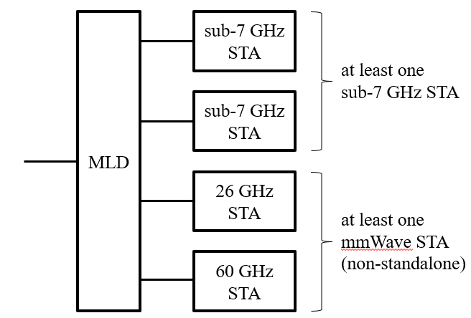
Suggestion
Extend the TGbq’s mmWave band to cover lightly licensed bands around 26 GHz
  26 GHz band may be considered as another STA of a TGbq MLD
A TGbq MLD would consist of
  at least one sub-7GHz STA
  at least one mmWave STA in non-standalone mode
    A mmWave STA can support 26 GHz band or 60 GHz band
    Standalone mode for 26 GHz can be discussed

Slide 6
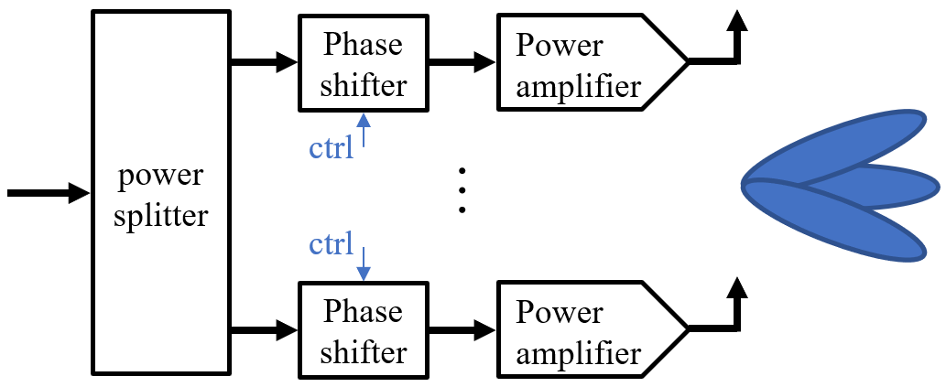
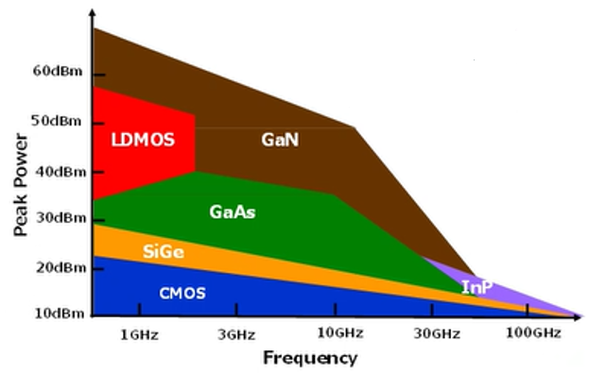
Benefits
26 GHz band provides the following benefits compared to 60 GHz
  at least 6dB more link budget
    Could result in PAAs with less elements and phase shifters
      PAA with same aperture results in one quarter of elements and phase
      shifters for 26 GHz band
      => simpler beamforming, simpler implementation
  more output power of power amplifiers [7, 8]
    +3dB for CMOS / +8dB for GaN
    Higher power efficiency [8]
  less phase noise [9]
  Potential reuse of PAAs for 3GPP
    The band overlaps with n257, n258, and n261 of FR2
    Clear benefit for integration in small formfactor smart devices
  Greenfield spectrum
    free of interference and legacy devices
    local managed network
of [7]

Slide 7
Role of the lightly licensed band
Typically, lightly licensed band operation is used to obtain clean and managed spectrum
  Allows for non-congested, private, reliable, fully controllable, and even predictable communications
This is also true for 26 GHz band, but a clean spectrum is less of an issue in 60 GHz band due to the propagation characteristics
Therefore, main benefits are ...
  ... to have a low-frequency mmWave spectrum which allows for simpler implementation
  ... to reuse 26 GHz antenna technology which already exists is some smart devices
  ... to seamlessly integrate 26 GHz band into existing WLAN setups by MLO framework

Slide 8
Items to be considered for 26 GHz band
Review of regulatory rules in each country
  Check compatibility with 802.11
  Revise PHY and MAC as needed
An initial and non-comprehensive list of items to be considered
  Requirements for out-of-band emission, channel spectrum masks, EIRP and TRP limits
  Supported vs required bandwidths
  Features related to interference avoidance
    Regulators typically mandate a “duty to cooperate” if interference between neighboring networks is detected in a lightly licensed band

Slide 9
Conclusions
A 60 GHz mmWave link comes with various implementation challenges
  E.g. high pathloss, high phase noise, antenna architecture, ...
Worldwide Regulators are opening the 26 GHz band as a lightly licensed band for private networks
  The 26 GHz bands ranges from 24 to 29 GHz depending on country
Suggestion is to add these mmWave bands as another STA to a TGbq MLD
Adding those mmWave bands to TGbq comes with several benefits
  E.g. higher link budget, simpler PAA, simpler beamforming, lower phase noise, reuse of existing antenna technology in smart devices
Suggest TGbq to check compatibility of 802.11 with 26 GHz band regulations
  Change PAR to define mmWave as ranging from 24 GHz to 71 GHz
  Revise PHY and MAC as needed

Slide 10
References
[1] 11-23/1819r1 “Integrated mmWave Design Considerations”
[2] 11-23/1905r0 “High Level Thoughts on IMMW”
[3] 11-24/0116r7 “IMMW Draft Proposed PAR”
[4] 11-25/0867r0 “IMMW PHY Performance and Design Implications”
[5] A. Schott, A. Ichkov, N. Beckmann, N. König and L. Simić, "Mm-Wave Connectivity in Industrial Environments: A Measurement Study at 28 and 60 GHz," GLOBECOM 2024
[6] 5G spectrum for local industrial networks
[7] K. Kohama et al., IWPC Workshop, A GaN Technology to Meet Future Radio Requirements, October 2024
[8] Power Amplifiers Performance Survey 2000-Present
[9] VCO survey – Phase Noise versus Carrier Frequency

