Slide 1
NPCA EDCA Slot Boundaries
Date: 2025-09-17
Authors:

Slide 2
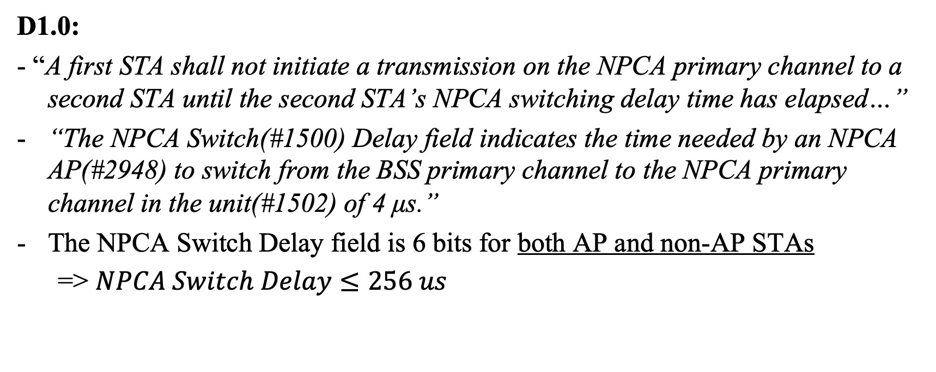
Background
D1.0:
- “A first STA shall not initiate a transmission on the NPCA primary channel to a second STA until the second STA’s NPCA switching delay time has elapsed…”
“The NPCA Switch(#1500) Delay field indicates the time needed by an NPCA AP(#2948) to switch from the BSS primary channel to the NPCA primary channel in the unit(#1502) of 4 μs.”
The NPCA Switch Delay field is 6 bits for both AP and non-AP STAs
=> $NPCA Switch Delay≤256 us$

Slide 3
Problem Statement
How to take into account different switching delays of the peer STAs?
How to prevent collisions when multiple STAs, targeting the same peer STA, complete their switch to and backoff on the NPCA channel before the peer STA finishes switching?
How to retain EDCA ACs prioritization?
The problem concerns the channel access rules, hence, should be defined in the standard

Slide 4
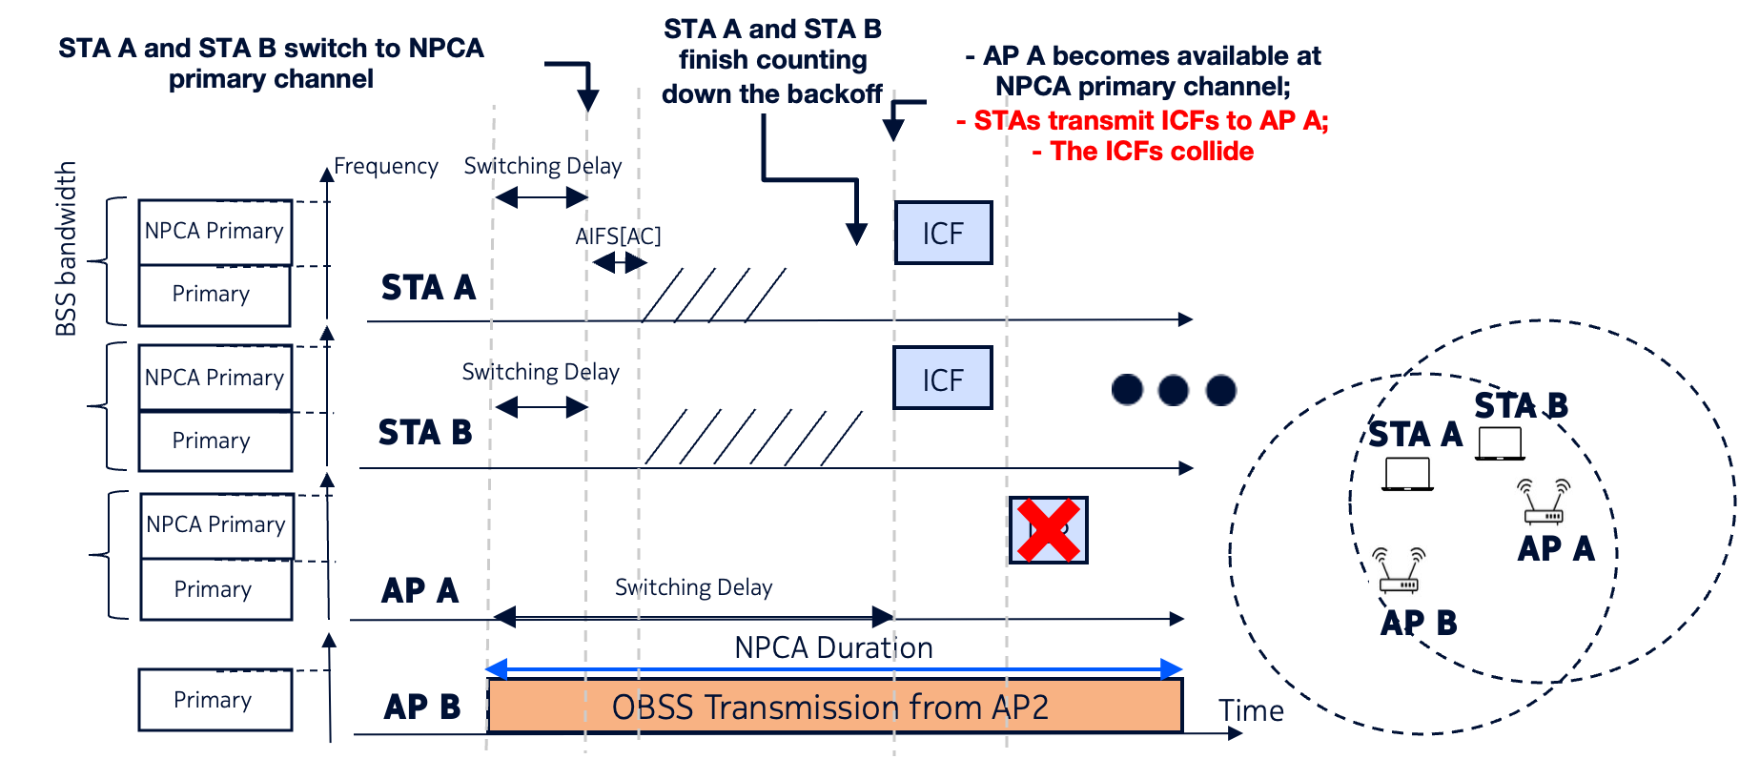
Option 0. When do different switching delays cause issues?

Slide 5
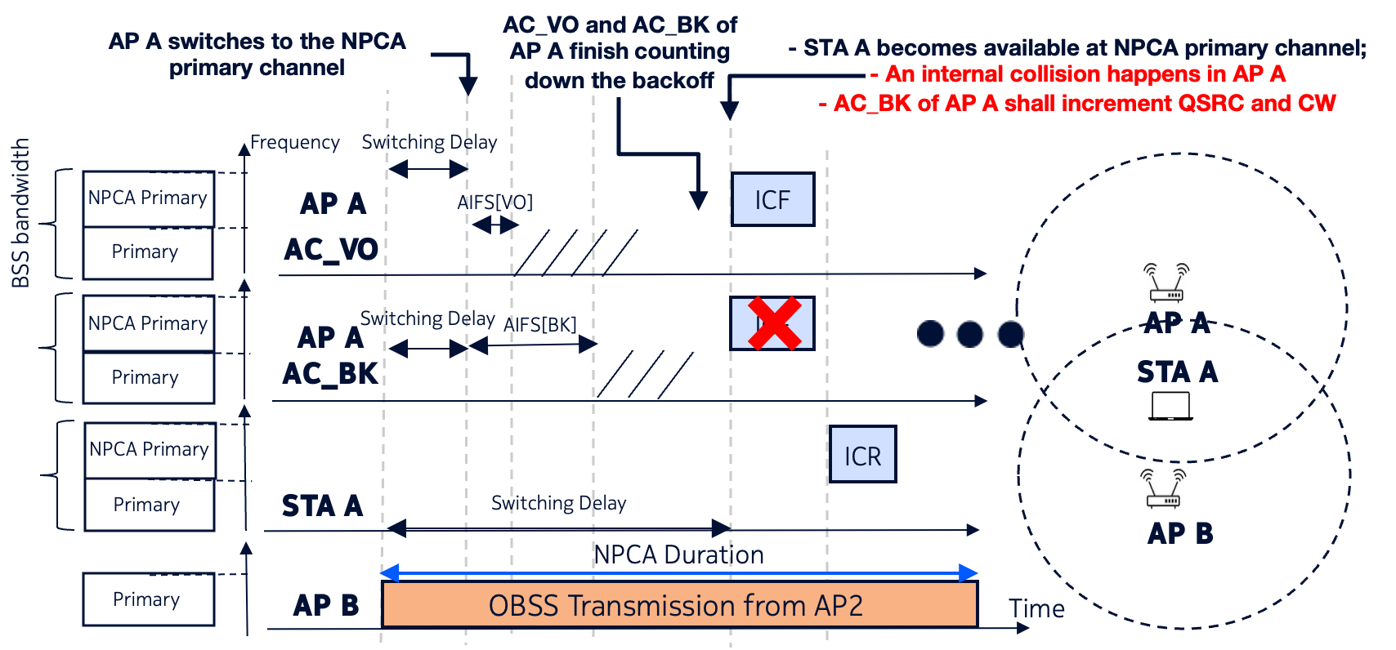
Option 0. What if APs switching delay is shorter?
Unnecessary internal collisions from AP ACs finishing the backoff are still unavoidable.

Slide 6
Option 0 Contradicts the Baseline Operation
“At each of the <…> [EDCA] slot boundaries, if
— There is a frame available for transmission at an EDCAF, and
— The backoff counter for that EDCAF has a value of 0, and
— Initiation of a transmission sequence is not allowed to commence at this time for an EDCAF of higher UP, that EDCAF shall either choose not to transmit (which results in invocation of the backoff procedure as specified in 10.23.2.2 (EDCA backoff procedure)) or initiate a TXOP.
”
In other words, if the STA doesn’t initiate a TxOP, it shall restart the backoff

Slide 7
Avoiding Excessive Collisions Upon Switching
Let us define NPCA Activation Time as the time the STA may start EDCA procedures on the NPCH
Option 1. Let the NPCA Activation Time for a STA1 be the moment the switching delay of STA1 expires.
If the STA1’s backoff expires before the peer-STA’s finishes switching, STA1 shall restart the backoff without changing the QSRC

Slide 8
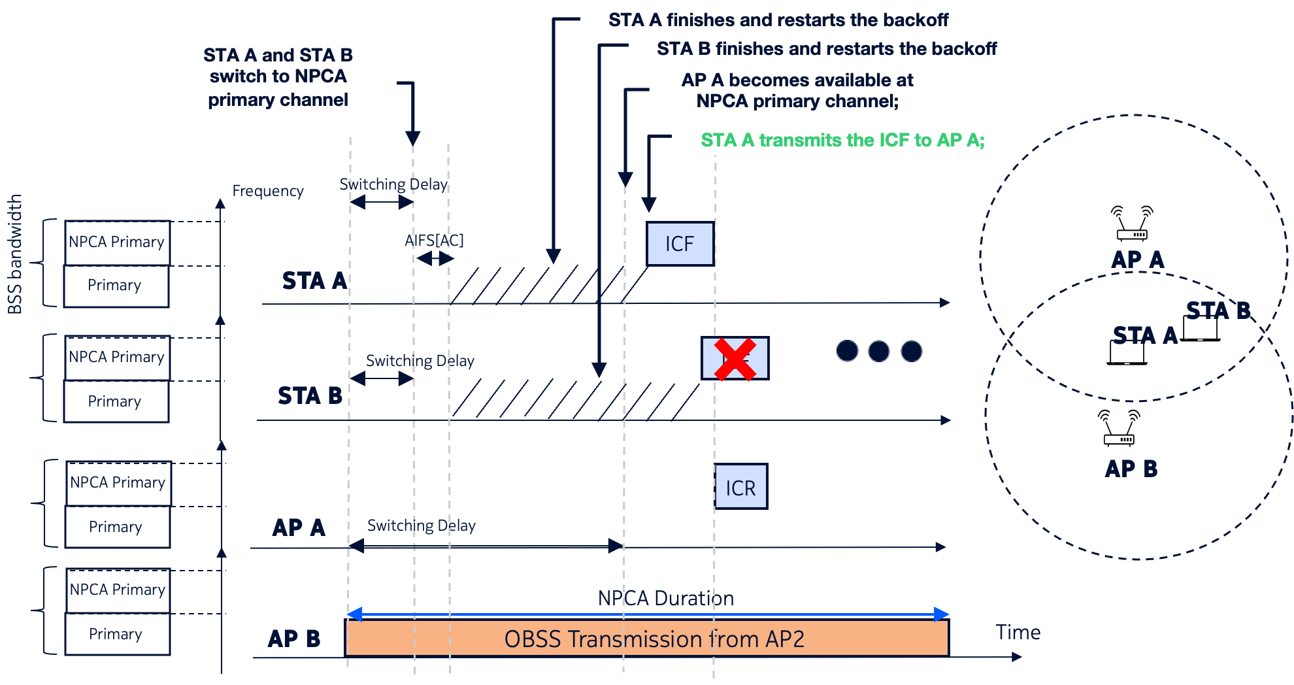
Option 1. STA restarts the backoff until the peer STA is available

Slide 9
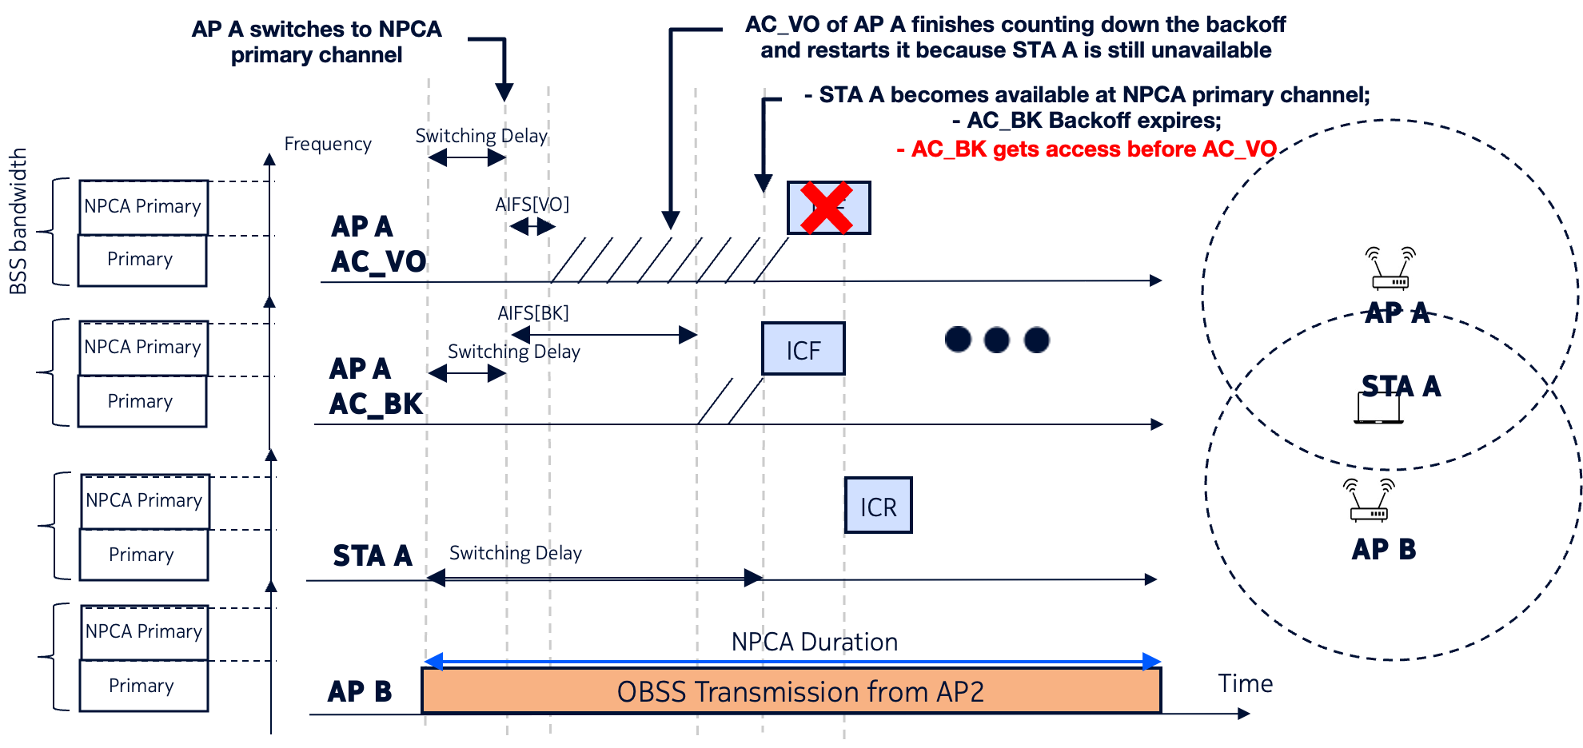
What if AC_VO and AC_BK of AP A contend?

Slide 10
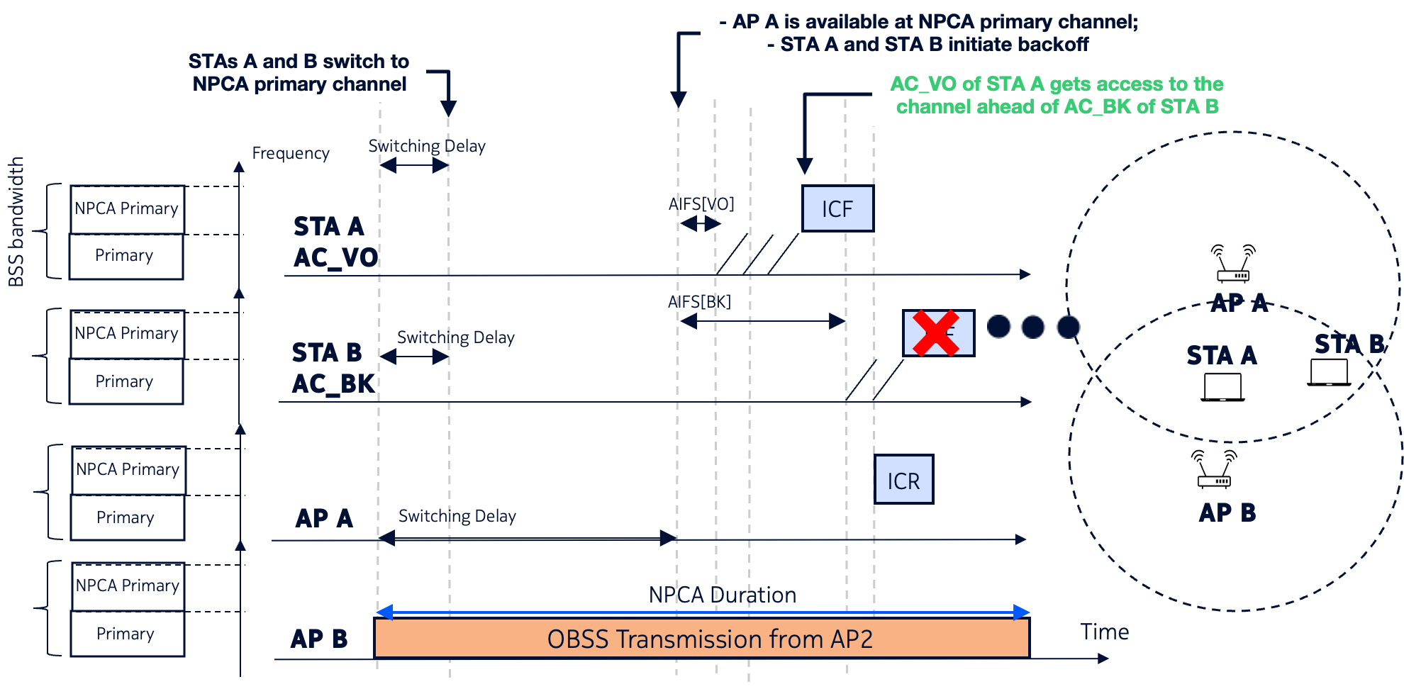
Maintaining EDCA Priorities
Option 2. Let the NPCA Activation Time be the moment both the STA and its peer STA(s) are available at the NPCA primary channel.
*
*
* AIFS may end by the time the peer STA is available

Slide 11
SPs
SP1. Do you agree to define a time reference when an STA initiate the backoff on the NPCA primary channel (NPCH)?
SP2. Which policy for considering different NPCA switching delays of STAs do you prefer?
Option 1. The NPCA STA shall restart the backoff if it completes before the peer STA is available on the NPCH
Option 2. The NPCA STA shall start the backoff only when its peer STA is available on the NPCH

Slide 12
References
IEEE 802.11 Working Group, Draft Standard for Information Technology—Telecommunications and Information Exchange Between Systems—Local and Metropolitan Area Networks—Specific Requirements—Part 11: Wireless LAN Medium Access Control (MAC) and Physical Layer (PHY) Specifications, IEEE P802.11-REVmf/D1.0, August 2025.
Draft Standard for Information technology—Telecommunications and information exchange between systems Local and metropolitan area networks— Specific requirements. Part 11: Wireless LAN Medium Access Control (MAC) and Physical Layer (PHY) Specifications Amendment 6: Enhancements for ultra-high reliability (UHR), IEEE P802.11bn™/D1.0, August 2025

Slide 13
Backup

Slide 14
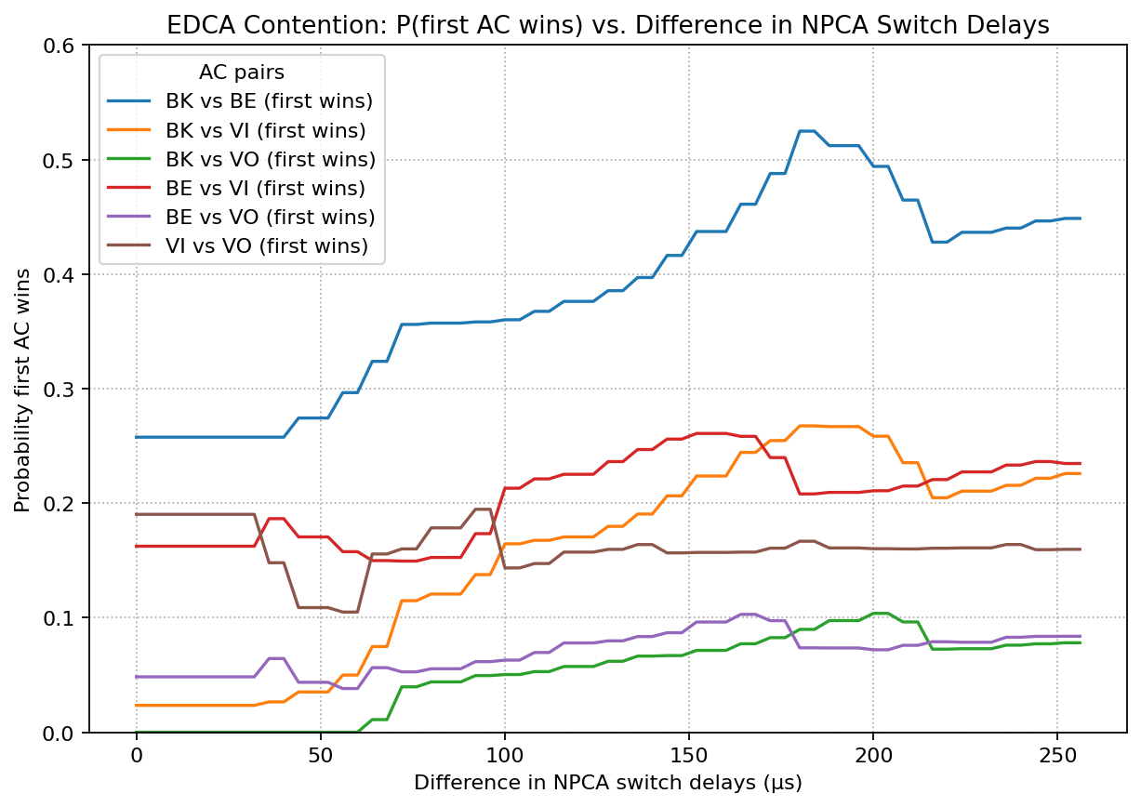
Switching delays vs. odds for ACs to win contention
Default EDCA parameters
CW=CWmin
Difference = 0 indicates the odds for the baseline operation on the primary channel

Slide 15
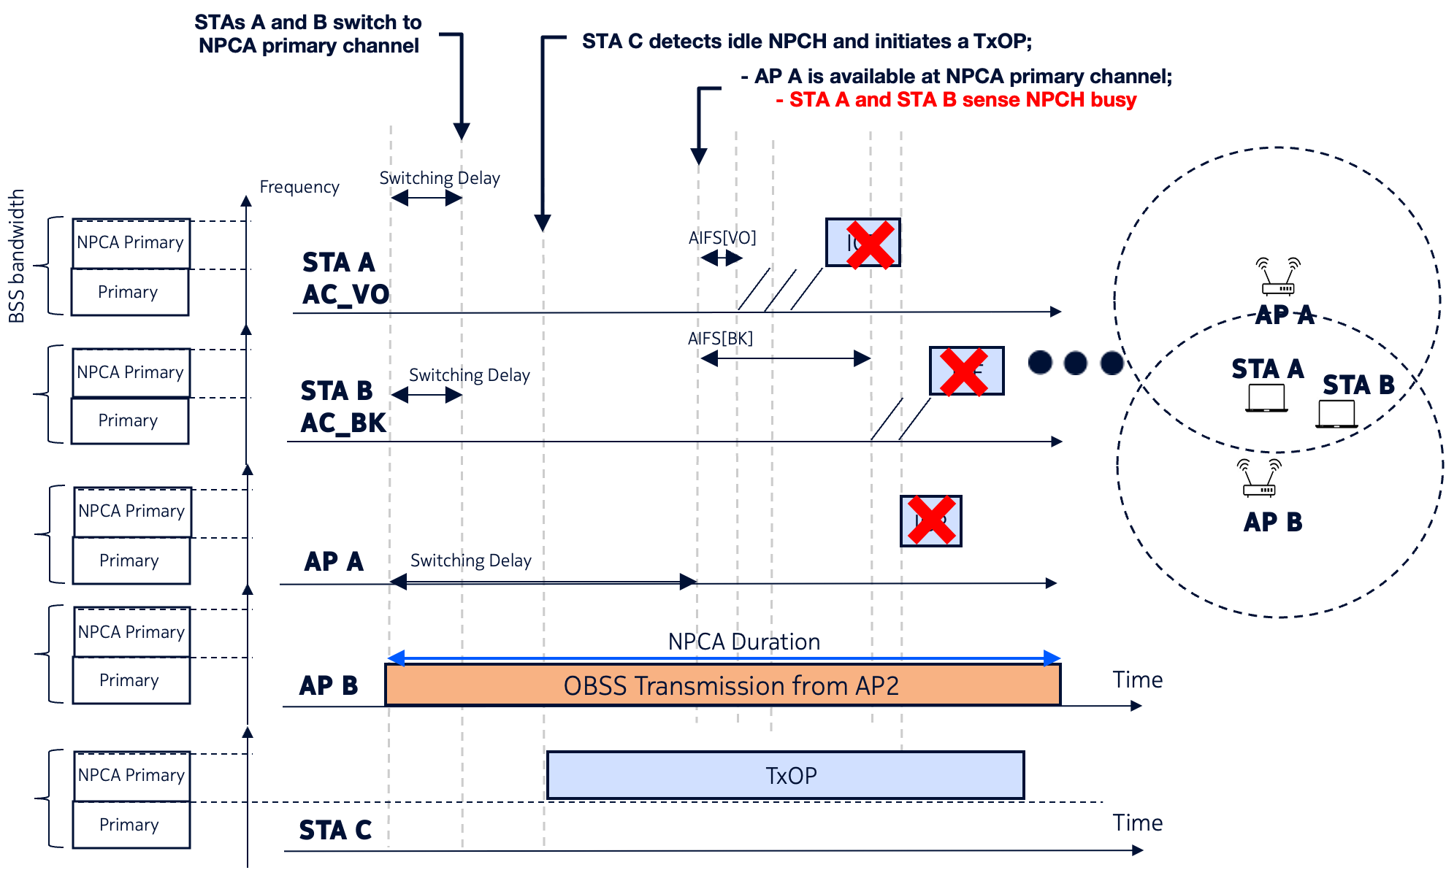
Option 2. Issue
Another STA may capture the medium while the NPCA STAs are waiting for their peers to become available on the NPCH

Slide 16
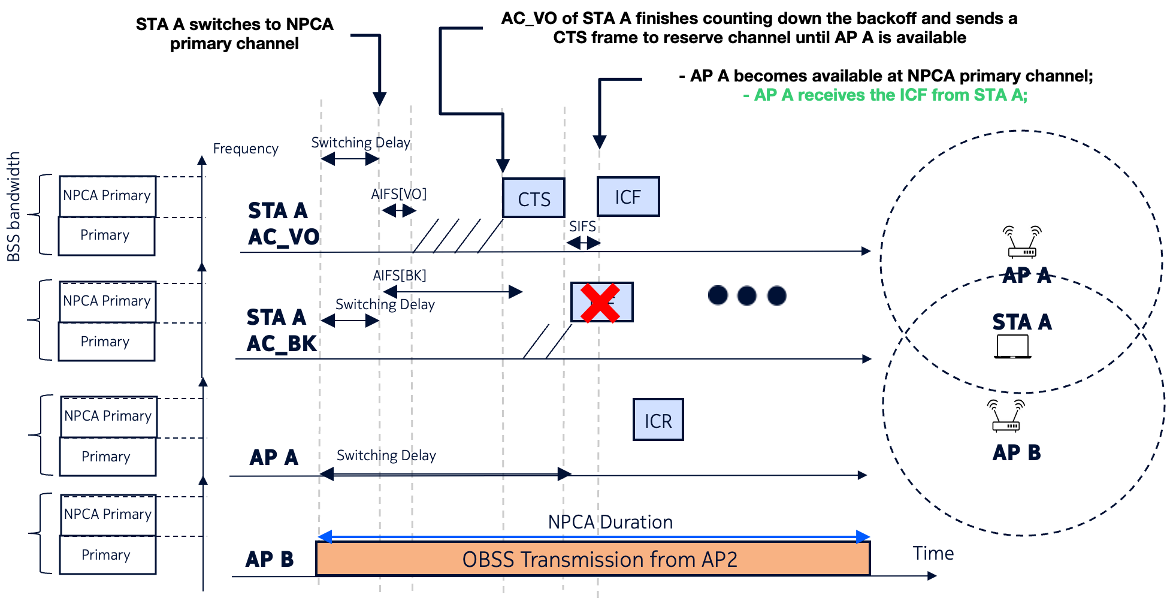
Option 3. Reserve the medium by sending a special frame
AC priorities are preserved
Faster-switching STAs get priority when accessing NPCH
Reduced chances of NPCA STAs losing contention to the NPCH residents
Channel is occupied with unnecessary transmissions
The channel reserving frame needs to have variable length, i.e., CTS-to-self doesn’t fit perfectly

