Slide 1
NPCA EDCA Slot Boundaries
Date: 2025-09-10
Authors:

Slide 2
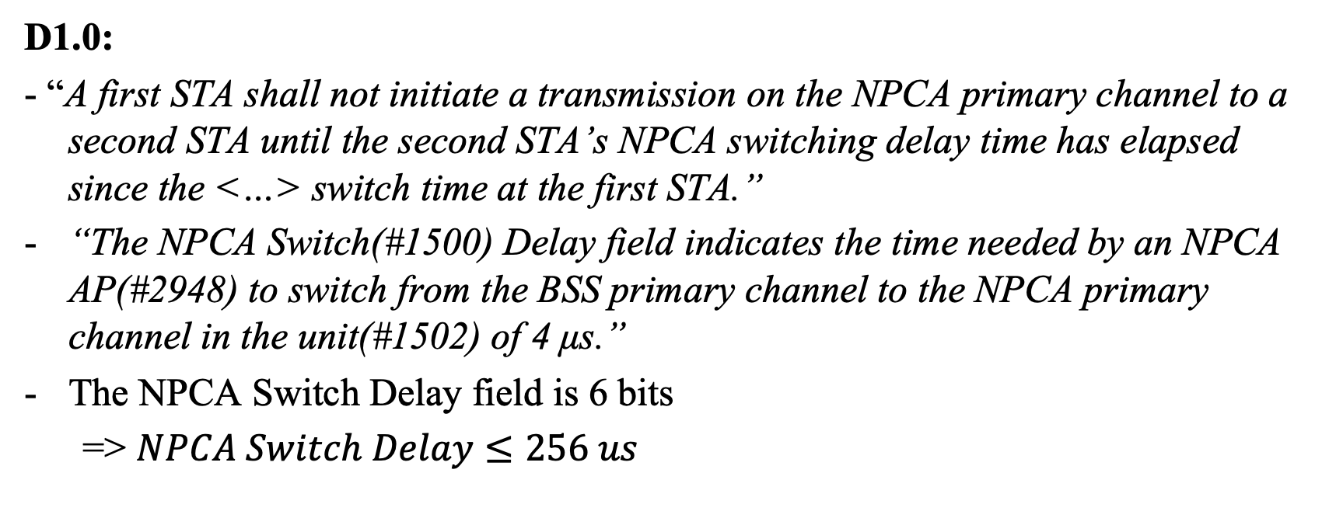
Background
D1.0:
- “A first STA shall not initiate a transmission on the NPCA primary channel to a second STA until the second STA’s NPCA switching delay time has elapsed since the <…> switch time at the first STA.”
“The NPCA Switch(#1500) Delay field indicates the time needed by an NPCA AP(#2948) to switch from the BSS primary channel to the NPCA primary channel in the unit(#1502) of 4 μs.”
The NPCA Switch Delay field is 6 bits
  => $NPCA Switch Delay≤256 us$

Slide 3
Problem Statement
How to take into account different switching delays of the peer STAs?
  How to avoid collisions between different STAs with the same peer?
  How to retain EDCA ACs prioritization?
The problem concerns the channel access rules, hence, should be defined in the standard

Slide 4
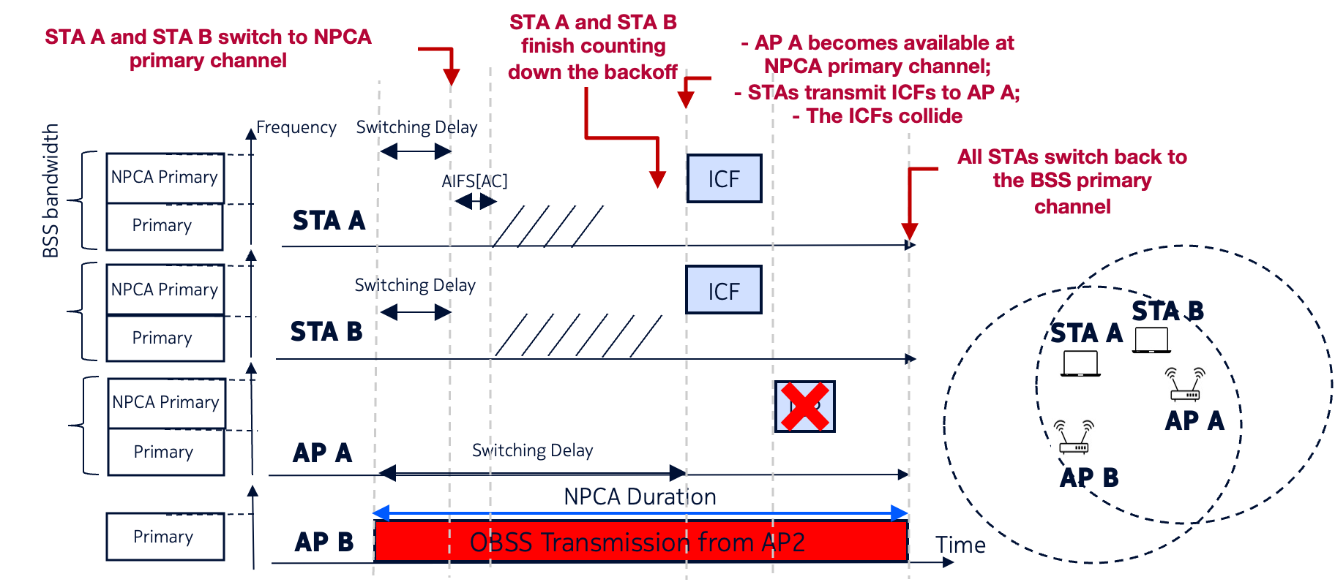
Why are different switching delays an issue?

Slide 5
Avoiding Excessive Collisions Upon Switching
Let us define NPCA Activation Time as the time the STA may start EDCA procedures on the NPCH
Option 1. Let the NPCA Activation Time for STA1 be the moment the switching delay of STA1 expires.
If the switching time of a peer-STA of STA1 is long enough that STA1 backoff expires earlier, STA1 shall re-select the backoff without changing the QSRC

Slide 6
Option 1. Illustration

Slide 7
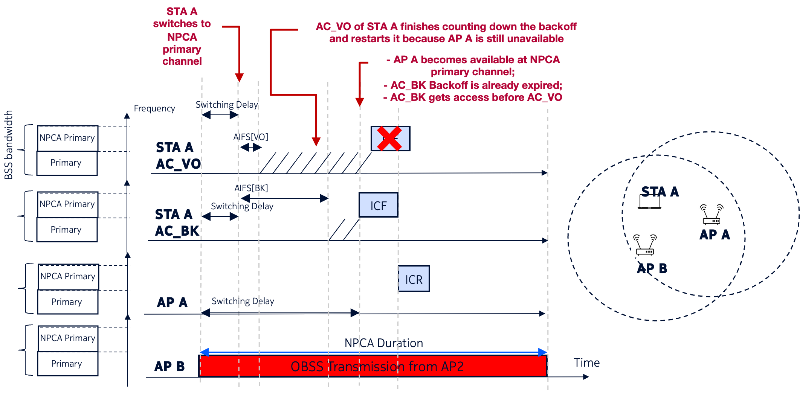
Option 1. Issue
What if AC_VO and AC_BK of a STA A contend?

Slide 8
Maintaining EDCA Priorities
Option 2. Let the NPCA Activation Time be the moment both the STA and its peer STA(s) are available at the NPCA primary channel.

Slide 9
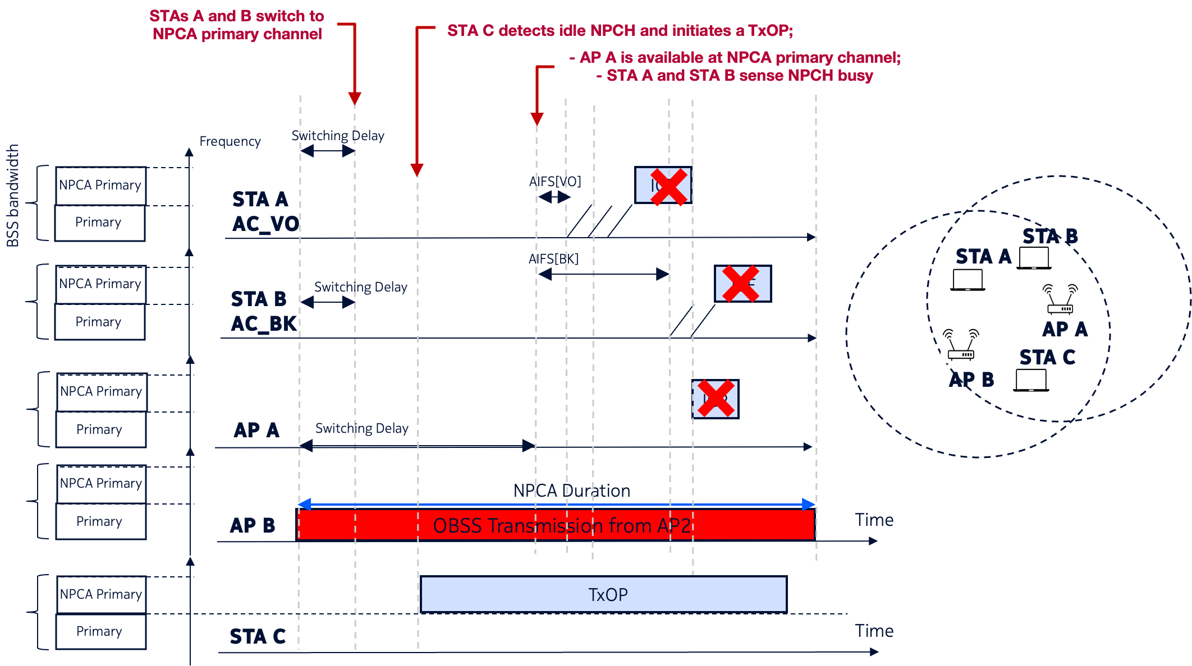
Option 2. Issue
Another STA may capture the medium while the NPCA STAs are waiting for their peers to become available on the NPCH

Slide 10
Option 3. Reserve the medium by sending a special frame
AC priorities are preserved
Faster-switching STAs get priority when accessing NPCH
Reduced chances of NPCA STAs losing contention to the NPCH residents

Slide 11
SPs
SP1. Do you agree that the NPCA STA should take into account the peer STA’s switching delay when initiating a backoff procedure?
SP2. Which option to resolve the issue of different switching delays of an NPCA STA and its peer NPCA STA do you prefer?
  Option 1. The NPCA STA shall restart the backoff if it completes before the peer STA is available on the NPCH
  Option 2. The NPCA STA shall start the backoff only when its peer STA is available on the NPCH
  Option 3. After completing the backoff, the NPCA STA may send a frame to reserve the medium until the peer STA is available on the NPCH

