Slide 1
NPCA EDCA Slot Boundaries
Date: 2025-07-28
Authors:

Slide 2
Problem Statement
How to take into account different switching delays of the peer STAs?
  How to avoid collisions between different STAs with the same peer?
  How to retain EDCA ACs prioritization?

Slide 3
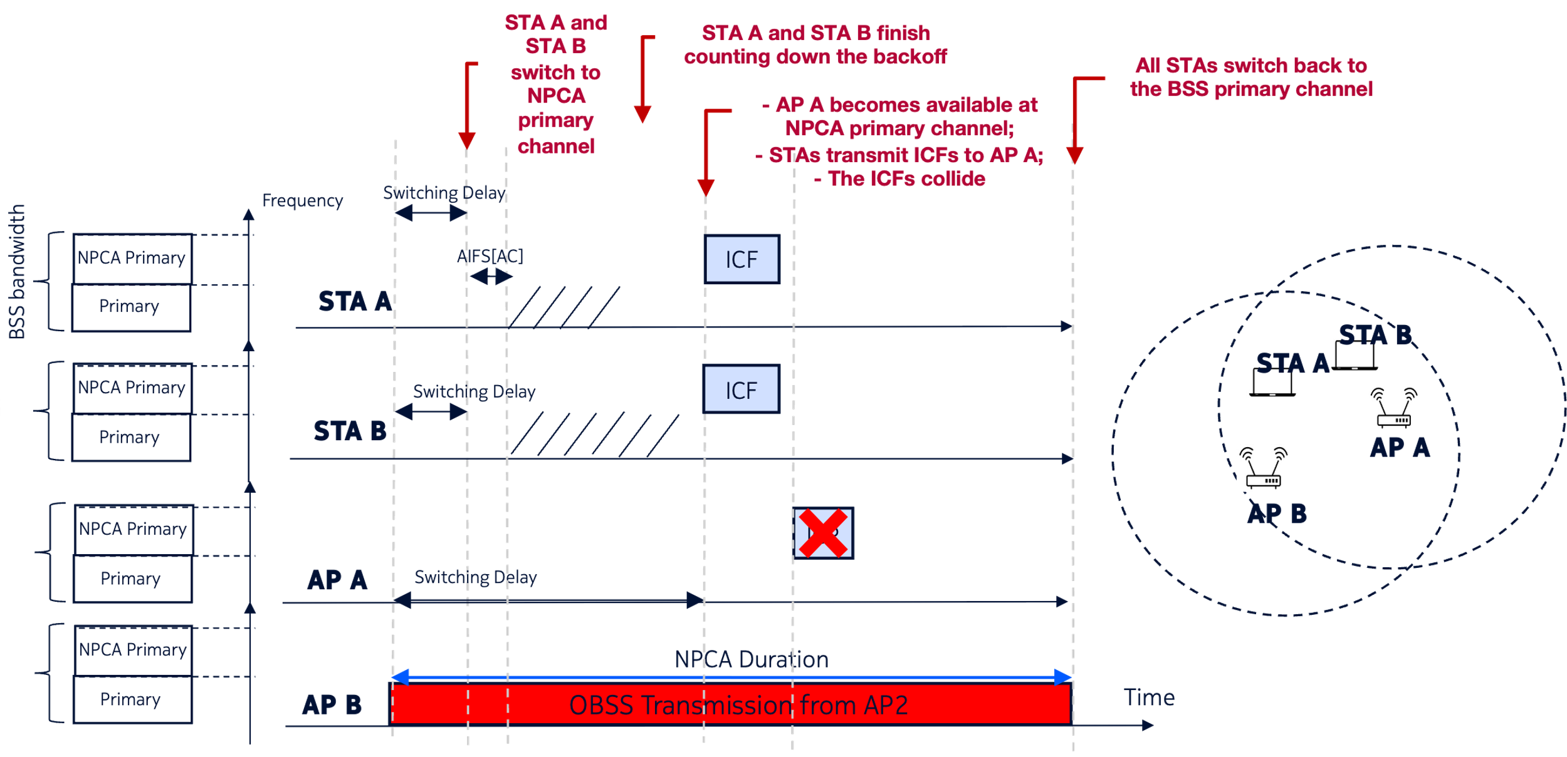
Problem Illustration
Suppose that different STAs have sufficiently different switching delays:

Slide 4
Avoiding Excessive Collisions Upon Switching
Let us define NPCA Activation Time as the time the STA may start EDCA procedures on the NPCH
Option 1. Let the NPCA Activation Time for STA1 be the moment the switching delay of STA1 expires.
If the switching time of a peer-STA of STA1 is long enough that STA1 backoff expires earlier, STA1 shall re-select the backoff without changing the QSRC

Slide 5
Option 1. Illustration

Slide 6
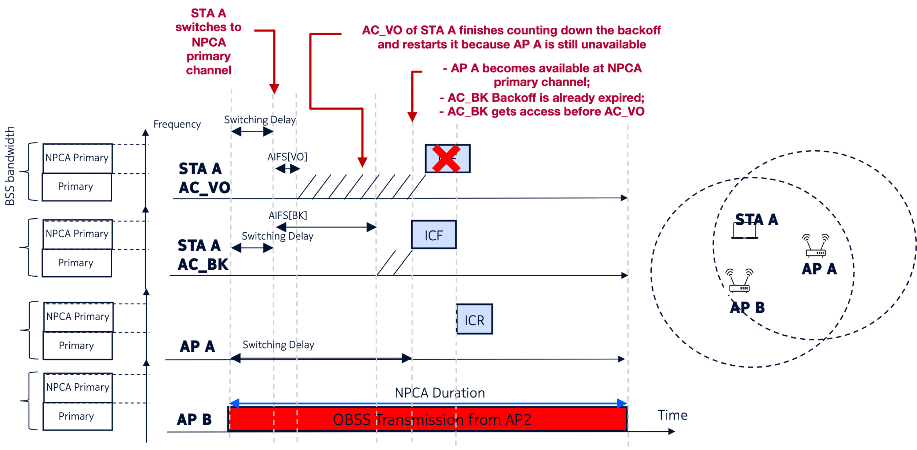
Option 1. Issue
What if AC_VO and AC_BK of a STA A contend?

Slide 7
Maintaining EDCA Priorities
Option 2. Let the NPCA Activation Time be the moment both the STA and its peer STA(s) are available at the NPCA primary channel.

Slide 8
SP
Do you agree that an NPCA STA shall start counting down backoff only after both the STA and its intended peer STA(s) is available at the NPCA primary channel?

