Slide 1
Phase Rotation for IMMW PPDU
Date: 2025-07-29
Authors:

Slide 2
Abstract
Integrated mmWave (IMMW) PAR [1] defines the scope to leverage or reuse existing 802.11 OFDM PHY
  802.11 OFDM PHY may be upclocked by a factor of 8 (or 4) for mmWave
In this presentation, we discuss modifications to the phase rotations applied to legacy fields

Slide 3
IMMW PPDU: Wide BW [2]
160 MHz
LSTF | LLTF | U-SIG | IMMW SIG | IMMW STF | IMMW LTF | Data | PE
LSTF | LLTF | U-SIG | IMMW SIG
… | … | … | …
LSTF | LLTF | U-SIG | IMMW SIG
Wide BW extension
  IMMW may define multiple PPDU BW, e.g. 160MHz, 320MHz, 640MHz, 1280MHz, etc.
  Leverage the design in sub-7GHz OFDM, WideBW is extended from base BW for better coex
    L-STF to IMMW-SIG: FD duplicated from base BW
    IMMW-STF/LTF/Data/PE: use new wideBW tone plan, e.g. sub-7GHz 40MHz/80MHz/160MHz

Slide 4
Background: Phase Rotation in Sub-7 GHz
Example:
For CBW = 160 MHz,
Phase rotation: [1, -1, -1, -1, 1, -1, -1, -1]
  PAPR with phase rotation = 5.9144 dB
  PAPR without phase rotation = 11.12 dB
For CBW = 320 MHz,
Phase rotation: [1, -1, -1, -1, 1, -1, -1, -1,
-1, 1, 1, 1, -1, 1, 1, 1]
  PAPR with phase rotation = 7.7653 dB
  PAPR without phase rotation = 14.13 dB
1
L-STF
L-LTF
…
-1
L-STF
L-LTF
…
-1
L-STF
L-LTF
…
Current design based
on 80 MHz sub-band
-1
L-STF
L-LTF
…
1
L-STF
L-LTF
…
-1
L-STF
L-LTF
…
-1
L-STF
L-LTF
…
-1
L-STF
L-LTF
…

Slide 5
Problem
For mmWave, no need for (quasi-)optimization considering a sub-band (e.g., 80 MHz)
  Leads to inefficiency in PAPR
  Each STA might be allocated the entire BW
PAPR more critical issue in mmWave
  Need to be reduced as much as possible
  Possible to optimize considering phase rotation for each 160 MHz (smallest unit)
For CBW = 1.28 GHz (with 8 sub-channels),
Phase rotation: [1, -1, -1, -1, 1, -1, -1, -1]
  PAPR with phase rotation = 5.9144 dB
For CBW = 2.56 GHz (with 16 sub-channels),
Phase rotation: [1, -1, -1, -1, 1, -1, -1, -1,
-1, 1, 1, 1, -1, 1, 1, 1]
  PAPR with phase rotation = 7.7653 dB
Sequences can be optimized to reduce PAPR further

Slide 6
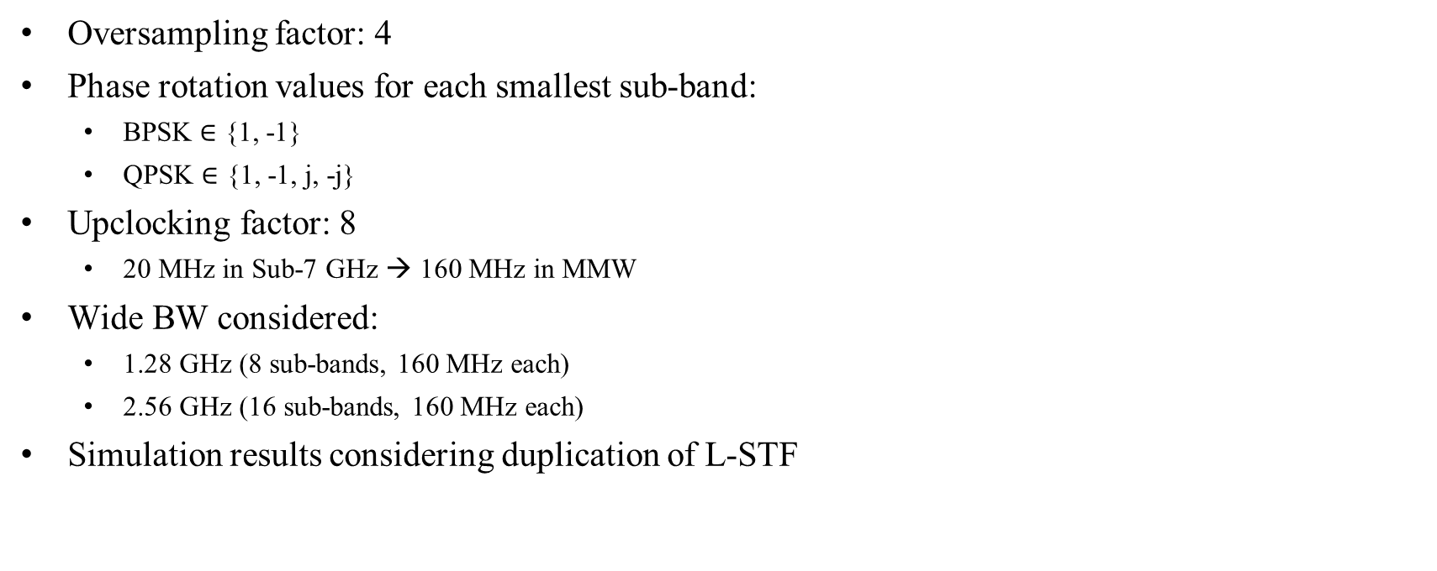
Simulation Parameters
Oversampling factor: 4
Phase rotation values for each smallest sub-band:
  BPSK $∈$ {1, -1}
  QPSK $∈$ {1, -1, j, -j}
Upclocking factor: 8
  20 MHz in Sub-7 GHz → 160 MHz in MMW
Wide BW considered:
  1.28 GHz (8 sub-bands, 160 MHz each)
  2.56 GHz (16 sub-bands, 160 MHz each)
Simulation results considering duplication of L-STF

Slide 7
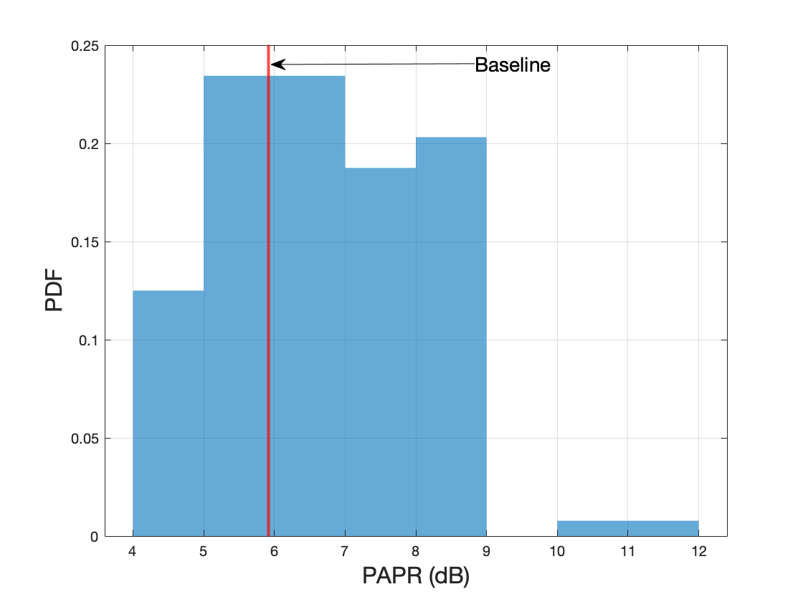
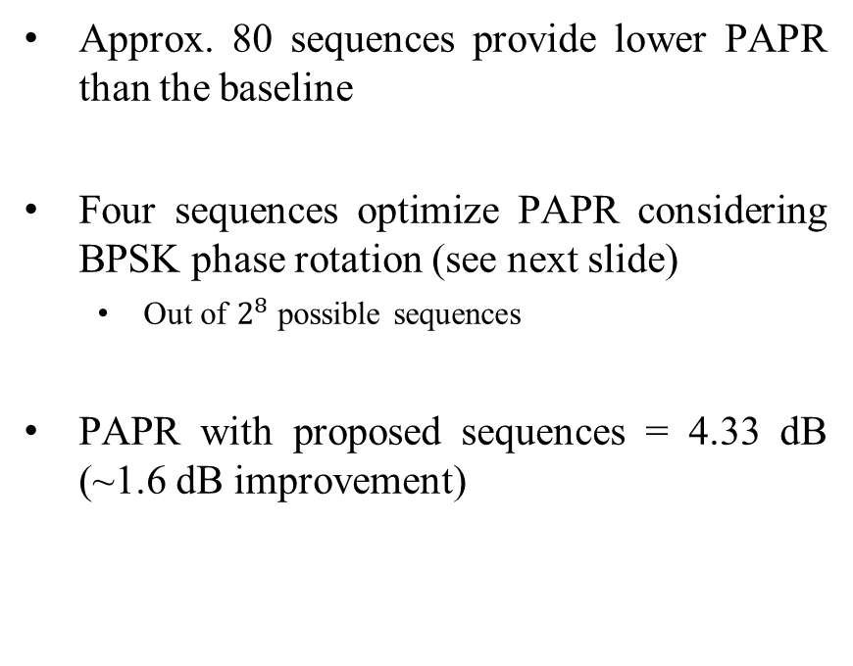
Phase Rotation (BPSK) for CBW 1.28 GHz
Approx. 80 sequences provide lower PAPR than the baseline
Four sequences optimize PAPR considering BPSK phase rotation (see next slide)
  Out of $2^{8}$ possible sequences
PAPR with proposed sequences = 4.33 dB (~1.6 dB improvement)

Slide 8
Phase Rotation (BPSK) Sequences (CBW 1.28 GHz)
For 11bq, we have four options to obtain the minimum PAPR possible
Seq. 1 = [-1 -1 1 1 1 1 -1 1]
Seq. 2 = [-1 1 -1 -1 -1 -1 1 1]
Seq. 3 = [1 -1 1 1 1 1 -1 -1]
Seq. 4 = [1 1 -1 -1 -1 -1 1 -1]
PAPR with phase rotation = 4.33 dB
Baseline:
Seq. = [1, -1, -1, -1, 1, -1, -1, -1]
PAPR with phase rotation = 5.9144 dB

Slide 9
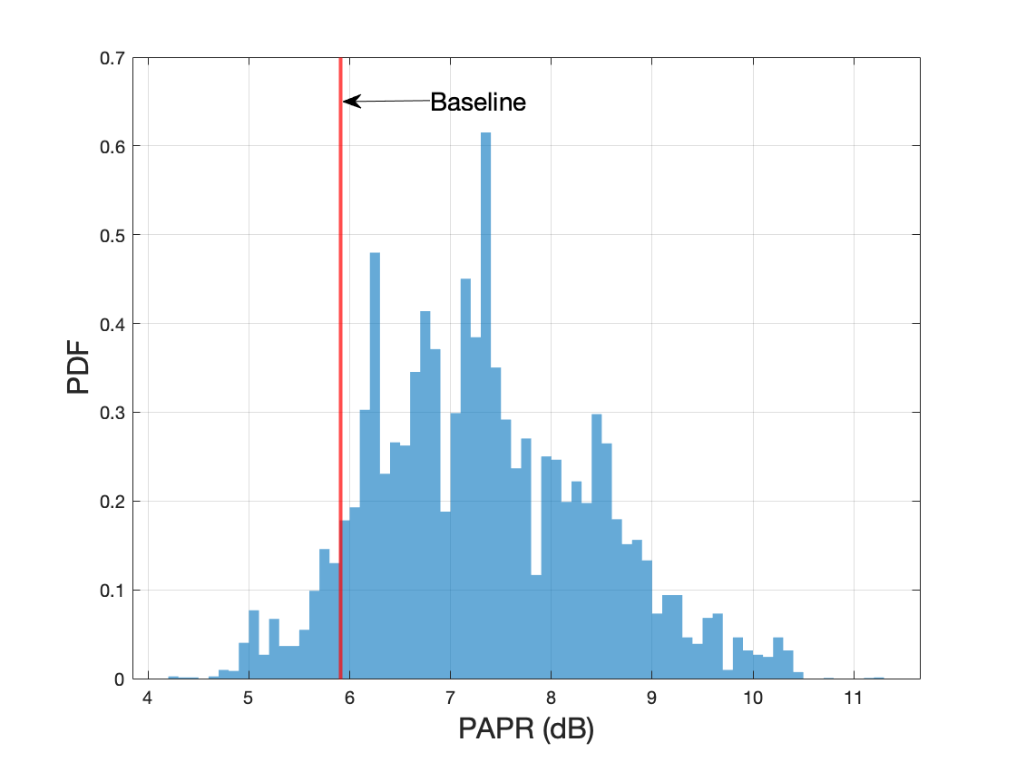
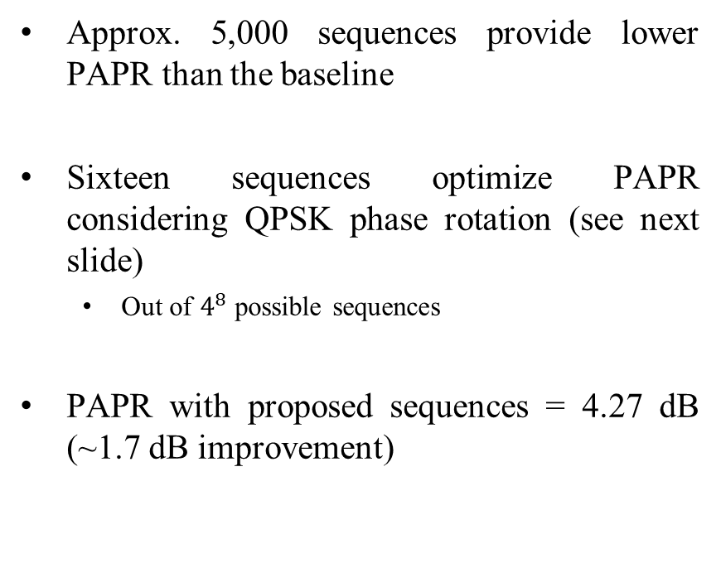
Phase Rotation (QPSK) for CBW 1.28 GHz
Approx. 5,000 sequences provide lower PAPR than the baseline
Sixteen sequences optimize PAPR considering QPSK phase rotation (see next slide)
  Out of $4^{8}$ possible sequences
PAPR with proposed sequences = 4.27 dB (~1.7 dB improvement)

Slide 10
Phase Rotation (QPSK) Sequences (CBW 1.28 GHz)
With QPSK, we have sixteen options to obtain the minimum PAPR possible
PAPR with phase rotation = 4.27 dB
Baseline:
Seq. = [1, -1, -1, -1, 1, -1, -1, -1]
PAPR with phase rotation = 5.9144 dB
Seq. 1 = [1, j, 1, j, -1, -j, -1, j]
Seq. 2 = [1, j, -1, j, 1, -j, 1, -j]
Seq. 3 = [1, -j, 1, -j, -1, j, -1, -j]
Seq. 4 = [1, -j, -1, -j, 1, j, 1, j]
Seq. 5 = [-1, j, 1, j, -1, -j, -1, -j]
Seq. 6 = [-1, j, -1, j , 1, -j, 1, j]
Seq. 7 = [-1, -j, 1, -j, -1, j, -1, j]
Seq. 8 = [-1, -j, -1, -j, 1, j, 1, -j]
Seq. 9 = [j, 1, j, 1, -j, -1, -j, 1]
Seq. 10 = [j, 1, -j, 1, j, -1, j, -1]
Seq. 11 = [j, -1, j, -1, -j, 1, -j, -1]
Seq. 12 = [j, -1, -j, -1, j, 1, j, 1]
Seq. 13 = [-j, 1, j, 1, -j, -1, -j, -1]
Seq. 14 = [-j, 1, -j, 1, j, -1, j, 1]
Seq. 15 = [-j, -1, j, -1, -j, 1, -j, 1]
Seq. 16 = [-j, -1, -j, -1, j, 1, j, -1]

Slide 11
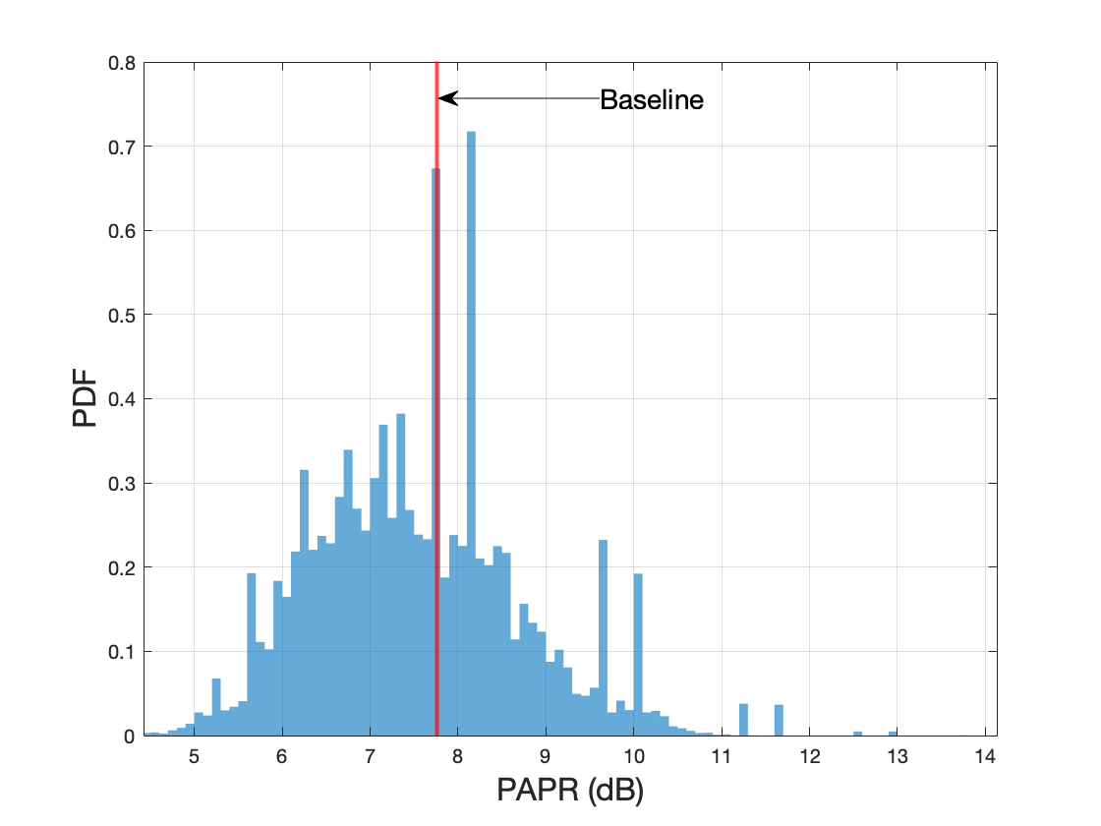
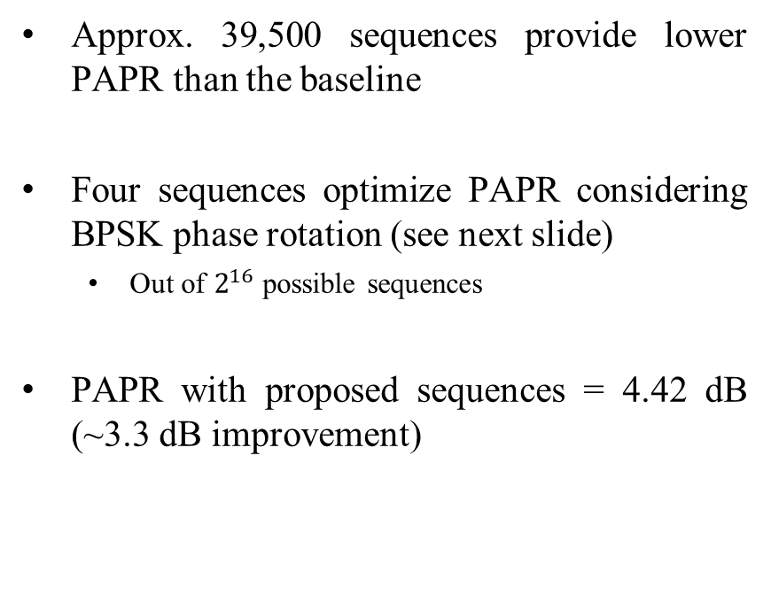
Phase Rotation (BPSK) for CBW 2.56 GHz
Approx. 39,500 sequences provide lower PAPR than the baseline
Four sequences optimize PAPR considering BPSK phase rotation (see next slide)
  Out of $2^{16}$ possible sequences
PAPR with proposed sequences = 4.42 dB (~3.3 dB improvement)

Slide 12
Phase Rotation (BPSK) Sequences (CBW 2.56 GHz)
For 11bq, we have four options to obtain the minimum PAPR possible
Seq. 1 = [-1 -1 -1 1 1 1 1 -1 1 1 -1 1 1 1 -1 1]
Seq. 2 = [-1 1 -1 -1 -1 1 -1 -1 1 -1 -1 -1 -1 1 1 1]
Seq. 3 = [1 -1 1 1 1 -1 1 1 -1 1 1 1 1 -1 -1 -1]
Seq. 4 = [1 1 1 -1 -1 -1 -1 1 -1 -1 1 -1 -1 -1 1 -1]
PAPR with phase rotation = 4.42 dB
Baseline:
Seq. = [1, -1, -1, -1, 1, -1, -1, -1, -1, 1, 1, 1, -1, 1, 1, 1]
PAPR with phase rotation = 7.7653 dB

Slide 13

Phase Rotation (QPSK) Sequences (CBW 2.56 GHz)
Sixteen sequences optimize PAPR considering QPSK phase rotation (see next slide)
  Out of $4^{16}$ possible sequences
PAPR with proposed sequences = 4.24 dB (~3.5 dB improvement)

Slide 14
Phase Rotation (QPSK) Sequences (CBW 2.56 GHz)
With QPSK, we have sixteen options to obtain the minimum PAPR possible
PAPR with phase rotation = 4.24 dB
Baseline:
Seq. = [1, -1, -1, -1, 1, -1, -1, -1, -1, 1, 1, 1, -1, 1, 1, 1]
PAPR with phase rotation = 7.7653 dB
Seq. 1 = [1, 1, 1, j, j, 1, 1, -j, 1, -1, -1, 1, -1, j, -j, 1]
Seq. 2 = [1, 1, 1, -j, -j, 1, 1, j, 1, -1, -1, 1, -1, -j, j, 1]
Seq. 3 = [1, j, -j, -1, 1, -1, -1, 1, j, 1, 1, -j, -j, 1, 1, 1]
Seq. 4 = [1, -j, j, -1, 1, -1, -1, 1, -j, 1, 1, j, j, 1, 1, 1]
Seq. 5 = [-1, -1, -1, j, j, -1, -1, -j, -1, 1, 1, -1, 1, j, -j, -1]
Seq. 6 = [-1, -1, -1, -j, -j, -1, -1, j, -1, 1, 1, -1, 1, -j, j, -1]
Seq. 7 = [-1, j, -j, 1, -1, 1, 1, -1, j, -1, -1, -j, -j, -1, -1, -1]
Seq. 8 = [-1, -j, j, 1, -1, 1, 1, -1, -j, -1, -1, j, j, -1, -1, -1]
Seq. 9 = [j, 1, -1, -j, j, -j, -j, j, 1, j, j, -1, -1, j, j, j]
Seq. 10 = [j, -1, 1, -j, j, -j, -j, j, -1, j, j, 1, 1, j, j, j]
Seq. 11 = [j, j, j, 1, 1, j, j, -1, j, -j, -j, j, -j, 1, -1, j]
Seq. 12 = [j, j, j, -1, -1, j, j, 1, j, -j, -j, j, -j, -1, 1, j]
Seq. 13 = [-j, 1, -1, j, -j, j, j, -j, 1, -j, -j, -1, -1, -j, -j, -j]
Seq. 14 = [-j, -1, 1, j, -j, j, j, -j, -1, -j, -j, 1, 1, -j, -j, -j]
Seq. 15 = [-j, -j, -j, 1, 1, -j, -j, -1, -j, j, j, -j, j, 1, -1, -j]
Seq. 16 = [-j, -j, -j, -1, -1, -j, -j, 1, -j, j, j, -j, j, -1, 1, -j]

Slide 15
References
[1] P802.11bq_PAR, https://www.ieee802.org/11/PARs/P802.11bq_PAR.pdf
[2] https://mentor.ieee.org/802.11/dcn/25/11-25-0360-00-00bq-high-level-thoughts-on-immw-phy-design.pptx
[3] https://mentor.ieee.org/802.11/dcn/19/11-19-1493-01-00be-phase-rotation-for-320mhz.pptx

Slide 16
SP
Do you agree that 11bq should optimize the phase rotation applied to the legacy portion of the Wide BW IMMW PPDU? Actual values for phase rotation are TBD.
Y/N/A

