Slide 1
Discussion on mmWave Link Management
Date: 2025-09-01
Authors:
Name | Affiliation | Address | Phone | Email
Liuming Lu | OPPO |  |  | luliuming@oppo.com
Chaoming Luo
Ning Gao
Weijie Xu
Liangxiao Xin
Liuming Lu (OPPO)

Slide 2
Introduction
According to IMMW Proposed PAR, 11bq aims to expand the multi-link operation defined in the sub-7.25 GHz band specifications to support non-standalone operation in the unlicensed bands between 42 GHz and 71 GHz
In 11be stage the multi-link operation(MLO) has been specified including the link management mechanisms that regulate or influence how links are used for frame exchange under MLO.
Discovery of AP MLD, Multi-link setup
TTLM, Dynamic link transitions
MLD individually addressed Management frame delivery, …
Due to almost the same transmission/reception characteristics for links in the sub-7GHz band, MLO is defined based on the assumption that each enabled link has similar functions for management frame delivery except some special case such as mobile NSTR AP MLD.
As for IMMW MLD the mmWave link and sub-7GHz link have very different transmission/reception characteristics, MLO including the link management mechanisms need to be further reconsidered to meet the requirements of IMMW.
This contribution analyzes the issues for MLO-based mmWave Link Management, and proposes two modes of operation for the mmWave link and their flexible management.

Slide 3
Recap
The advantages and disadvantages of mmWave link and sub-7GHz link
Links for IMMW MLD | Advantages | Disadvantages
mmWave Link | ultra-high speed and low latency due to wide bandwidth; lower congestion level and conflict probability | limited range poor signal penetration through obstacles like walls and trees line-of-sight requirement: signals can be blocked even by small obstacles susceptibility to atmospheric conditions like rain and moisture
Sub-7GHz Link | longer range better penetration of obstacles lower attenuation | lower bandwidth, leading to slower data rates due to the finite spectrum available high conflict probability and congestion especially in dense environment that results in significant interference and poor efficiency due to the increasing number of devices competing for it.

Slide 4
Requirements for mmWave Link Management (1)
The objective of the mmWave link management is to make the IMMW devices perform reliable high-rate communication to support low-latency applications, reduced overhead for managements, lower power consumption, flexible link management to be adaptive to different kinds of environments or scenarios.
Case-1 the sub-7GHz link needs to be responsible for the management of mmWave link and the delivery of the management frames on the mmWave link needs to be limited or disallowed in some cases where:
The mmWave link performs high power consumption or low efficiency for communication, e.g. the usage of high-band to transmit low-volume management frame
the communication on the mmWave link is unreliable due to its limited range and poor signal penetration through obstacles

Slide 5
Requirements for mmWave Link Management (2)
The objective of the mmWave link management is to make the IMMW devices perform reliable high-rate communication to support low-latency applications, reduced overhead for managements, lower power consumption, flexible link management to be adaptive to different kinds of environments or scenarios.
Case-2. the mmWave link is capable of managing of its own link, the delivery of the management frames on the link can be allowed in some cases where
mmWave link has better communication quality and reliable communication on its link is possible.
The congestion and high conflicts happen on the sub-7GHz link.
The communication on the sub-7GHz link is over-loaded and occupies too much overhead.

Slide 6
Proposals - the modes of operation for the mmWave link (1)
According to the requirements for mmWave link management, one mode of operation for the mmWave link to be considered is an MLO-based controlled operation mode in which data transmission on the mmWave link is managed and controlled by the sub-7GHz link
In the MLO-based controlled operation mode for the mmWave link, the sub-7GHz link is responsible for the management of mmWave link and the delivery of the management frames on the mmWave link needs to be limited or disallowed, e.g., one or more of the following management frames can be considered to be not transmitted on the mmWave link.
Beacon frame, Probe Request/Response frames, an individually addressed Class 3 management frame, an individually addressed deauthentication frame, an individually addressed Disassociation frame

Slide 7
Proposals - the modes of operation for the mmWave link (2)
The other mode of operation for the mmWave link to be considered is an MLO-based independent operation mode in which data transmission on the mmWave link is managed and controlled by its own link.
In the MLO-based independent operation mode for the mmWave link, the mmWave link is capable of managing of its own link, the delivery of some of the management frames on the link needs to be allowed, e.g., one or more of the following management frames can be considered to be transmitted on the mmwave link.
Beacon frame, Probe Request/Response frames, an individually addressed Class 3 Management frame, an individually addressed deauthentication frame, an individually addressed Disassociation frame

Slide 8
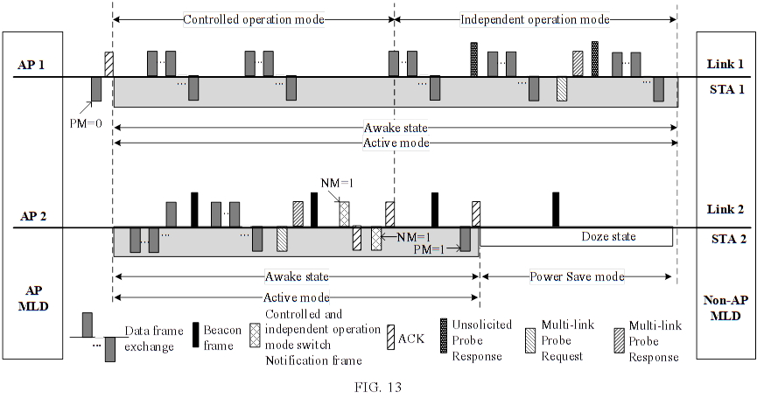
Proposals – dynamic management of the modes of operation for the mmWave
The dynamic and flexible transition between the MLO-based controlled operation mode and MLO-based independent operation mode for the mmWave link can be considered to make the IMMW devices adapt to different kinds of environments or scenarios.
An example: the IMMW non-AP MLD has set up two links with the IMMW AP MLD. And after the association, the mmWave link operates on the MLO-based controlled operation mode in which only data frame exchanges are done on the link.
In the case that the sub-7GHz link suffers from congestion and high conflicts or are over-loaded, after the operation mode transition management frame exchange on the sub-7GHz link, the mmWave link operates on the MLO-based independent operation mode.
mmWave link
sub-7GHz link

Slide 9
Summary
The MLO specified in 11be needs to be optimized to meet the requirements of IWWM devices due to the very different transmission/reception characteristics between the mmWave link and sub-7GHz link.
This contribution proposes two modes of operation for the mmWave link, and the dynamic management mechanism of the two modes that can switch between each other：
(1) MLO-based controlled operation ：data transmission on the mmWave link is managed and controlled by sub-7GHz link
the sub-7GHz link is responsible for the management of the mmWave link and the delivery of the management frame on mmWave link needs to be limited or disallowed
(2) MLO-based independent operation mode：data transmission on the mmWave link is managed and controlled by its own link.
the mmWave link is capable of managing of its own link, the delivery of some of the management frames on the link can be allowed

Slide 10
References
[1] IEEE P802.11be/D7.0
[2] IMMW Draft Proposed PAR, https://mentor.ieee.org/802.11/dcn/24/11-24-0116-07-immw-immw-draft-proposed-par.docx
[3] IMMW Draft Proposed CSD, https://mentor.ieee.org/802.11/dcn/24/11-24-0549-06-immw-immw-draft-proposed-csd.docx
[4] MLO aided 60 GHz operation, https://mentor.ieee.org/802.11/dcn/25/11-25-1126-00-00bq-mlo-aided-60-ghz-operation.pptx
[5] IMMW technical scope proposal, https://mentor.ieee.org/802.11/dcn/23/11-23-2004-00-immw-technical-scope-proposal.pptx
[6] Discussion on general direction of integrated mmWave, https://mentor.ieee.org/802.11/dcn/23/11-23-1968-00-immw-discussion-on-general-direction-of-integrated-mmwave.pptx
[7] Flexible sub-7Ghz and mmWave Integration in IMMW, https://mentor.ieee.org/802.11/dcn/23/11-23-1974-00-immw-flexible-sub-7ghz-and-mmwave-integration-in-immw.pptx
Liuming Lu (OPPO)

Slide 11
SP1
SP 1: Do you agree to specify an MLO-based controlled operation mode for mmWave link of IMMW devices with the following features ?
the sub-7GHz link is responsible for the management of the mmWave link and the delivery of the management frame on the mmWave link needs to be limited or disallowed
Liuming Lu (OPPO)

Slide 12
SP2
SP 2: Do you agree to specify an MLO-based independent operation mode for the mmWave link of IMMW devices with the following features ?
the mmWave link is capable of managing of its own link, and the delivery of some of the management frames on the mmWave link can be allowed
Liuming Lu (OPPO)

Slide 13
SP3
SP 3: Do you agree to specify an mechanism for the dynamic management of the two modes including an MLO-based controlled operation mode and an MLO-based independent operation mode for mmWave link of IMMW devices?
The mechanism allows the two modes to switch between each other
Liuming Lu (OPPO)

