Slide 1
LDPC Dtm Equation for IM
Date: 2025-07-28
Authors:

Slide 2
Background
In one design under consideration for Interference Mitigation, IM pilots are inserted along with data tones into the LDPC Tone Mapper during PPDU construction [1][2].
  The LDPC Tone Mapper (i.e. LDPC Dtm) insertion method provides for an efficient and downstream-transparent way to distribute IM pilots across the OFDM symbol such that their resulting spacing is consistent.
This contribution proposes a small modification to the LDPC Dtm mapping equation to adjust the offset of the IM pilot locations with the OFDM symbol, when using IM with the method above.

Slide 3
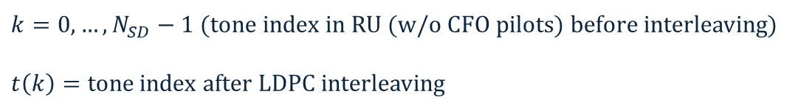



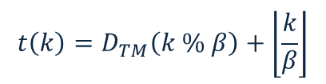
Recap of Baseline LDPC Dtm operation
The baseline equation for LDPC Dtm is the following:
$k=0,…,N_{SD}−1$ (tone index in RU (w/o CFO pilots) before interleaving)
$t\left(k\right)=$ tone index after LDPC interleaving
$$t\left(k\right)=D_{TM}\left(k \% \frac{N_{SD}}{D_{TM}}\right)+\left\lfloor \frac{k∙D_{TM}}{N_{SD}}\right\rfloor$$
Conceptually, it may be easier to visualize by defining a $β=\frac{N_{SD}}{D_{TM}}$ to represent the number of regions (i.e. total bins) over which the interleaving process will distribute tones
$$t\left(k\right)=D_{TM}\left(k \% β\right)+\left\lfloor \frac{k}{β}\right\rfloor$$
$N_{SD}$ tones of Dtm output
…
Bin 0
Bin 1
Bin $β−1$
Output bin start tone index
Offset from output bin start tone index
Offset in bin
Bin start
Sequential input tones are distributed to the output bins in circular round-robin fashion

Slide 4
Issue using baseline LDPC Dtm for IM pilot insertion
Input to Dtm
Dtm output
First IM pilot tone mapping
Negative band-edge tone in IFFT input
For this insertion method, baseline Dtm equation will always place first IM pilot on negative-most subcarrier in PPDU bandwidth
Imbalanced IM pilot coverage at band edges and DC boundaries can affect covariance estimates of data tones in those regions, resulting in larger variations in IM gain
More symmetric IM pilot coverage can additionally ease covariance estimation frequency domain interpolation
pilots
Npilot, IM
First data tone mapping
data
Nsd
…
Ndata, IM
DC subcarriers boundary in IFFT input
…
Positive band-edge tone in IFFT input

Slide 5





Methods for shifting IM pilots within PPDU BW
Could define for IM pilots to be inserted in the middle of the data stream, at input to baseline Dtm operation
Our proposal: Modify the Dtm equation to introduce a simple offset, directly achieving the same result without changing original Dtm input ordering
Input to Dtm
Dtm output
Input to Dtm
Dtm output
Start of data
$$\left\lfloor \frac{D_{TM}}{2}\right\rfloor$$
First IM pilot mapping
$$\left\lfloor \frac{D_{TM}}{2}\right\rfloor$$
data
LDPC Dtm
pilots
New LDPC Dtm
$$\left\lfloor \frac{D_{TM}}{2}\right\rfloor ∗\frac{N_{SD}}{D_{TM}}$$
pilots
data
First data tone mapping
data
…
…
$$\left\lfloor \frac{D_{TM}}{2}\right\rfloor or \left\lceil \frac{D_{TM}}{2}\right\rceil$$
$$\left\lfloor \frac{D_{TM}}{2}\right\rfloor or \left\lceil \frac{D_{TM}}{2}\right\rceil$$
However, this approach may require some implementations to buffer or hold data streams, at either the Tx during PPDU formation or Rx during IM pilot and data processing
Next slide will detail modification to Dtm equation

Slide 6
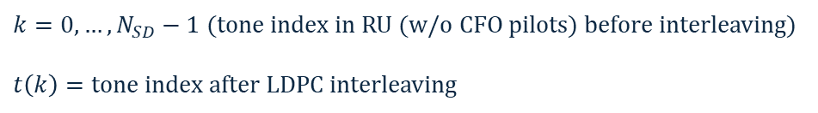



Proposed modification to LDPC Dtm formula for IM
Baseline LDPC Dtm equation (for continued use w/ non-IM PPDUs):
$k=0,…,N_{SD}−1$ (tone index in RU (w/o CFO pilots) before interleaving)
$t\left(k\right)=$ tone index after LDPC interleaving
$$t\left(k\right)=D_{TM}\left(k \% \frac{N_{SD}}{D_{TM}}\right)+\left\lfloor \frac{k∙D_{TM}}{N_{SD}}\right\rfloor$$
LDPC Dtm equation for IM PPDUs, with an added $γ$-term for tone mapping offset
$$t′\left(k\right)=\left(D_{TM}\left(k \% \frac{N_{SD}}{D_{TM}}\right)+γ+\left\lfloor \frac{k∙D_{TM}}{N_{SD}}\right\rfloor \right)\%{ N}_{SD}$$
$γ$ = offset amount, e.g. $\left\lfloor \frac{D_{TM}}{2}\right\rfloor$
Tx-side benefits:
  No need to modify input vector to Dtm operation
Rx-side benefits:
  Can be streamlined with existing FFT unloading + inverse Dtm operations, for some implementations
Original output bin start tone index
Bin shift
Offset from output bin start tone index
Output wraparound handling for last bin
Shifted output bin start tone index

Slide 7
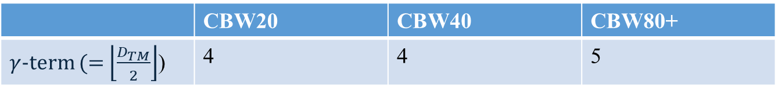

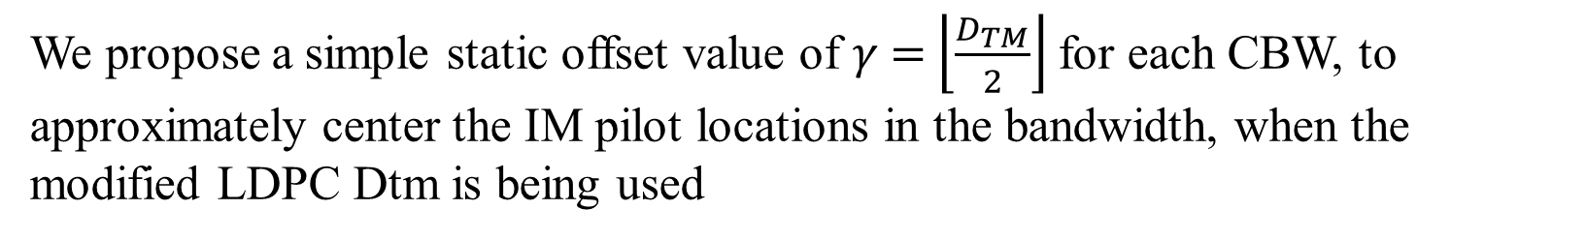
Proposed $γ$-term (i.e. offsets) for IM-specific LDPC Dtm
We propose a simple static offset value of $γ$ = $\left\lfloor \frac{D_{TM}}{2}\right\rfloor$ for each CBW, to approximately center the IM pilot locations in the bandwidth, when the modified LDPC Dtm is being used
 | CBW20 | CBW40 | CBW80+
$γ$-term (= $\left\lfloor \frac{D_{TM}}{2}\right\rfloor$) | 4 | 4 | 5
(See appendix slide for illustrated example of old vs. new LDPC Dtm operation)

Slide 8
Summary
This presentation proposes a modification to the LDPC Dtm equation when used for inserting IM pilots, specifically by introducing a shift-term for the purposes of centering the IM pilot locations in the bandwidth.

Slide 9


Strawpoll 1:
Do you support defining the LDPC Dtm equation used for IM-mode as the following:
Y/N/A
$$t\left(k\right)=\left(D_{TM}\left(k \% \frac{N_{SD}}{D_{TM}}\right)+γ+\left\lfloor \frac{k∙D_{TM}}{N_{SD}}\right\rfloor \right)\%{ N}_{SD}$$
Where $γ$ = static, CBW-specific offset amount

Slide 10
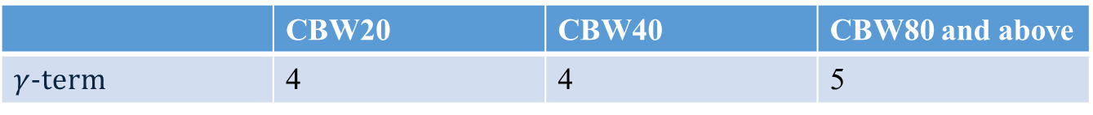
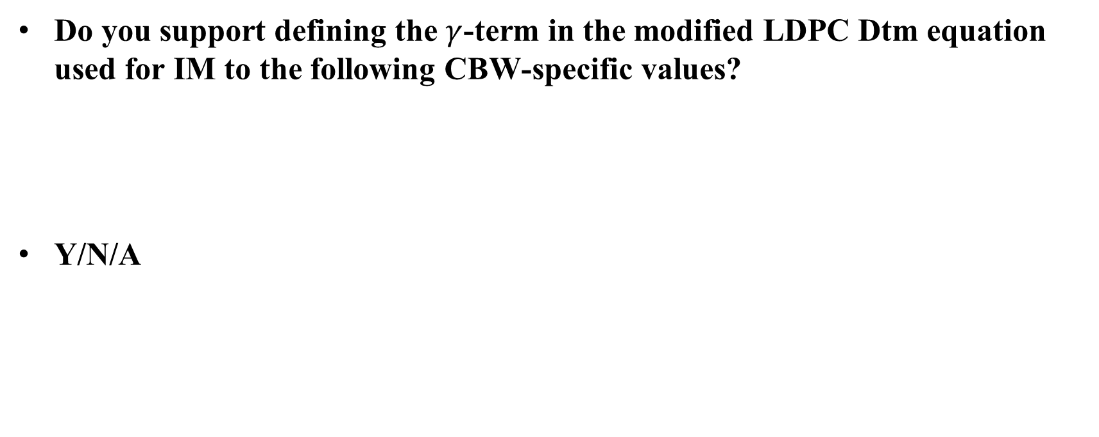
Strawpoll 2:
Do you support defining the $γ$-term in the modified LDPC Dtm equation used for IM to the following CBW-specific values?
Y/N/A
 | CBW20 | CBW40 | CBW80 and above
$γ$-term | 4 | 4 | 5

Slide 11
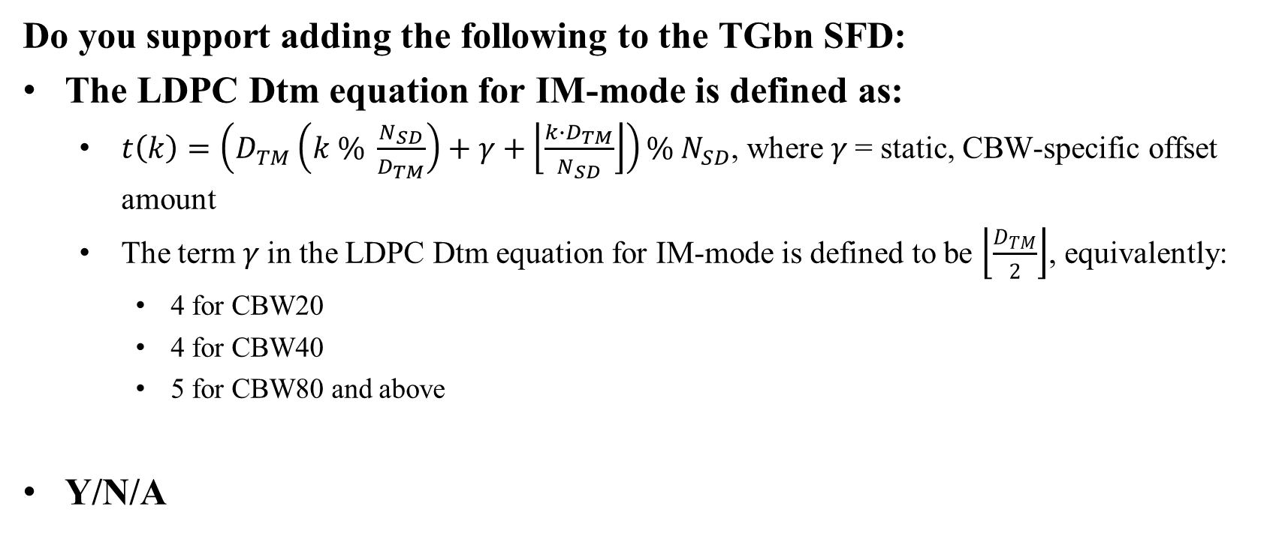
(New combined) Strawpoll
Do you support adding the following to the TGbn SFD:
The LDPC Dtm equation for IM-mode is defined as:
  $t\left(k\right)=\left(D_{TM}\left(k \% \frac{N_{SD}}{D_{TM}}\right)+γ+\left\lfloor \frac{k∙D_{TM}}{N_{SD}}\right\rfloor \right)\%{ N}_{SD}$, where 𝛾 = static, CBW-specific offset amount
  The term 𝛾 in the LDPC Dtm equation for IM-mode is defined to be $\left\lfloor \frac{D_{TM}}{2}\right\rfloor$, equivalently:
    4 for CBW20
    4 for CBW40
    5 for CBW80 and above
Y/N/A

Slide 12
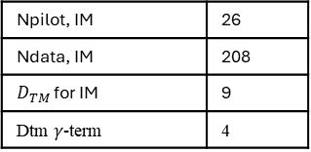
Appendix: CBW20 IM Example
The following example compares the IM pilot locations in CBW20, using the baseline and modified LDPC Dtm equation, with the following numerology:
Npilot, IM | 26
Ndata, IM | 208
$D_{TM}$ for IM | 9
Dtm $γ$-term | 4
Baseline Dtm equation
Modified Dtm equation

Slide 13
References
[1] 11-25/1329r0: Interference Mitigation Pilots Design, Shimi Shilo, et al., July 2025
[2] 11-24/1785r2: Interference Mitigation Pilots – Definitions, Shimi Shilo, et al., January 2025

