Slide 1
Open Points in the CBF Sounding
Date: 2025-07-10
Authors:
Name | Affiliations | Address | Phone | email
Dana Ciochina | Sony Group Corporation |  |  | Dana.Ciochina@sony.com
Thomas Handte |  |  |  | Thomas.Handte@sony.com
Daniel Verenzuela
Yusuke Tanaka |  |  |  | Yusuke.YT.Tanaka@sony.com
Kosuke Aio
Ryuichi Hirata

Slide 2
Introduction
Significant progress has been made in the definition of the CBF procedure
  Sounding sequences and transmission flow have been proposed and accepted [1]-[2]
Several points are still open:
  Behavior in case of failed cross BSS sounding:
    Several solutions to indicate the missing CSI report [3]-[6]
  Missing indications in case of more than one sounding sequence in one TXOP [7]
We herein propose a solution to both problems by means of flexible sounding sequence indications
We further discuss the NAV protection in case multiple sounding sequences are to be performed in one TXOP

Slide 3
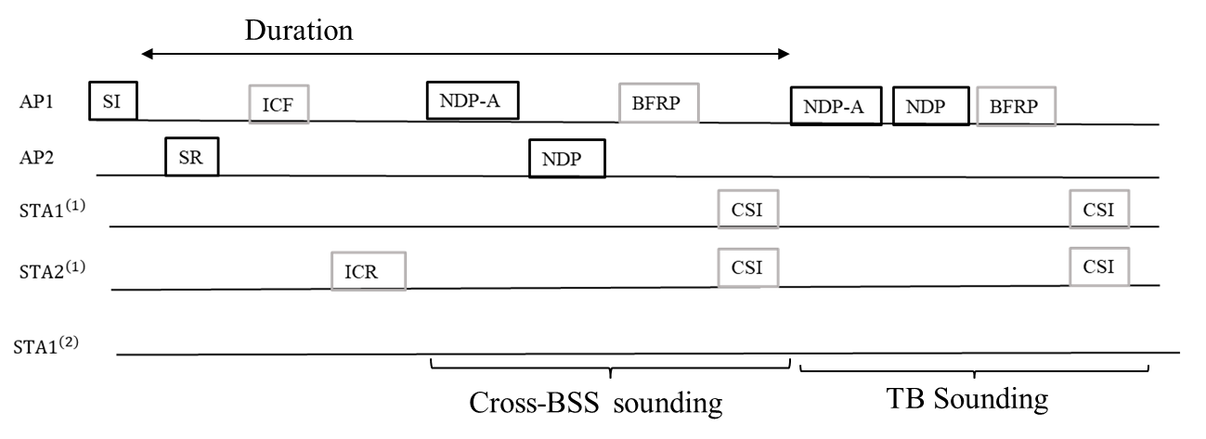
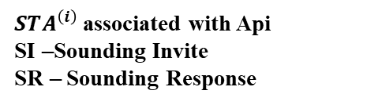
Co-BF Sounding - Recap
Co-BF Sounding consists of:
  Sounding initiated by AP1: cross BSS sounding and TB Sounding (in Figure)
  Sounding initiated by AP2: cross BSS sounding and TB Sounding (as in Figure, role of AP1 and AP2 interchanged)
$STA^{\left(i\right)}$associated with Api
SI –Sounding Invite
SR – Sounding Response
Notes:
  Duration in the Sounding Invite (SI) protects the cross BSS sounding
  Cross-BSS Sounding: transmitter of NDPA and sounding invite frame is the same.

Slide 4
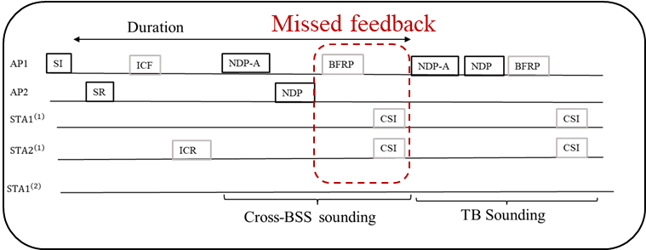
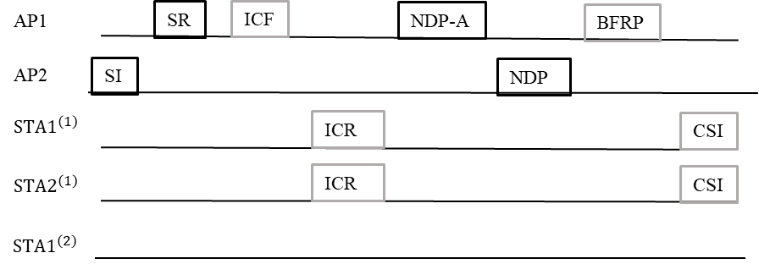
Failed CSI Feedback and CSI Recovery (1/2)
Description and Status
  A responding AP (AP2) involved in the cross BSS sounding initiated by a different AP (AP1) depends on overhearing the CSI report, based on the BFRP sent by the initiating AP
  Mechanisms to indicate a failed feedback were proposed to be included (e.g., as separate frame, in NDPA, Sounding Invite, COBF response)
Open Point 1:
  A responding AP which has missed the CSI feedback in the cross BSS sounding of the initiating AP cannot proactively request a repetition of the respective sounding sequence (recovery sounding) – no such sequence defined in D1.0
Failed CSI Feedback Issue
Example: Recovery Sounding as standalone Sequence

Slide 5
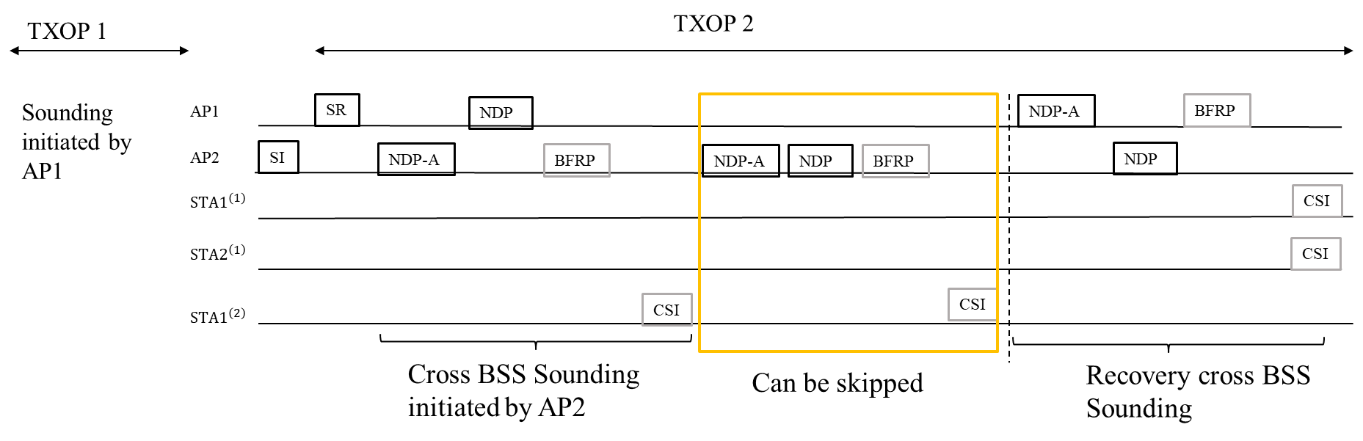
Failed CSI Feedback and CSI Recovery (2/2)
A recovery sounding sequence:
  May be performed as standalone or together with other sequences of the sounding that are still needed, depending on the sequences that have already be performed
  Additional Information should already be known at the initiator AP (AP2) compared to the regular sequences: e.g., Duration, parameters (same STA setup, BW, Nss). MCS may be lowered.
Example: Recovery within the Sounding initiated by AP2
This is a particular case of performing multiple cross BSS sounding sequences in one TXOP

Slide 6
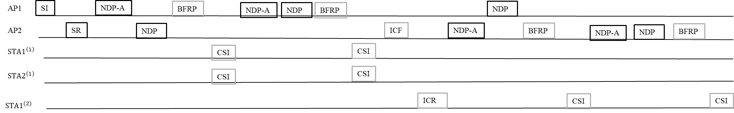
Multiple Sounding Sequences in one TXOP
Description and Status
  Several contributions and comments, proposed all or multiple sequences to be performed within TXOP.
  Performing multiple sequences in a TXOP has multiple advantages: less contention rounds, overhead reduction, similar CSI freshness
  Design should be flexible: not all sequences can be performed together
Open Point 2:
  AP2 does not know if, when or which sequences it can perform sounding in the session initiated by AP1
We will refer to this part as initiator sounding and this part as responder sounding

Slide 7
Solution to Open Point 1 and 2
Both open points can be solved by one solution
  by defining individual sequence indications and appropriate parameters in the schedule invite and schedule response frames
Main Indications within Sounding Invite to enable the solutions:
  Co-BF sounding session identification
  Initiator cross-BSS Sounding
  Responder cross-BSS Sounding:
    Depending on the session identification it can be interpreted as:
      the responder cross BSS Sounding is allowed (new session) or
      responder cross BSS Sounding is requested (existing session)
        A sounding has been performed but the feedback was not correctly received
        Other parts of the sounding may be skipped
Further indications within the Sounding Invite and Response which support the flow are shown as examples in the following slides.
Note on the order of the sequences:
  It is beneficial for the order to be predefined and the examples are built on this assumption

Slide 8
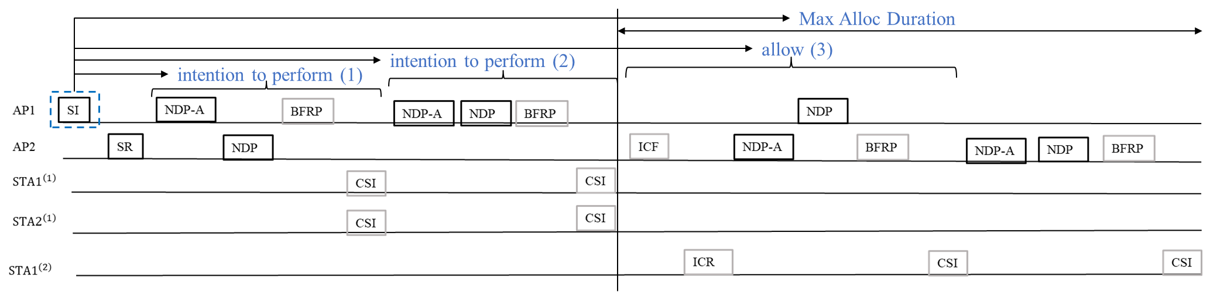
Sequence Indication Example – Sounding Invite
The Sounding Invite (SI) may contain indications for:
  Sounding Session – new or existing
  Initiator Cross-BSS sounding (1) – indicates whether the initiator intends to perform cross-BSS Sounding
  Initiator in-BSS Sounding (2) – indicates whether the initiator intends to perform in BSS Sounding
  Responder Cross BSS Sounding (3) – indicates availability of AP1 to participate, AP2 may perform if available
  Max Alloc Duration (for responder AP sounding) - the durations of the in-BSS trainings are not known by the other APs. AP1 estimates the duration of the initiator sounding and indicates the remaining duration within the TXOP to allow AP2 to estimate if it has time for its own inBSS.

Slide 9
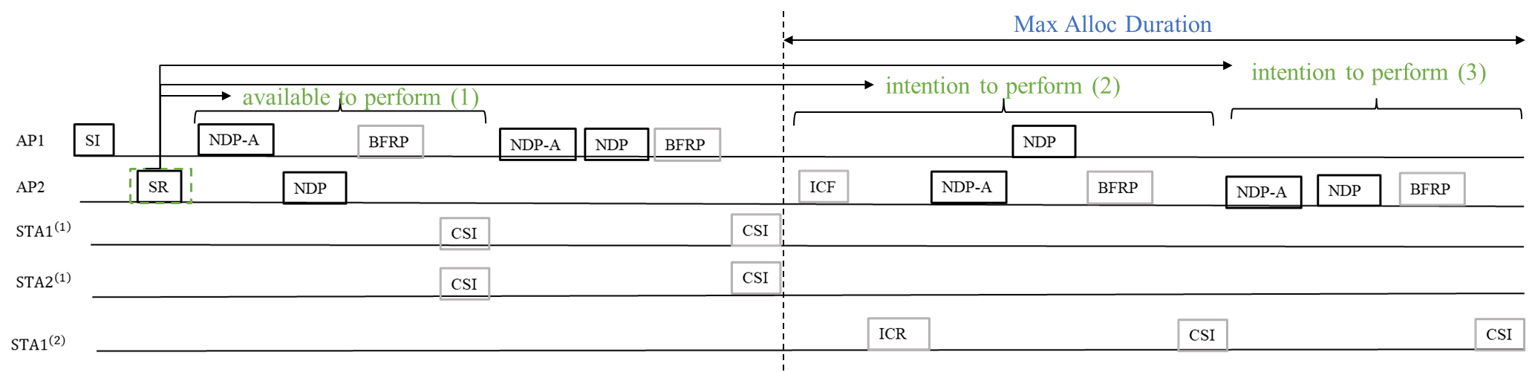
Sequence Indication Example – Sounding Response
The Sounding Response (SR) may contain indications for:
  Sounding Session - new or existing
  Initiator cross-BSS sounding (1) – indicates availability of AP2 to participate in the initiator cross BSS sounding
  Responder cross-BSS Sounding (2)– indicates intention to perform Responder Cross BSS Sounding
    Parameter: Duration of cross-BSS Sounding,
  Responder in-BSS Sounding (3) – indicates intention to perform (if Duration allows)
    Parameter: Duration of in-BSS Sounding
By using the suggested SI/SR indications, any combination of sounding sequences can be performed

Slide 10
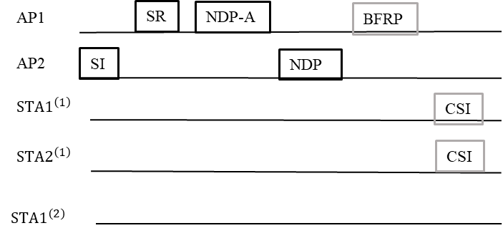
Sequence Indication Example for Recovery Sounding
Sounding Invite: as in Slide 8 with the settings
  Sounding Session: existing
  Initiator Cross BSS sounding – no need to perform
  Initiator in BSS Sounding –depending on need to perform
  Responder Cross BSS Sounding – indicates request for responder to participate:
  Duration set according to the repeated sequence
    Same or adjusted in case of lower MCS
Sounding Response: as in Slide 9 with the settings:
  Initiator Cross BSS sounding – N/A
  Responder Cross BSS Sounding – indicates availability to perform
  Responder in BSS Sounding – N/A

Slide 11
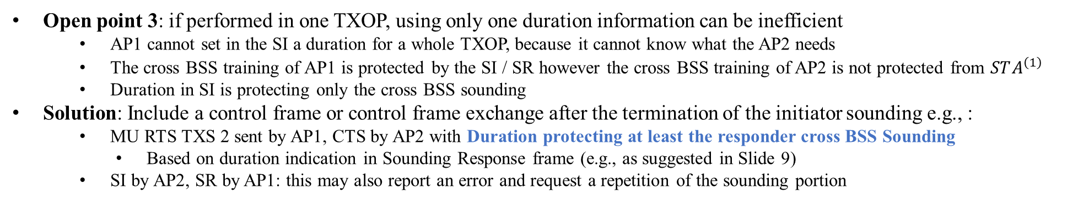


Multiple Sounding Sequences in one TXOP - Protection
May not be heard by $STA_{i}^{\left(1\right)}$
$$at least this part should be protected$$
Missing frame(s) to protect the sounding
Open point 3: if performed in one TXOP, using only one duration information can be inefficient
  AP1 cannot set in the SI a duration for a whole TXOP, because it cannot know what the AP2 needs
  The cross BSS training of AP1 is protected by the SI / SR however the cross BSS training of AP2 is not protected from $STA^{\left(1\right)}$
  Duration in SI is protecting only the cross BSS sounding
Solution: Include a control frame or control frame exchange after the termination of the initiator sounding e.g., :
  MU RTS TXS 2 sent by AP1, CTS by AP2 with Duration protecting at least the responder cross BSS Sounding
    Based on duration indication in Sounding Response frame (e.g., as suggested in Slide 9)
  SI by AP2, SR by AP1: this may also report an error and request a repetition of the sounding portion

Slide 12
Summary
It is beneficial to have a mechanism allowing an AP to trigger the repetition of a failed cross BSS sounding sequence
  This can be enabled by appropriate sounding sequence indications within the sounding invite and response frames
We proposed sounding indications to allow APs to perform multiple cross BSS sounding sequences in a TXOP in a flexible manner.

Slide 13
References
[1] 25/681 PDT-CRs-Joint-sounding-procedure
[2] 25/879 CoBF Signaling Details
[3] 25/745 CSI Open Issues in CBF
[4] 25/492 CBF sounding sequence MAC aspects
[5] 25/379 Considerations on UHR Sounding Operation
[6] 25/1034 OBSS CSI Report Check for CBF
[7] 25/865 Considerations on Co-BF Sounding Failure
[8] 25/866 Explicit Co-BF Sounding Type and Rounds Indications

