Slide 1
Interference Mitigation Pilots Design
Date: July 24, 2025
Authors:

Slide 2
Introduction
Interference mitigation is already defined in the spec, and there are some missing designs and TBDs that we need to solve
Previously, we presented the motivation, suggested designs and many simulation results [1]
In this contribution we present additional detailed simulations and suggest a detailed design for the Interference Mitigation pilots
We focus on:
  The number of IM pilots
  How to spread them in frequency using the LDPC Tone Mapper
  Location of IM Pilots (as specified by indices) at the input buffer to the LDPC Tone Mapper
  Value of the IM pilots

Slide 3
Simulation Assumptions & Interference Modeling
The following summarizes our simulation assumptions and how we model the interference (for all simulation results in this contribution):
  Interference Modeling
    For simplicity and flexibility in controlling the bandwidth & frequency location of the interference, interfering signals are OFDM based (with proper spectral shaping); at the interferer’s transmitter, random complex values are injected into the IFFT input bins corresponding to the desired interference frequency allocation
    In order to ensure there is no synchronization with the desired signal, the IFFT size used by the interferer is different than that used for generating the desired signal; in addition, per -PPDU a random OFDM symbol timing offset and a random carrier frequency offset (at a sub-subcarrier-spacing level) are inserted, relative to those of the desired signal
    When configured as a narrowband interferer, its allocated (fixed-bandwidth) frequency range within the signal’s channel bandwidth is randomized per PPDU
    Interference is set ‘on’ during the entire data portion of the PPDU
    The interfering signal is convolved with channel taps that are generated using the same channel model (e.g. TGn-D) as the desired signal; namely, the interference experiences a channel of the same type – but of a different (random, per-PPDU) realization thereof – as that of the desired signal
  Additional interference modeling options to consider (that we’ve simulated in the past)
    Interference can begin and end at random within the data portion of the PPDU

Slide 4
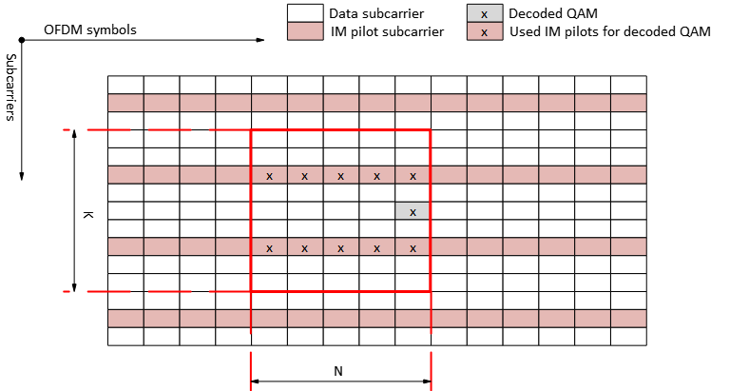
Simulation Assumptions & Interference Modeling
(cont.)
  Receiver operation
    Practical CHEST is used
    Covariance of interference & noise is computed based on the IM pilots – with filtering across IM pilots in time & frequency (see schematic example below) – and then used to compute the MVDR equalization weights
      The choice of filter coefficients in time/frequency is up to implementation – considering aspects such as the trade-off between averaging and reaction time to a rising interference, how to cope with the first data OFDM symbols, etc.
  Additional receiver operation options to consider
    Identification of interference
    (wideband or narrowband) may
    be employed
  Simulation results
    PER is generated for all MCS values
    across the entire SNR range, for a
    pre-determined SIR, with and without
    interference mitigation
    We choose the MCS for each scheme, in
    each SNR, which maximizes the goodput
    (optimal link adaptation) – and generate the goodput curve; similarly, we also choose between IM enabled & IM disabled modes based on whichever maximizes the goodput

Slide 5
Optimal number of IM pilots – Wideband Interference
Focusing on large RUs we show ~10-12.5% is near-optimal for nearly the entire SNR range
The figure below shows that
spreading IM pilots every 8-10
subcarriers yields the highest
goodput for the majority of the
SNR range (taking overhead
into consideration)
This figure corresponds to a
242-tone RU with 5dB SIR, and
a receiver with 4 Rx antennas,
but results are consistent with
other assumptions

Slide 6
Optimal number of IM pilots – Narrowband Interference
Results are consistent for a narrowband (1MHz) interference, as shown below; here we assume a 242-tone RU with 5dB SIR and a receiver with 4 Rx antennas
Although 1MHz constitutes
only ~5% of the signal’s BW,
without IM applied there is a
severe impact on the
performance
Using ~10% resources as
IM pilots yields the highest
goodput for the majority of
the SNR range

Slide 7
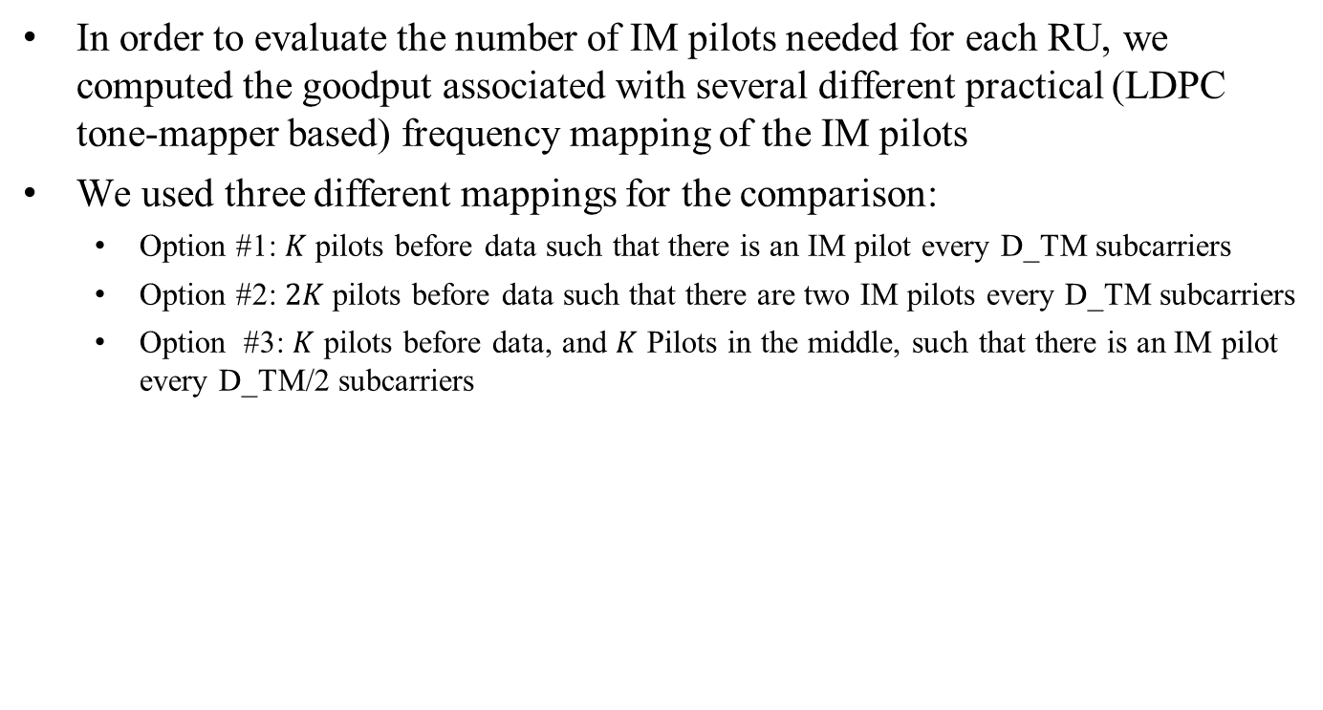
Number of IM Pilots - Simulations
In order to evaluate the number of IM pilots needed for each RU, we computed the goodput associated with several different practical (LDPC tone-mapper based) frequency mapping of the IM pilots
We used three different mappings for the comparison:
  Option #1: $K$ pilots before data such that there is an IM pilot every D_TM subcarriers
  Option #2: $2K$pilots before data such that there are two IM pilots every D_TM subcarriers
  Option #3: $K$ pilots before data, and $K$ Pilots in the middle, such that there is an IM pilot every D_TM/2 subcarriers
Option #1
Option #2
Option #3
IM Pilots
IM Pilots
IM Pilots
N_SD/2
Data
Data
Data
IM Pilots
N_SD/2
Data
Before LDPC
Tone Mapping
Before LDPC
Tone Mapping
After LDPC
Tone Mapping
Before LDPC
Tone Mapping
After LDPC
Tone Mapping
Before LDPC
Tone Mapping
After LDPC
Tone Mapping

Slide 8
Number of IM Pilots - Simulations
For option #1 in the previous slide, the following figures show the almost uniform distribution of IM pilots in their physical locations within a 242-tone RU after the LDPC tone mapping block (right-hand side shows a zoom-in near the origin), where the D_TM=9
10
9
9
10
9
9
9
*amplitude difference is used for illustrative purposes only

Slide 9
242-tone RU
In the case of a 242-tone RU, the value of D_TM is 9
In the figure below, we compare the goodput of a single IM pilot every 9 tones, two IM pilots every 9 tones and a single IM pilot every ~4.5 tones (on average), with SIR=5dB
As shown, using a single
IM pilot every 9 tones
(with the existing LDPC
tone mapper) yields best
results
This means a total of
26 IM pilots (~11%)
which spans the entire RU

Slide 10
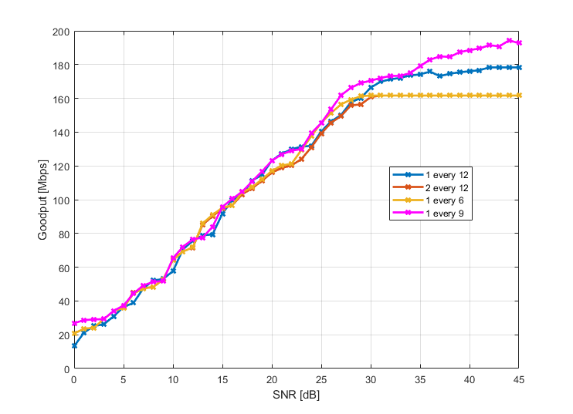
484-tone RU
In the case of a 484-tone RU, the value of D_TM is 12
In the figure below, we compare the goodput of a single IM pilot every 12 tones, two IM pilots every 12 tones and a single IM pilot every 6 or 9 tones, with SIR=5dB
As shown, using a single
IM pilot every 9 tones
(new D_TM=9) is
better for the majority
of the SNR range
This means a total of
52 IM pilots (~11%)
which spans the entire RU

Slide 11
996-tone RU
In the case of a 996-tone RU, the value of D_TM is 20
In the figure below, we compare the goodput of a single IM pilot every 20 tones, two IM pilots every 20 tones and a single IM pilot every 10 tones, with SIR=5dB
As shown, using a single
IM pilot every 10 tones
is better for the entire
SNR range
  2 IM Pilots every 20 tones
  is suboptimal in the high
  SNR regime
This means a total of
98 IM pilots (10%)
which spans the entire RU
  Using new D_TM=10

Slide 12
Number of IM Pilots for RU size ≤ 996-tones
Based on the previous slides, the following number of IM pilot tones can be used for an RU smaller than or equal to 996-tones:
  26 IM pilots for a 242-tone RU (~11%)
  52 IM pilots for a 484-tone RU (~11%)
  98 IM pilots for a 996-tone RU (10%)
For RUs larger than 996-tones (2x996, 4x996) the number is a multiple of 98 IM pilots

Slide 13
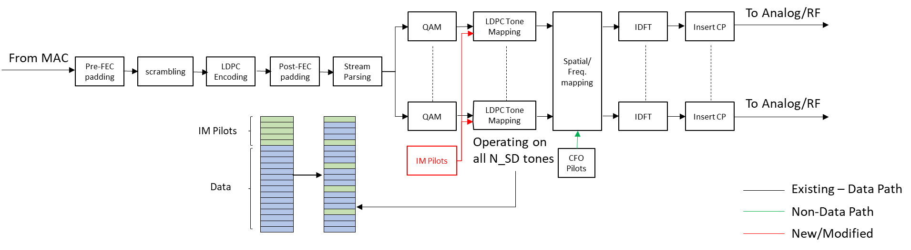
Using LDPC Tone Mapper to Spread IM Pilots
As proposed earlier, we’d like the IM pilots to be inserted into the LDPC Tone Mapper in such a way that ensures they are (almost) uniformly spread in frequency, once actually transmitted
  Same operation across all OFDM symbols
At the receiver side, IM pilots will be read at the output of LDPC Tone
De-mapper

Slide 14
Location of IM Pilots w.r.t. LDPC Tone Mapper
We want the receiver to compute the interference covariance – based on the IM pilots – before carrying out data subcarrier equalization
Putting IM pilots at the beginning (of the input buffer to the LDPC tone mapper) will result in the receiver accessing/processing them – using the LDPC tone demapper addressing mechanism – before data tones
This allows the receiver to compute and use the IM pilots of the k-th OFDM symbol in the equalization of the same, k-th OFDM symbol
We therefore prefer data is preceded by IM pilots at the input to the LDPC tone mapper
IM Pilots
Indexing/processing order
Data
Before LDPC
Tone Mapping
Before LDPC
Tone Mapping
After LDPC
Tone Mapping

Slide 15
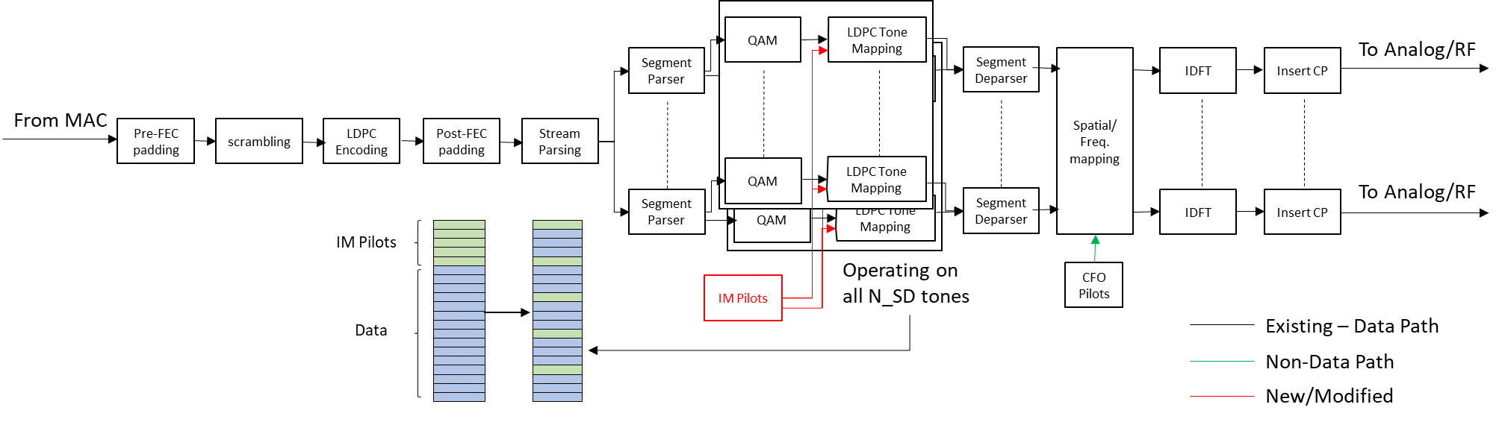
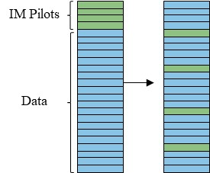
Extension to RU>996-tones
For an RU larger than 996-tones, IM pilots are added to each frequency subblock (as shown below)
The processing per each subblock is the same as for an RU<=996-tones

Slide 16
Value of the IM pilots
There are two options for IM pilot values, endowing them with:
  Zero energy
  Non-zero energy
Each option has its pros and cons
We think that zero-energy IM pilots have one important benefit – they allow the receiver to estimate phase offset and interference separately, without increasing the complexity (and implying no change to the CFO estimation mechanism)
We therefore propose using zero-energy IM pilots, i.e. setting zero values for them

Slide 17
Summary
We suggested the number of IM pilots for each PPDU BW size
Discussed how the LDPC TM is used to spread IM Pilots
For the placement of IM pilots at the input to the LDPC tone mapper, we suggest a single block of IM pilots before the data QAMs – which allows the receiver to react to an interference within the current OFDM symbol without adding latency
  We also suggest the corresponding value of D_TM
  Explained why we propose zero-energy IM pilots

Slide 18
Straw Poll #1
Do you support to add the following into 11bn SFD?
  When IM is used, the LDPC tone mapper operates on both data and IM pilot tones

Slide 19
Straw Poll #2
Do you support to add the following into 11bn SFD?
  The IM pilots are located contiguously at the input to the LDPC tone mapper, before the data QAMs

Slide 20
Straw Poll #3
Do you support to add the following into 11bn SFD?
  The number of IM pilots is
    26 for a 242-tone RU
    52 for a 484-tone RU
    98 for a 996-tone RU
    2x98 for a 2x996-tone RU
    4x98 for a 4x996-tone RU

Slide 21
Straw Poll #4
Do you support to add the following into 11bn SFD?
  IM pilots have zero energy

Slide 22
Straw Poll #5
Do you support to add the following into 11bn SFD?
  When IM is used, the value of D_TM is as follows:
    9 for a 242-tone RU
    9 for a 484-tone RU
    10 for a 996-tone RU (same value is used for every 80MHz subblock when PPDU BW is wider than 80MHz)

Slide 23
References
[1] 11-24-1264r0: Supporting Rx Interference Mitigation in TGbn (Shimi Shilo et al)
Notes:
at least one mode of operation capable of improved support, compared to 802.11be, for applications with stringentworst-case latency and jitter requirementscompared to 802.11be // i.e., avoid “worst-case”

