Slide 1
DSSS TX Power Ramp
Date: 2025-07-26
Authors:

Slide 2
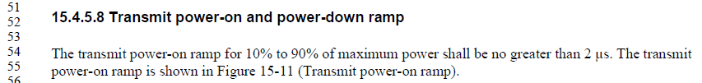
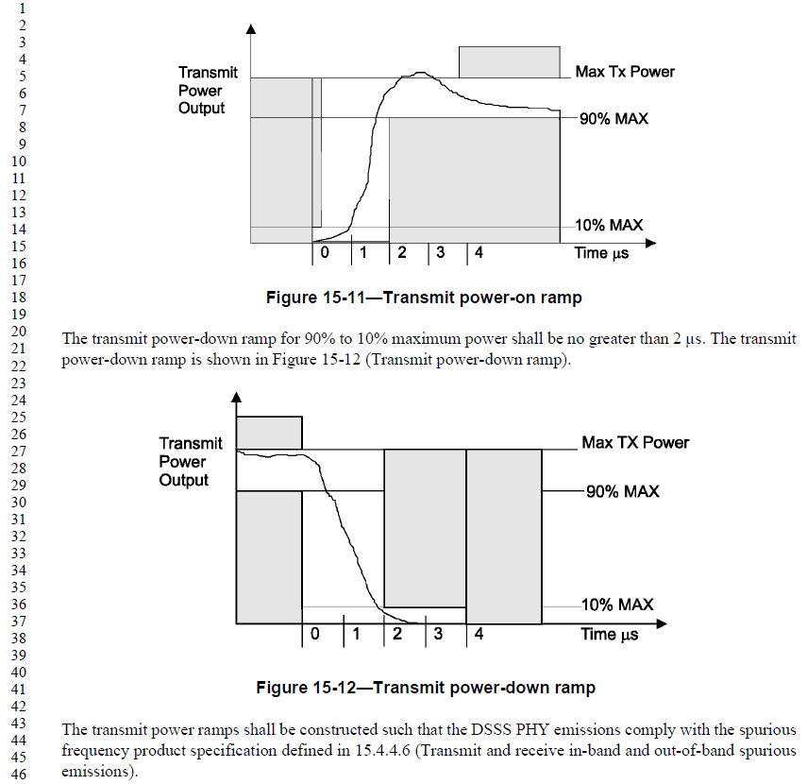
Background
DSSS (Clause 15) and DSSS/HR (Clause 16) PHY (a.k.a. 11b) have the
“Transmit power-on and power-down ramp” requirement
  DSSS: REVme D0.2 P3381-3382
  Same requirement for DSSS/HR at REVme D0.2 P3410-3411

Slide 3
Issue
Instantaneous TX power fluctuates over time during the PPDU
The “instantaneous” maximum TX power often occurs far before the end of the PPDU
  Exact TX power fluctuation over time is implementation specific
  Figure at right shows an example where the
  Matlab resample() function was used to
  upsample the TX waveform
    Have also checked various other upsampling schemes
    and this is sufficient for discussion
  In this particular example, the instantaneous
  maximum TX power occurs >4 usec before
  the end of the PPDU
    See next slide
11b 5.5 Mbps TX waveform example

Slide 4
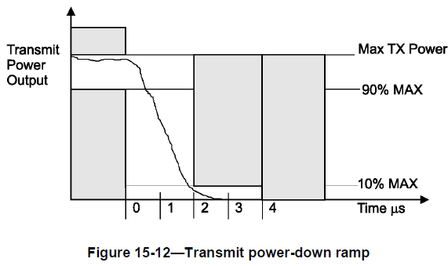
Issue (cont’d)
Continuing the example from the previous slide
  The TX power does not exceed 90% of
  max. TX power near the end of the PPDU,
  hence one cannot find the ‘starting’ point
  to measure the 2 usec transition window
Where is this point??
End of
PPDU
Zoom in
2 us
11b 5.5 Mbps TX waveform example

Slide 5
Issue (cont’d)
Some testing devices seem to use the
last time the TX power falls below 90% of
max. TX power to start the
2 usec measurement window
  Since the PPDU transmission has not ended,
  TX power will exceed 10% of max. TX power
  after the 2 usec window
  Clearly, this is not what 802.11 intended
End of
PPDU
2 us

Slide 6
Proposed Solution – Option 1
Require that TX power drops below 10% of max. TX power within 2 usec starting from the end of the PPDU (as indicated by the LENGTH field in the preamble)
  No 90% requirement (as instantaneous TX power might not reach 90% near the end of PPDU due to TX power fluctuation)
End of PPDU as indicated by LENGTH field in the preamble
2 us

Slide 7
Proposed Solution – Option 2
Change the reference from “maximum TX power” to “average TX power”
Average TX power
2 us
90% of Average TX power
10% of Average TX power

Slide 8
Concluding Remarks
The DSSS, DSSS/HR TX power ramp requirement did not take into consideration the instantaneous TX power fluctuation
Two options are proposed to resolve the issue
  Open to other suggestions as well
Discussion in this slide deck focused on TX power ramp-down
  Once path forward for TX power ramp-down is decided, similar path could be taken for the TX power ramp-up

