Slide 1
SD4ADDR: Bridging In-Vehicle Ethernet and V2X via SDN-Based Address Translation
Date: 28-07-2025
Authors:
Name | Affiliation | Address | Phone | Email
Rúben Castelhano | Instituto de Telecomunicações / UAveiro | - | - | rubencastelhano@ua.pt
Tiago Marques | Instituto de Telecomunicações / UAveiro | - | - | tamarques@ua.pt
Duarte Raposo | Instituto de Telecomunicações | - | - | dmgraposo@av.it.pt
Eurico Dias | Instituto de Telecomunicações | - | - | dias.eurico@ua.pt
Rodrigo Rosmaninho | Instituto de Telecomunicações | - | - | r.rosmaninho@ua.pt
Pedro Rito | Instituto de Telecomunicações / UAveiro | - | - | pedrorito@ua.pt
Miguel Luís | Instituto de Telecomunicações / IST | - | - | nmal@av.it.pt
Susana Sargento | Instituto de Telecomunicações / UAveiro | - | - | susana@ua.pt

Slide 2
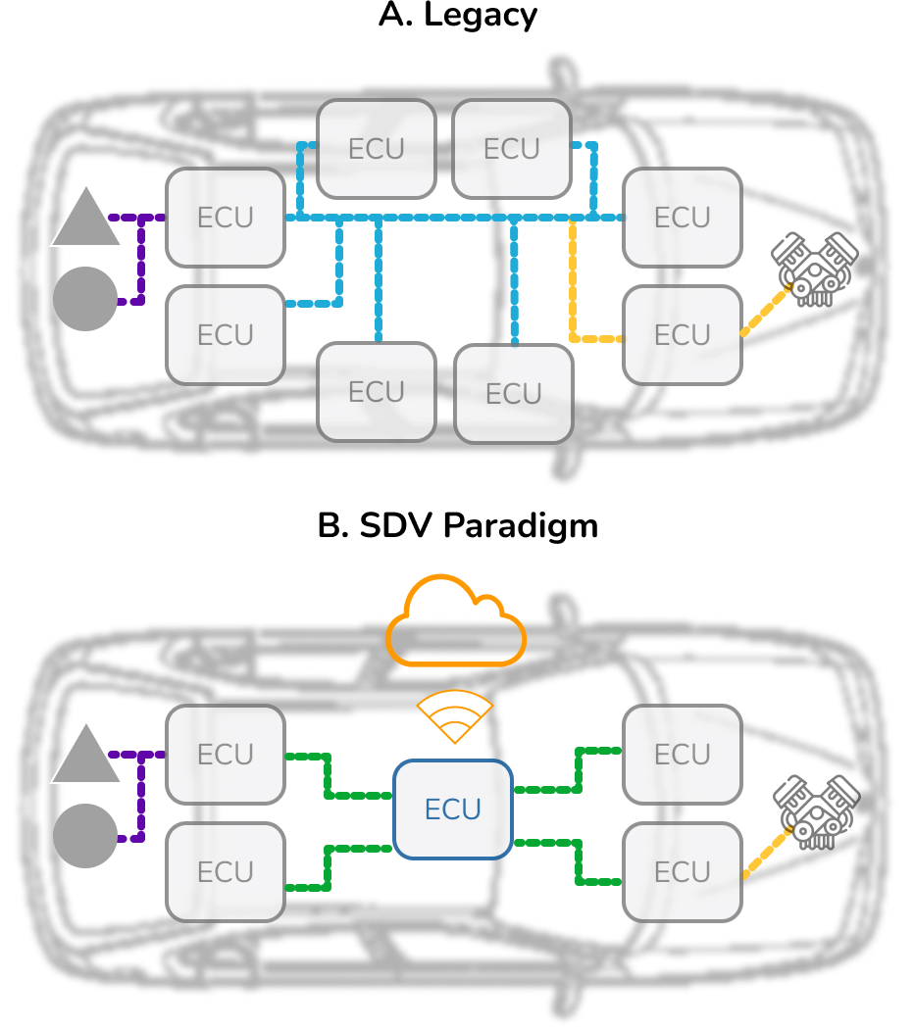
Abstract
Legacy connected vehicles relied on domain specific ECUs communicating over traditional buses (CAN, LIN, etc.), that are being replaced by Ethernet based technologies, to support new sensors (Video, Lidar, Radar...)
The Software Defined Vehicle (SDV) paradigm decreases hardware / software combinations and therefore complexity through a Service-Oriented Architecture (SOA)
Current vehicular communication standards, such as ITS-G5 (IEEE 802.11p based), are not well suited for Ethernet based access to these remote services
We propose and evaluate an encapsulation-based approach that enables centralized and intelligent control of this traffic

Slide 3
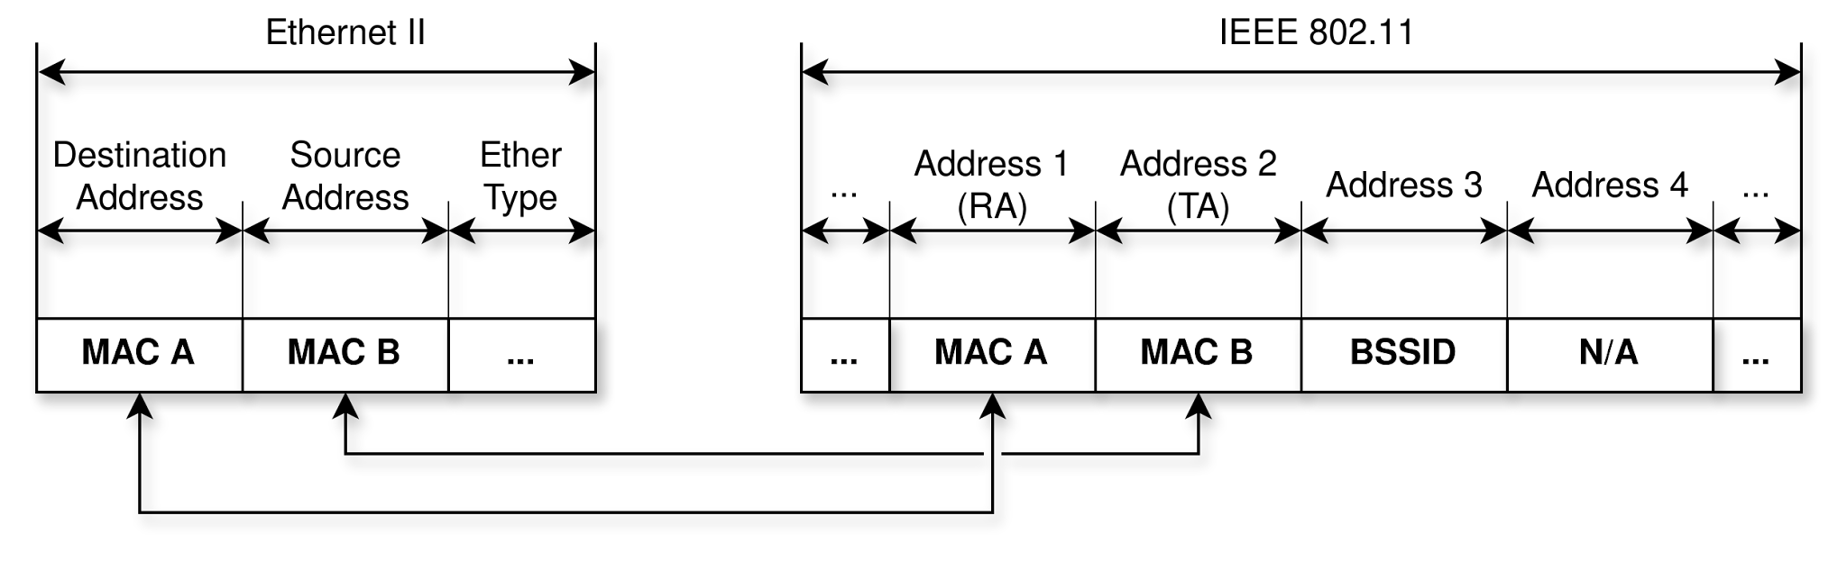
The current issues with Ethernet traffic forwarding in IEEE 802.11 interfaces
Multiple challenges stem from driver level translations between 802.3 Ethernet and 802.11 headers:
  Only allows direct point-to-point communication (no external traffic forwarding)
  Broadcast forces MCS 1 (3Mb/s)

Slide 4
Previous approaches
To address the caused by the MAC address translation multiple approaches have been proposed:
  MAC address rewriting on every wireless hop:
    Requires Layer 3 and higher to be analyzed to determine the the original source and destination
    Hinders Layer 2 protocol forwarding for unknown protocols
  Layer 3 tunnels between wireless nodes:
    Requires a tunnel to be established before traffic can be forwarded
    A unique tunnel is required for every unique pair or wireless interfaces
  The use of the 4-address mode:
    Poor driver support
    No control over traffic forwarding
    Incompatible with IEEE 802.11p

Slide 5
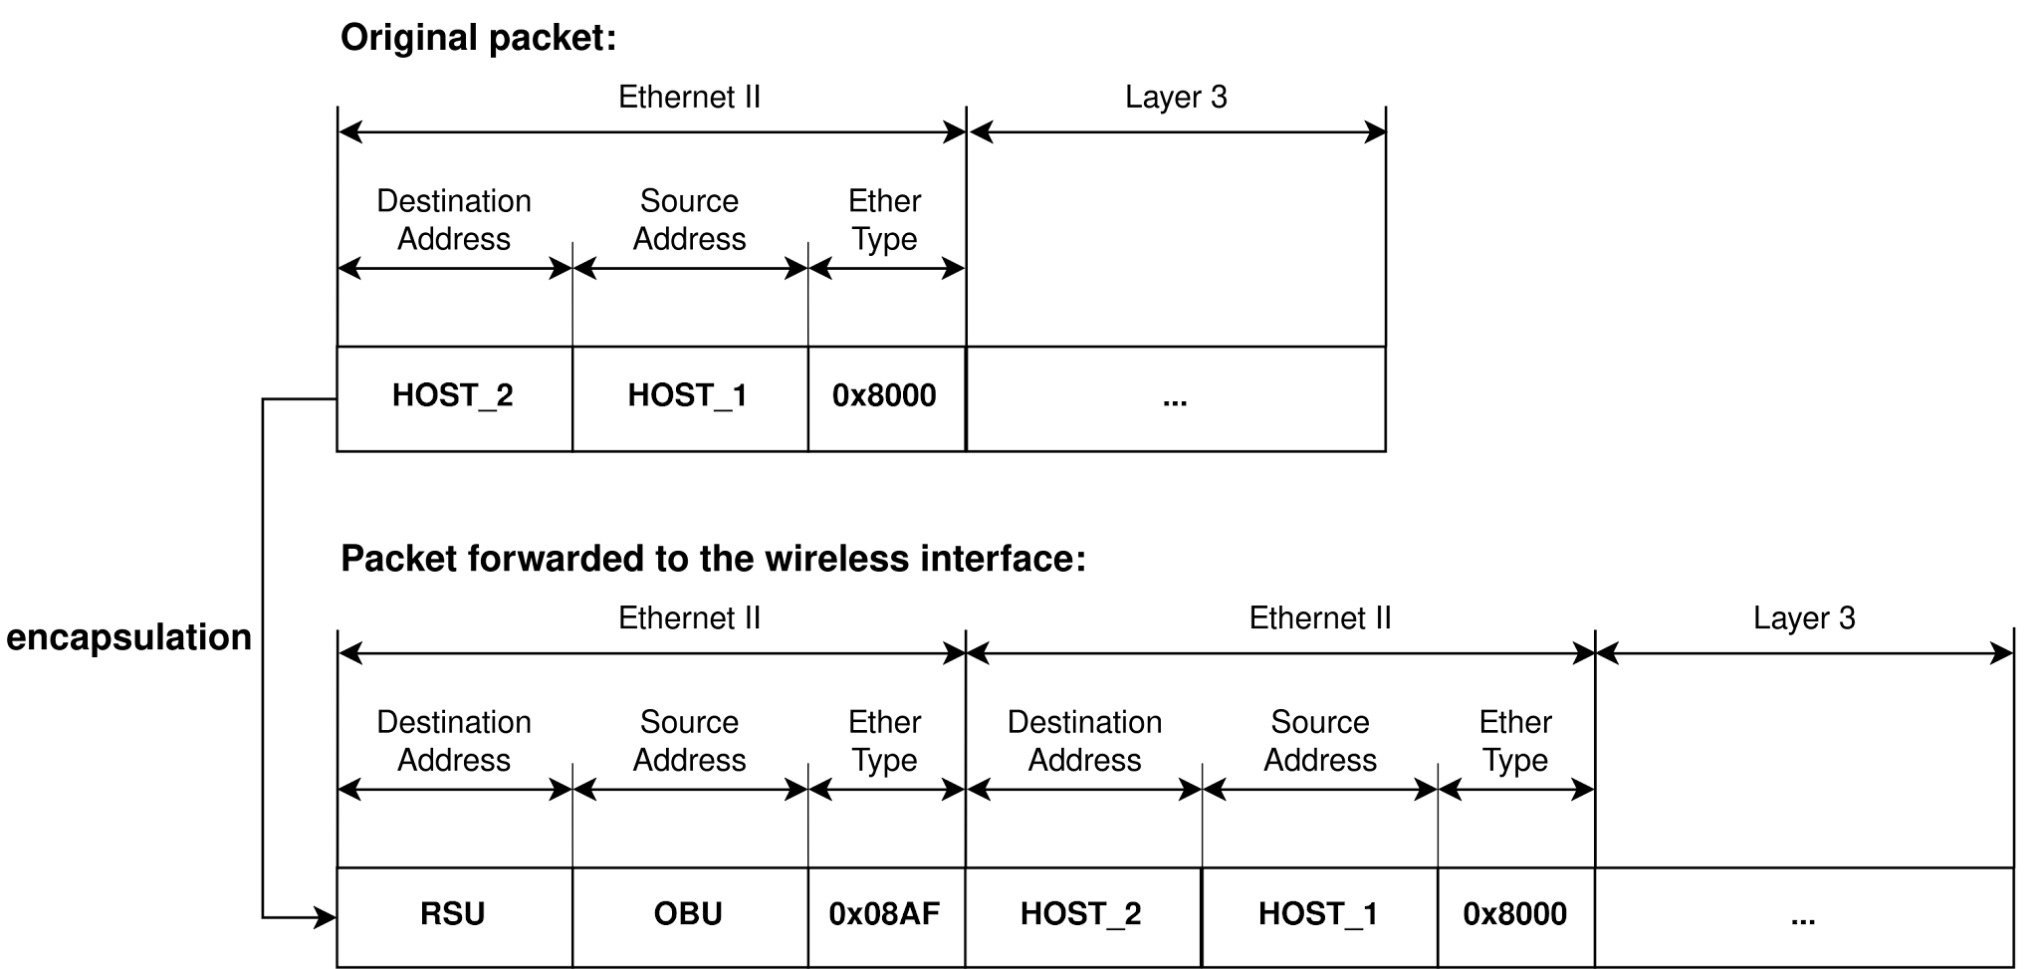
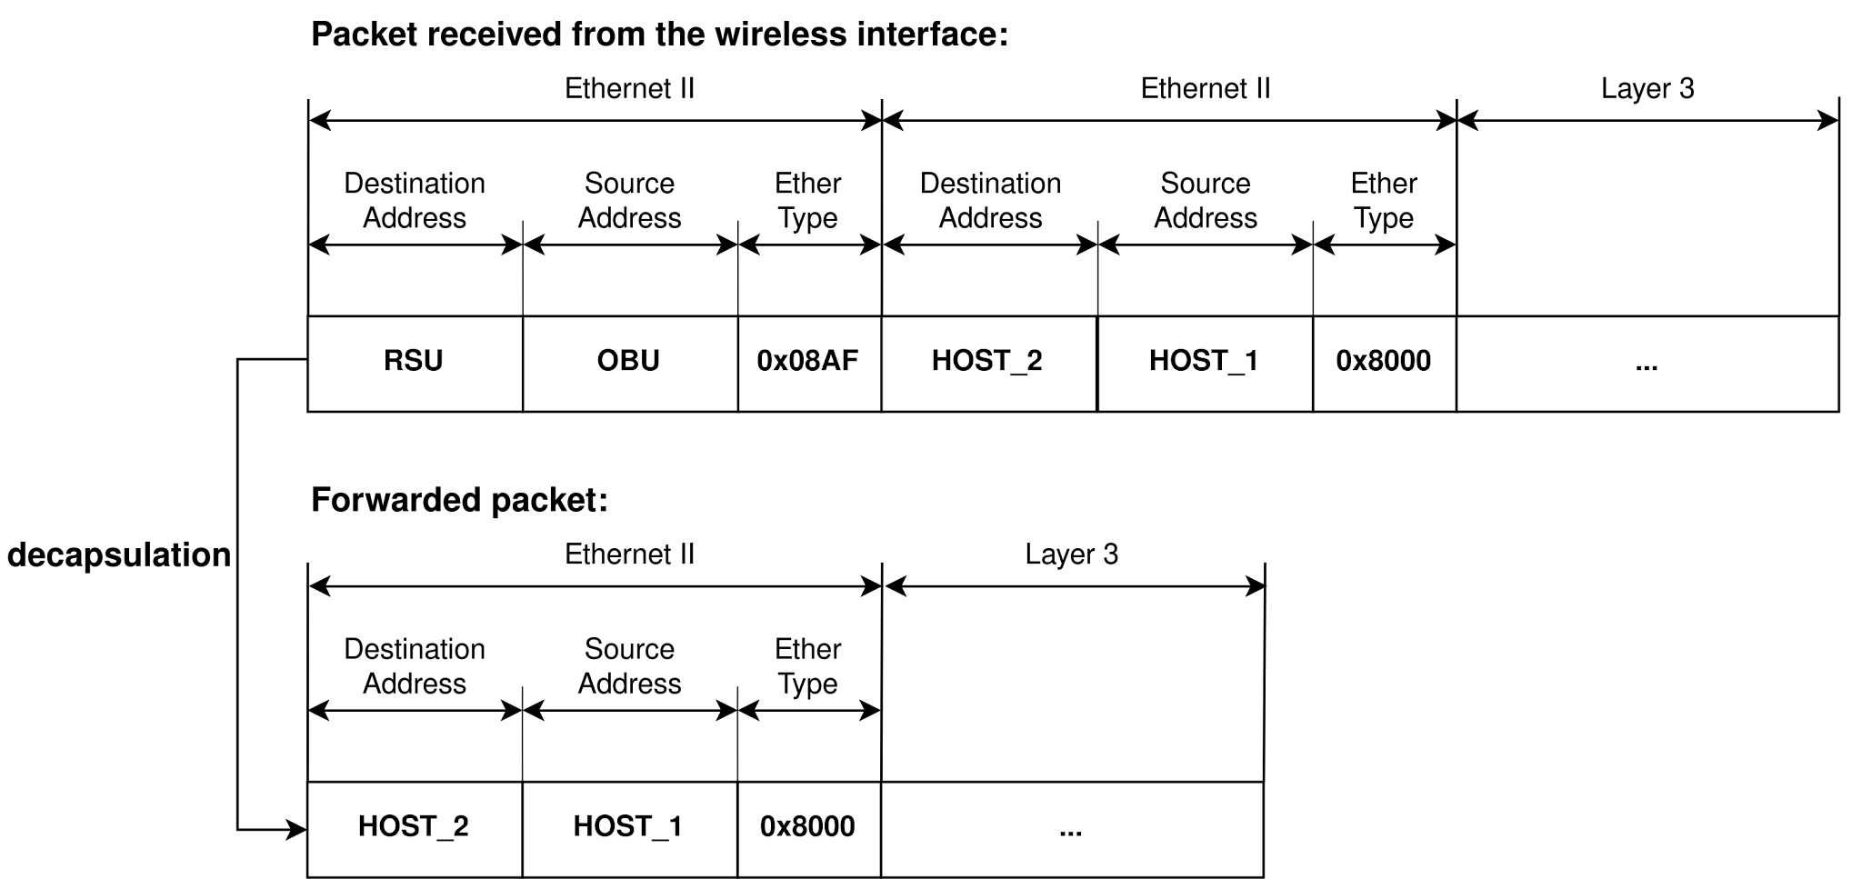
A new approach: Software Defined 4-Address Mode (SD4ADDR)
SD4ADDR involves essentially replicating 4-address mode functionality in OCB mode by leveraging the MAC address translation mechanism:
  Before forwarding a packet to a wireless interface, an additional Ethernet header is inserted and the beginning of the packet and it’s MAC addresses set to the source and destination wireless interfaces the packet is to be from and to
  On reception, this additional header can be removed if the remaining hops are wired or the addresses changed otherwise

Slide 6
Implementation
SD4ADDR was implemented in OvS and the ONOS SDN controller
  OvS already implemented some encapsulation and decapsulation operations via the encap and decap actions: developed as OpenFlow extensions
    We extended these actions to support Ethernet-over-Ethernet encapsulation and decapsulation using etherType 0x08AF to denote SD4ADDR encapsulated packets
  The ONOS controller and it’s OpenFlow implementation were extended to support these actions
  A custom ONOS application leveraging SD4ADDR to manage OBU data and control planes was developed

Slide 7
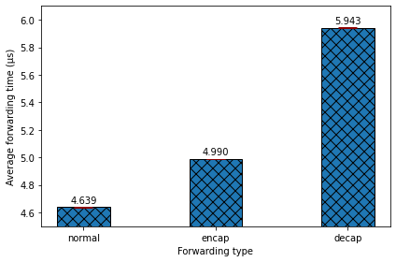
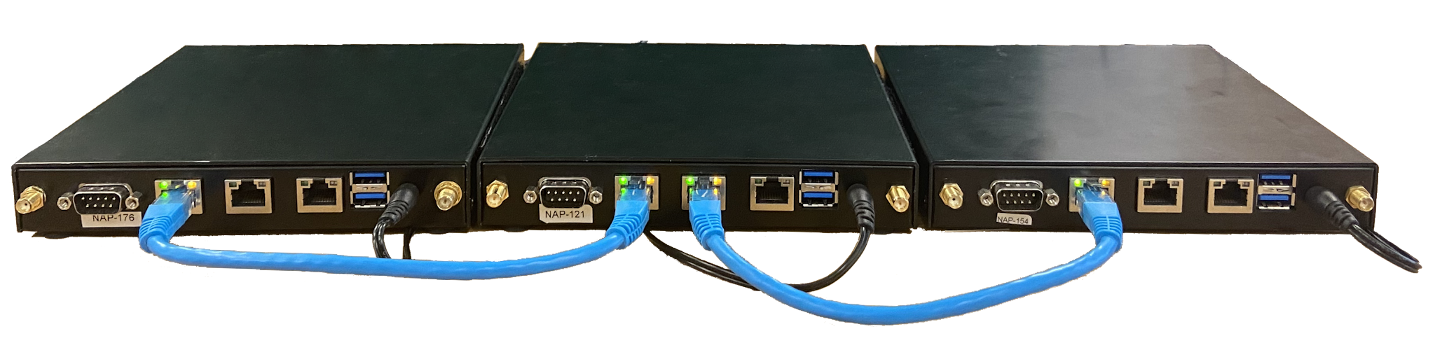
Forwarding time evaluation
The forwarding time of the SD4ADDR versions of the encap and decap actions was measured and compared against “normal” forwarding, where the packet is not modified in any way:
  Focus on processing impact, so Ethernet interfaces used
  While the encapsulation and decapsulation processes do impact forwarding time, the effect is not significant enough to cause any measurable impact on application and service performance metrics
  The higher increase observed for decapsulation is due to the the recirculation process, which re-parses the decapsulated packet

Slide 8
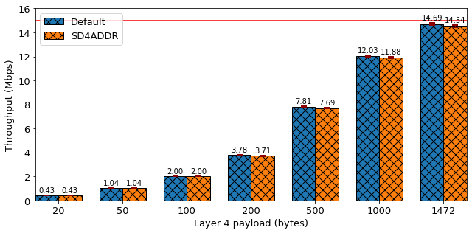
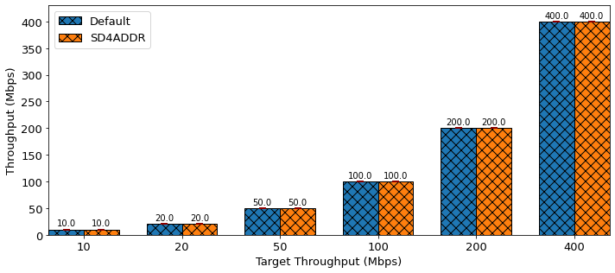
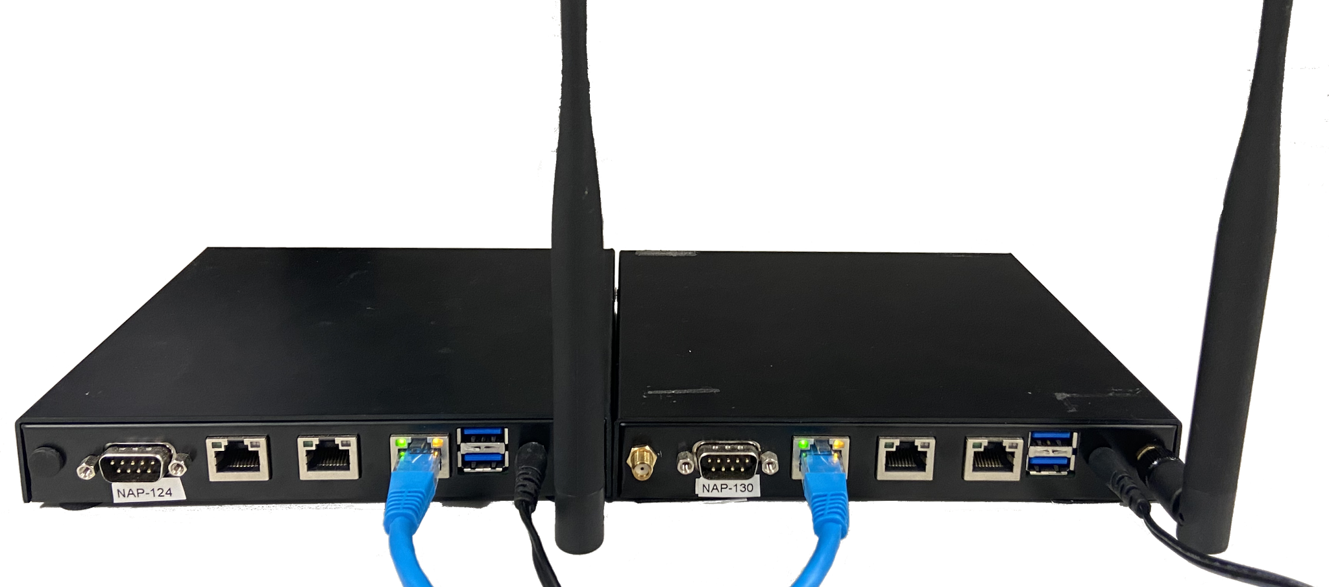
Throughput impact evaluation
The impact on throughput was measured using IEEE 802.11p wireless interfaces and compared to the forwarding of "normal" traffic for a variety of payload sizes
To rule out the possibility of the measured impact being related to the additional processing required for the encapsulation and decapsulation processes, maximum throughput tests were also conducted using an Ethernet connection
Tests were repeated for TCP and UDP
IEEE 802.11p results show a negligible performance penalty for the SD4ADDR for larger payloads mainly associated to the 14 bytes of overhead introduced
Ethernet results demonstrate that this impact is not due to processing limitations, as much higher throughputs can be achieved, and also highlight its applicability for future evolutions of IEEE 802.11p, such as IEEE 802.11bd

Slide 9
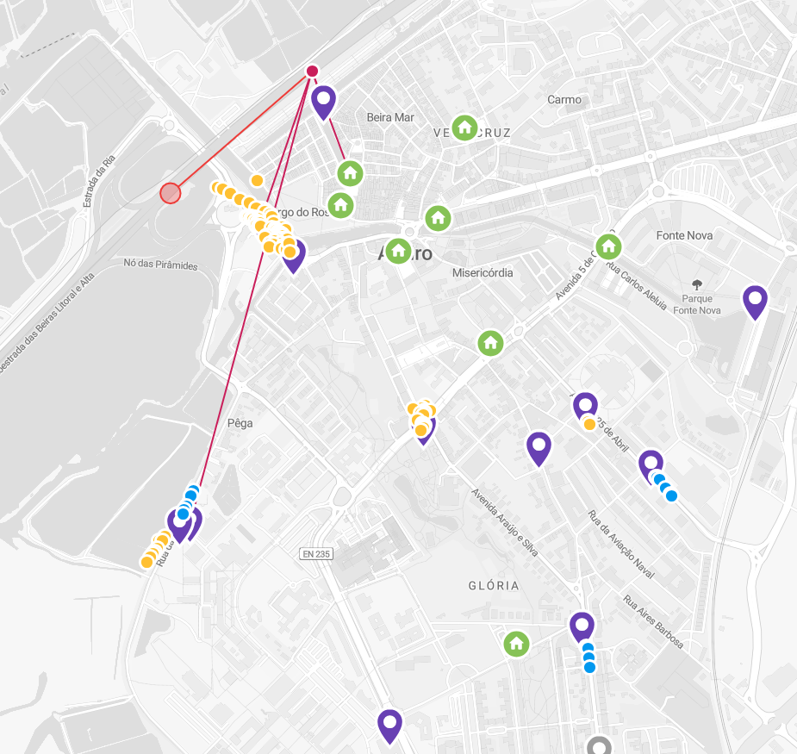
Real World Deployment
SD4ADDR is currently deployed in the Aveiro Tech City Living Lab (ATCLL) in Portugal
  22 RSUs currently active
  Each RSU is equipped with multiple edge nodes (NVIDIA Jetson, Camera, Radar, etc.)
  Additional OBUs to be installed soon
  new.aveiro-living-lab.it.pt/realtime

Slide 10
Conclusions
The SD4ADDR approach improves on existing solutions:
  It erases no information from the original packet, enabling intelligent V2X Layer 2 traffic forwarding in vehicular networks
  Minimal management overhead through simple OpenFlow flows
  Widely available:
    Manufacturer and driver agnostic
    Can easily be implemented in other SDN protocols and controllers
Minimal performance impact and future scalability:
  Negligible impact on forwarding time
  Minimal impact on throughput
  Can be applied to future IEEE 802.11 amendments, such as IEEE 802.11bd

Slide 11
References
10.1109/HPCS48598.2019.9188200
10.1109/WiMOB.2013.6673345
10.1109/CNSM.2014.7014211
10.1109/VNC61989.2024.10575942
10.1109/PIMRC.2018.8580785

