Slide 1
A novel application—Simplified device provisioning
Date: 2025-07-28
Authors:

Slide 2
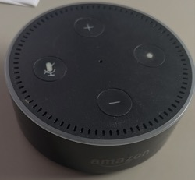
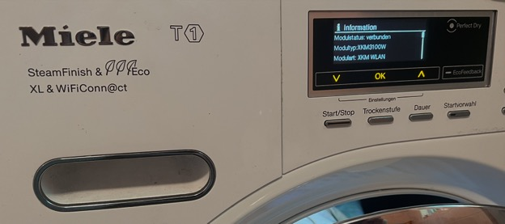
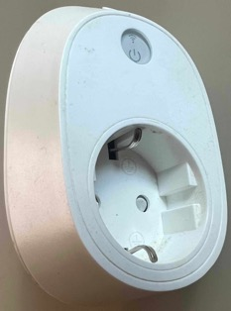
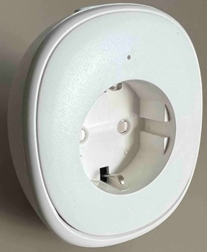
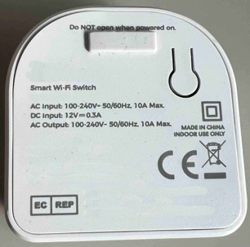
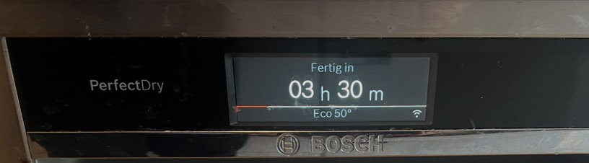
Provisioning headless devices
Headless devices lack interfaces for direct input
  Even if various buttons are available, a user cannot type in a Pre-Shared Key (PSK) or a Service Set Identifier (SSID) to connect to
  Typically, one reset button is the minimum
Typical methods for provisioning headless devices use vendor-specific apps

Slide 3
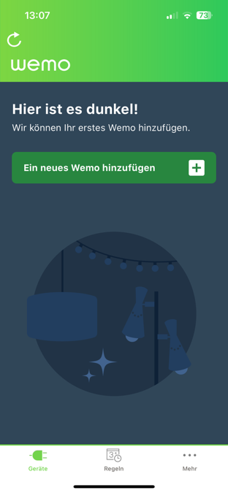
App-based provisioning—Example
Download, install, and open vendor specific app
Accept terms and conditions
Configure privacy settings
Often, user needs to create and register a profile with the device vendor’s cloud
Notes:
A humorous exaggeration can be found in the following comic strip
https://www.msn.com/en-us/entertainment/comics/reality-check-by-dave-whamond/ss-AA1H1Lmy

Slide 4
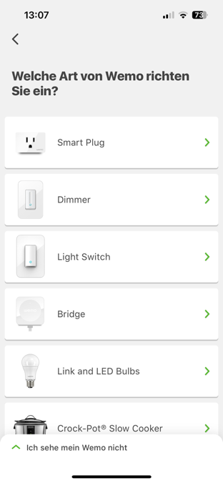
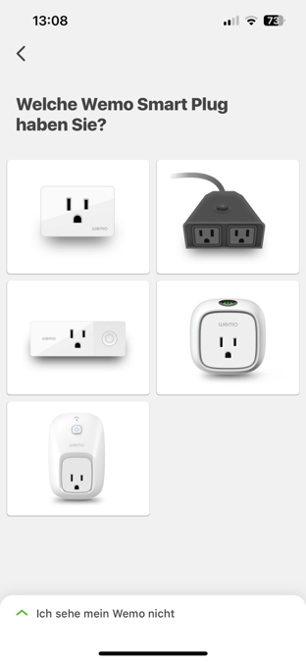
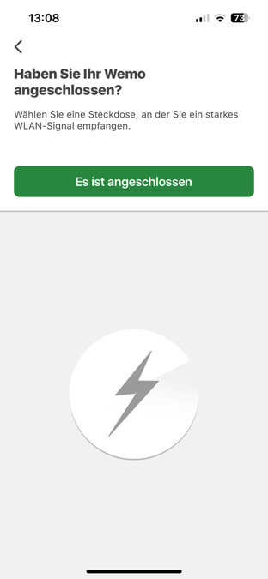
App-based provisioning—Example (continued, 2)
⑤
⑤
⑥
Select product from the manufacturer’s list
Power on device

Slide 5
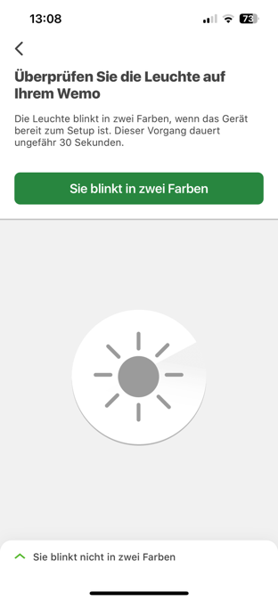
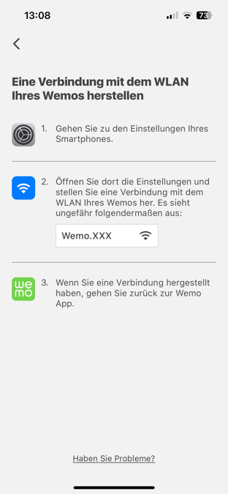
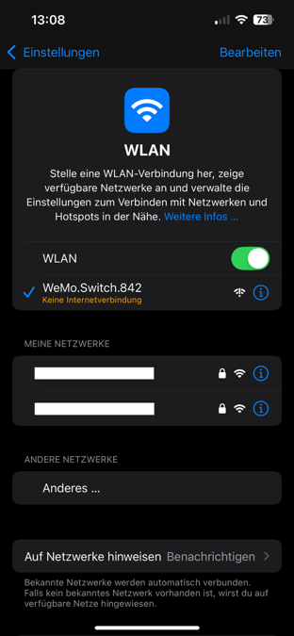
App-based provisioning—Example (continued, 3)
⑦
⑧
⑨
Push reset button
  Might not be needed when device is to be provisioned out-of-box
Headless device operates as AP
  Connect to this BSS

Slide 6
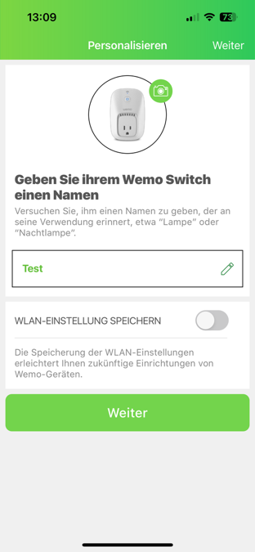
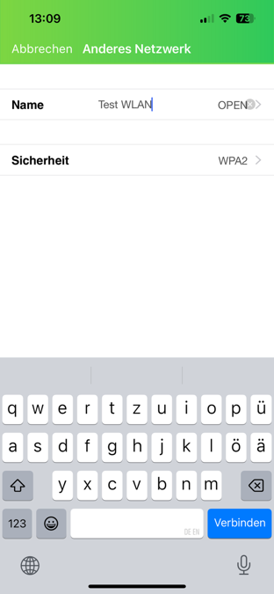

App-based provisioning—Example (continued, 4)
Name device
Provide SSID name
Select encryption scheme
Enter PSK
Afterwards, the headless device reboots
⑬
⑪ ⑫
⑩

Slide 7
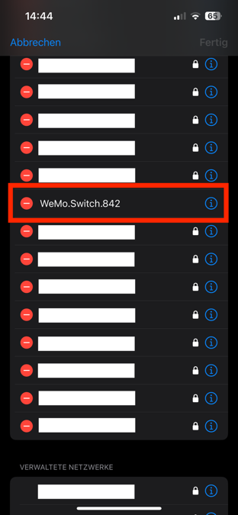
App-based provisioning—Example (continued, 5)
On reboot of the headless device, the device used for configuration loses connection to the headless device’s temporary SSID and needs to also connect to the provisioned SSID
This temporary SSID remains in the list of previously connected (known) networks
  Although used only once, this SSID clogs the user’s list of known SSIDs
⑯

Slide 8
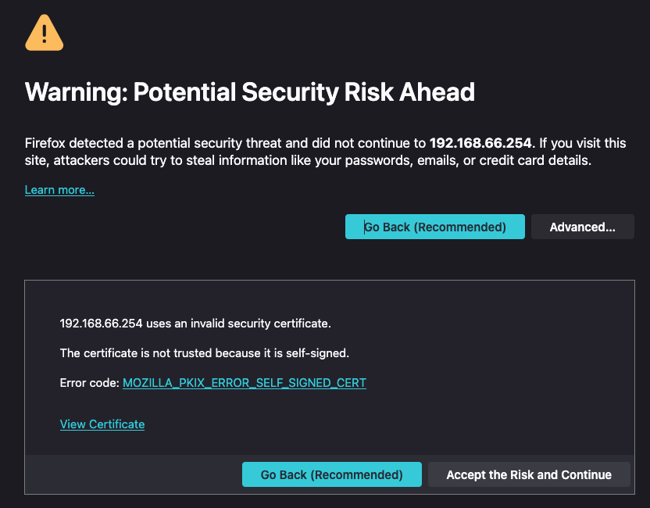
App vs. web page-based provisioning
Some headless devices operate a web server that provides a form to input provisioning data for the device
  Web servers may operate encrypted HTTPS and/or unencrypted HTTP
Use of HTTP causes browser warnings
  Some browsers deny connecting to HTTP at all
The headless device’s provisioning BSS operates unencrypted, too
  With HTTP, provisioning data could be intercepted, therefore
Headless devices rely on self-signed HTTPS certificates
  To avoid adverse effect of stolen certificates, official certificates have a lifetime of at most 90 d
  Therefore, embedding official certificates into a headless device is not a suitable solution
User needs to accept browser warning if a device is to be provisioned via HTTPS

Slide 9
Alternative provisioning methods
Wi-Fi Alliance’s (WFA) Wireless Protected Setup (WPS) [1]
  Push-button solution possible with headless devices
  However, headless device could connect to wrong SSID if multiple SSIDs offer WPS
WFA’s Easy Connect [2] provides an elegant solution for headless devices
  However, very low market penetration
Some devices employ a separate Bluetooth module to receive provisioning data
  No web-page based provisioning possible
  Need to use vendor’s app
  After provisioning, the Bluetooth module might not be used ever again

Slide 10
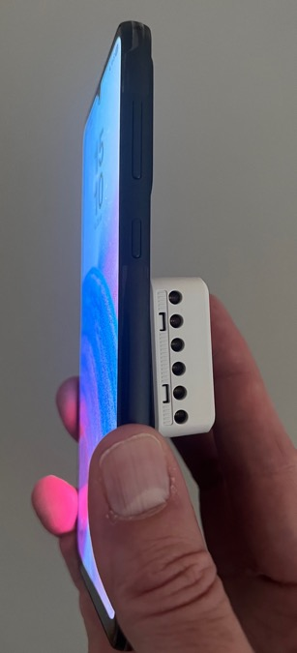
How to improve the device provisioning process?
Using IEEE 802.11bp, a provisioner may be capable to power a headless device’s IEEE 802.11 radio
  Close proximity keeps power transfer losses low
  Once powered, the provisioner may transmit the provisioning data to the headless device’s IEEE 802.11 module
  No need to power the headless device’s main CPU or other elements
  The headless device stores the credentials in its IEEE 802.11 module’s flash memory
Provisioner (AP STA or non-AP STA) also providing power
Headless device

Slide 11
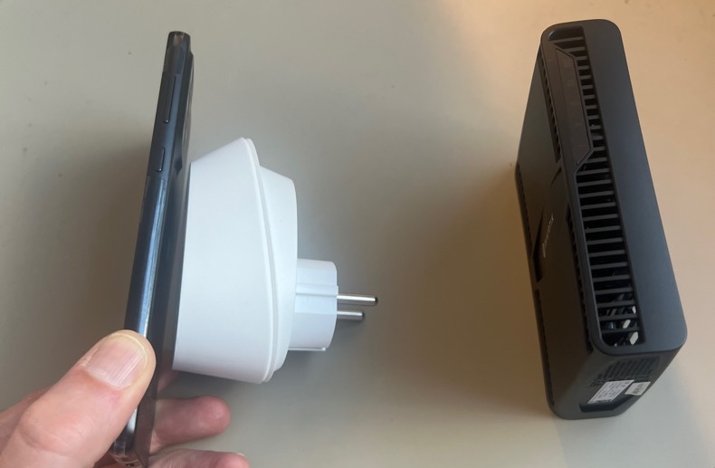
Separating the role of provisioner and wireless power provider
It may be desirable to limit knowledge of the provisioning data to the AP
  However, the AP may not be conveniently located
A wireless power providing device may help the headless device to establish an encrypted tunnel to the AP
  Used for securely transferring provisioning data to the headless device
Device providing wireless power
Provisioning data carried in encrypted tunnel
Headless device
Provisioner (e. g. AP)

Slide 12
Advantages (1)
Using IEEE 802.11bp for device provisioning allows headless devices to be configured in a convenient location
  Before headless device is deployed at final its location
Intuitive process of bringing a headless device in close proximity
  Like whispering a secret into somebody’s ear
IEEE 802.11bp for provisioning allows devices to be provisioned before they are powered
  Important for mass deployments
Users need to apply few steps, only
  Bring headless device in close proximity
  Confirm that provisioning begins
  Wait for indication that provisioning completed

Slide 13
Advantages (2)
Provisioning an IEEE 802.11 device could become as simple as a hotel’s front desk programming your room key card
  IEEE 802.11bp provides the potential to introduce an interoperable device provisioning mechanism that works independent of vendor specific solutions (apps etc.), QR codes, or out-of-band signaling
Adding device provisioning as feature will speed up market growth of IEEE 802.11bp
A simplified provisioning scheme helps to make using IEEE 802.1X the new norm
  Today, many headless devices support PSKs, only
    Mostly because vendors are afraid that the complexity of, e. g., WPA-Enterprise would cause customers to request support
  Even home WLANs consist of dozens of devices, which makes changing a PSK a cumbersome task
  Individual PSKs [3] [4] per MAC address cannot work with IEEE 802.11bh
  The use of PSKs does not scale [5]

Slide 14
Required MAC Messages
Need to be provisioned
  Indication of supported credential type
Capability to provide provisioning
  Direct, indirect, or unable
Provisioning status
  Successful or failed and reason code
Messages to protect transmission of credentials
  Diffie-Hellman key exchange to set up encrypted tunnel
  Messages by provisioner, the to be provisioned device, and a potentially relaying (power transferring) device

Slide 15
Information
Support for device provisioning is limited to the definition of MAC layer messages. Therefore, support for device provisioning is orthogonal to other IEEE 802.11bp goals and will not hinder its progress.
Straw poll
Do you agree that IEEE P802.11bp should consider adding support for device provisioning?

Slide 16
References
Wi-Fi Alliance, “Wi-Fi Protected Setup Specification,” Accessed: 2025-07-24. [Online]. Available: https://www.wi-fi.org/file/wi-fi-protected-setup-specification
Wi-Fi Alliance, “Wi-Fi Easy Connect Specification,” Accessed: 2025-07-24. [Online]. Available: https://www.wi-fi.org/file/wi-fi-easy-connect-specification
D. Henrici, “Jedem einen — WLAN mit individuellen Schlüsseln sichern,” c’t — magazin für computertechnik, no. 14, pp. 135–137, Jun. 2024.
RADIUSdesk, “Private PSK (PPSK) function on hostapd,” Accessed: 2025-07-24. [Online]. Available: https://radiusdesk.com/wiki24/technical/ppsk-hostapd
B. Hart et al., “A perspective on proposed Ultra-High Reliability (UHR) features for enterprise use cases,” IEEE 802.11 submission 11-22/1580r1, Sep. 2022. [Online]. Available: https://mentor.ieee.org/802.11/dcn/22/11-22-1580-01

