Slide 1
High-resolution sensing with multiband communication signals
Date: 2025-07-29
Authors:

Slide 2
Abstract
Integrated Sensing And Communication (ISAC) systems are expected to perform accurate radar sensing while having minimal impact on communication. Ideally, sensing should only reuse communication resources, especially the spectrum. While multi-static ISAC is ideally suited for wireless networks since it does not require full-duplex, lack of synchronization implies time-varying timing and frequency offsets that prevent the estimation of sensing parameters. We first present how to overcome this challenge using compensates for the timing offset by exploiting the channel correlation across subsequent packets. An additional challenge is that communication systems often operate on narrow subbands with low sensing resolution. Combining contiguous subbands has shown significant resolution gain in active localization. However, multiband ISAC remains unexplored due to communication subbands being highly sparse (non-contiguous) and affected by phase offsets that prevent their aggregation (incoherent). To tackle these problems, we design HiSAC, the first multiband ISAC system that combines diverse subbands across a wide frequency range to achieve super-resolved passive ranging. To solve the non-contiguity and incoherence of subbands, HiSAC combines them progressively, exploiting an anchor propagation path between transmitter and receiver in an optimization problem to achieve phase coherence. We implement HiSAC on an experimental platform in the millimeter-wave unlicensed band and test it on objects and humans. Our results show it enhances the sensing resolution by up to 20 times compared to single-band processing while occupying the same spectrum.

Slide 3
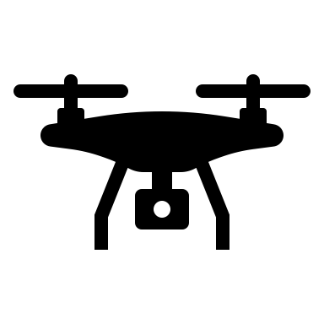
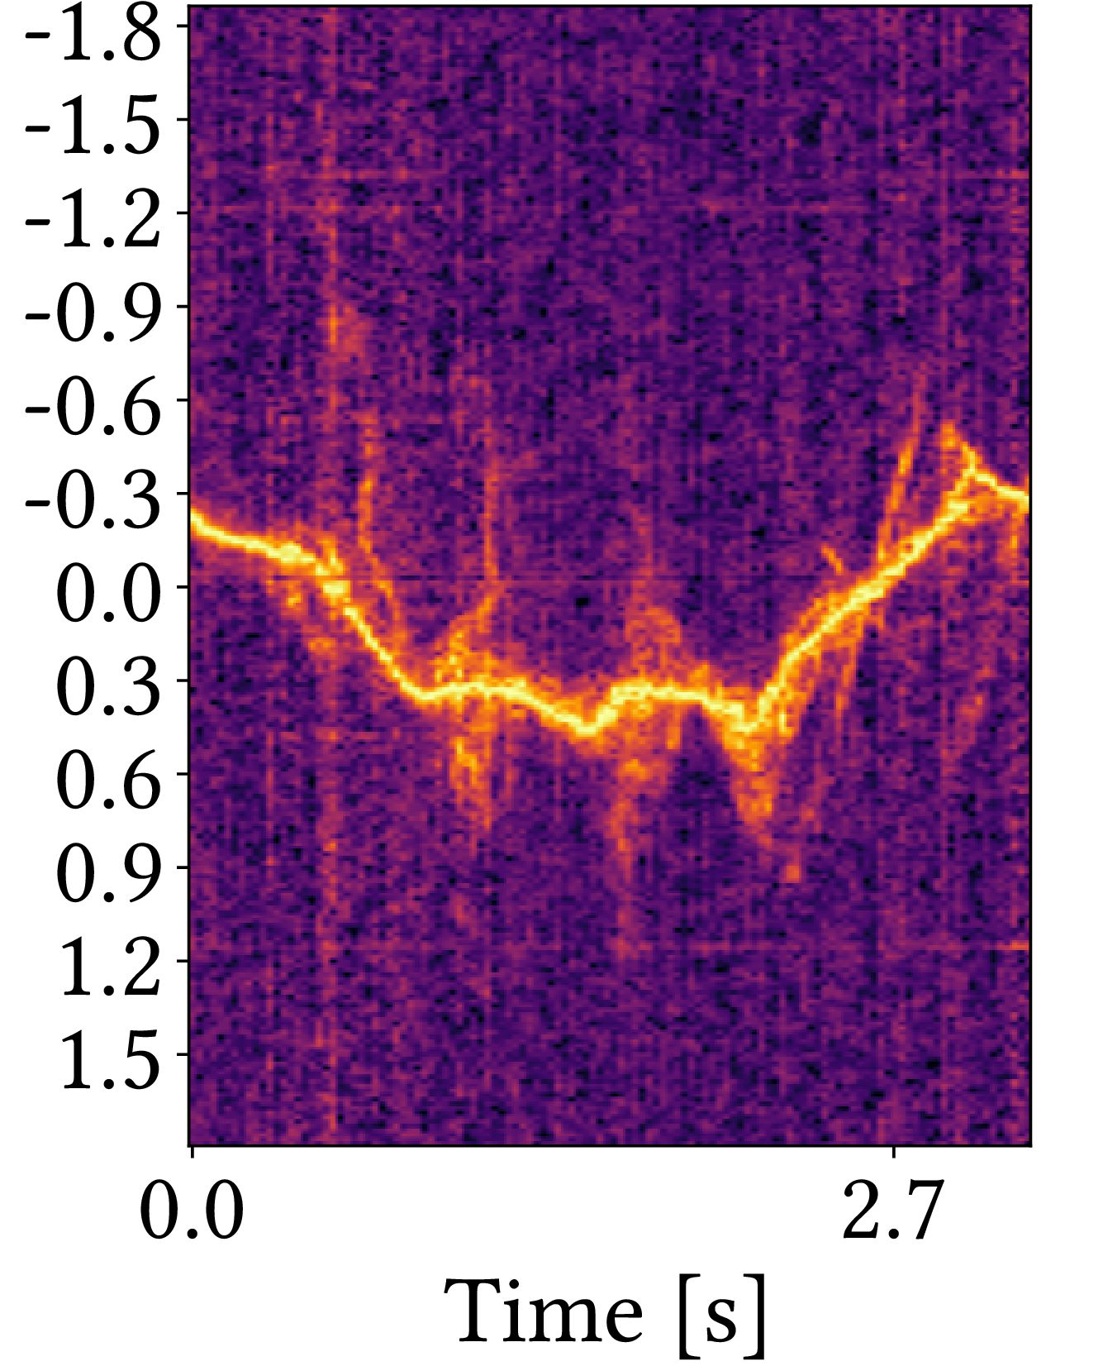
Motivation for Multi-Static Sensing
July 2025
Mono-static design requires (simple) full-duplex operation
Make use of the many different available links in a wireless network to learn more about the environment
Reflector
Active/passive localization
Micro-Doppler: Small scale Doppler variations around the main Doppler component from moving parts of the object
Receiver
Transmitter
micro-Doppler spectrum
Moving parts
Sum of Doppler
shifts
Arms
Torso
Legs
Joerg Widmer, IMDEA Networks

Slide 4
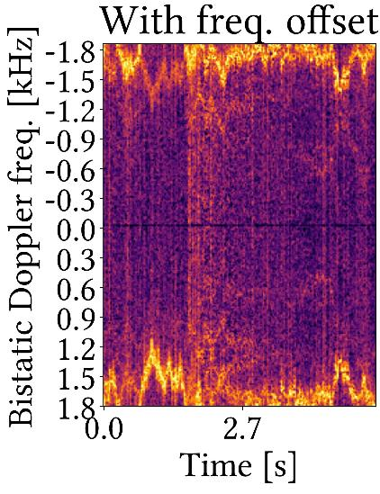
Challenge: unsynchronized nodes
July 2025
Clock asynchrony Frequency offset
Timing offset
Transmitter
micro-Doppler
??
Offset
Receiver
Joerg Widmer, IMDEA Networks
Notes:
The resulting micro-Doppler frequencies are coupled with the offset
Need to track micro-Doppler over trains of packets
The offset is 2 orders of magnitude bigger → Micro Doppler is destroyed
compensating for the FO for each packet separately removes the FO and the Doppler shift
estimating the phase differences and Doppler shifts requires processing the received samples coherently across subsequent packets.
The FO can not be considered constant within such extended time intervals (several milliseconds), and it makes the phase of signal samples across different packets incoherent, preventing the estimation of Doppler shifts

Slide 5
JCAS with unsynchronized transceivers (JUMP)
July 2025
Channel Impulse Responses
Timing offset compensation
Multipath detection and tracking
CFO removal
+ micro-Doppler extraction
Slide 5
Joerg Widmer, IMDEA Networks
Notes:
Need an approach that works with single RF chain, no synchronized clocks
3 main components: timing offset, object tracking, micro-Doppler estimation
Packet k, BP b, path l

Slide 6
Timing offset compensation
July 2025
Multipath environment changes slowly across time
Holds even with dynamic targets if packet rate is high
Deals with NLOS and multi-path changes
CIR at
CIR at
Cross-correlation
Estimate and compensate
For the relative TO
Slide 6
Joerg Widmer, IMDEA Networks
Notes:
Assume the multipath environment changes slowly over time
We can then consider the CIR magnitude at 2 subsequent time steps (packets)
If the assumption in the first bullet holds, the 2 CIRs will have the same profile (in approximation) except for a shift in the delay domain due to the RELATIVE timing offset between the two packets
The relative TO can be estimated by detecting the location of the strongest cross-correlation peak
LOS occlusions leads to “slow” disappearance of the corresponding path from the CIR

Slide 7
Our design: JUMP
July 2025
Timing offset compensation
Channel Impulse Responses
Correlator
+ voting
CIR
shift
Multipath detection and tracking
Peak det. &
AoD est.
Bistatic
localization
EKF
CFO removal
+ micro-Doppler extraction
Joerg Widmer, IMDEA Networks
Notes:
Then we do passive localization
Peak detection: via Cell-Averaging Constant False-Alarm Rate (CA-CFAR)
AoD: correlation between each BP shape and the CIR profile for a specific channel tap (TX BP shapes known)
Select strong static reference path

Slide 8
CFO Compensation
July 2025
Micro-Doppler extraction needs phase-coherent measurements over (long) sequences of CIR measurements
CFO is
Time varying: destroys phase coherence across packets
Two orders of magnitude larger than the Doppler shift of interest
Example: 60 GHz carrier, Sivers antennas, human motion
→ Estimation + compensation is not feasible
Slide 8
Joerg Widmer, IMDEA Networks

Slide 9
Our solution
July 2025
Doppler + Offset
Track static path(s)
Cancel frequency offset
No estimation needed!
Doppler only
TX
RX
Conjugate
multiplication
Offset
only
Static
Slide 9
Joerg Widmer, IMDEA Networks
Notes:
Key idea: CFO is constant in all multipath components of the CIR
Conjugate multiplication of the static signal with the dynamic one to remove offset
Cancels out the CFO without estimating it, thus the cancellation is errorless
micro-Doppler is almost as good as the one you get from a phase locked system
micro-Doppler quality depends on the SNR on the static path used for the cancellation

Slide 10
Our design: JUMP
July 2025
Timing offset compensation
Channel Impulse Responses
Correlator
+ voting
CIR
shift
Multipath detection and tracking
Peak det. &
AoD est.
Bistatic
localization
EKF
Ref.
path
CFO removal + micro-Doppler extraction
Spectral analysis
CFO removal
Joerg Widmer, IMDEA Networks
Notes:
Then we do passive localization
Peak detection: via Cell-Averaging Constant False-Alarm Rate (CA-CFAR)
AoD: correlation between each BP shape and the CIR profile for a specific channel tap (TX BP shapes known)
Select strong static reference path

Slide 11
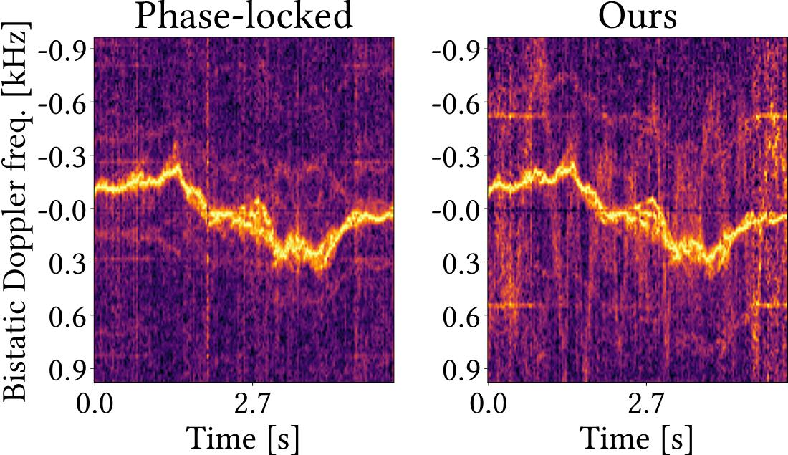
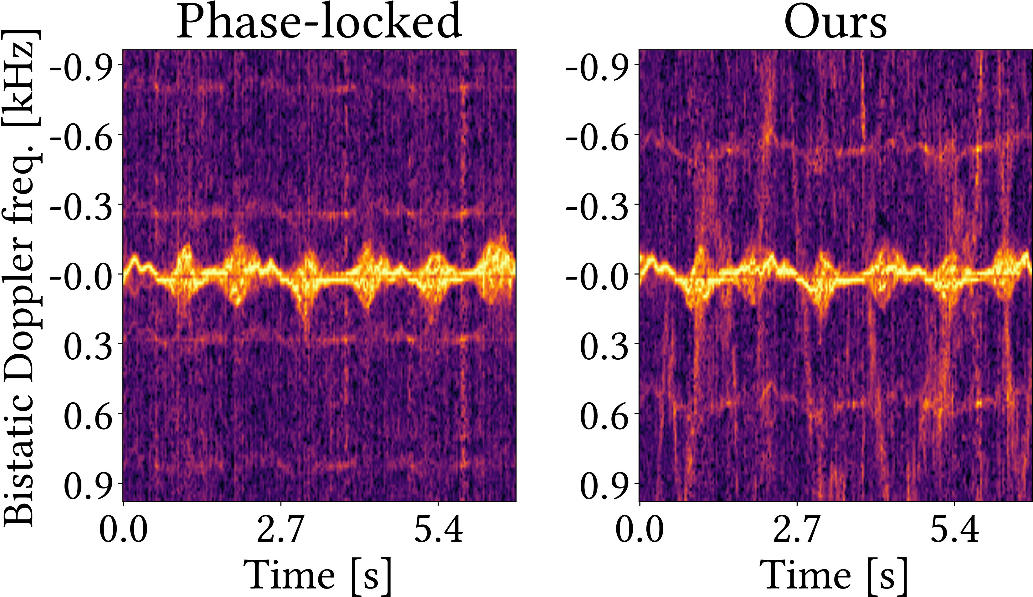
CFO cancellation
July 2025
WALKING
SITTING
Joerg Widmer, IMDEA Networks
Notes:
Key result for CFO cancellation:
With CFO the microDoppler is unusable
Resulting microDoppler after cancellation is almost identical to the one from a phase locked system

Slide 12
Integrated sensing and communications resolution
Communication signals
Targets
Resolution
Signal
bandwidth
Transmitter
Resolvable
Unresolvable
Receiver

Slide 13
Multiband ISAC
IDEA: can we overcome the low-resolution by
combining multiple bands?
CHALLENGE: can we do it flexibly leveraging existing multiband communications for sensing with no overhead?

Slide 14
Coherent multiband processing
Clock/LO asynchrony
TX
RX
Timing offset (TO)
Extend
Extend
Hardware non/ideality
Carrier
frequency
Offset (CFO)
Channel Frequency
Response

Slide 15
Coherent multiband processing
Clock/LO asynchrony
TX
RX
Phase mismatch
Timing offset (TO)
Extend
Extend
Extend
Hardware non/ideality
Carrier
frequency
Offset (CFO)
Channel Frequency
Response
Slide 15

Slide 16
Our high-resolution multiband sensing approach
Gaps
1) Compressed sensing coherent
combination
3) Single-band aided fullband combination
4) Moving average temporal aggregation
2) Phase offsets compensation
Gaps

Slide 17
Phase offsets compensation
Initialization
|CIR|
Optimization problem
2) Phase offsets compensation
|CIR|
Delay
Find optimal phase rotation and re-modulation
Delay
TO is shared by all paths

Slide 18
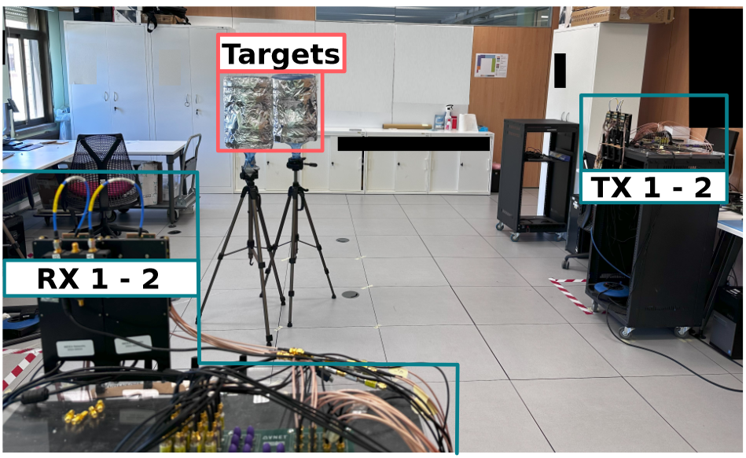
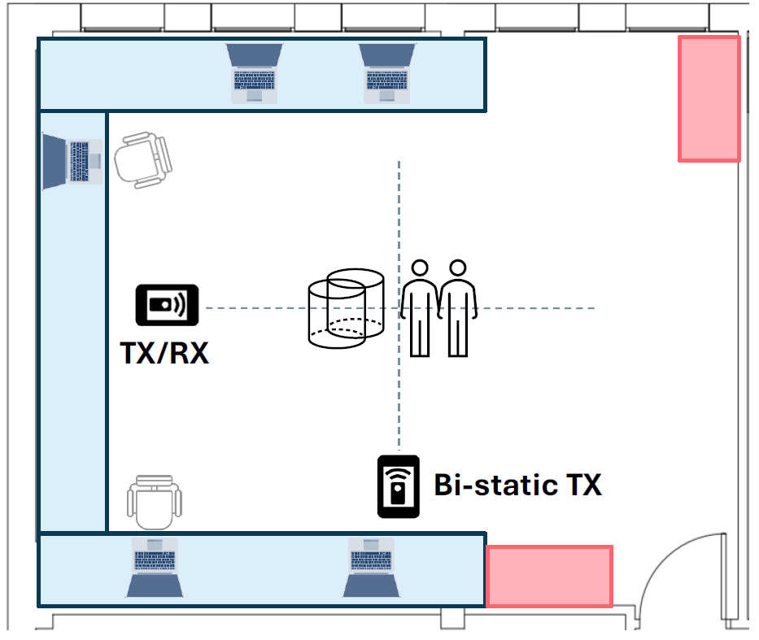
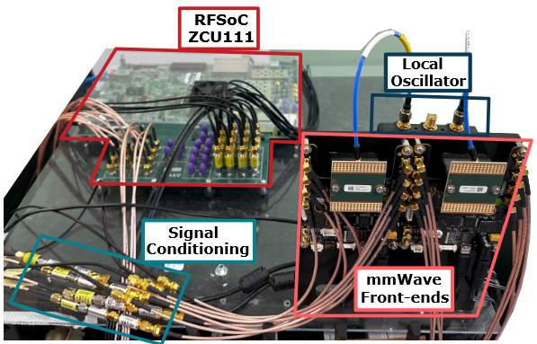
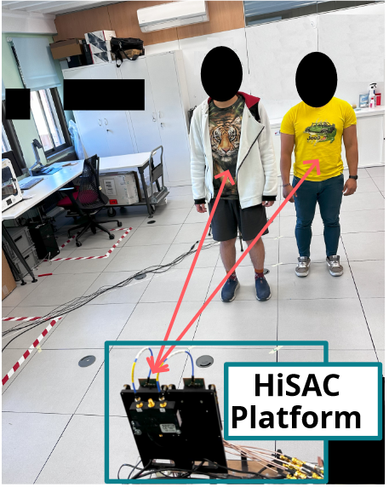
Experimental setup (60 GHz band)
Metal
cylinders
People

Slide 19
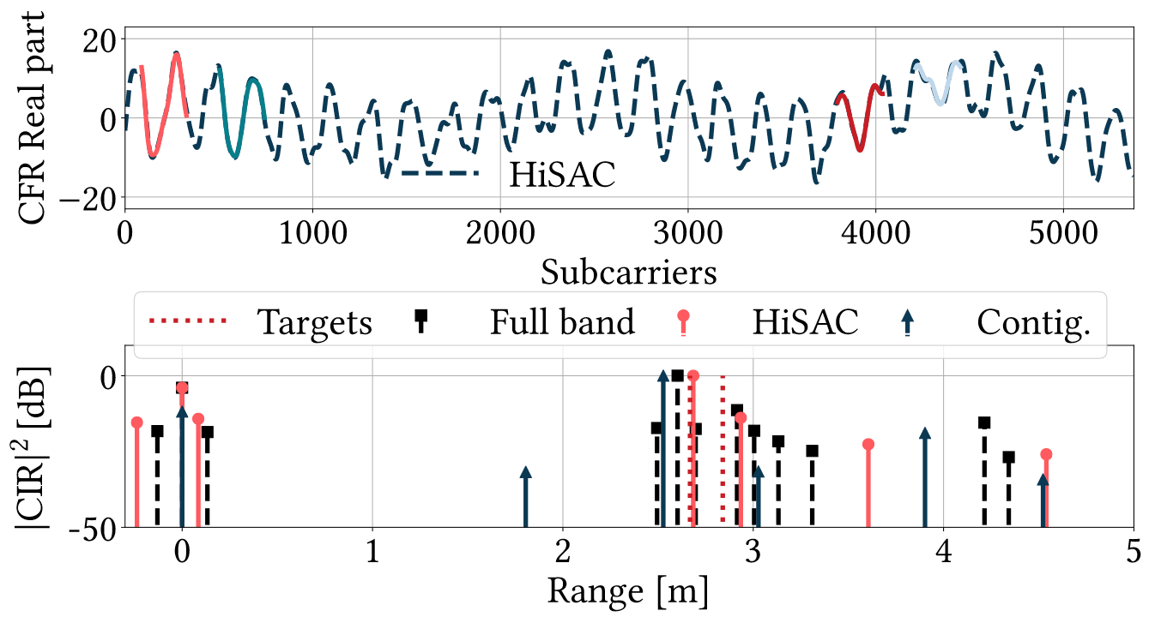
Wideband channel reconstruction
1.2 GHz
58 MHz

Slide 20
Moving people sensing
Full 1.2 GHz
bandwidth
58 MHz
subbands
Comparable resolution

Slide 21
Cross-technology – 5G-NR & WiGig
400 MHz
1.76 GHz
5G-NR
OFDM
1.86 GHz Gap
IEEE 802.11ay SC
59.69 GHz
62.64 GHz

Slide 22
Concluding remarks
High-resolution single- and multi-band ISAC
3x to 20x resolution gain
No additional overhead
Cross-technology
Developments
Frequency anisotropy
Impact of Doppler

Slide 23
References
Jacopo Pegoraro, Jesus Omar Lacruz, Tommy Azzino, Marco Mezzavilla, Michele Rossi, Joerg Widmer, and Sundeep Rangan. JUMP: Joint communication and sensing with unsynchronized transceivers made practical. IEEE Transactions on Wireless Communications, Feb. 2024
Jacopo Pegoraro, Jesus O. Lacruz, Michele Rossi, and Joerg Widmer. 2024. HiSAC: High-Resolution Sensing with Multiband Communication Signals. In Proceedings of the 22nd ACM Conference on Embedded Networked Sensor Systems (SenSys '24). Association for Computing Machinery, New York, NY, USA, 549–563. https://doi.org/10.1145/3666025.3699357.

