Slide 1
NAV setting for CoBF
Date: 2025-07-30
Authors:

Slide 2
Introduction
Coordinated Beamforming (CoBF) is one of the MAPC features [1]
High level frame exchange sequences for the CoBF/CoSR(Coordinated SR) have been defined, and further details are currently under discussion
In this contribution, we discuss NAV management methods, considering various frame exchange sequences and early termination of CoBF/CoSR

Slide 3
Recap: CoBF sequence [1]
Each AP performing CoBF/CoSR may exchange In-BSS ICF/ICR after exchanging CoBF/CoSR Invite and Response frames
The AP responding with a CoBF/CoSR Response frame indicates whether it accepts or rejects invitation to the CoBF/CoSR procedure
  If invitation is accepted, the CoBF/CoSR Response frame also indicates whether the Coordinated AP intends to exchange In-BSS ICF/ICR frames

Slide 4
Premature termination of the CoBF sequence
The CoBF sequence initiated by a CoBF Invite frame is prematurely terminated under the following conditions:
  Condition 1: No response is received to the CoBF Invite frame
    In this case, the AP that transmitted the CoBF Invite frame needs to invoke a new backoff procedure
  Condition 2: Invitation is rejected by the responding AP
    In this case, the AP that transmitted the CoBF Invite frame may proceed In-BSS frame exchange following the CoBF Response frame
CoBF Invite
In-BSS PPDU
CoBF Invite
ICF
Coordinating AP
Coordinating AP
In-BSS frame exchanges
ICR
CoBF Response
Coordinated AP
Busy medium
Coordinated AP
Reject CoBF invitation
No response
Condition 1
Condition 2

Slide 5
NAV problem of the terminated CoBF sequence
Unnecessarily maintained NAV
  When the CoBF Response frame is not received:
    Although the TXOP initiation by the AP that transmitted the CoBF Invite frame failed, the STAs that received the frame maintain their NAVs based on its Duration/ID field value
  When the CoBF invitation is rejected:
    The STAs associated with the responding AP set their Intra-BSS NAV based on the CoBF Response frame
    An OBSS STA that has received the CoBF Response frame set their Basic NAV even the STA is hidden from the AP transmitting the CoBF Invite frame
CoBF Invite
ICF1
In-BSS frame exchanges
Coordinating AP
(BSS1)
ICR1
CoBF Invite
In-BSS PPDU
CoBF Response
Coordinating AP
Coordinated AP
(BSS2)
Reject
Coordinated AP
Busy medium
Non-AP STA (BSS2)
Non-zero intra-BSS NAV
No response
3rd STA
(hidden STA of Coordinating AP)
Non-zero Basic NAV
3rd STA
Non-zero NAV

Slide 6
Considerations
To avoid prolonged maintenance of unnecessary NAVs, it is desirable to set the Duration/ID field of the CoBF Invite frame to a minimal value
  However, if the value is set too small (e.g., only to protect the CoBF Response frame), other STAs may occupy the medium during the In-BSS ICF/ICR exchange
Basic Requirements
  The medium should be protected by the NAV at least until each AP transmits its 2nd PPDU
    When an AP transmits its 2nd PPDU, it implies that the AP is utilizing the TXOP to send a DL PPDU
      If the AP that transmitted the CoBF Invite frame transmits a 2nd PPDU, it implies the AP has successfully obtained its TXOP
      If the AP that sent the CoBF Response frame transmits a 2nd PPDU, it implies the AP will be participating in the CoBF/CoSR procedure
Duration/ID
(too small)
CoBF Invite
Coordinating AP
Busy medium
CoBF Resp
ICF2
Coordinated AP
ICR2
Hidden STA of the Coordinated AP
Frame exchanges
NAV

Slide 7
AP’s 2nd PPDU in CoBF/CoSR sequence
Coordinating AP and Coordinated AP
(Case 1)
ICF1/ICR1_X
ICF2/ICR2_X
Coordinating AP
CoBF-I
CoBF TF
DL PPDU1
Coordinated AP
CoBF-R
DL PPDU2
Coordinated AP’s latest Tx timing
(Case 2)
ICF1/ICR1_O
ICF2/ICR2_X
Coordinating AP
CoBF-I
ICF1
ICR1
CoBF TF
DL PPDU1
Coordinated AP
CoBF-R
DL PPDU2
Coordinating AP’s latest Tx timing
(Case 3)
ICF1/ICR1_X
ICF2/ICR2_O
Coordinating AP
CoBF-I
CoBF TF
DL PPDU1
Coordinated AP
CoBF-R
ICF2
DL PPDU2
ICR2
(Case 4)
ICF1/ICR1_O
ICF2/ICR2_O
Coordinating AP
CoBF-I
ICF1
ICR1
CoBF TF
DL PPDU1
Coordinated AP
CoBF-R
ICF2
DL PPDU2
ICR2

Slide 8
Duration/ID field of the Co-BF Invite frame
Optimal Duration/ID field value (to fit the basic requirements)
  Optimal value (#1): SIFS + CoBF Response + SIFS + ICF2/ICR2 (unknown) + SIFS
    Since the length of the ICF2/ICR2 is variable, the Coordinating AP should consider the maximum length of the ICF2/ICR2
    This value could be used when the Coordinating AP does not exchange In-BSS ICF/ICR(ICF1/ICR1)
      This value takes into account the situation where the Coordinating AP transmits the 2nd PPDU the latest (Case 3)
  Optimal value (#2): SIFS + CoBF Response + SIFS + ICF1/ICR1 (Intended length) + SIFS + CoBF TF + SIFS
    This value could be used when the Coordinating AP exchanges In-BSS ICF/ICR
      This value takes into account the situation where the Coordinated AP transmits the 2nd PPDU the latest (Case 2)
  The Coordinating AP uses (#2) if it intends to perform In-BSS ICF/ICR, and uses (#1) if it does not, to calculate the shortest Duration/ID field value
Using a simplified value instead of the optimal values could also be considered
  The simplified Duration/ID value is a static value that is equal to or greater than the maximum of the optimal values
    SIFS + CoBF Response (Max_Length) + SIFS + ICF/ICR(Max_Length) + SIFS + CoBF TF(Max_Length) + SIFS
      The Coordinating AP may use this fixed maximum value regardless of: The length of the CoBF Response frame it requests, ICF1/ICR1, ICF2/ICR2 and the CoBF Trigger frame it plans to transmit

Slide 9
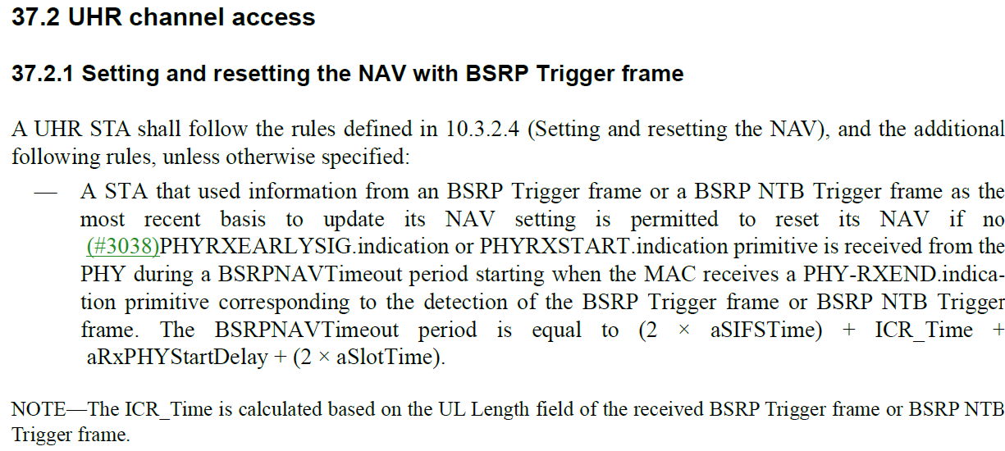
Recap: BSRPNAVTimeout
802.11bn D1.0

Slide 10
NAV Reset Rule for CoBF Sequence
In Case 3, 2nd PPDU from the Coordinating AP is transmitted after SIFS + CoBF Response + ICF2/ICR2 + SIFS, and this duration is longer than BSRPNAVTimeout
  If the UHR STAs reset their NAV when the BSRPNAVTimeout expires, the medium of the Coordinating AP may be occupied by the UHR STA when the AP attempts to transmit the CoBF TF (as shown in the figure below)
Solutions:
  Solution 1: The Coordinating AP always exchanges In-BSS ICF/ICR (ICF1/ICR1)
    This results in fixed overhead
  Solution 2: Restrict the NAV reset if the NAV was set upon reception of a CoBF Invite frame
    Requires adding an indicator to the BSRP NTB TF that specifies whether a NAV reset is allowed
BSRPNAVTimeout
Co-BF Invite
Coordinating AP
Busy medium
Co-BF Resp
ICF2
Coordinated AP
ICR2
Hidden STA of the Coordinated AP
Frame exchanges
NAV
Reset NAV

Slide 11
Summary
Discussion on how to set the Duration/ID field of the CoBF Invite frame to prevent unnecessary NAV retention
  Optimal values: Minimally sufficient value depending on whether ICF1/ICR1 is planned
  Simplified value: Using a single, unified static value that is long enough to cover all possible scenarios for simpler implementation
Discussion on an issue caused by NAV reset after receiving a CoBF Invite frame(BSRP NTB TF) and possible solutions
  Solution 1: Force that the Coordinating AP to always performs an ICF/ICR exchange
  Solution 2: Add an indicator to the BSRP NTB TF that explicitly disallows NAV reset

Slide 12
References
[1] Draft P802.11bn D1.0
[2] 11-25/0879 CoBF Signaling Details (Sherief Helwa, Qualcomm)
[3] 11-25/0437 CC D0.1 subclause 37.11 (Laurent Cariou, Intel)
[4] 11-25/0425 ICF and NAV Operation (Liwen, NXP)

Slide 13
SP 1
Do you agree to add the following text to the TGbn SFD?
  The Duration field in the CoBF Invite frame shall be set to protect the start time of the second PPDU transmitted by each of the Coordinating AP and the Coordinated AP, and shall not be set to indicate the end of the TXOP.

