Slide 1
IMMW Channel Access Considerations
Date: 2025-07-24
Authors:

Slide 2
Abstract
Several presentations consider MAC design aspects
  [1] discusses channel protection, NAV timers, DUP PPDU format, Beacons and more
  [2] discusses sector level channel access, which couples the sub-7 GHz and 60 GHz bands
  [3] discusses SP operation—but leaves hidden node as a remaining problem
In this presentation we use simulations to evaluate the collision probability when transmissions have high directivity
The results shows that it may be feasible to use a no-LBT approach for IMMW

Slide 3
Background
To compensate for high attenuation in mmWave, it is necessary to use directive transmissions with high beamforming gain
However, directive transmissions make it difficult to protect from hidden nodes
  Omni-directional control transmissions are not attractive due to the range difference with the beamformed transmissions
On the one hand, one either needs to “over-protect” from interferers with directive control transmissions or risk to suffer from unintentional interference
On the other hand, mmWave spectrum is ideal for spatial reuse due to the high attenuation and should be leveraged

Slide 4
General Thoughts
EN 303 753 [4] specifies Wideband Data Transmission Systems (WDTS) operation for fixed equipment using no-LBT in the 57-71 GHz frequency range in Europe
  Two modes of operation
    High EIRP/PSD mode—Requiring more than 30 dB directivity gain from antennas
    Low EIRP/PSD mode—With no requirements
  Together with time and frequency diversity it is deemed that LBT is not necessary for good coexistence
How likely is it to experience interference given similar assumptions for IMMW?
Notes:
Max TRP 25 dBm
EIRP 40/55 dBm
PSD = 23/38 dBm/MHz

Slide 5
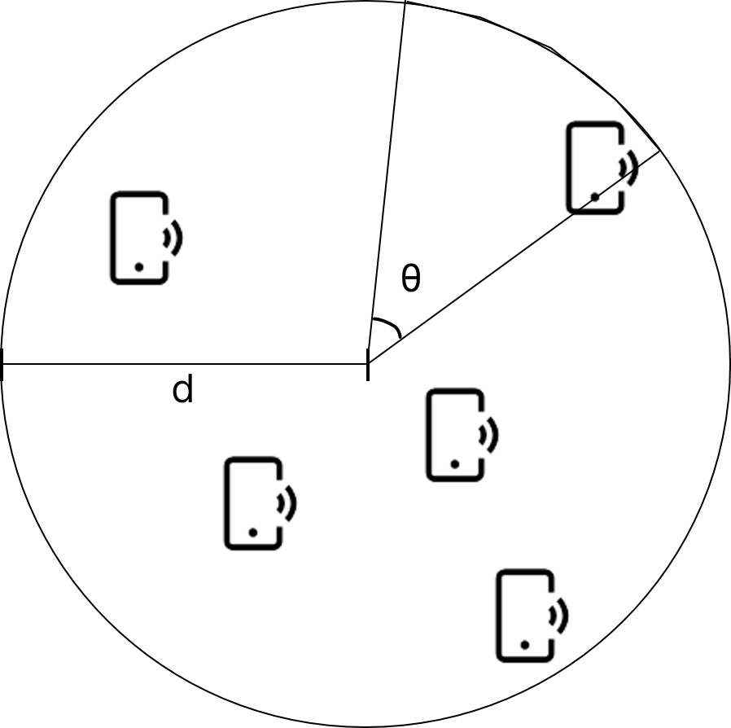
Simulation Methodology
Circular area with radius d
Randomly drop ten devices
  For each timestep randomly determine a number of active STAs based on random 20 % to 40 % duty cycle
  At origin transmit a beam in a random direction
  Count as collision if the beam direction falls within an angle threshold, θ, of a device and the device is active during this timestep
50 000 drops, each drop is simulated over ten timesteps
Result: Mean and 95th percentile (P95) collision probability

Slide 6
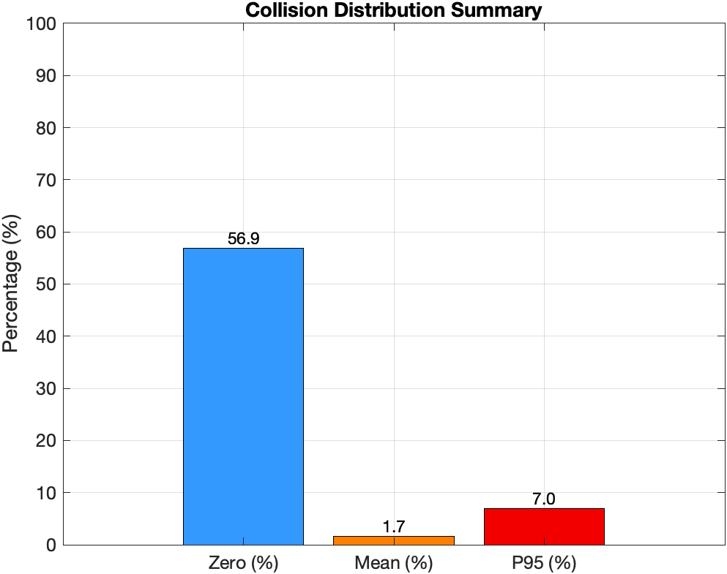
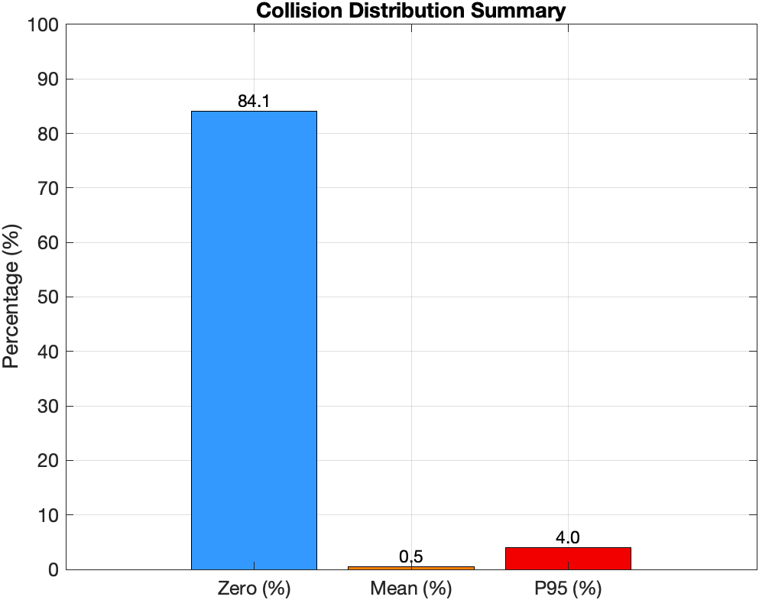
Results
θ = 20.3°
θ = 6.4°
For sufficiently narrow beams, the collision probability is so small that an LBT based channel access does not provide an advantage

Slide 7
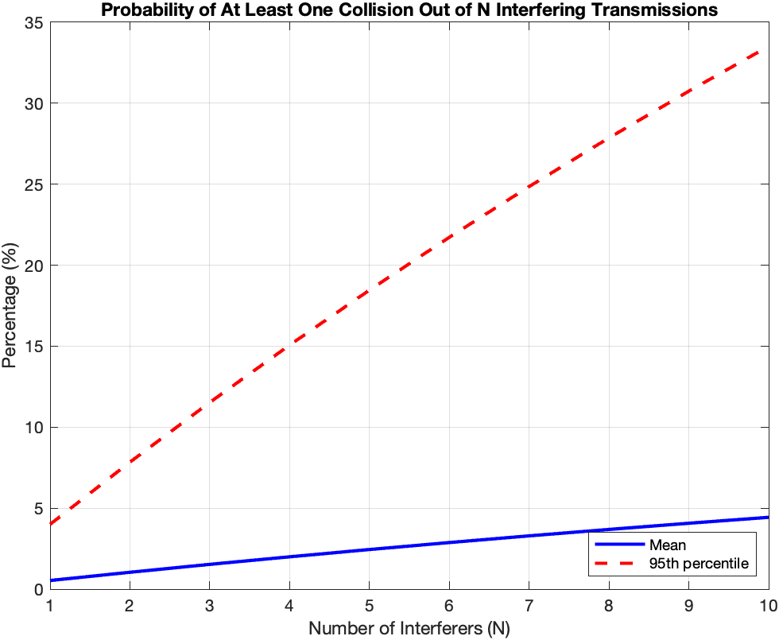
Results
θ = 6.4°
With up to ten transmitting devices
  Low likelihood on average
  P95 quickly rises
Simulations overestimate the number of collisions
  Devices placed in two-dimensional plane
  Transmitting device is always active

Slide 8
Additional Thoughts
This simple design for channel access allows for reduced complexity & overhead compared to previous sub-7 GHz and 60 GHz channel access methods
How does it fit into IEEE 802.11bq?
  Primary channel access mode?
  Preferred: optional channel access mode together with more classical Wi-Fi channel access
How can we deal with the P95 situations?
  Important for low latency services and dense environments

Slide 9
Conclusions
Having a low complexity channel access mechanism, leveraging the several degrees of freedom, seems to be a feasible approach for IMMW
  Especially for best effort type of traffic
Care should be taken in order to improve the P95 performance for more latency sensitive applications or dense environments with many devices

Slide 10
Strawpoll
SP: Do you support looking further into a no-LBT mode for directive IMMW transmissions?
Y: N: A:

Slide 11
References
[1] https://mentor.ieee.org/802.11/dcn/25/11-25-0428-01
[2] https://mentor.ieee.org/802.11/dcn/25/11-25-0899-00
[3] https://mentor.ieee.org/802.11/dcn/25/11-25-0433-02
[4] https://www.etsi.org/deliver/etsi_en/303700_303799/303753/01.01.01_60/en_303753v010101p.pdf

