Slide 1
Discussion on OFDMA Multiple Access Mechanism
Date: 2025-07-24
Authors:

Slide 2
Introduction
Current UL backscatter mainly adopt single-carrier modulation in which the transmitting tag exclusively occupies the spectrum.
With the rapid rise of connectivity needs from pervasive IoT applications, 11bp tends to support large number of IoT devices with short bursts of data.
Classic multiple access mechanisms, including TDMA, FDMA, CDMA, has been discussed in recent proposals[1, 2, 3].
We raise a discussion to explore the feasibility of OFDMA mechanism as an option for multiple access for AMP STAs.

Slide 3
OFDMA: Fundamentals & Feasibility
OFDMA is a multi-carrier modulation mechanism where frequency bands can partially overlap and thus has higher spectrum efficiency than FDMA, but constrained by strict orthogonality within subcarriers.
To apply OFDMA in AMP scenario, different OFDM subcarriers should be assigned to different AMP STAs at the same time, by letting AMP AP coordinate frequency shift of individual AMP STAs.
From [4], enabling OFDMA at backscattering AMP STAs only incurs tens of $μW$ level power consumption. Besides, tight synchronization can be achieved within OFDM CP duration of 0.8$μs$, validating feasibility of OFDMA for AMP.

Slide 4
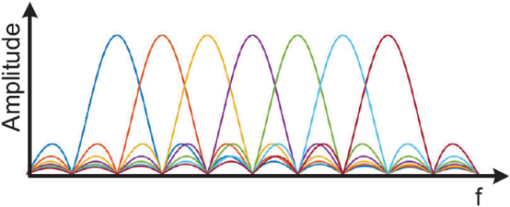
Potential Challenges
OFDMA requires tight synchronizations between AMP AP and multiple AMP STAs, to ensure orthogonality of analog OFDM symbols synthesized by multiple AMP STAs.
There are many factors impacting synchronization, including clock offset diversity, frequency offset diversity caused by shifting operation, different types of phase offsets, unstable signal strength between downlink preamble and backscatter symbols [4].

Slide 5
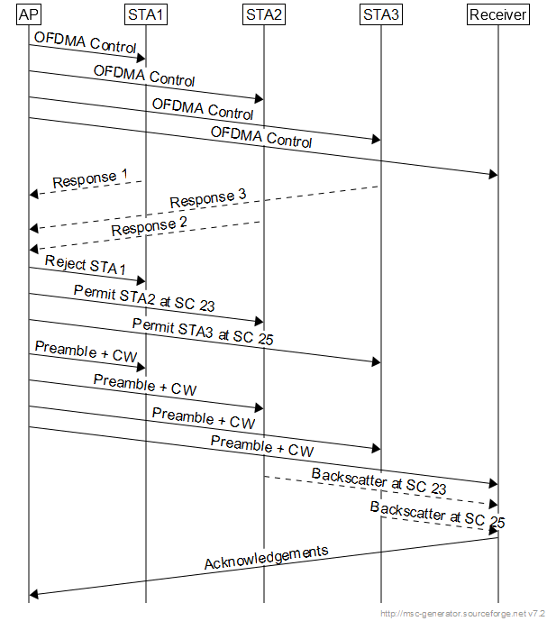
Conceived OFDMA General Signaling Interaction

Slide 6
Summary
We discuss the feasibility of OFDMA based multiple access scheme for AMP backscatter communication system.
AMP AP must coordinate all AMP STAs to achieve tight synchronizations by transmitting DL preambles.
Specific AMP STAs perform frequency shifted backscatter to locate on given subcarriers and modulate its UL data as if single-carrier modulation were performed. Multiple AMP STAs backscatter on different subcarriers to form analog OFDM symbols at AMP receiver.

Slide 7
References
[1] Xu et al. Multiple Access for AMP IoT. 11-24/1501r0, 2024.
[2] He et al. Multiple access mechanisms for AMP. 11-24/1776r1, 2024.
[3] He et al. Trigger based multiple access for AMP. 11-25/0031r1.
[4] Zhao et al. Enabling OFDMA-Enabled Wi-Fi Backscatter. In ACM MobiCom, 2019.

Slide 8
SP
Do you agree that 11bp should define OFDMA as an option for multiple access mechanism for frequency shifted backscatter AMP STAs?

