Slide 1
Discussion on OFDM Sample-level Modulation for Uplink Backscatter AMP STAs
Date: 2025-07-24
Authors:

Slide 2
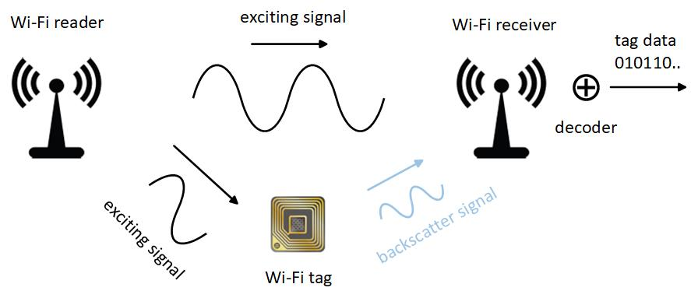
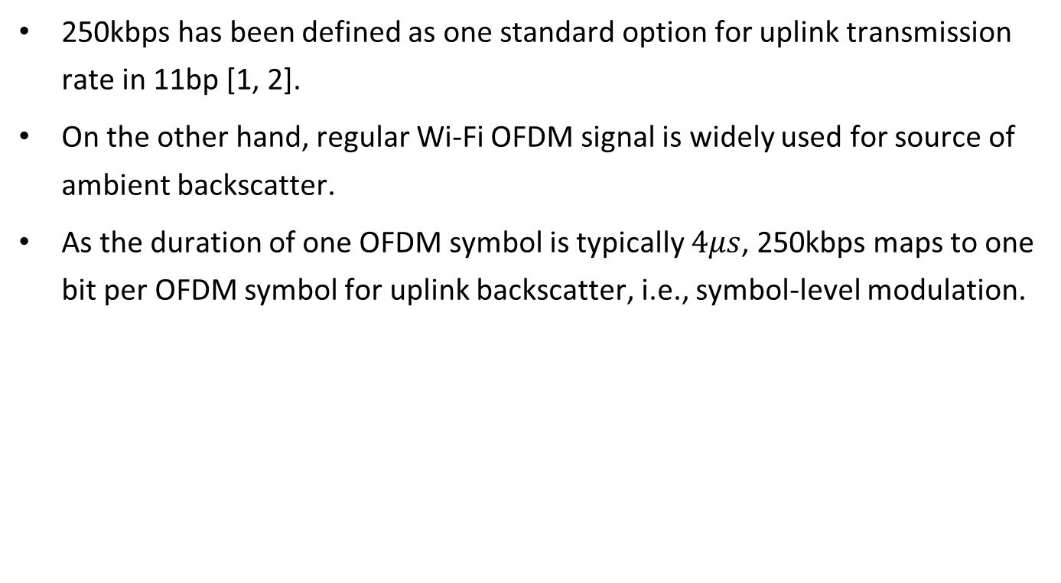
Introduction
250kbps has been defined as one standard option for uplink transmission rate in 11bp [1, 2].
On the other hand, regular Wi-Fi OFDM signal is widely used for source of ambient backscatter.
As the duration of one OFDM symbol is typically $4μs$, 250kbps maps to one bit per OFDM symbol for uplink backscatter, i.e., symbol-level modulation.

Slide 3
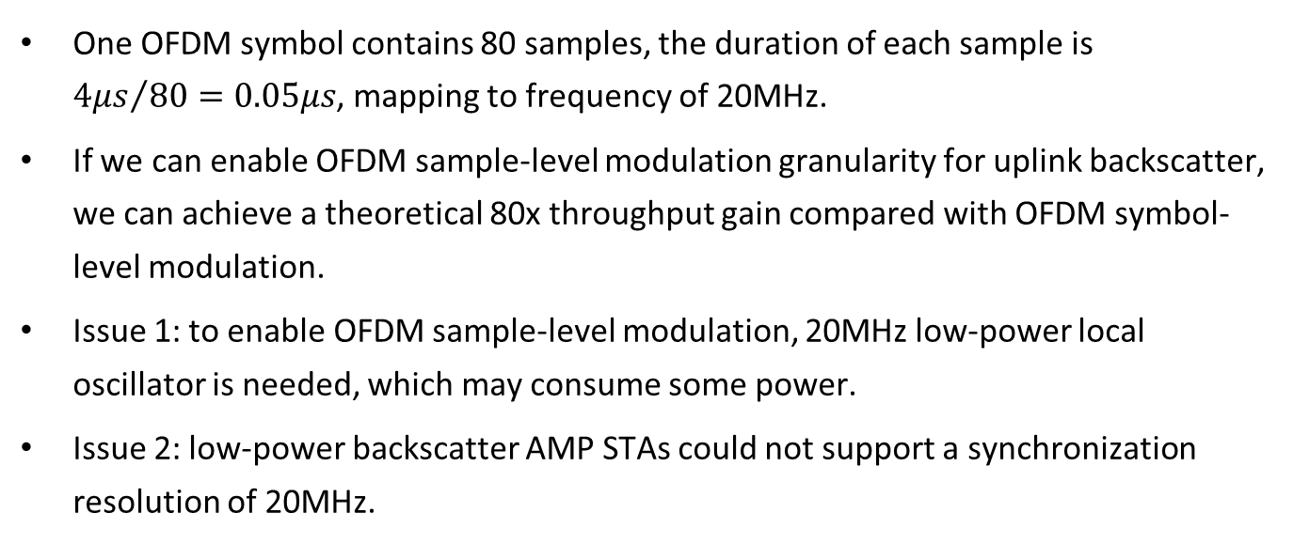
Symbol-level to sample-level modulation
One OFDM symbol contains 80 samples, the duration of each sample is ${4μs}/{80=0.05μs}$, mapping to frequency of 20MHz.
If we can enable OFDM sample-level modulation granularity for uplink backscatter, we can achieve a theoretical 80x throughput gain compared with OFDM symbol-level modulation.
Issue 1: to enable OFDM sample-level modulation, 20MHz low-power local oscillator is needed, which may consume some power.
Issue 2: low-power backscatter AMP STAs could not support a synchronization resolution of 20MHz.

Slide 4
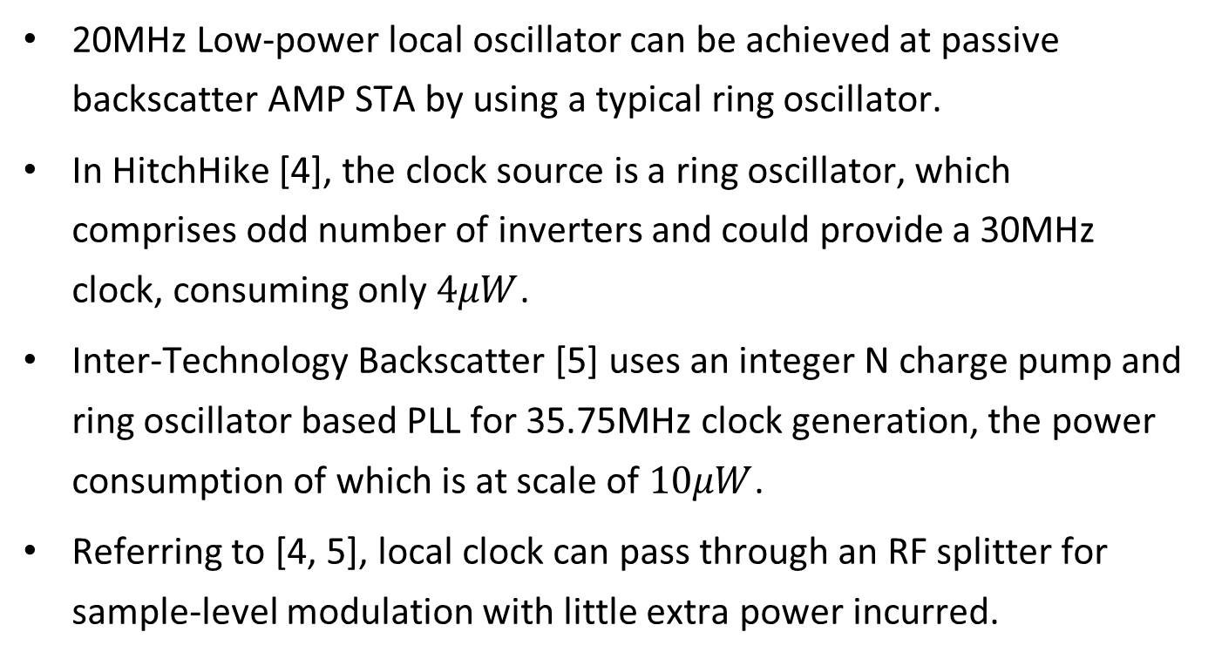
Power consumption of 20MHz local oscillator
20MHz Low-power local oscillator can be achieved at passive backscatter AMP STA by using a typical ring oscillator.
In HitchHike [4], the clock source is a ring oscillator, which comprises odd number of inverters and could provide a 30MHz clock, consuming only $4μW$.
Inter-Technology Backscatter [5] uses an integer N charge pump and ring oscillator based PLL for 35.75MHz clock generation, the power consumption of which is at scale of $10μW$.
Referring to [4, 5], local clock can pass through an RF splitter for sample-level modulation with little extra power incurred.

Slide 5
Lack of sample-level synchronization resolution
For passive backscatter AMP STAs, it is hard for them to achieve OFDM sample-level synchronization, to cooperate with sample-level modulation.
The synchronization circuit must meet the low-power constraints of passive AMP STAs. A typical circuit is shown below, which consists of impedance matching, envelope detection, comparator, etc [6].
Hence, even if passive backscatter AMP STAs could achieve OFDM sample-level modulation locally, it cannot achieve sample-level synchronization with downlink Wi-Fi OFDM packets.

Slide 6
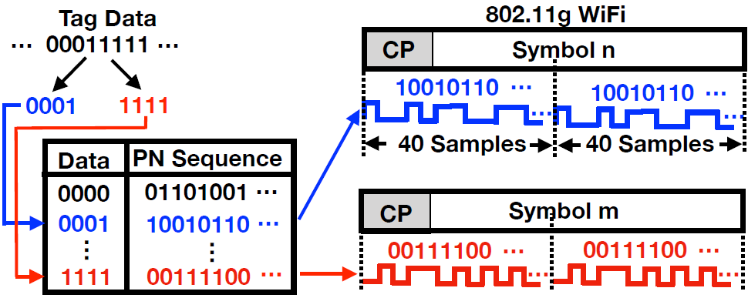
Potential solution from TScatter [3]
CP would be removed in regular Wi-Fi receiver, hence valid backscatter data should not be embedded in CP part.
Backscatter AMP STA embeds only 40 bits twice in 80 samples, creating sufficient redundancy to counter against synchronization errors between uplink sample-level modulation and downlink Wi-Fi OFDM signals.
More redundancy is added through coding-based method: use longer orthogonal PN sequence to represent backscatter data.

Slide 7
Summary
Compared with OFDM symbol-level modulation, OFDM sample-level modulation can achieve a theoretical 80x throughput gain under perfect sync.
Power consumption with 20MHz clock is at acceptable scale in passive backscatter AMP STAs.
We can think for complete solutions, including robust coding, synchronization, decoding algorithms, etc, with the premise of OFDM sample-level modulation for uplink backscatter, under which framework the uplink transmission rate can be significantly increased.

Slide 8
References
[1] 11-25-0027r1. AMP PPDU Design.
[2] 11-25-0033r1. UL Data rates for AMP.
[3] Liu et al. Verification and Redesign of OFDM Backscatter. In USENIX NSDI, 2021.
[4] Zhang et al. HitchHike: Practical Backscatter Using Commodity WiFi. In ACM Sensys, 2016.
[5] Iyer et al. Inter-Technology Backscatter. Towards Internet Connectivity for Implanted Devices. In ACM SIGCOMM, 2016.
[6] Na et al. Leggiero: Analog WiFi Backscatter with Payload Transparency. In ACM MobiSys, 2023.
Notes:
Motion 16,

Slide 9
SP
Do you agree that 11bp should define an extra modulation option that enables OFDM sample-level modulation, besides current OFDM symbol-level modulation, in uplink backscatter scenario?

