Slide 1
Discussion on TRN field in IMMW PPDU
Date: 2025-07-24
Authors:
Name | Affiliations | Address | Phone | email
Mengshi Hu | Huawei |  |  | humengshi@huawei.com
Shimi Shilo
Ming Gan

Slide 2
Training (TRN) field
The format of IMMW PPDU has been discussed in some proposals, where the TRN was also mentioned:
In [1], the authors mentioned that the TRN could be further considered but there was no detailed discussion.
In [2], the authors mentioned that for the IMMW NDP, one TRN field could be used for channel sounding and more TRN fields could be included for the beam training.
We find that there is a lack of detailed discussions on TRN field. In this proposal, the followings on TRN are discussed:
TRN field structure in 802.11ad
TRN field structure in 802.11ay
Considerations for 802.11bq (IMMW)

Slide 3
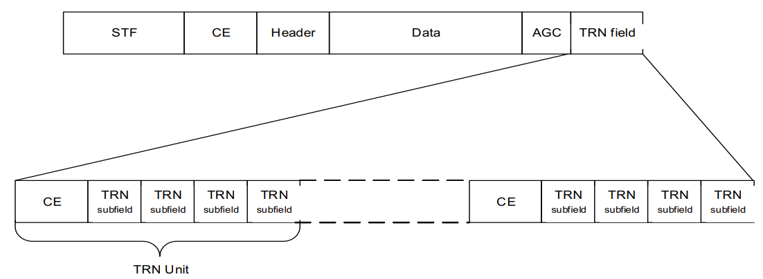
TRN field in 802.11ad (1/2)
In 802.11ad, the following TRN field related format is supported [3]:
The TRN field enables transmitter and receiver AWV training.
A value of N in the Training Length field indicates that the AGC has 4N subfields and that the TRN field has 5N subfields.
AGC field in 802.11ad
The AGC field in the BRP PPDU is composed of 4N AGC subfields.
In a BRP-RX PPDU, the transmitter shall use the same TX AWV as in the preamble and Data fields of the PPDU.
In a BRP-TX PPDU, the transmitter may change the TX AWV configuration at the beginning of each AGC subfield. The set of AWVs used for the AGC subfields should be the same as that used for the TRN-T subfields.

Slide 4
TRN field in 802.11ad (2/2)
TRN field in 802.11ad [3]
The TRN field is composed of N TRN Units. Each TRN Unit is composed of a CE subfield and 4 TRN subfields.
In a BRP-RX PPDU, all of the TRN and CE subfields are transmitted using the same AWV as the preamble and Data field of the PPDU.
In a BRP-TX PPDU, the transmitter may change AWV at the beginning of each TRN subfield.

Slide 5
TRN field in 802.11ay (1/4)
EDMG PPDU structure [3]
TRN field in 802.11ay
The TRN field enables transmit and receive AWV training by EDMG STAs. Three structures are supported:
a. TRN field structure of EDMG BRP-TX PPDU
b. TRN field structure of EDMG BRP-RX PPDU
c. TRN field structure of EDMG BRP-RX/TX PPDU
Note: In 802.11ay, multiple transmit chains can be estimated at the same time in a TRN subfield of the TRN field.

Slide 6
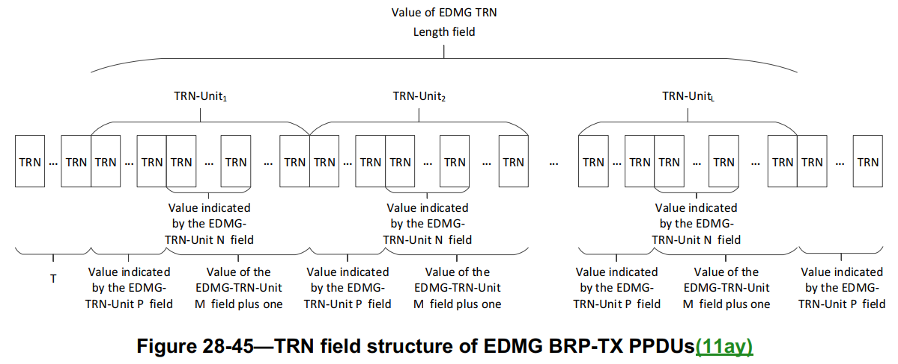
TRN field in 802.11ay (2/4)
BRP-TX PPDU [3]
For EDMG BRP-TX PPDUs, the transmitter may change the AWV at the beginning of each set of N TRN subfields present in the last M TRN subfields of each TRN-Unit in the TRN field. The N consecutive TRN subfields that comprise each set of N TRN subfields shall be transmitted with the same AWV.
In a word:
Same AWV within N TRN subfields in a TRN-Unit
May have different AWVs for each N TRN subfields in a TRN-Unit
May have different AWVs for each TRN-Unit

Slide 7
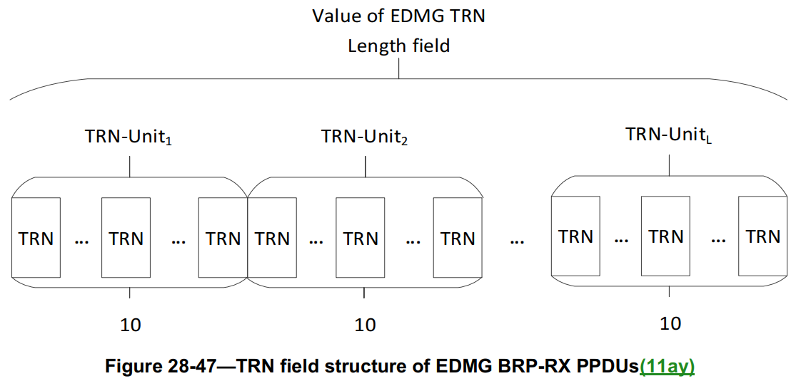
TRN field in 802.11ay (3/4)
BRP-RX PPDU [3]
In an EDMG BRP-RX PPDU, all TRN subfields of all TRN-Units shall be transmitted using the same AWV as the preamble and Data fields of the PPDU. Moreover, each TRN-Unit shall have 10 TRN subfields.

Slide 8
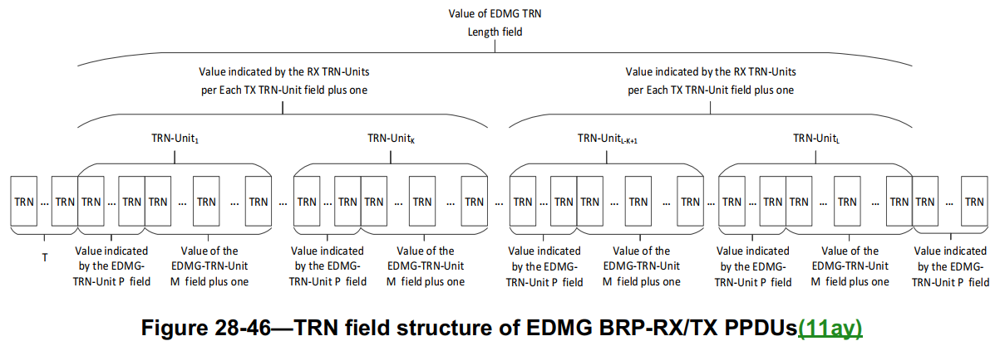
TRN field in 802.11ay (4/4)
BRP-RX/TX PPDU [3]
For EDMG BRP-RX/TX PPDUs, the transmitter may change AWV once at the beginning of the last M TRN subfields of each TRN-Unit with the constraint that the same AWV configuration shall be used in the transmission of R TRN-Units, where R is the value of the RX TRN-Units per Each TX TRN-Unit field in the EDMG Header-A plus one.
In a word:
Same AWV in the last M TRN subfields of a TRN-Unit
Same AWV within R TRN-Units (Train receive beams)
May have different AWVs for every R TRN-Units (Train transmit beams)

Slide 9
Considerations for 802.11bq
For 802.11bq, here are the items that we think should be firstly discussed in the TRN discussion.
Whether or not to define the TRN field (or other names with the same functionality);
What are the use cases of using the TRN field;
If TRN is supported, more details could be further discussed, such as:
Maximum number of supported spatial streams;
etc.

Slide 10
Summary
The TRN fields used for AWV training in 802.11ad and 802.11ay were introduced.
Some essential items that should be discussed in the TRN field discussion in 802.11bq were listed.

Slide 11
References
[1] Eunsung Park, et al. 11-25-0365-01-00bq-ppdu-format-for-immw
[2] Rui Cao, et al. 11-25-0360-00-00bq-high-level-thoughts-on-immw-phy-design
[3] IEEE Draft P802.11REVme_D7.0

Slide 12
Appendix TRN related fields in 802.11ay
Note that in 802.11ay, there exist many TRN related fields in its preamble.
Table: Some TRN related fields in 802.11ay
EDMG TRN Length | 8 bits | EDMG TRN-Unit N | 2 bits | DMG TRN | 1 bits
RX TRN-Units per Each TX TRN-Unit | 8 bits | TRN Subfield Sequence Length | 2 bits | Number of Transmit Chains | 3 bits
EDMG TRN-Unit P | 2 bits | TRN-Unit RX Pattern | 1 bits | Dual Polarization TRN Training | 1 bits
EDMG TRN-Unit M | 4 bits | TRN Aggregation | 1 bits | … | …

