Slide 1
Disassociation Risk in NPCA Operations
Date: 2025-07-23
Authors:
Name | Affiliation | Address | Phone | Email
Yanchun Li | Huawei |  |  | liyanchun@huawei.com
Weijie Wang
Ming Gan
Yunbo Li
Yan Xin
Mengshi Hu
Guogang Huang
Xin Li
Xuming Wu
Xiang Wang
Yanchun Li (Huawei)

Slide 2
Introduction
11bn defines NPCA schemes:
AP and STA can switch to NPCA channel when their primary channel is busy.
A number of contributions have identified that unsynchronized NPCA switching effect exists [1-3]. Beside, simulation shows performance loss[1].
This contribution considers that NPCA also has conflict with other 802.11 mechanism, if not carefully designed.
  STA’s unsynchronized switching to NPCA primary channel causes missing of beacon reception. And consecutive missing of beacon frames leads to disassociation.

Slide 3
Recap: Issue in NPCA
Current NPCA in 11bn Draft is opportunistic and lack of direct coordination between AP and STAs.
STAs may switch to NPCA primary channel while AP stays in legacy primary channel.
In TXOP based NPCA, STA may stay in NPCA primary channel much longer.
NPCA primary channel
Legacy primary channel
OBSS PPDU
OBSS TXOP

Slide 4
NPCA and TBTT
If an AP and a STA is having a TXOP on the NPCA Primary channel overlaps with the TBTT, the AP can’t transmit the Beacon frame or group addressed frames on NPCA primary channel. So, after NPCA transmission, the AP switches back to the BSS Primary channel and transmit its beacon.
Target Beacon Transmission Time (TBTT)
NPCA primary channel
Legacy primary channel
OBSS occupation
Beacon

Slide 5
Missing of Beacon Reception
Risk: STA’s switching to NPCA channel at TBTT leads to missing of beacon
Target Beacon Transmission Time (TBTT)
NPCA primary channel
STA’s view：
Legacy primary channel
OBSS occupation
AP’s view:
Legacy primary channel
Beacon

Slide 6
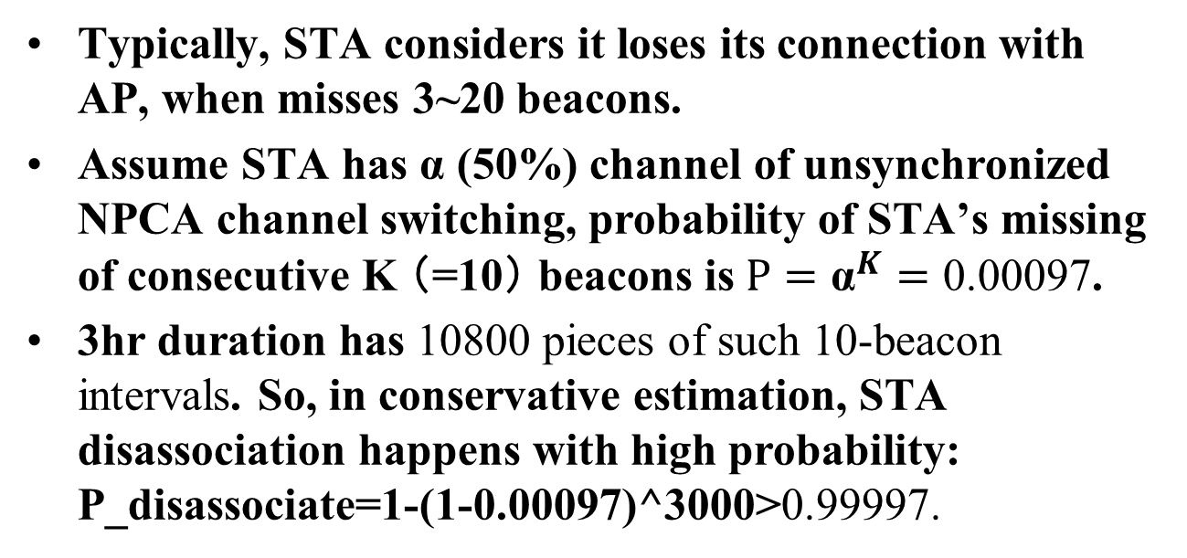
Is the risk significant or trivial?
- Disassociation probability
Typically, STA considers it loses its connection with AP, when misses 3~20 beacons.
Assume STA has α (50%) channel of unsynchronized NPCA channel switching, probability of STA’s missing of consecutive K （=10） beacons is $P={\text{α}}^{K}=\text{0.00097}$.
3hr duration has 10800 pieces of such 10-beacon intervals. So, in conservative estimation, STA disassociation happens with high probability: P_disassociate=1-(1-0.00097)^3000>0.99997.

Slide 7
Candidate solutions
Option 1: Robust NPCA schemes with explicit or implicit AP triggering [1-3]
  Define a NPCA mode which includes AP triggered NPCA channel switching.
  An explicit signaling frame which lets STAs to switch to NPCA primary channel
  An implicit signaling (absent of an expect frame from AP) which lets STAs to switch to NPCA primary channel
Option 2: Truncate NPCA TXOP/transmission before TBTT.
Option 3: Disable NPCA at TXOP limit time ahead of TBTT.

Slide 8
Summary
This contribution discussed disassociation risk in NPCA operations.
  Unsynchronized NPCA channel switching leads to high dissociation probability.
  It puts ultra-high reliable operation of 11bn in risk
Further improvement of NPCA scheme is needed:
  Robust NPCA scheme proposed in contributions[1-3]
  Disable NPCA around TBTT time.

Slide 9
References
[1] https://mentor.ieee.org/802.11/dcn/24/11-24-2110-00-00bn-impact-of-hidden-nodes-on-npca-performance.pptx
[2] https://mentor.ieee.org/802.11/dcn/24/11-24-1435-01-00bn-uhr-multi-channel-access.pptx
[3] https://mentor.ieee.org/802.11/dcn/24/11-24-0318-00-00bn-robust-secondary-channel-access.pptx
Yanchun Li (Huawei)

Slide 10
SP
SP : Do you support to improve NCPA scheme which can mitigate disassociation risk during NPCA operation?
Yes
No
Abs
Yanchun Li (Huawei)

