Slide 1
Hybrid OFDM MC-CDMA for IEEE 802.11
July 2025
doc.: IEEE 802.11-25/1282r1
Date: 2025-07-28
Authors:
Name | Affiliation | Address | Phone | Email
Abdalla Hussein | Huawei |  |  | abdalla.hussein@huawei.com
Osama Aboul-Magd
Junghoon Suh
Yan Xin
Mahmoud Hasabelnaby

Slide 2
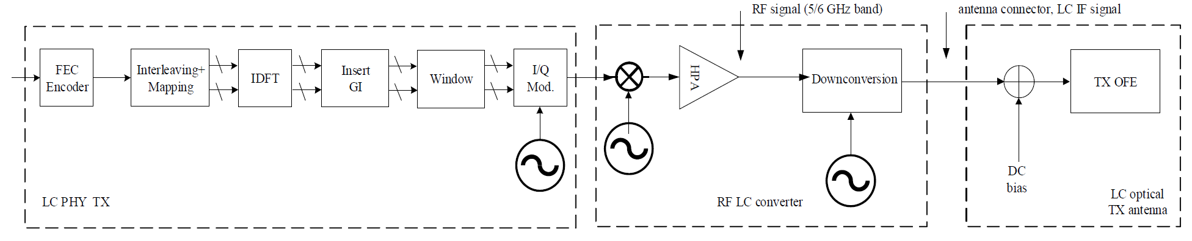
Background
July 2025
doc.: IEEE 802.11-25/1282r1
Among the main TGbr objectives [1] is to support to new channelization (wider bandwidth) – 320 MHz or 640 MHz channels as well as PAPR reduction.
Currently, the 802.11bb is based on DC-biased Optical OFDM (DCO-OFDM) [2].
  This is achieved by optionally, first filtering the IF signal to ensure it’s real.
  Then, adding a DC bias and clipping to ensure that the generated signal is unipolar.

Slide 3
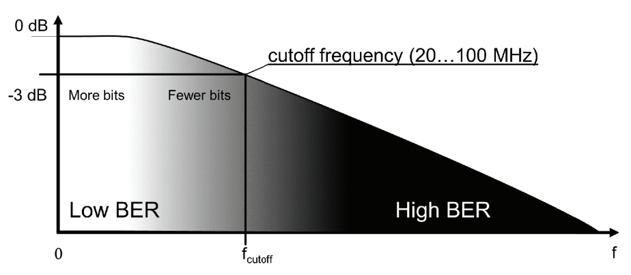
Problem Statement
July 2025
doc.: IEEE 802.11-25/1282r1
Typical commercial LEDs have a low cut-off frequency in the range of 20-100 MHz.
802.11bb does not provide a solution to utilize the remaining bandwidth.
Several research works have shown that uniform bit-loading and power allocation is sub-optimal as it introduces ISI.

Slide 4
Proposed Solution
July 2025
doc.: IEEE 802.11-25/1282r1
Adopt Multi-Carrier CDMA (MC-CDMA)
  Instead of directly adopting the current 802.11 waveform, we propose adopting MC-CDMA.
  This requires the addition of a Direct Sequence Spreading step prior to computing IFFT and generating the OFDM symbol.
This solution introduces additional robustness through diversity allowing the usage of more channel bandwidth.
Direct Sequence Spreading

Slide 5
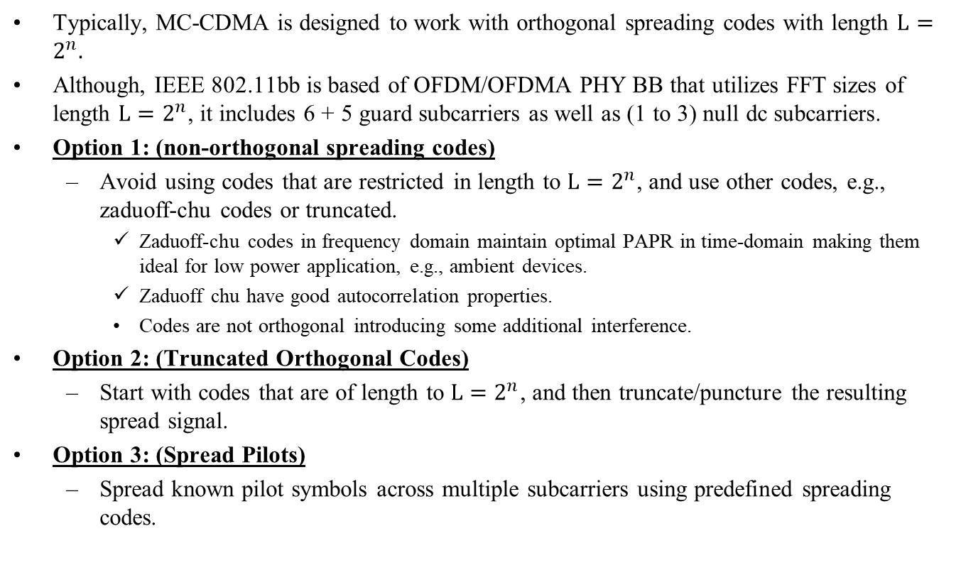
Spreading Procedure
July 2025
doc.: IEEE 802.11-25/1282r1
Typically, MC-CDMA is designed to work with orthogonal spreading codes with length $L=2^{n}.$
Although, IEEE 802.11bb is based of OFDM/OFDMA PHY BB that utilizes FFT sizes of length $L=2^{n}$, it includes 6 + 5 guard subcarriers as well as (1 to 3) null dc subcarriers.
Option 1: (non-orthogonal spreading codes)
  Avoid using codes that are restricted in length to $L=2^{n}$, and use other codes, e.g., zaduoff-chu codes or truncated.
    Zaduoff-chu codes in frequency domain maintain optimal PAPR in time-domain making them ideal for low power application, e.g., ambient devices.
    Zaduoff chu have good autocorrelation properties.
    Codes are not orthogonal introducing some additional interference.
Option 2: (Truncated Orthogonal Codes)
  Start with codes that are of length to $L=2^{n}$, and then truncate/puncture the resulting spread signal.
Option 3: (Spread Pilots)
  Spread known pilot symbols across multiple subcarriers using predefined spreading codes.

Slide 6





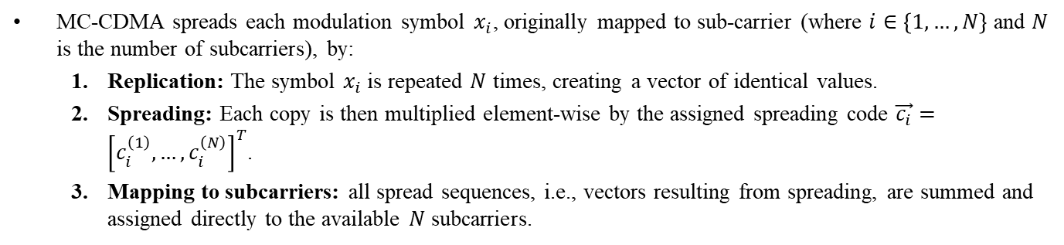






MC-CDMA block diagram
July 2025
doc.: IEEE 802.11-25/1282r1
MC-CDMA spreads each modulation symbol $x_{i}$, originally mapped to sub-carrier (where $i∈\left\{1,…,N\right\}$ and $N$ is the number of subcarriers), by:
  Replication: The symbol $x_{i}$is repeated $N$ times, creating a vector of identical values.
  Spreading: Each copy is then multiplied element-wise by the assigned spreading code $\vec{c_{i}}={\left[c_{i}^{\left(1\right)}, …, c_{i}^{\left(N\right)}\right]}^{T}$.
  Mapping to subcarriers: all spread sequences, i.e., vectors resulting from spreading, are summed and assigned directly to the available $N$ subcarriers.
$$c_{1}^{(1)}$$
$$x_{1}^{(1)}$$
S/P
$$Σ$$
Interleaving/ Symbol Mapping
$$x_{1}$$
$$c_{1}^{(N)}$$
IDFT
$$x_{1}^{(N)}$$
$$c_{N}^{(1)}$$
$$x_{N}^{(1)}$$
S/P
$$Σ$$
$$x_{N}$$
$$c_{N}^{(N)}$$
$$x_{N}^{(N)}$$

Slide 7
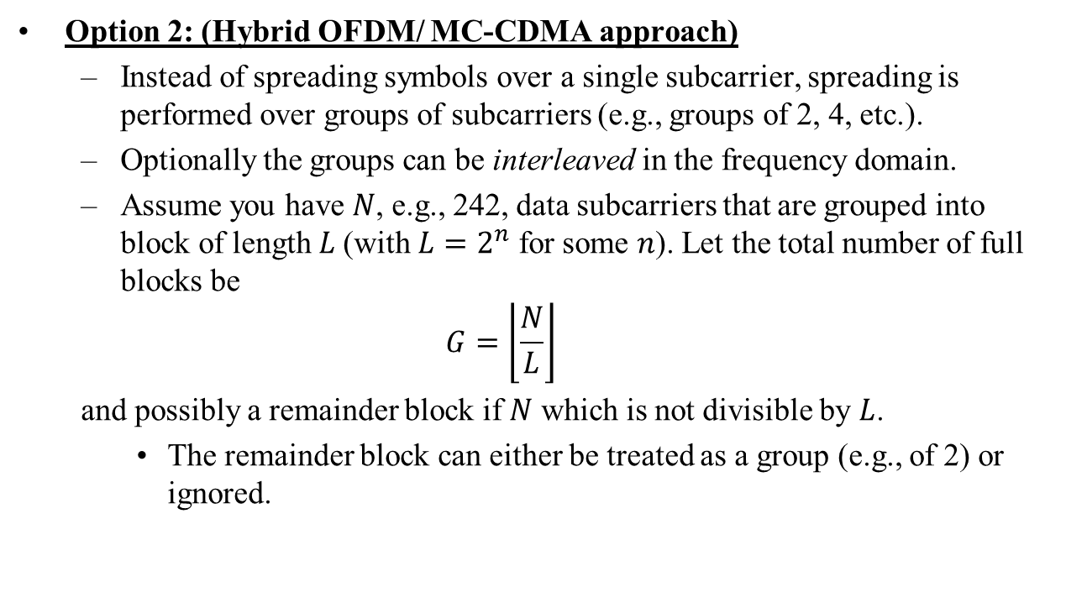
Hybrid OFDM/ MC-CDMA
July 2025
doc.: IEEE 802.11-25/1282r1
Option 2: (Hybrid OFDM/ MC-CDMA approach)
  Instead of spreading symbols over a single subcarrier, spreading is performed over groups of subcarriers (e.g., groups of 2, 4, etc.).
  Optionally the groups can be interleaved in the frequency domain.
  Assume you have $N$, e.g., 242, data subcarriers that are grouped into block of length $L$(with $L=2^{n}$ for some $n$). Let the total number of full blocks be
  $$G=\left\lfloor \frac{N}{L}\right\rfloor$$
  and possibly a remainder block if $N$ which is not divisible by $L$.
    The remainder block can either be treated as a group (e.g., of 2) or ignored.

Slide 8








Option 2 – Implementation options
July 2025
doc.: IEEE 802.11-25/1282r1
The diagram below presents the proposed hybrid OFDM/MC-CDMA block diagram, featuring both non-interleaved and interleaved options.
  Non-Interleaved Option: Spreading is applied directly within designated subcarrier groups.
  Interleaved Option: An additional interleaving step is introduced before subcarrier mapping. This ensures that code chips generated from a single symbol are distributed across the entire bandwidth, enhancing frequency diversity and resilience against fading.
$$x_{1}$$
Direct Sequence Spreading
IDFT
$$x_{1}$$
IDFT
Interleaving/ Symbol Mapping
Interleaving/ Symbol Mapping
Direct Sequence Spreading
$$x_{L}$$
$$x_{L}$$
$$x_{\left(G−1\right)L+1}$$
Direct Sequence Spreading
$$x_{\left(G−1\right)L+1}$$
Direct Sequence Spreading
$$x_{GL}$$
$$x_{GL}$$
$$x_{GL+1}$$
$$x_{GL+1}$$
Direct Sequence Spreading
Direct Sequence Spreading
$$x_{N }$$
$$x_{N }$$

Slide 9
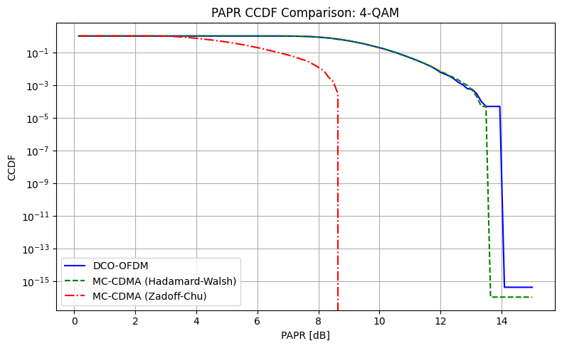
Simulation results
July 2025
doc.: IEEE 802.11-25/1282r1
From the results, it is clear that the spreading/coding design is critical for PAPR reduction.
Parameter | Value
Num Symbols | 20000
NFFT | 64
CP | 16
DC bias | 7 dB
Oversampling factor | 4

Slide 10
Summary
July 2025
doc.: IEEE 802.11-25/1282r1
In this contribution, we propose a hybrid OFDM /MC-CDMA as a new mode for ELC PHYs.
This approach enables improved channel usage, PAPR reduction, and configurable complexity-performance tradeoffs adaptable to different deployment scenarios.

Slide 11
References
July 2025
doc.: IEEE 802.11-25/1282r1
[1] IEEE 11-25/185r2, Draft P802.11br PAR.
[2] IEEE 802.11-18/1582r4 IEEE 802.11bb Reference Channel Models for Indoor Environments

