Slide 1
Discussion on DRU Improvements
Date: 2025-07-26
Authors:
Name | Affiliation | Address | Phone | email
Ke Zhong | Ruijie Networks Co., Ltd. |  |  | zhongke@ruijie.com.cn
Fachang Guo

Slide 2
Abstract
Introduction
Discussion on DRU Improvements
Conclusion

Slide 3
Introduction
In PAR of P802.11bn, the Ultra High Reliability (UHR) capability has been defined to improve Rate-vs-Range enhancement, reduce latency, and reduce power consumption for AP, compared to Extremely High Throughput (EHT) MAC/PHY operation [1].
A DRU transmission is allowed only in a UL OFDMA transmission to maximize the power boost gain of each DRU.
.
DRU in the current Draft 0.3 version [2]:
The DRUs defined for UHR UL TB PPDU transmission are 26-tone DRU, 52-tone DRU, 106-tone DRU, 242-tone DRU, and 484-tone DRU.
Distribution bandwidth (DBW) defined for UHR UL TB PPDU transmission are 20 MHz, 40 MHz, 60 MHz and 80 MHz.
The 26-tone DRU, 52-tone DRU, and 106-tone DRU are defined in 20 MHz distribution bandwidth.
The 26-tone DRU, 52-tone DRU, 106-tone DRU, and 242-tone DRU are defined in 40 MHz distribution bandwidth.
The 52-tone DRU, 106-tone DRU, and 242-tone DRU are defined in 60 MHz distribution bandwidth.
The 52-tone DRU, 106-tone DRU, 242-tone DRU, and 484-tone DRU are defined in 80 MHz distribution bandwidth.
A UHR UL TB PPDU using OFDMA transmission may carry a mixture of 26-, 52-, 106-, 242-, and 484- tone DRUs.
For a 160 MHz UHR TB PPDU and a 320 MHz UHR TB PPDU, a hybrid mode where DRUs and Regular RUs (RRUs) are simultaneously used in one UHR TB PPDU is allowed. For a UHR TB PPDU with the hybrid mode, either DRU or RRU are used within each 80 MHz frequency subblock and DRUs and RRUs are not mixed within a certain 80 MHz frequency subblock.
The minimum RRU size is 242 in the hybrid mode.

Slide 4
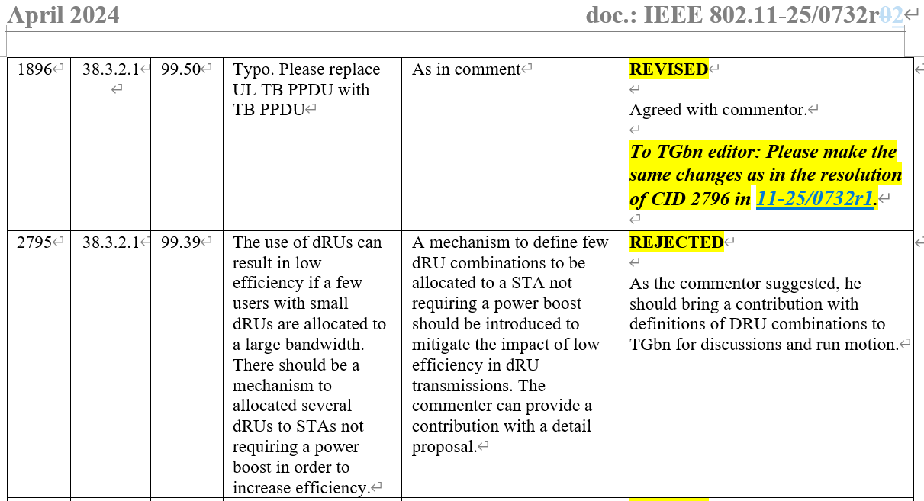
Potential DRU Issues – Recap [3]
CID 2795 was rejected due to the lack of a submitted related contribution.
The potential problem is that a mechanism might be necessary to specify a limited set of DRU combinations allocated to STAs without power boost requirements, in order to mitigate the impact of low efficiency in DRU transmissions.

Slide 5
Potential Problem Scenarios
Non-AP STAs supporting only RRU transmission cannot use this 20 MHz PPDU bandwidth
Null or other DRU non-AP STA
Null or other DRU non-AP STA
20 MHz
20 MHz
Non-AP STAs supporting only RRU transmission cannot use this 20 MHz PPDU bandwidth
20 MHz
Non-AP STA 1: 26-tone DRU in 20 MHz DBW
20 MHz
Non-AP STA 1:26-tone DRU 1 in 20 MHz DBW
Non-AP STA 2:26-tone DRU 4 in 20 MHz DBW
40 MHz
Non-AP STA 2: 26-tone DRU in 40 MHz DBW
40 MHz
Non-AP STAs supporting only RRU transmission cannot use this 40 MHz PPDU bandwidth
Drawbacks:
Low spectral efficiency and high transmission latency
Drawbacks:
Low spectral efficiency and high transmission latency
Other DRU non-AP STAs or RRU non-AP STAsA
Other DRU non-AP STAs or RRU non-AP STAsA
80 MHz
80 MHz
Scenario 1: small-sized DRU transmission occupies 20 MHz + 40 MHz
Scenario 2: small-sized DRU transmission only occupies 20 MHz

Slide 6
Proposed Solutions
Note:
Only 20 MHz DBW + 20 MHz DBW + 40 MHz DBW is shown
Similar for 40 MHz DBW + 20 MHz DBW + 20 MHz DBW
20 MHz DBW
20 MHz RRU
20 MHz RRU
80 MHz TB PPDU
without preamble puncturing
80 MHz TB PPDU
without preamble puncturing
80 MHz TB PPDU
without preamble puncturing
20 MHz RRU
20 MHz DBW
20 MHz RRU
40 MHz RRU
40 MHz RRU
40 MHz DBW
20 MHz DBW
20 MHz DBW
20 MHz RRU
80 MHz TB PPDU
without preamble puncturing
80 MHz TB PPDU
without preamble puncturing
80 MHz TB PPDU
without preamble puncturing
20 MHz DBW
20 MHz RRU
20 MHz DBW
40 MHz RRU
40 MHz DBW
40 MHz DBW

Slide 7
Proposed Solutions
20 MHz punctured
20 MHz DBW
40 MHz DBW
40 MHz DBW
80 MHz TB PPDU
with 20 MHz preamble puncturing
20 MHz DBW
80 MHz TB PPDU
with 20 MHz preamble puncturing
20 MHz punctured
80 MHz TB PPDU
with 20 MHz preamble puncturing
80 MHz TB PPDU
with 20 MHz preamble puncturing
20 MHz punctured
20 MHz RRU
40 MHz RRU
40 MHz RRU
20 MHz RRU
20 MHz punctured
20 MHz punctured
20 MHz RRU
40 MHz RRU
40 MHz RRU
80 MHz TB PPDU
with 20 MHz preamble puncturing
20 MHz RRU
80 MHz TB PPDU
with 20 MHz preamble puncturing
20 MHz punctured
80 MHz TB PPDU
with 20 MHz preamble puncturing
80 MHz TB PPDU
with 20 MHz preamble puncturing
20 MHz punctured
20 MHz DBW
40 MHz DBW
40 MHz DBW
20 MHz DBW
20 MHz punctured

Slide 8
Proposed Solutions
The proposed design however introduces additional overhead in:
(1) scheduling mechanisms
(2) tone plan configuration
(3) signaling operations
(4) AP receiver complexity
To limit adverse effects, it is further suggested that enablement of supplemental RRU/DRU combinations SHALL be conditional upon meeting the following criteria:
PPDU Bandwidth | Supported DRU Type | DBW
80 MHz | 26-tone DRU | 20 MHz, 40 MHz
 | 52-tone DRU | 20 MHz, 40 MHz
160 MHz | 26-tone DRU | 20 MHz, 40 MHz
 | 52-tone DRU | 20 MHz, 40 MHz
320 MHz | 26-tone DRU | 20 MHz, 40 MHz
 | 52-tone DRU | 20 MHz, 40 MHz
Note: only small-sized DRUs can enable supplemental RRU/DRU combinations within a certain 80 MHz frequency subblock.

Slide 9
Conclusion
To improve spectral efficiency and reduce transmission latency, supplemental RRU/DRU combinations within a certain 80 MHz frequency subblock were proposed in this presentation.
The proposed new feature for DRU could be considered at later stages, e.g., after Draft 1.0 version.
 | Proposed supplemental RRU/DRU combinations
80 MHz TB PPDU without preamble puncturing | 20 MHz DBW + 20 MHz RRU + 40 MHz RRU
 | 20 MHz RRU + 20 MHz DBW + 40 MHz RRU
 | 20 MHz RRU + 20 MHz RRU + 40 MHz DBW
 | 20 MHz DBW + 20 MHz DBW + 40 MHz RRU
 | 20 MHz DBW + 20 MHz RRU + 40 MHz DBW
 | 20 MHz RRU + 20 MHz DBW + 40 MHz DBW
To limit adverse effects, it is further suggested that enablement of supplemental RRU/DRU combinations SHALL be conditional upon meeting the following criteria:
PPDU Bandwidth | Supported DRU Type | DBW
80 MHz | 26-tone DRU | 20 MHz, 40 MHz
 | 52-tone DRU | 20 MHz, 40 MHz
160 MHz | 26-tone DRU | 20 MHz, 40 MHz
 | 52-tone DRU | 20 MHz, 40 MHz
320 MHz | 26-tone DRU | 20 MHz, 40 MHz
 | 52-tone DRU | 20 MHz, 40 MHz
 | Proposed supplemental RRU/DRU combinations
80 MHz TB PPDU with 20 MHz preamble puncturing | 20 MHz punctured + 20 MHz DBW + 40 MHz RRU
 | 20 MHz DBW + 20 MHz punctured + 40 MHz RRU
 | 40 MHz DBW + 20 MHz punctured + 20 MHz RRU
 | 40 MHz DBW + 20 MHz RRU + 20 MHz punctured
 | 20 MHz punctured + 20 MHz RRU + 40 MHz DBW
 | 20 MHz RRU + 20 MHz punctured + 40 MHz DBW
 | 40 MHz RRU + 20 MHz punctured + 20 MHz DBW
 | 40 MHz RRU + 20 MHz DBW + 20 MHz punctured
Note: only small-sized DRUs can enable supplemental RRU/DRU combinations within a certain 80 MHz frequency subblock.

Slide 10
Straw Poll
Do you agree to include the following into the 11bn SFD?
  For a 160 MHz UHR TB PPDU and a 320 MHz UHR TB PPDU, a hybrid mode where DRUs and Regular RUs (RRUs) are simultaneously used in one UHR TB PPDU is allowed. For a UHR TB PPDU with the hybrid mode, either DRU or RRU are used within each 80 MHz frequency subblock and DRUs and RRUs are allowed to be mixed within a certain 80 MHz frequency subblock.
    Yes:
    No:
    Abstain:

Slide 11
References
[1] IEEE 802.11-23/0480r3, UHR proposed PAR, Laurent Cariou (Intel)
[2] IEEE P802.11bnTM/D0.3
[3] IEEE 802.11-25/0732r2, CC50 CRs Related to Tone Plan for DRUs, Shuling Julia Feng (Mediatek)

