Slide 1
Status update: ns-3 Wi-Fi Simulations
Date: 2025-07-27
Authors:

Slide 2
Abstract
Summarizes key updates to ns-3 (www.nsnam.org) Wi-Fi module in releases ns-3.43 - ns-3.45 (2024-25)
  I. New helper: Wi-Fi transmission statistics helper (WifiTxStatsHelper)
  II. Updated fine timing measurement (FTM) module on UW dev branch
III. Introducing: Web-ns-3, a cloud-based Network Simulation as a Service (NSaaS) platform
  An AI-in-the-loop example (Multi-BSS)

Slide 3
I. Wi-Fi MAC transmission statistics helper
Motivation
  ns-3 is packet-level full-stack Wi-Fi simulator: for MAC simulations, per node delay/throughput statistics are key desired outputs
  ns-3 Trace can be used to gather transmission timestamps and outcomes in MAC, but complicated for beginner/student users
    Need a convenient way to achieve objective with few lines of code
MAC queue
t1: packet #5 enqueues
5
4
3
2
1
→ When is the packet enqueued?
t2: packet #5 becomes head-of-line (HOL)
7
6
5
→ What is the queueing delay (t2 - t1)?
Is the packet successful?
For success:
  What is the channel access delay (t3 - t2)?
  What link (in MLO) has been used?
For failure, what is the cause (e.g., retry limit reached)?
t3: packet #5 dequeues (i.e., is successfully transmitted or dropped)
9
8
7
6

Slide 4
Wi-Fi MAC transmission statistics helper
Design
  Input: the helper is notified (by ns-3 Trace) of each packet’s
    MAC enqueue → timestamp; the node & device IDs of the packet
    Transmission start → timestamp
    Block/non-block Ack reception → timestamp; the link used
    MAC dequeue → timestamp (= Ack timestamp if successful); reason of failure if failed

Slide 5
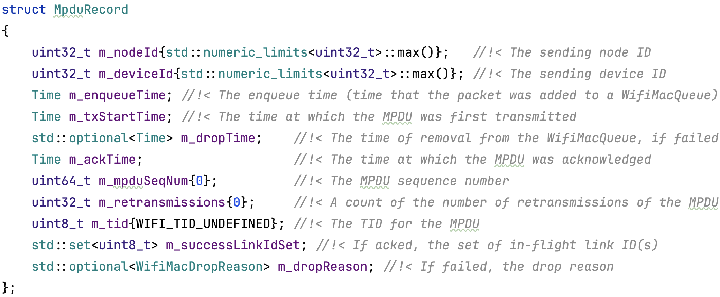
Wi-Fi MAC transmission statistics helper
Design
  Output: the helper provides statistics including
    Per-MPDU information for both successful and failed MPDUs:
Return the unordered map of records

Slide 6
Wi-Fi MAC transmission statistics helper
Design
  Output: the helper provides statistics including
    Node, device, and link-level information (counts):
      Success count
      Failure count (by reason)
      Retransmission count

Slide 7
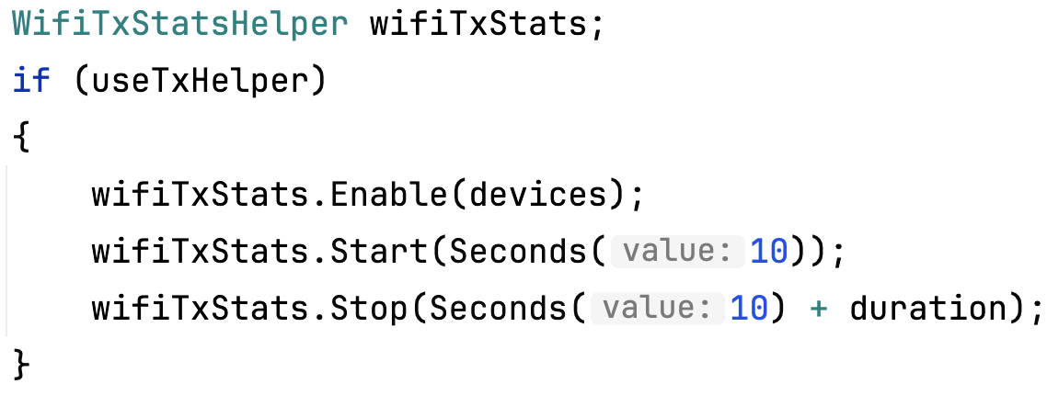
Wi-Fi MAC transmission statistics helper
How to use (general steps)
  Step 1: enable the helper before simulation start (code is common for all use cases), code snippet from wifi-bianchi.cc
  Step 2: obtain statistics after simulation end (code depends on the scenario & what you need from simulation)
Enable on net devices
Set start/end time of data collection

Slide 8
Wi-Fi MAC transmission statistics helper
How to use (single link, single STA scenario)
  Objective: get the packet error rate (PER) versus distance & transmit power
Parameter | Value
Frequency | 5 GHz
Bandwidth | 20 MHz
MCS | 6
TX power | 16 - 18 dBm
Distance | 35 - 40 m
Noise figure | 7 dB
Path loss model | Friis
Payload | 1000 Bytes
Packet interval | 1 ms
STA
UL traffic
AP
Code: see web-ns3 demo 1
Also available at GitLab (https://gitlab.com/shmy315/ns-3-wifitxstatshelper-demos)

Slide 9
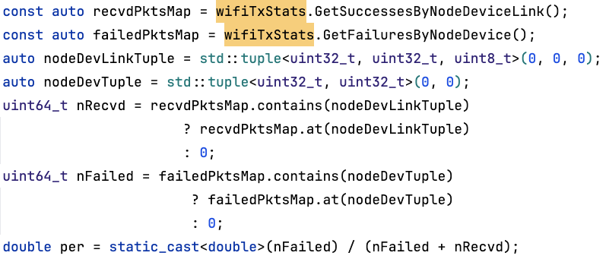
Wi-Fi MAC transmission statistics helper
How to use (single link, single STA scenario)
  Code to get PER

Slide 10
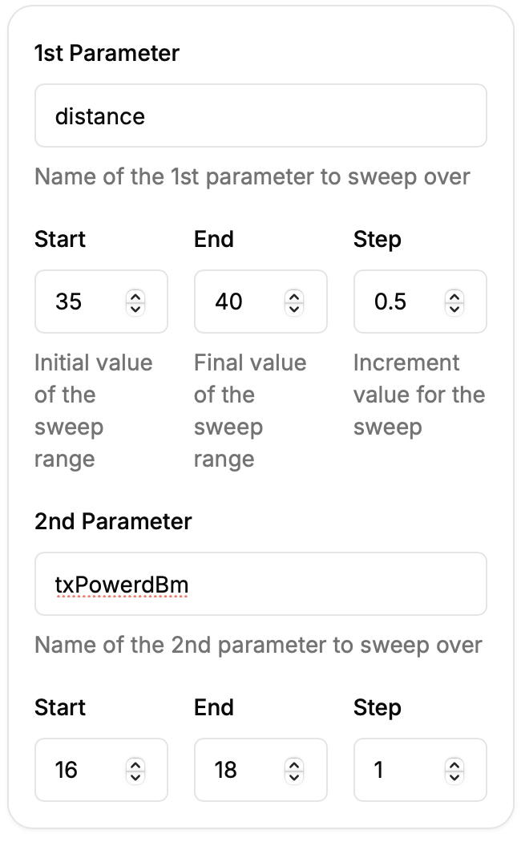
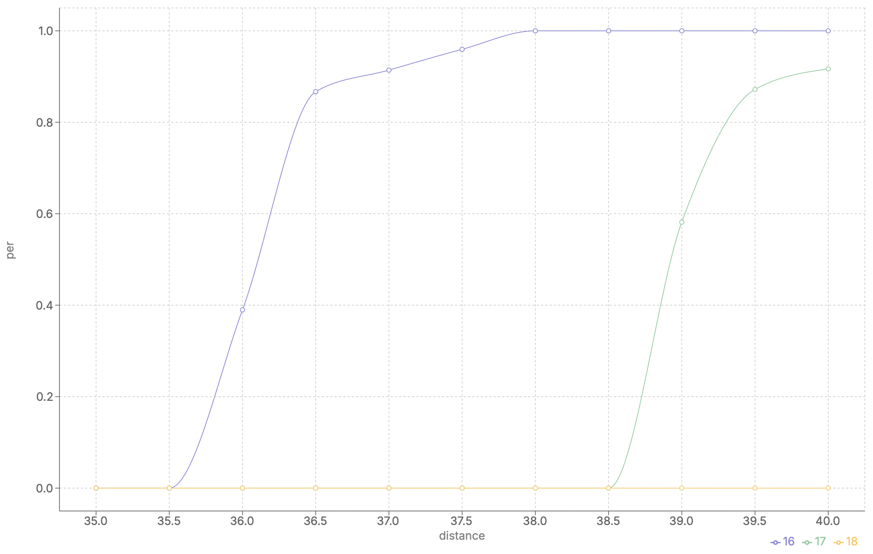
Wi-Fi MAC transmission statistics helper
How to use (single link, single STA scenario)
  Command line settings & result visualization in web-ns3

Slide 11
Wi-Fi MAC transmission statistics helper
How to use (multi link, multi STA scenario)
  Objective: get STA’s mean end-to-end delay (queueing delay + channel access delay) of each link versus packet interval & number of STAs
STA3
STA2
Parameter | Value
Link 1 | 5 GHz, 20 MHz, MCS 6
Link 2 | 6 GHz, 40 MHz, MCS 9
Distance | 5 m
TX power | 16 dBm
Noise figure | 7 dB
Path loss model | Friis
Payload | 1000 Bytes
Packet interval | 1 - 5 ms
Number of STAs | 10, 20, 30
STA4
STA1
AP
STA5
STAn
…
: UL traffic on 5 GHz link
: UL traffic on 6 GHz link
Code: see web-ns3 demo 2
Also available at GitLab (https://gitlab.com/shmy315/ns-3-wifitxstatshelper-demos)

Slide 12
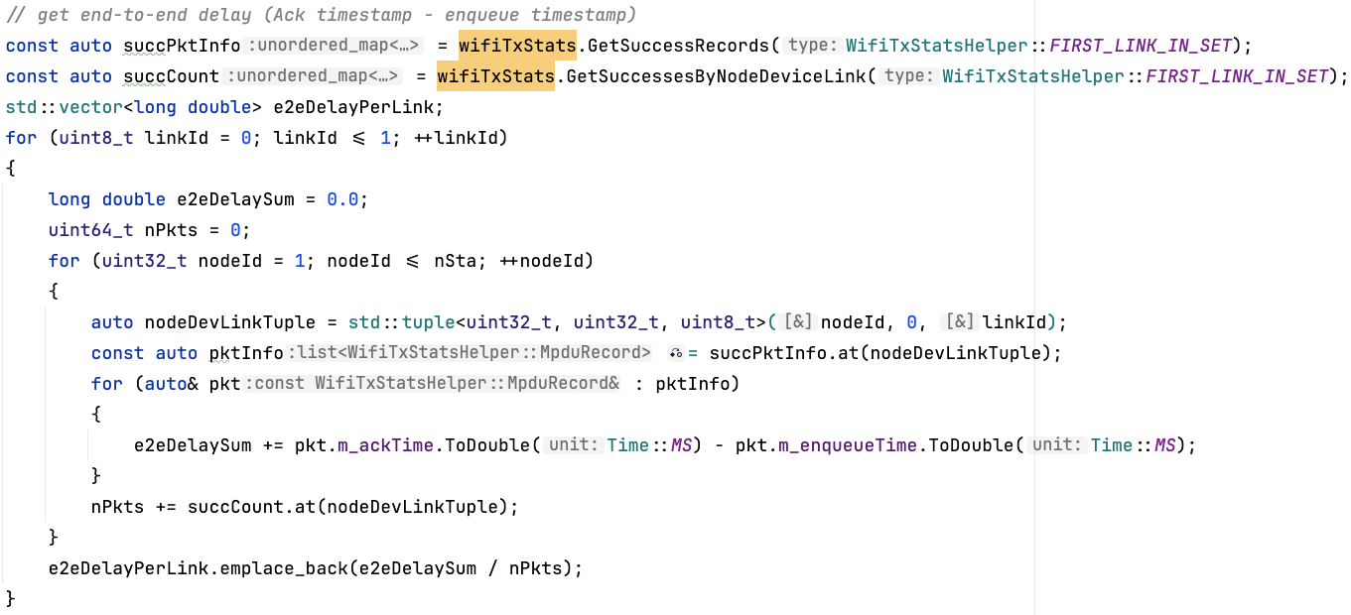
Wi-Fi MAC transmission statistics helper
How to use (multi link, multi STA scenario)
  Code to get mean end-to-end (E2E) delay per link

Slide 13
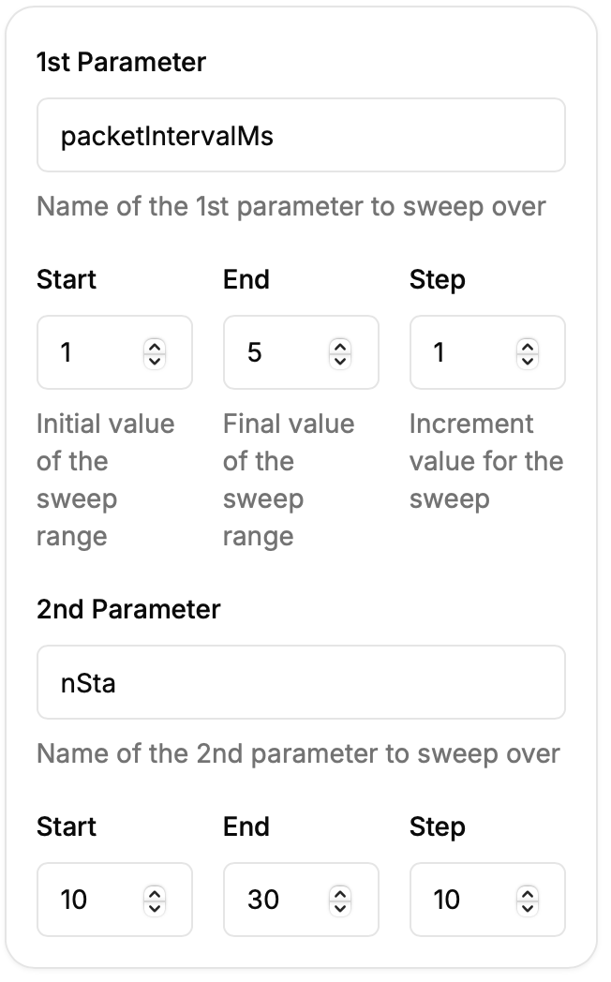
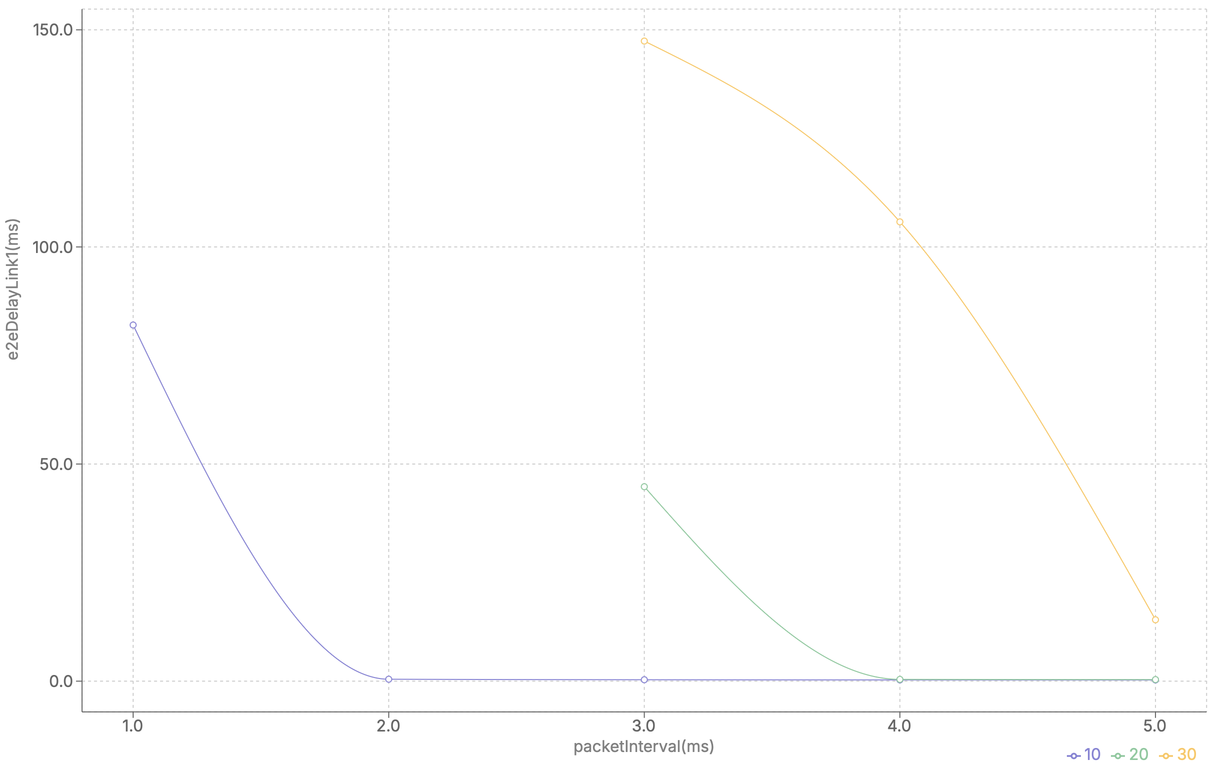
Wi-Fi MAC transmission statistics helper
How to use (multi link, multi STA scenario)
  Command line settings & result visualization (link 1) in web-ns3

Slide 14
Wi-Fi MAC transmission statistics helper
Current limitations
  Under saturated traffic conditions, memory usage can be high
    Shorten simulation time to reduce memory load
  No advanced data processing for delay statistics, e.g., delay CDF, percentiles, etc
    Implement using e.g. Python’s numpy

Slide 15
Wi-Fi MAC transmission statistics helper
Summary
  Provides a convenient way in Wi-Fi simulation to collect:
    per-MPDU information (key timestamps, link usage)
    per-node/device/link packet statistics (success/failure/retransmission counts)
  Detailed documentation available in both ns-3 model library (https://www.nsnam.org/docs/models/html/wifi-user.html#wifitxstatshelper) & source code (src/wifi/helper/wifi-tx-stats-helper.h)

Slide 16
Wi-Fi MAC transmission statistics helper
Backup

Slide 17
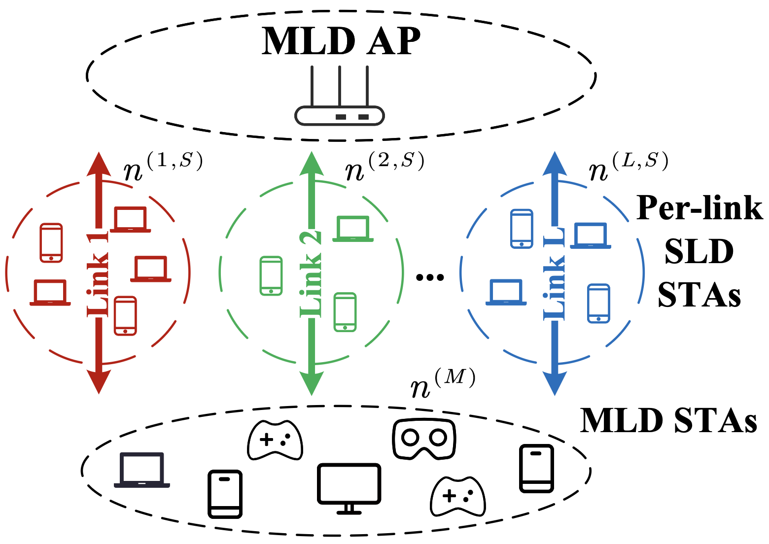
(Backup) Wi-Fi MAC transmission statistics helper
Example usage
  Scenario: a Wi-Fi 7 network, some STAs use multiple links (two in the simulation), i.e., multi-link devices (MLDs), others use only single link, i.e., single-link devices (SLDs)
Reference: Y. Gao, M. Shen, Y. Zou, H. Yin and S. Roy, "Latency Optimal Traffic-to-Link Allocation for MLO/SLO Coexistence in Wi-Fi 7," in IEEE Journal on Selected Areas in Communications, doi: 10.1109/JSAC.2025.3584497.

Slide 18
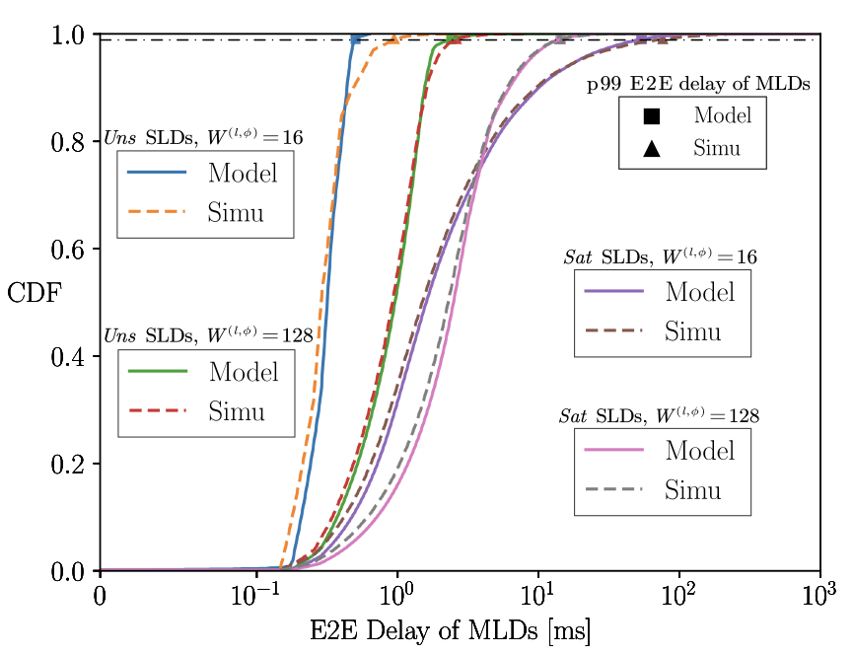
(Backup) Wi-Fi MAC transmission statistics helper
Example usage
  Performance metric #1: delay CDF of MLDs
    Step 1: get successful MPDU details using GetSuccessRecords()
    Step 2: iterate through the record and get (dequeue time - enqueue time) for each successful MPDU
    Step 3: calculate the CDF
Reference: Y. Gao, M. Shen, Y. Zou, H. Yin and S. Roy, "Latency Optimal Traffic-to-Link Allocation for MLO/SLO Coexistence in Wi-Fi 7," in IEEE Journal on Selected Areas in Communications, doi: 10.1109/JSAC.2025.3584497.

Slide 19
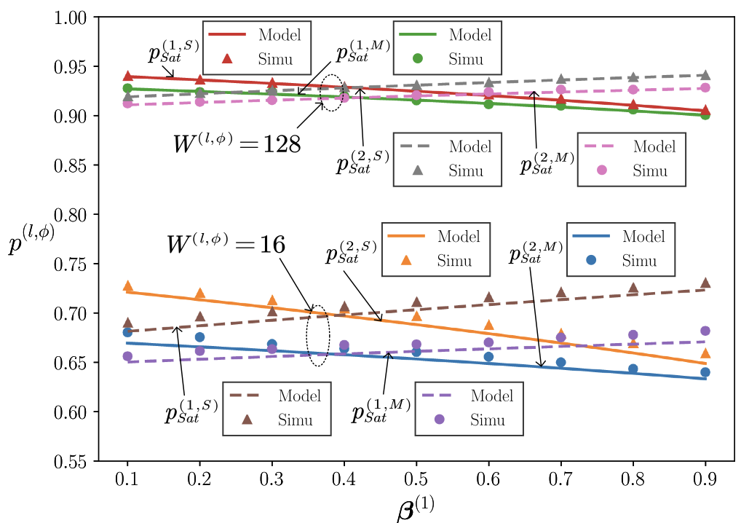
(Backup) Wi-Fi MAC transmission statistics helper
Example usage
  Performance metric #2: successful TX probability of MLDs versus traffic allocation probability on link 1 (link 1 + link 2 = 1)
    Step 1: get per STA successes using GetSuccessesByNodeDevice(), and get per STA failures using GetFailuresByNodeDevice()
    Step 2: calculate success probabilty
Reference: Y. Gao, M. Shen, Y. Zou, H. Yin and S. Roy, "Latency Optimal Traffic-to-Link Allocation for MLO/SLO Coexistence in Wi-Fi 7," in IEEE Journal on Selected Areas in Communications, doi: 10.1109/JSAC.2025.3584497.

Slide 20
II. Fine timing measurement (FTM) module
Motivation
  FTM is a key feature for Wi-Fi localization based on round-trip time (RTT) measurements between STA and APs
  In IEEE 802.11mc, STA’s measurements can be made concurrently with multiple APs (i.e., setup multiple FTM sessions at the same time). However this is not implemented in the previous module (https://github.com/tkn-tub/wifi-ftm-ns3)
  We extend the FTM module (https://gitlab.com/uw-ns3-research/ns-3-dev/-/tree/ftm-dev?ref_type=heads) to support concurrent FTM sessions

Slide 21
Fine timing measurement (FTM) module
Wi-Fi localization overview
  802.11mc (original FTM) → 802.11-2016
    Bandwidth: up to 80 MHz (802.11ac)
    Ranging accuracy: 1 - 2 m
  802.11az (Next Gen Positioning) → 802.11-2024
    Bandwidth: up to 160 MHz (802.11ax)
    Ranging accuracy: < 1 m
    MU-MIMO (DL, UL) support
    Improved security
  802.11bk: nearly complete
    Bandwidth: up to 320 MHz (802.11be)
    Ranging accuracy: < 0.1 m

Slide 22
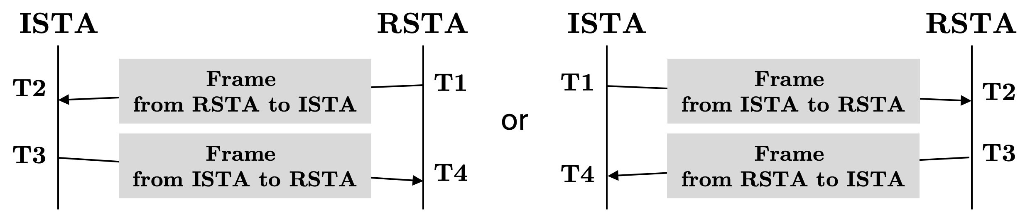
Fine timing measurement (FTM) module
FTM localization mechanism
  Measures the round-trip time (RTT) measurement between initiating STA (ISTA) and responding STA (RSTA)
  Require high timing accuracy and synchronization
ToD (T1 and T3): time of departure
ToA (T2 and T4): time of arrival
RTT: (T4 - T3) + (T2 - T1)

Slide 23
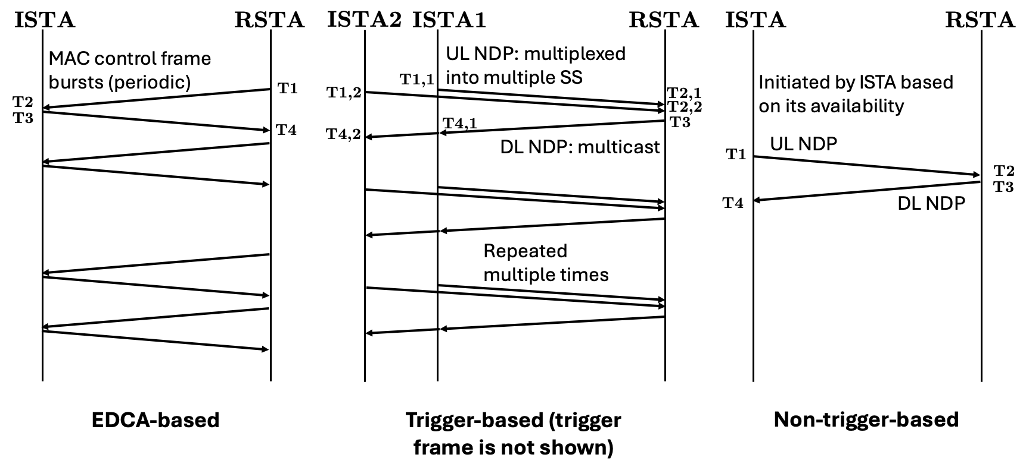
Fine timing measurement (FTM) module
Variants of RTT measurement procedure:
  EDCA-based (in both 11mc and 11az)
  Trigger-based (11az only)
  Non-trigger-based (11az only)
Comparison
NDP = null data PPDU
Easy to implement (only require MAC layer change)
Increased spectral efficiency; better scalability
Better flexibility; avoid scheduling conflicts
Reference: Next Generation Wi-Fi Positioning: An overview of IEEE 802.11az by Christian Berger and Jonathan Segev
https://www.computer.org/csdl/video-library/video/1UXPYs1JCrS

Slide 24
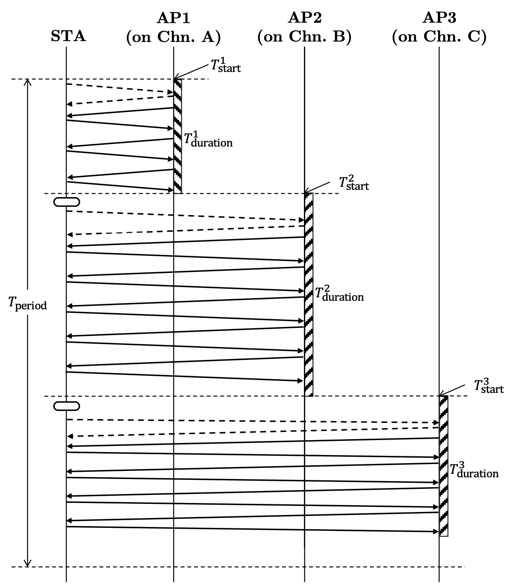
Fine timing measurement (FTM) module
Concurrent FTM sessions
  Different FTM sessions can overlap by scheduling their burst durations back-to-back

Slide 25
Fine timing measurement (FTM) module
ns3::FtmSession (one instance per session)
Design of ns-3 FTM module
Update timestamps
Schedule FTM frames
ns3::WifiMac
Rx FTM Req, decode
ns3::FtmManager (one instance per STA)
ns3::FtmSession (one instance per session)
Rx FTM, decode
Rx Ack, update counter
Existing modules in ns-3
…
ns3::FtmSession (one instance per session)
ns3::WifiPhy
PPDU Tx begin (ToD)
Consult and update scheduled burst durations
PPDU Rx Preamble detect begin (ToA)
ns3::FtmBurstScheduler
(ISTA only; keep track of FTM burst durations)

Slide 26
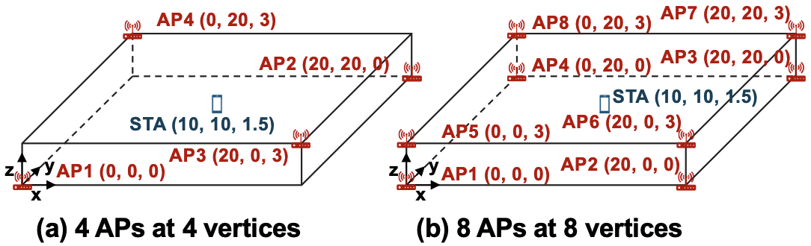
Fine timing measurement (FTM) module
Simulation scenario
  Two indoor wireless office scenarios
  All APs are RSTAs; ISTA is located at the center of box.
  Theoretically (b) has better accuracy due to its geometry
Each scenario can use 40/80 MHz bandwidth
Different measurement time (number of bursts) are tested
Reference: Muyuan Shen, Hao Yin, and Sumit Roy, "Wi-Fi Fine Timing Measurement in Action: Simulation of Performance Trade-Offs in Real-World Scenario," submitted to IEEE GLOBECOM 2025.

Slide 27
Fine timing measurement (FTM) module
Simulation results
  Accuracy vs. measurement time
Theoretical and simulated results align closely
DE decreases as measurement time increases, approaching theoretical limits
Increasing bandwidth (40 MHz → 80 MHz) significantly improves accuracy
Topology with more APs and lower GDOP (scenario b) achieves better accuracy
Reference: Muyuan Shen, Hao Yin, and Sumit Roy, "Wi-Fi Fine Timing Measurement in Action: Simulation of Performance Trade-Offs in Real-World Scenario," submitted to IEEE GLOBECOM 2025.

Slide 28
Fine timing measurement (FTM) module
Simulation results
  Accuracy vs. SNR
Localization accuracy improves with higher SNR
Doubling bandwidth (40 MHz → 80 MHz) consistently provides better accuracy
Scenario b (more APs, lower GDOP) achieves better accuracy
A 3 dB SNR drop nearly doubles DE
Reference: Muyuan Shen, Hao Yin, and Sumit Roy, "Wi-Fi Fine Timing Measurement in Action: Simulation of Performance Trade-Offs in Real-World Scenario," submitted to IEEE GLOBECOM 2025.

Slide 29
Fine timing measurement (FTM) module
Summary
  We updated the pervious FTM module to support concurrent FTM sessions
  We validated the localization results with our analytical model
  Source code available (https://gitlab.com/uw-ns3-research/ns-3-dev/-/tree/ftm-dev?ref_type=heads)

Slide 30
(Backup) FTM glossary
Symbol | Name | Meaning
n_{FTM,max} | FTMs per burst | Maximum number of FTM allowed to be sent (MAC enqueued) per burst
T_{duration} | Burst duration | The duration (i.e. time window in the MAC layer) of a burst
∆_{FTM,min} | Min delta FTM | Minimum interval between two FTM MAC enqueues
k | Number of bursts exponential | Two’s exponent of the number of FTM bursts in a session
T_{period} | Burst period | Time interval between the start (FTMR enqueue) of two bursts
n_{AP} | Number of APs | The number of responding STAs

Slide 31
(Backup) FTM protocol (1)
Parameters related to single FTM burst:
Symbol | Name | Meaning
n_{FTM,max} | FTMs per burst | Maximum number of FTM allowed to be sent (MAC enqueued) per burst
T_{duration} | Burst duration | The duration (i.e. time window in the MAC layer) of a burst
∆_{FTM,min} | Min delta FTM | Minimum interval between two FTM MAC enqueues
Example (n_{FTM,max}=3, T_{duration}=8ms, ∆_{FTM,min}=100us):
FTMR
enqueue
Random backoff of FTMR/FTM frames (AC: voice by default)
STA
FTMR
Ack
Ack
Ack
S
I
F
S
S
I
F
S
A
I
F
S
S
I
F
S
A
I
F
S
S
I
F
S
AP
Ack
FTM1
FTM2
FTM3
100us
100us
FTM1 enqueue
FTM2 enqueue
FTM3 enqueue
8ms

Slide 32
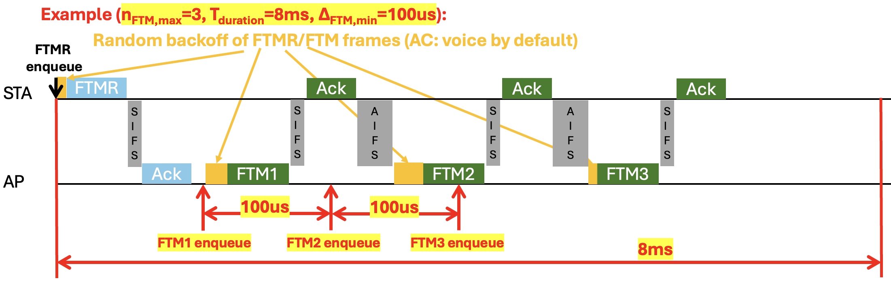
(Backup) FTM protocol (2)
Parameters related to multiple FTM burst:
Symbol | Name | Meaning
k | Number of bursts exponential | Two’s exponent of the number of FTM bursts in a session
T_{period} | Burst period | Time interval between the start (FTMR enqueue) of two bursts
Example (k=2 (i.e. 2²=4 bursts), T_{period}=100ms):
burst #1
burst #2
burst #3
burst #4
STA
8ms
8ms
8ms
8ms
AP
100ms
100ms
100ms

Slide 33
(Backup) FTM protocol (3)
Parameters related to concurrent FTM sessions:
Symbol | Name | Meaning
n_{AP} | Number of APs | The number of responding STAs
Example (nAP=4):
burst #1
w/ AP1
burst #1
w/ AP2
burst #1
w/ AP3
burst #1
w/ AP4
burst #2
w/ AP1
burst #2
w/ AP2
burst #2
w/ AP3
burst #2
w/ AP4
burst #3
w/ AP1
burst #3
w/ AP2
burst #3
w/ AP3
burst #3
w/ AP4
burst #4
w/ AP1
burst #4
w/ AP2
burst #4
w/ AP3
burst #4
w/ AP4
STA
8ms
8ms
8ms
8ms
8ms
8ms
8ms
8ms
8ms
8ms
8ms
8ms
8ms
8ms
8ms
8ms
AP1
100ms
100ms
100ms
AP2
AP3
AP4

Slide 34
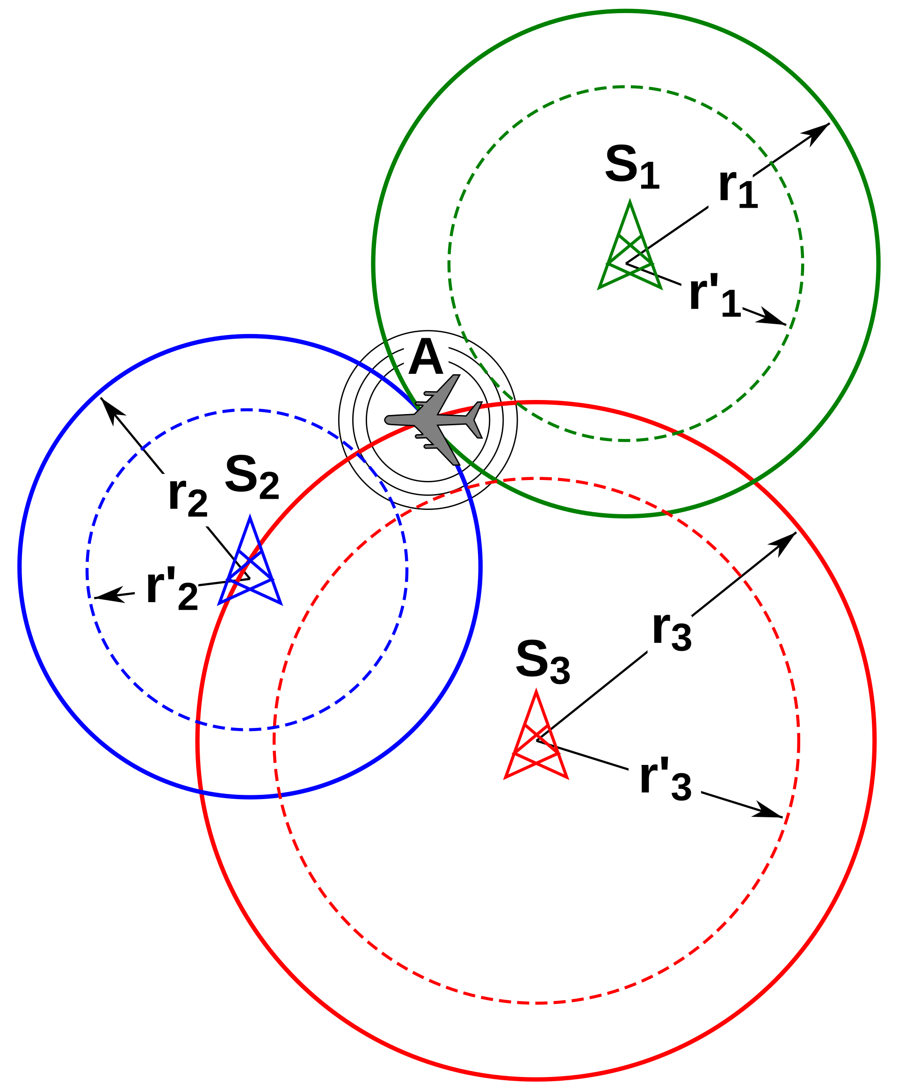
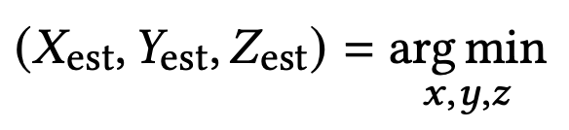
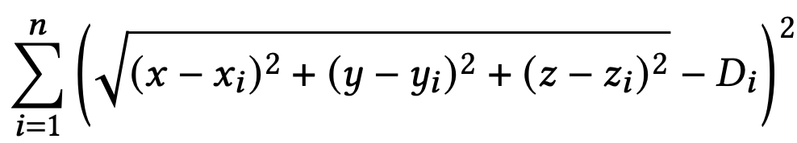
(Backup) Fine timing measurement (FTM) module
Multilateration: calculate location of ISTA in 3-D using non-linear least squares (NLLS) algorithm
  Input: True coordinates of RSTAs, measured distances
  Output: estimated coordinates of ISTAs
  Example algorithms
    Nelder-Mead
    Levenberg–Marquardt

Slide 35




(Backup) Fine timing measurement (FTM) module
Modeling time-of-arrival (ToA) error
  We assume AWGN channel under LOS condition
    → lower bound of Var(ToA error) is inversely proportional to bandwidth² and SNR².
ToA error is modeled as (symmetrically truncated) Gaussian:
Based on experiment:
Source code: https://gitlab.com/uw-ns3-research/ns-3-dev/-/tree/ftm-dev?ref_type=heads

Slide 36
III. Web-NS3

Slide 37
Network Simulations LLC Overview
Who are we?: A start-up company founded by Dr. Jing Zhu to advance network simulation technology through the provision of Network Simulation-as-a-Service (NSaaS). By leveraging open-source software such as ns-3 and NetworkGym, we aim to democratize access to high-fidelity network simulations, fostering innovation and collaboration within the industry and academia.
Mission Statement: To provide cutting-edge network simulation services that empower researchers, developers, and enterprises to design, test, and optimize next-generation networks. We strive to create a collaborative environment where open-source solutions drive technological advancements and industry growth.
Vision: To become the leading provider of network simulation services, enabling seamless integration of diverse wireless technologies and fostering an ecosystem of innovation and excellence in network design and optimization.
Empowering Network Design and Optimization with Simulation and AI

Slide 38
Motivation: Rethinking Network Simulation for Next-G
The Challenge: Simulation is a Bottleneck for Innovation
  Wireless networks are becoming increasingly complex
    Densification, diverse traffic (e.g., URLLC), mMIMO, multi-radio integration (e.g., Wi-Fi + Satellite)
    Rapid evolution at PHY/MAC layers (L1–L2)
    Industry relies heavily on at-scale network simulation for design & evaluation
  Emerging need to apply Software-Defined Networking (SDN) principles to decouple control intelligence from protocol stacks
    Enabling AI/ML in-the-loop simulation and rapid algorithm testing
Current options are inadequate
  Proprietary tools restrict reproducibility, hinder cross-layer/function experimentation, and make it difficult to leverage collaborative research and development
  Open-source simulators (e.g., ns-3) are powerful but require significant coding effort and complex setup
  Standalone installations limit access to computing resources and do not scale with increasing simulation complexity

Slide 39
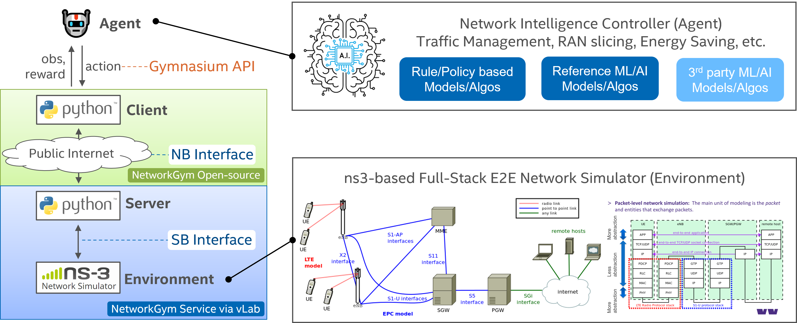
Opportunity: Modernizing NS-3 with Cloud + AI/ML
Combine NS-3 with Cloud-based scalability, Intuitive web interfaces, AI/ML in-the-loop
Leverage existing efforts
  NSF-supported ns-3 (UW-led, CNS2016379): https://www.nsnam.org/
    Widely used by academia, government, and industry for network protocol R&D
    Supports detailed simulation of IP-based networks, including Wi-Fi, LTE/5G, and satellite
    Written in C++ with Python bindings for scripting and configuration
  NetworkGym: https://netsim-llc.github.io/networkgym/
    JSON-config driven simulator abstraction
    OpenAI Gym API integration for seamless AI/ML experimentation
Cloud-based Network Simulation as a Service (NSaaS) to Enable Accessible, Scalable, and User-Friendly Network Simulation Workflows

Slide 40
Web-NS3: Cloud-Based Network Simulation as a Service
What is Web-NS3? A modern, cloud-hosted simulation platform that integrates the power of ns-3 with intuitive web-based interfaces and AI/ML-ready workflows, enabling rapid prototyping and scalable experimentation for Next-G wireless networks.
Key Features:
  No installation required: Run simulations directly in the browser
  User-friendly interface: Configure and launch complex network scenarios via “Example”
  Cloud scalability: Run multiple simulations in parallel on dedicated servers
  Data Visualization: Visualize metrics like throughput, latency, packet loss, etc.
  JupyterLab: Perform post-simulation data processing and visualization using Python notebooks
  ns-3 App Store: Access a curated library of specialized ns-3 builds for emerging use cases (e.g., O-RAN, Satellite, 5G/V2X, etc.), including forks not yet merged into the official mainline
Web-NS3: ns3.netsimsolutions.com

Slide 41
Web-NS3 NSaaS WorkFlow
Step 1: Select from the list of specialized ns-3 builds if needed
Step 2: Create a new Simulation scenario via example or file upload
Step 3: Edit the simulation script & runtime arguments (if needed), upload any supporting data or lib files
Step 4: Run Simulation
Step 7: Download output files for post-simulation data processing with Jupyterlab or other tools
Step 6: Create 2-D Graphs from the CSV or TSV formatted output files
Step 5: Monitor the simulation progress and terminal output

Slide 42
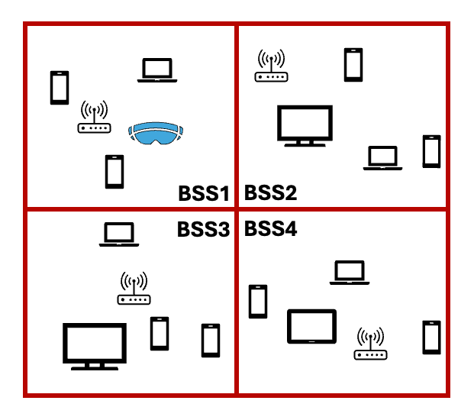
AI-in-the-loop demo with Web-ns3
Purpose: demonstrate the pipeline and visualization of NetworkGym
VR gaming scenario
  Multiple BSS in building w/ TGax path loss
  OBSS_PD not used
  VR device in BSS1: UL burst traffic
  Other devices: UL CBR traffic
Use Deep Reinforcement Learning (DRL) to select CCA_PD for BSS1
  Meet VR delay & throughput requirements
  Meet sum throughput requirement

Slide 43
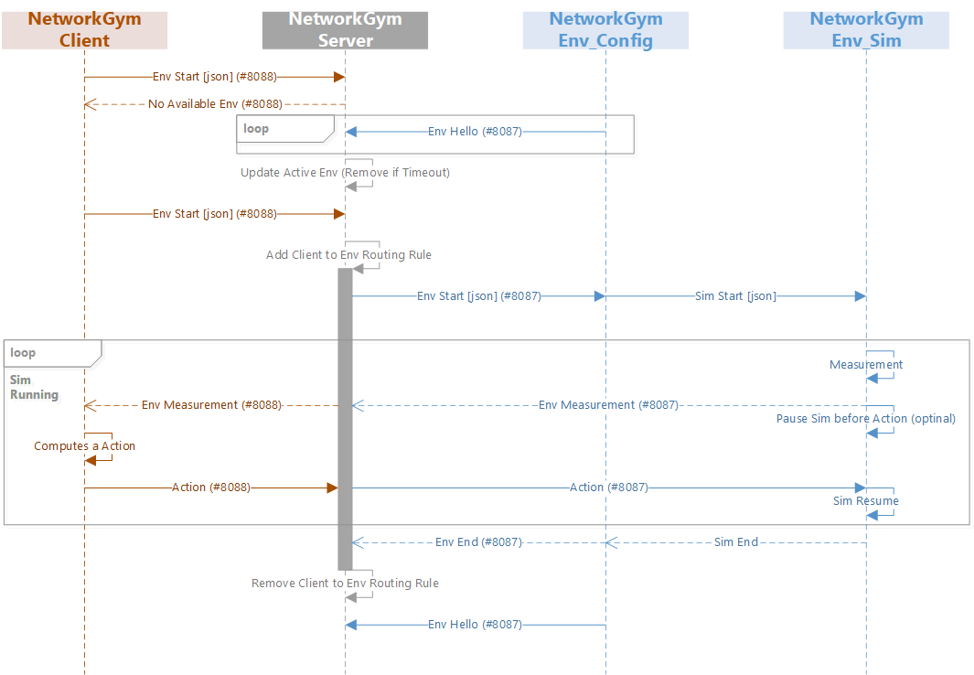
Frame exchange diagram
ns-3 scheduled measurements
AI agent
ns-3 action callbacks

Slide 44
RL parameters
State
  RX power of each node in BSS1 from each other node
  MCS of each node in BSS1
Reward: a function of VR delay, VR thpt & sum thpt
Action: new CCA_PD value (dBm) for BSS1
These will be visualized for each time step in the following demo.
  Algorithm is not tuned, so the performance metrics are for reference only.
For detailed parameters, see README at https://github.com/hust-diangroup/ns3-ai/tree/main/examples/multi-bss

Slide 45
Demo steps
Source code & instruction available (https://github.com/ShenMuyuan/networkgym)
Open 3 terminals with Python environment
Run dashboard, simulation, and client:
  (first terminal) python start_server.py
    This contains the dashboard
  (second terminal) python start_env_ns3_multibss.py
    This shows some ns-3 simulation logs
  (third terminal) python start_client_multibss.py
    This contains the visualization

Slide 46
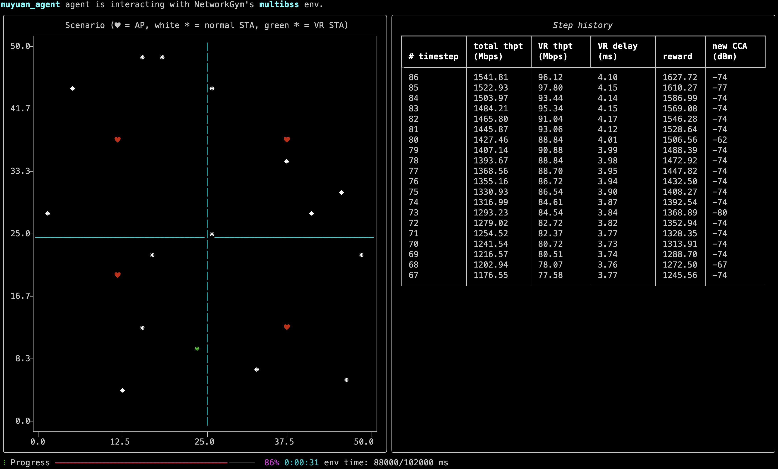
Example screenshot
Visualization of node locations
Training history
Progress bar

Slide 47
Resources & examples
NetworkGym (original Intel repo with a visualized GMA example): https://github.com/IntelLabs/networkgym
  Comprehensive visualization of network topologies
  Some documentation included
  Some code may be outdated (compatible with ns-3.41)
NetworkGym (Muyuan’s fork, contains A-plus-B, Thompson sampling, and Multi-BSS examples): https://github.com/ShenMuyuan/networkgym
  Compatible with latest release, ns-3.45
ns-3: https://www.nsnam.org
ns3-ai (contains original examples of A-plus-B, Thompson sampling, and Multi-BSS): https://github.com/hust-diangroup/ns3-ai
  With detailed documents
  For running simulation + AI locally

Slide 48
(Backup) Basic teaching example
A Plus B: teaching example of observation/action exchange between ns-3 and AI agent
  ns-3: generate 2 random integers (observations) per timestep
  Python: calculate the sum (action) per timestep
Providing the boilerplate to add custom algorithms and simulations

Slide 49
(Backup) Demo steps
Source code & instruction available (https://github.com/ShenMuyuan/networkgym)
Open 3 terminals with Python environment
Run dashboard, simulation, and client:
  (middle terminal) python start_server.py
  (right terminal) python start_env_ns3_apb.py
  (left terminal) python start_client_apb.py
Two numbers (observations) and sum (action) are displayed on the right → verifying that the action is passed into C++ on each timestep
Progress bar on the left

Slide 50
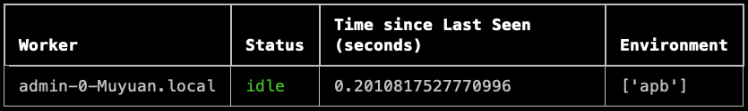
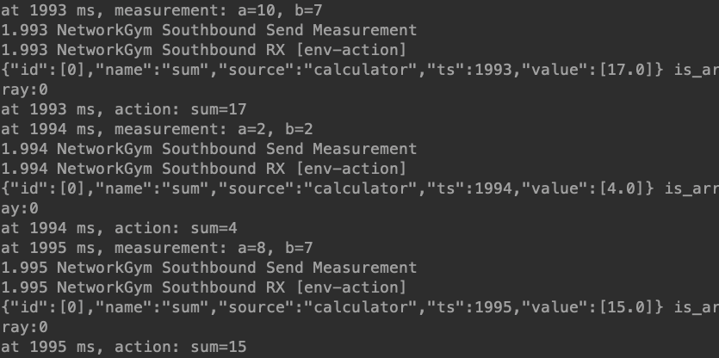
(Backup) Example screenshot
Client
Dashboard
Simulation

