Slide 1
MAPC Security guidelines
Date: 21 July 2025
Authors:
Name | Affiliations | Address | Phone | email
Michael Montemurro | Huawei | Toronto, Canada |  | Montemurro.Michael@gmail.com
Arik Klein | Huawei TRC |  |  | arik.klein@huawei.com

Slide 2
MAPC Agreement establishment process
MAPC agreements are established between OBSS AP peers:
  An AP discovers an AP peer by matching the MAPC ID
  similar concept to SSID / Mesh ID used for scanning
OBSS APs need to discover each other (to determine that a MAPC agreement can be established)
  MAPC ID can be used by an AP to determine whether it can establish a MAPC agreement with a peer.
  The one or more MAPC ID values needs to be provisioned on an AP that supports MAPC operation (presumably by an administrator)
  A Wildcard MAPC ID can be defined to establish a MAPC agreement with an OBSS AP with implicit trust (i.e. No AP group provisioning required)
TGbn have agreed on using a MAPC Discovery Request/Response frames for MAPC discovery

Slide 3
Trust between MAPC APs
When AP peers establish an agreement they first need to establish some sort of trust relationship:
  Mutual authentication could be explicit authentication i.e. the OBSS APs that support MAPC operation are provisioned with a credential (in addition to the MAPC ID).
  Mutual authentication could be implicit authentication – An AP trusts any OBSS AP that supports MAPC operation and is provisioned with the MAPC ID.
Credentials could be:
  A password
  A certificate
Note that there are no privacy requirements for MAPC agreements.

Slide 4
802.11 authentication for MAPC
802.11 authentication procedure is used to establish such a trust relationship.
802.11 authentication (with respect to changes made by TGbi) provides a means to establish trust:
  Password – SAE authentication
  Certificates – 802.1X EAP authentication, cached PMKID
  Implicit trust – PASN
802.11bn should be able to use existing 802.11 various authentication protocols for MAPC agreements

Slide 5
Authentication frames and MAPC
APs that negotiated a MAPC agreement also operate an infrastructure BSS.
The connection between peer APs in establishing a MAPC agreement is different from an infrastructure connection.
  MAPC is discovered independently
  The authentication for the purpose of a MAPC agreement needs to be independent of an infrastructure connection – it needs to be clear that authentication for MAPC is distinct from joining a STA the BSS or establishing a pre-association connection
To address these requirements, the authentication protocol should be carried over MAPC Negotiation Request/Response frames.

Slide 6
MAPC agreement establishment
MAPC agreements are established through the exchange of Public Action frames – namely: MAPC Negotiation Request/Response frames.
It would be more efficient from a communications point of view to use these frames to carry the authentication information.
TGbn can leverage existing Authentication frame fields/elements to embed the authentication protocol in the MAPC Negotiation Request/Response.
Advantages of this approach:
  Minimal (or no) security changes for TGbn with respect to MAPC agreements
  Minimizes the number of frame exchanges to establish a MAPC agreement
  Give flexibility to an administrator on how they want to deploy MAPC operation

Slide 7
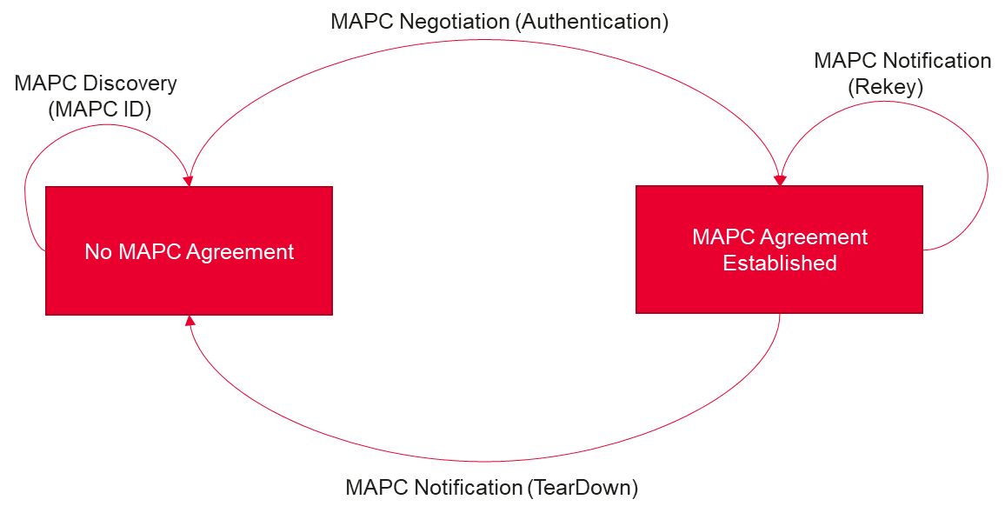
MAPC agreement establishment – state machine

Slide 8
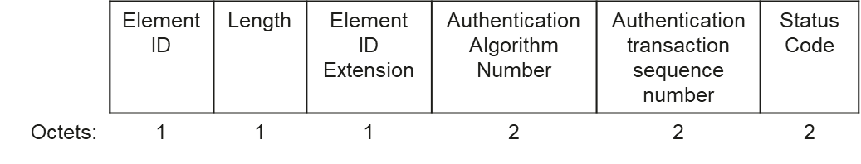
MAPC agreement establishment – more details
MAPC Element Extensions
  MAPC Control field extension
    Add MAPC ID Present field
    Add Authentication container Present field
  MAPC Common Info extension
    Add MAPC ID field (2 octets)
  MAPC Schemes Info extension
    Add MAPC authentication subelement
    The MAPC authentication subelement will include at least:
      Add RSNE, ESNXE fields
      Add Authentication Container element
      Parameters per AA number
    Detailed format – TBD.

Slide 9


MAPC Key derivation
PTK will be derived to protect the management frames between OBSS APs
  During MAPC Negotiation procedure
  During MAPC Parameters update
  During MAPC Rekey procedure
PTK derivation for explicit authentication (SAE, 802.1X, PMKSA) – using 4-way handshake procedure
PTK derivation for implicit authentication (PASN) – using DHss

Slide 10
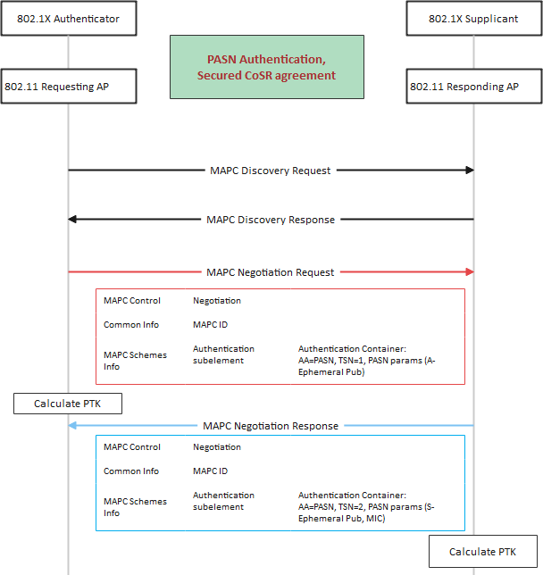
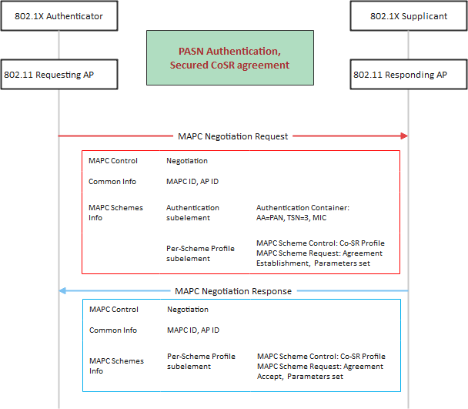
MAPC Security procedure – Example 1

Slide 11
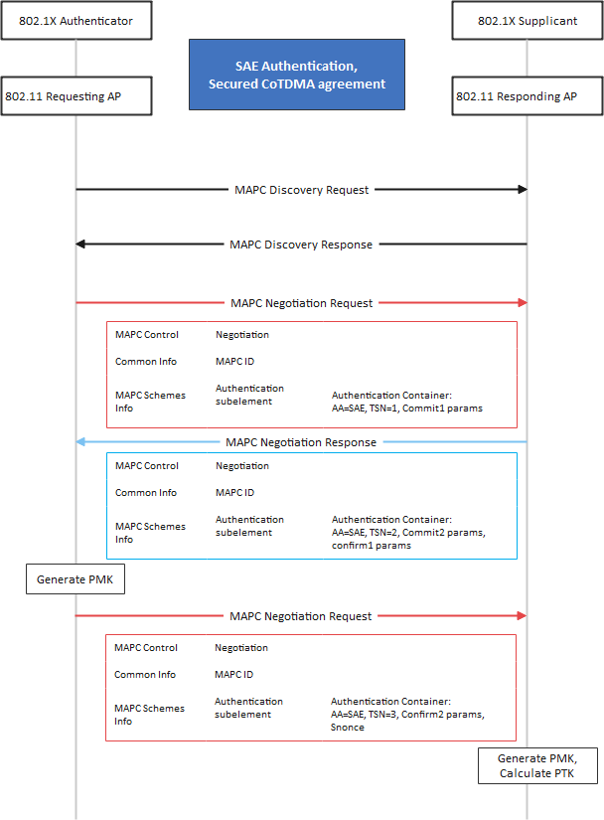
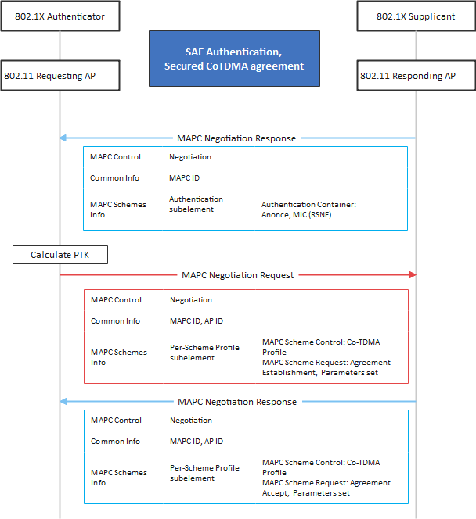
MAPC Security procedure – Example 2

