Slide 1
Dynamic Unavailability Announcement Threshold
Date: 2025-07-15
Authors:

Slide 2
Introduction
Motion #355 introduced the MaxStandaloneDuoBSRP threshold that is indicated by AP in a DUO parameter set to determine the maximum number of unsolicited unavailability announcements per Beacon Interval that can be sent by a non-AP STA as a TXOP holder when transmitted without a QoS data packet.
Move to add to the TGbn SFD the following:
Do you agree to the following conditions for transmitting unsolicited unavailability indications that can be sent by a non-AP as a TXOP holder in a BSRP GI3 trigger frame:
  No restriction when sent with QoS data transmitted in the TXOP
  When sent without QoS data transmitted in the TXOP, not more than MaxStandaloneDuoBSRP number of times every beacon interval where MaxStandaloneDuoBSRP is a non-zero value and part of the DUO parameter set indicated by the AP
  Note: BSRP GI3 Trigger frame is a BSRP Trigger frame that solicits an M-BA response that is carried in non-HT (dup) PPDU format

Slide 3
Existing Proposal/SP on Threshold value
MaxStandaloneDUOBSRP is specified in a 4-bit field:
The default value of MaxStandaloneDUOBSRP, for every interval of 100 TUs, is 20, and the field is not present when the AP selects the default value;
When the field value is in the range of [0, 14], it indicates, for every interval of 100 TUs, MaxStandaloneDUOBSPR is equal to the field value (i.e., [0, 14]) plus 15;
When the field value is equal to 15, it indicates the AP has no limit for MaxStandaloneDUOBSRP.
Existing proposal provides a way to define a default value of 20, minimum threshold value of 15 for MaxStandaloneDUOBSRP.
Pros: Provides a method to indicate a minimum 15 as the preferred threshold value at a non-AP STA
Cons:
  The value may be too high for all DUO Assisting APs to support.
  The minimum value of 15 being hardcoded may not be suitable for a wide range of non-AP STAs.
  There is no way for the AP to reduce the minimum threshold required by a non-AP STA
  There is no way to customize the MaxStandaloneDUOBSRP suitable to non-AP STA and/or AP
  There is no way a non-AP STA can update its minimum preferred threshold count

Slide 4

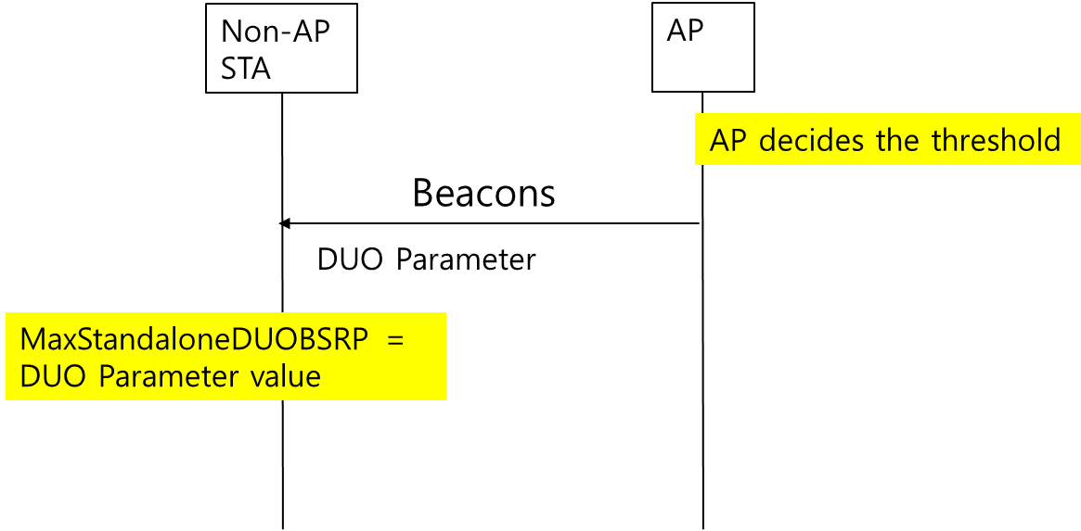
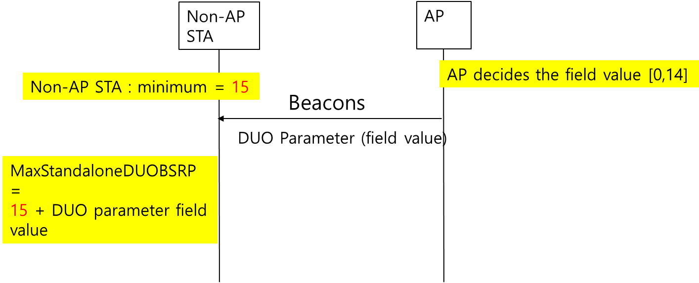
Problem Statement
Prone to more
interrupts
Mid-end
Smartphone
TV
Medium interrupts
Prone to more
interrupts
VR
Laptop
High end
Smartphone
Lesser interrupts
Lesser interrupts
Option 1: Draft 0.3 : Current status
In both current Draft 0.3 and some of the existing proposals, there are limitations to setting the threshold value of MaxStandaloneDUOBSRP as per said proposals.
Limitations include not providing a flexible enough framework suitable for wide range of devices in order to reduce complexity and in doing so can reduce impact and usage of feature.
While the aim of specification ideally should be:
  Provide a flexible framework for a wide range of devices to implement and use the feature.
  Reduce complexity in implementation.
  Encourage feature usage and deployment
Option 2: Existing proposal

Slide 5
Proposal
Non-AP STA sets a preferred DUO Threshold Count and indicates to AP
  Options: (Re)Association/Probe Request/ Gen Enablement/Update
AP evaluates it’s own requirements and constraints – decides to set an individual or common value and indicates to non-AP STA
  Options: (Re)Association/Probe Response/ Gen Enablement/ Update
  Custom / Individual Value: AP has flexibility to reduce or increase the minimum DUO Threshold Count preferred by the non-AP STA.
  Common / Broadcast Value: AP determines and overrides all non-AP STA preference.
AP can also broadcast the common value when chosen, in Beacons

Slide 6
DUO Threshold Count Preference – Non-AP STA
UHR Mode Change element
9.4.2.X.3 Mode Specific Parameters for DUO
When the value of the Mode ID field is 2,
— the Mode Tuple field corresponds to DUO, and
— the Mode Specific Control field is reserved, and
— the Mode Specific Parameters field is defined as below
The DUO Threshold count field for a non-AP STA includes a 4 bit indicator of the minimum threshold value that a non-AP STA prefers. The value is from 5 to 15.
The value 0 indicates that the non-AP STA has no preference.
The DUO Threshold count can be included during DUO Enable or when a non-AP STA wants to update the DUO Threshold count value based on it’s specific needs.
 | Element ID | Length | Element ID Extension | Mode Tuple List
Octets: | 1 | 1 | 1 | variable
 | B0 B5 | B6 | B7 | B8 B11 | B12 B15 | variable
 | Mode ID | Mode Enable | Mode Update | Mode Length | Mode Specific Control | Mode Specific Parameters
Bits: | 6 | 1 | 1 | 4 | 4 | variable
 | B0 B3 | B4 B7
 | DUO Threshold count | Reserved
Bits: | 4 | 4

Slide 7
Proposal: DUO Threshold parameter
The DUO Threshold parameter field for an AP includes the following
  Individual field : A 1 bit indicator that indicates that the AP supports custom value and the AP field value is to be updated over the minimum threshold count the non-AP STA prefers as MaxStandaloneDUOBSRP.
  If the Individual field is set to 0- the AP field value is the actual MaxStandaloneDUOBSRP and non-AP STA needs to use this directly.
  The AP field value is encoded as below:
    If Individual field is set to 1:
        If (B1 of AP field value is set to 0)
          MaxStandaloneDUOBSRP = DUO Threshold count (from non-AP STA) + AP field value (B2 to B6)
          Note: Value of MaxStandaloneDUOBSRP < 30
        Else (B1 of AP field value is set to 1)
          MaxStandaloneDUOBSRP = DUO Threshold count (from non-AP STA) – AP Field value (B2 to B6)
          Note: Value of MaxStandaloneDUOBSRP > = 5
    If Individual field is set to 0:
    MaxStandaloneDUOBSRP = AP field value (B1 to B6)
  In (Re)Association / Probe Response/ DUO update response non-AP STA specific values can be supported.
  In Beacons, when the Individual field is set to 1, AP Field value is reserved.
    When the Individual field is set to 0, 5 bits in AP field value indicates the MaxStandaloneDUOBSRP value to be used by all the non-AP STA(s)
UHR Parameters Update element
 | Element ID | Length | Element ID Extension | Countdown Timer | Mode Tuple List
Octets: | 1 | 1 | 1 | 1 | variable
 | B0 B5 | B6 | B7 | B8 B15 | variable
 | Mode ID | Mode Enable | Mode Update | Mode Length | Mode Specific Parameters
Bits: | 6 | 1 | 1 | 8 | variable
MaxStandaloneDUOBSRP | Reserved
 | B0 | B1 B6 | B7
 | Individual | AP field value | Reserved
Bits: | 1 | 5 | 1

Slide 8
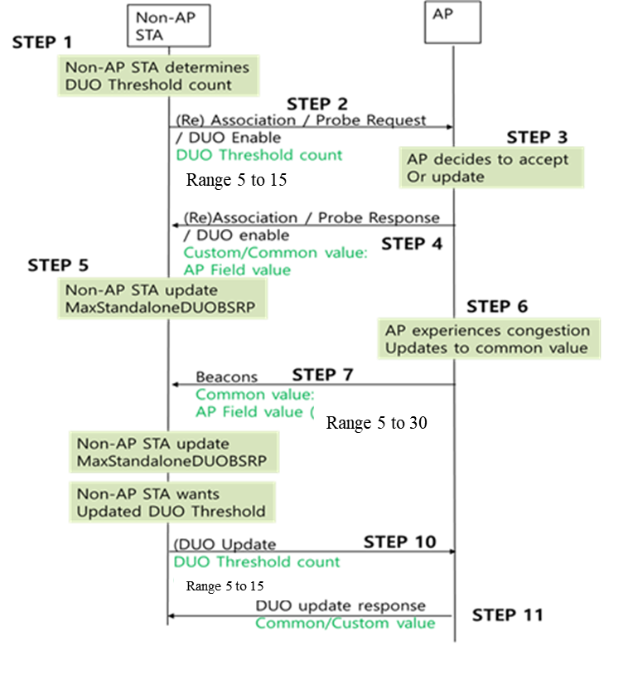
Illustration

Slide 9
Straw poll 1
Do you support that a non-AP STA can indicate it’s preferred minimum threshold for MaxStandaloneDUOBSRP?
  Non-AP STA(s) can indicate DUO Threshold Count in (Re)Association/Probe/Gen. Enablement/Update frame
  When non-AP STA sends value 0, it indicates that it has no preference.
  Non-AP STA shall not send it’s preferred threshold when Beacon is broadcasting MaxStandaloneDUOBSRP

Slide 10
Straw Poll 2
Do you support that AP may indicate value required to derive MaxStandaloneDUOBSRP threshold?
  Beacon indicates common value, 5 bits indicates the MaxStandaloneDUOBSRP (5>=Range <30)
  When Beacon does not include MaxStandaloneDUOBSRP
    Options : (Re)Association/Probe Response/ Generic Enablement/Update Response
      MaxStandaloneDUOBSRP is specified in a 6-bit field
      An Individual bit B0 can be set by an AP to indicate if it supports an individual value per non-AP STA or supports a common value in the entire BSS.
      In the remaining 5 bits of AP field value (B1 to B6):
        Bit B1 indicates if AP intends to increase or reduce the non-AP STA's preferred minimum threshold
        Bit B2 to B6: When the field value is in the range of [0, 14], it indicates, for every Beacon interval, MaxStandaloneDUOBSPR is equal to the field value (i.e., [0, 14]) plus or (minus) a DUO Threshold count;

Slide 11
Reference
[1] Draft P802.11bn_D1.0

