Slide 1
[Discussion on Power Save Mode & Capabilities Management]
Date: 2025-01-08
Authors:

Slide 2
Introduction
Contributions in 802.11bn discuss many power save features for AP and STA like below:
Dynamic Power Save : Defines that a STA that is a UHR Mobile AP or a UHR non-AP STA wherein the STA may transition from a lower capability mode to a higher capability mode upon reception of an initial control frame. [1]
Scheduled AP Power Save: Defines AP Power Save mechanism through adjustment of the AP’s schedule & capability in periodic intervals [2][3]
Cross Link Power Save: Defines allowing a signalling mechanism to indicate the power management mode of other affiliated links on one enabled link [4]. Alternatively, for an AP an active state can be defined with one active link and the proposal allows the other links to transition from doze state to awake state or vice versa based on need or requests from non-AP STA. [5]
Related to Dynamic Power Save, the group has also built consensus on below aspect [6]:
Motion 9: TGbn defines a power save mode for a STA that is a UHR Mobile AP or a UHR non-AP STA wherein the STA may transition from a lower capability mode to a higher capability mode upon reception of an initial control frame
Lower capability mode (e.g., 20 MHz BW, one SS, limited data rates, PPDU format)
Higher capability mode (e.g., operating BW, NSS and MCSs, with at least one higher capability than that in the lower power capability mode)
Initial Control frame is TBD
Whether that applies for a non-mobile AP is TBD

Slide 3
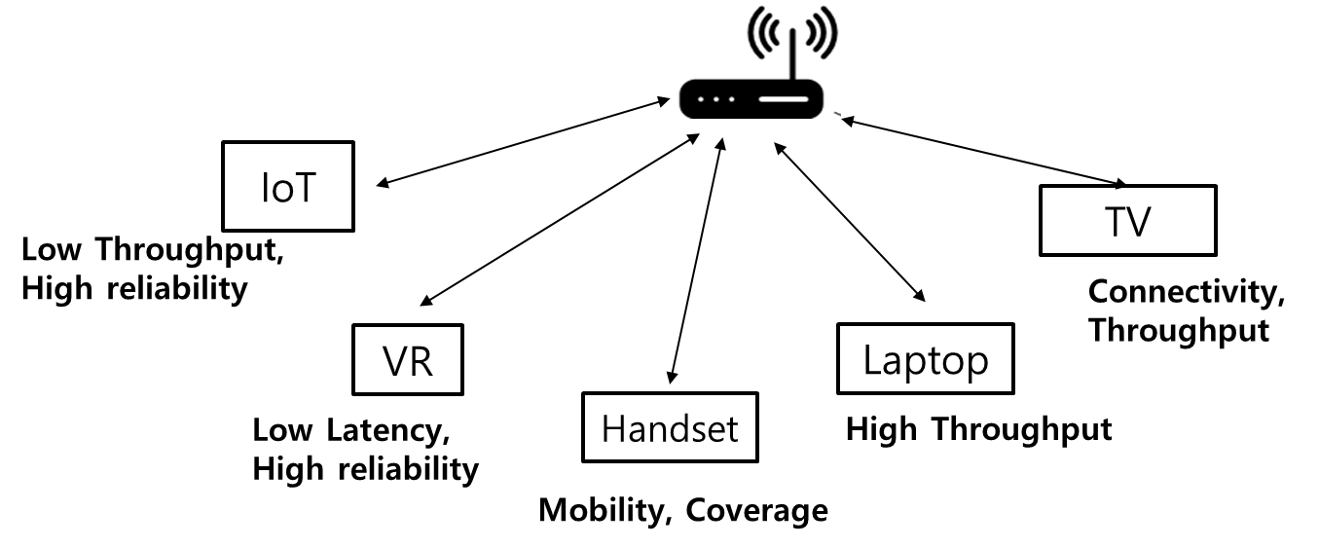
What is the definition of Low Capability Mode & High Capability Mode?
There are different types of devices that cater to different use cases and need to meet different KPIs like throughput, reliability, latency, connectivity/coverage, mobility and power consumption.
The question is:
Considering such a vast and diverse ecosystem of STAs, how can we define a framework to indicate/update low and high capability modes of operation for each STA so that it meets the aforementioned KPIs?
The proposal:
The specification should provide a flexible framework that allows each STA to define their own definition of high and low capability mode and have a method to indicate the same to it’s peer STA.
AP
Low
Power
consumption
High Power
consumption
Opportunistic
Power
consumption

Slide 4
A Typical Sequence of Power Save Feature – Support & Usage
Power Save Feature -Support
Power Save Feature – Turns ON
Power Save Feature – Operation
Power Save Feature - Mode management
Power Save
mode ON
Event Detected
ICF
High
Data
Workout
Low: 20MHz, 1 link, 1NSS, QPSK
High: 40MHz, 1 link, 2NSS,16QAM
Low
Low
Mode update: To choose throughput
PS-ON
ICF
High
Data
Low
battery
Low: 40 MHz, 1 link, 2NSS, 16QAM
High: 160MHz, 2 link, 4NSS,256QAM
Low
Low
Mode update : To choose battery life
ICF
High
Data
Toggle Background
data
Low: 20 MHz, 1 link, 1NSS, QPSK
High: 320MHz, 3 link, 4NSS, 1024QAM
Low
Low
Mode update : To choose optimization
What is the definition of
Low / High capability mode?
How to indicate the choice
of mode?
Where to send these capabilities?

Slide 5
Capabilities for Power Save Feature
Option 1: Legacy Capability Design
Power Save Feature :
UHR / New Element[7] capabilities
Feature is Turned ON
UHR MLD Capabilities & Operation for links
BW, NSS, MCS, Links
UHR Capabilities: BW, MCS, NSS
(Capability: High: 320MHz,3links, 4NSS)
Beacon
Association
Response
DATA
ICF
UHR AP
Association
Request
DPS-ON
ACK
ICR
UHR
Non-AP STA
Low Capability
(20Mhz, 1links, 1NSS)
Low Capability
(20Mhz, 1links, 1NSS)
(Capability High: 160MHz, 2 links, 2NSS)
High Capability
(160Mhz, 2links, 2NSS)
(eg: Wearable,
Smartphone with low battery)
Option 1: When power save feature is turned ON, UHR Non-AP STA in this illustration can move to highest capability as indicated in UHR Capabilities or it can be based on only scheduling requirements and/or inbound data packet characteristics.
Cons: This option follows legacy design but does not take into account STA’s power saving requirement.

Slide 6
Capabilities for Power Save Feature
Option 2: UHR Capability Design for Power Save
Power Save Feature and associated high capability :
UHR / New Element[7] capabilities
Feature is Turned ON
UHR MLD Capabilities & Operation for links
BW, NSS, MCS, Links
UHR Capabilities: BW, MCS, NSS
Indicates the highest capability
supported by STA
Indicates the highest during power save
(Capability: High: 320MHz,3links, 4NSS
Power Save High: 160Mhz, 2 links, 2 NSS)
Beacon
Association
Response
DATA
ICF
UHR AP
Association
Request
DPS-ON
ACK
ICR
UHR
Non-AP STA
Low Capability
(20Mhz, 1links, 1NSS)
Low Capability
(20Mhz, 1links, 1NSS)
(Capability High: 160MHz, 2 links, 2NSS
Power Save High: 80MHz, 2 links, 2 NSS)
High Capability
(80MHz, 2links, 2NSS)
(eg: Wearable,
Smartphone with low battery)
Option 2: The STA can indicate that, even if it supports higher capabilities, in power save mode, it can restrict its highest capability of operation. This can ensure that STA power saving requirements are also included in the decision to transition to high capability mode. There is more flexibility available to STA to indicate its preferences.

Slide 7
Power Save Mode Indication Change
Use Case: Toggling between High Capability mode and Low Capability mode
DPS-ON (Beacon)
ICR
ACK
ICR
ACK
ICR
ACK
UHR Mobile AP
DATA
DATA
DATA
UHR
Non-AP STA
ICF
ICF
ICF
High Capability
High Capability
High Capability
Low Capability
Low Capability
Low Capability
1. Toggling between Low & High Capability modes
In this use case, we see that a UHR Mobile AP is toggling multiple times from low to high capability mode as requested by the Non-AP STA which causes more overhead.
Hence there is a need to define a method to indicate changed power save mode to handle such toggling issues.

Slide 8
Illustration of Power Save Mode Notification
(Capability High: 160MHz, 2 links, 4NSS
Power Save High: 80MHz, 2 links, 2 NSS)
DPS-ON (Beacon)
DPS mode Change
ICR
ACK
ICR
ACK
ACK
ACK
UHR Mobile AP
DATA
DATA
(Mode: Low 40MHz,1 link, 2NSS)
DATA
DATA
UHR
Non-AP STA
ICF
ICF
High Capability
(40MHz, 1 link, 2NSS)
High Capability
(40MHz, 1 link, 2NSS)
Low Capability
Low Capability
Low Capability
1. Toggling between Low & High Capability modes
Toggling & need of ICF-ICR
reduced
Power Save mode change indication can be sent to change the operation of the device in low capability mode from lowest the device supports to a higher value to reduce toggling as shown in this use case.
In some other examples, we could also have this message be used to update the high capability mode of operation during power save to fine tune its performance to match certain throughput or latency requirements.
The framework here provides flexibility to change the current low capability or high capability mode of operation during functioning of Power Save feature.

Slide 9
Proposal: Capability Mode Usage and Definition
We propose that it is necessary to define the Capability mode and use the said definition to set and communicate the lowest and highest capability supported by STA and update the same even when a change in power save mode is needed.
Capability Mode
Definition
Device Capabilities
(High)
Change in Power Save
Mode (High/Low)
Beacon/(Re)-Association Req-Rsp/Probe Req-Rsp/ New Message[7]
Management/Action Frame (New)
Includes BW, MCS, Number of links, NSS etc for lowest and highest capability modes supported by STA
Includes BW, MCS, Number of links, NSS etc of current capability mode
Notes:
OMI and OMN- is it allowed in association

Slide 10
Straw Poll 1
Do you agree to include a mechanism in 802.11bn for a STA to indicate the low/high operating capabilities associated with its DPS mode during the association procedure?
Note 1: The operating capabilities may include BW, MCS, NSS etc.
Note 2: Other scenarios where power save feature including low/high operating mode is advertised is TBD

Slide 11
Straw Poll 2
Do you agree to define in 802.11bn, a STA can send a message to change/modify it’s operating mode (i.e low/high capability modes) for the DPS feature defined in Tgbn?

Slide 12
References
[1] 11/23-1965r2 “Dynamic Power Save– follow up”, George Cherian et. al.
[2] 11/23- 1835r0 “AP Power Management”, Yongsen Ma et.al.
[3] 11/24- 0097r0 “AP Power Management – Follow-up”, Yongsen Ma et.al.
[4] 11/23-2003r1 “Client Power Save”, Laurent Cariou et.al.
[5] 11/24-352r “Enabling Unscheduled AP PS Follow-up”, Guogang Huang et.al.
[6] 11/24/0171r15 “tgbn-motions-list-part-1”
[7] 11/24/1611r0 “Power Save Capabilities”, Manasi Ekkundi et.al

