Slide 1
Follow-up on sync field for AMP PPDU
July 2025
Doc.: IEEE 802.11-25/1265r3
Date: 2025-07-25
Authors:
Name | Affiliation | Address | Phone | Email
Ke Wang | OPPO |  |  | wangke6@oppo.com
Jinyu Zhang |  |  |  | v-qiyinan@oppo.com
Weijie Xu |  |  |  | xuweijie@oppo.com
Yinan Qi
Sehngjiang Cui

Slide 2
Abstract
Doc.: IEEE 802.11-25/1265r3
In this contribution, the DL and UL sync fields for both non-backscatter AMP STA and non-backscatter AMP STA are discussed.

Slide 3
DL data decoding performance
Doc.: IEEE 802.11-25/1265r3
In AWGN channel, required SNR for 250kbps is ~-6.9dB and Required SNR for 1Mbps is ~-3.5dB
Waveform: OFDM-OOK
Noise @ 80MHz
AWGN
Payload =100 bit
Data rate: 250kbps/1Mbps
Figure 1: DL data decoding performance

Slide 4
DL sync for non-BC AMP STA
Doc.: IEEE 802.11-25/1265r3
For non-backscatter AMP STA, both correlation based receiver and differential decoder receiver[1] can be used.
Firstly, the DL sync performance using correlation based receiver is evaluated. The processing model is as in below.
Differential decoder receiver will be discussed later.
Noise（5ms）
Legacy preamble
Sync field
Date field
Local sequence
Figure 2: Processing model

Slide 5
DL sync for non-BC AMP STA: Length 16
Doc.: IEEE 802.11-25/1265r3
DL sync sequence: length 16 (0110100110001011), chip duration= 2us. Clock accuracy:0ppm and 10000ppm. Channel: AWGN
It can be seen that the impact from clock drifting is small.
Required SNR <-7dB for the proposed sequence.
Figure 3: DL sync performance

Slide 6
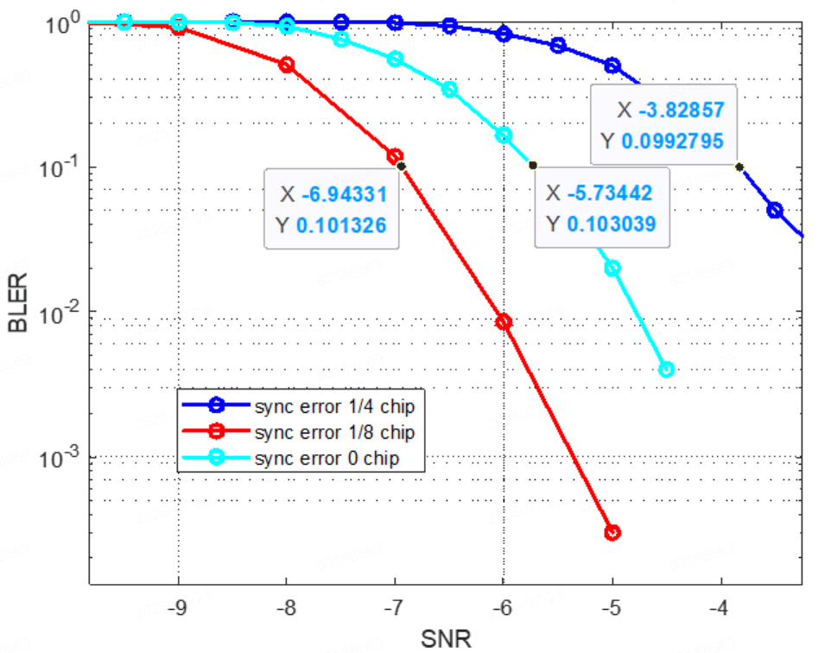
Impact on data decoding
Doc.: IEEE 802.11-25/1265r3
The impact on data decoding is evaluated. It can be seen that there is ~1.2dB performance loss when sync error is 1/8 chip and ~3dB performance loss when sync error is 1/4 chip.
Figure 4: Impact on data decoding

Slide 7
DL sync for non-BC AMP STA: length 32(1)
Doc.: IEEE 802.11-25/1265r3
DL sync sequence with length 32:S=00101110100010110101101110011000
The correlation results of S and S_bar for correlation based receiver are as in below:

Slide 8
DL sync for non-BC AMP STA: length 32(2)
Doc.: IEEE 802.11-25/1265r3
DL sync sequence with length 32:(00101110100010110101101110011000)
The correlation results for differential decoder are as in below:

Slide 9
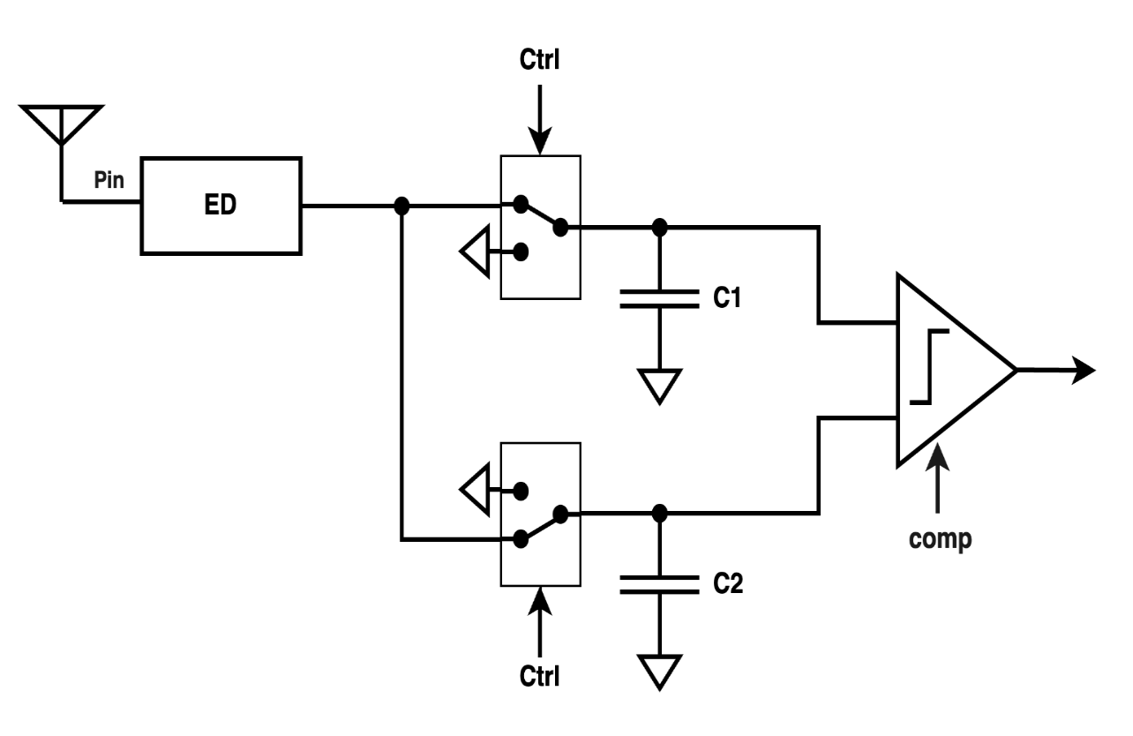
Differential decoder receiver architecture (1)
Doc.: IEEE 802.11-25/1265r3
It was proposed in [1] to use differential decoder receiver to process DL sync. Differential decoder receiver can be implemented without AGC and ADC thus it can lower the complexity and power consumption.
Figure 5: Differential decoder receiver [1]

Slide 10
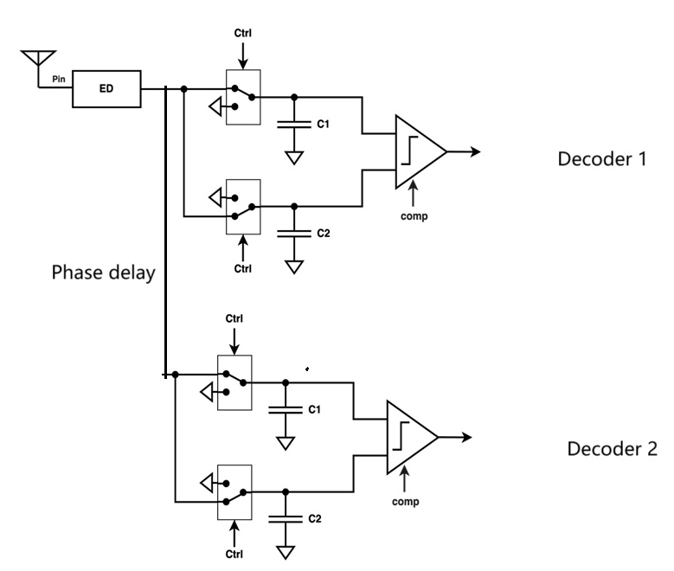
Differential decoder receiver architecture (2)
Doc.: IEEE 802.11-25/1265r3
However, differential decoder is composed of analogue circuits, there is no digital buffering during signal processing. Therefore, it isn’t able to derive the right timing by shifting digital samplings.
On the other hand, it needs to support multiple differential decoders to get the right timing.
  Different differential decoders correspond to different timing hypotheses
  It needs phase delay between the analogue signals input to two different differential decoders.
Figure 6: Parallel differential decoder receiver

Slide 11
Differential decoder receiver architecture (3)
Doc.: IEEE 802.11-25/1265r3
The sync performance will depend on the number of the parallel differential decoders. When there are two parallel differential decoders, there will be a maximum of ¼ chip offset and ¾ chip offset of the input signal for these 2 differential decoders.
Therefore, it needs to evaluate how many parallel differential decoders are needed in order to get sufficient sync performance.
In addition, multiple differential decoders will share the received DL signal. The input power for each differential decoder will be 1/N of that of the DL signal. It will affect the received SNR of each differential decoder.
So, it can be expected that the sync performance of differential decoder will be much lower than that of the digital correlation receiver.

Slide 12
DL sync for backscatter AMP STA
Doc.: IEEE 802.11-25/1265r3
The maximum clock accuracy of backscatter AMP STA is 100000ppm.
Only envelope detection without correlation detection can be used at the receiver.
Proposed sync sequence is ‘01011101’.
  The first bit 0 indicate the start of DL modulation
  The second bit 1 and third bit 0 are used to estimate the chip duration.
  3 PW ON carrier is a code violation (non Manchester).
  The last 0/1 transition provides timing for data decoding

Slide 13
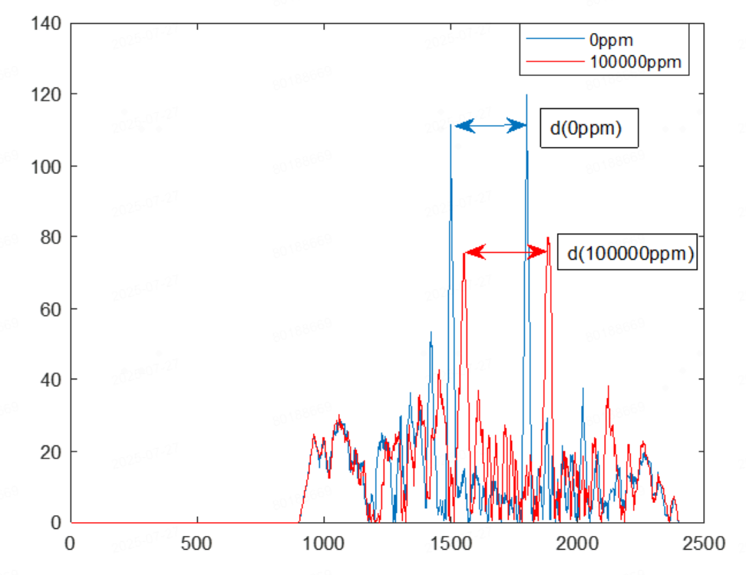
UL sync for backscatter AMP STA(1)
Doc.: IEEE 802.11-25/1265r3
Clock accuracy is 100000ppm. Besides providing UL synchronization, it will be beneficial if the UL sync can help to estimate the chip duration.
UL sync structure [S S] is proposed for backscatter AMP STA. The chip duration can be estimated using correlation:
  d(0ppm)/ d(100000ppm) = standard chip duration(0ppm)/actual chip duration(100000ppm)
    d(0 ppm) is the number of samplings between the correlation peaks in case of 0 ppm. d(100000 ppm) is the number of samplings between the correlation peaks in case of 100000 ppm

Slide 14
UL sync for backscatter AMP STA(2)
Doc.: IEEE 802.11-25/1265r3
  The length of S shall be as short as possible in order to have small accumulation of chip offset (from the 1st chip to the last chip of the UL sync sequence).
  An m sequence with length 15 is proposed.
  In Table 1, it show the performance for chip duration estimation.
Table 1: Residual estimation error of chip duration
SNR(dB) | 0.6 | 0.8 | 1.8 | 6.4
Residual estimation error of chip duration | 5% | 4% | 3% | 2%

Slide 15
Summary
Doc.: IEEE 802.11-25/1265r3
In summary, this submission
  Analyze the performance for DL sync sequences for non-backscatter AMP STA.
  Analyze implementation requirements for differential decoders and the potential impact on sync performance
  Propose DL sync sequence for BC AMP STA
  Propose UL sync sequence for BC AMP STA
Wang Ke (OPPO)

Slide 16
Reference
July 2025
Doc.: IEEE 802.11-25/1265r3
IEEE 802.11-25/0705r0 An Analysis of SYNC Field for Downlink PPDU
Wang Ke (OPPO)

