Slide 1
Follow-up on sync field for AMP PPDU
July 2025
Doc.: IEEE 802.11-25/1265r0
Date: 2025-07-25
Authors:
Name | Affiliation | Address | Phone | Email
Ke Wang | OPPO |  |  | wangke6@oppo.com
Jinyu Zhang |  |  |  | v-qiyinan@oppo.com
Weijie Xu |  |  |  | xuweijie@oppo.com
Yinan Qi
Sehngjiang Cui

Slide 2
Abstract
Doc.: IEEE 802.11-25/1265r0
In this contribution, the DL and UL sync fields for both non-backscatter AMP STA and non-backscatter AMP STA are discussed.

Slide 3
DL data decoding performance
Doc.: IEEE 802.11-25/1265r0
In AWGN channel, required SNR for 250kbps is ~-6.9dB and Required SNR for 1Mbps is ~-3.5dB
Waveform: OFDM-OOK
Noise @ 80MHz
AWGN
Payload =100 bit
Data rate: 250kbps/1Mbps
Figure 1: DL data decoding performance

Slide 4
DL sync for non-BC AMP STA(1)
Doc.: IEEE 802.11-25/1265r0
For non-backscatter AMP STA, both correlation based receiver and differential decoder receiver[1] can be used.
Firstly, the DL sync performance using correlation based receiver is evaluated.
Differential decoder receiver will be discussed later.

Slide 5
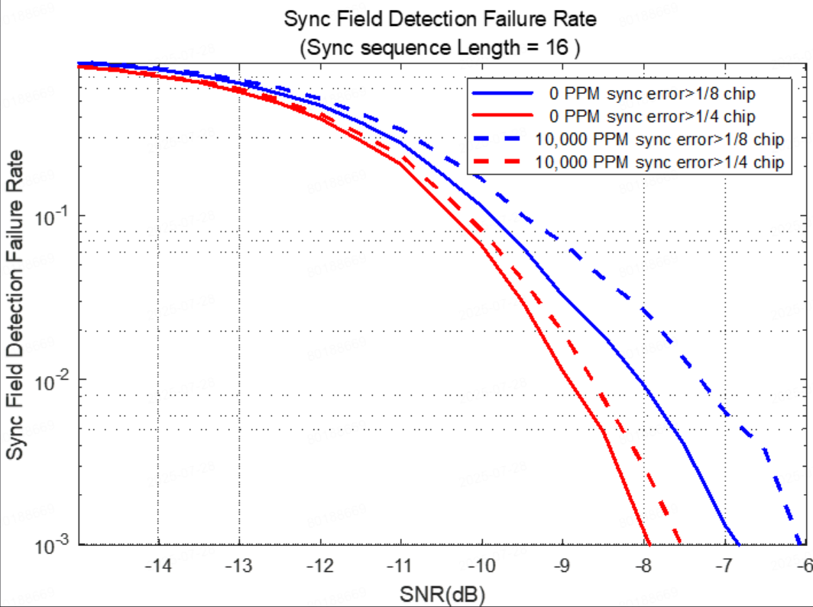
DL sync for non-BC AMP STA(2)
Doc.: IEEE 802.11-25/1265r0
DL sync sequence: length 16 (0110100110001011), chip duration= 2us. Clock accuracy:0ppm and 10000ppm. Channel: AWGN
It can be seen that the impact from clock drifting is small.
Required SNR <-7dB for the proposed sequence.
Figure 2: DL sync performance

Slide 6
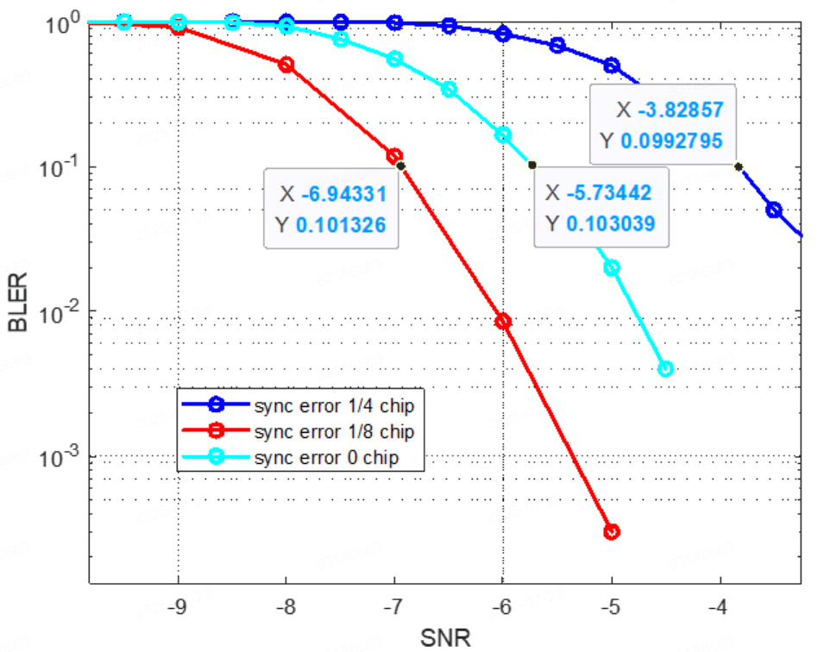
Impact on data decoding
Doc.: IEEE 802.11-25/1265r0
The impact on data decoding is evaluated. It can be seen that there is ~1.2dB performance loss when sync error is 1/8 chip and ~3dB performance loss when sync error is 1/4 chip.
Figure 3: Impact on data decoding

Slide 7
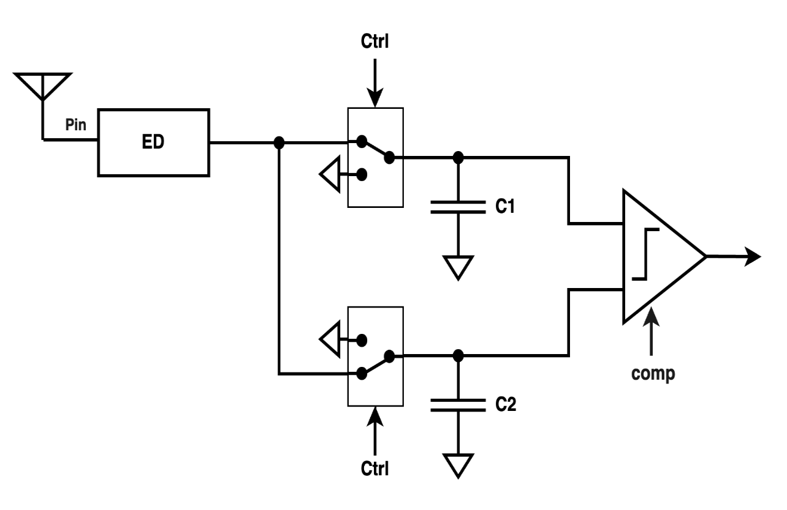
Differential decoder receiver architecture (1)
Doc.: IEEE 802.11-25/1265r0
It was proposed in [1] to use differential decoder receiver to process DL sync. Differential decoder receiver can be implemented without AGC and ADC thus it can lower the complexity and power consumption.
Figure 4: Differential decoder receiver [1]

Slide 8
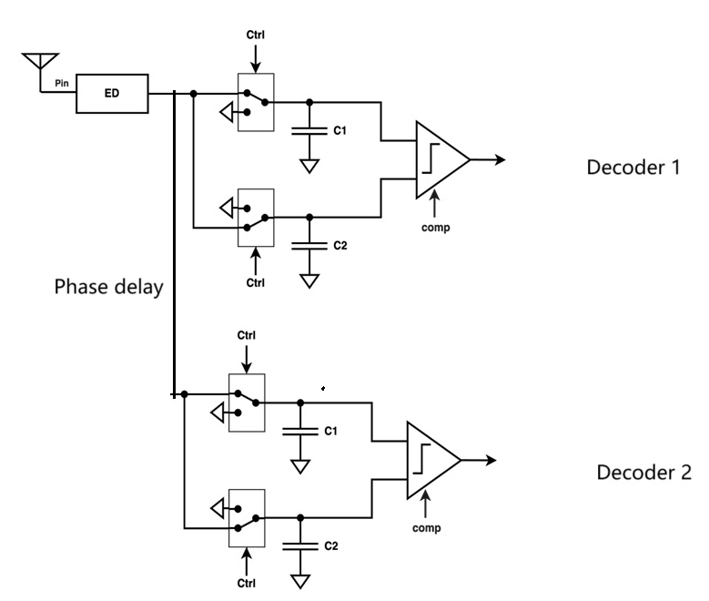
Differential decoder receiver architecture (2)
Doc.: IEEE 802.11-25/1265r0
However, differential decoder is composed of analogue circuits, there is no digital buffering during signal processing. Therefore, it isn’t able to derive the right timing by shifting digital samplings.
On the other hand, it needs to support multiple differential decoders to get the right timing.
  Different differential decoders correspond to different timing hypotheses
  It needs phase delay between the analogue signals input to two different differential decoders.
Figure 5: Parallel differential decoder receiver

Slide 9
Differential decoder receiver architecture (3)
Doc.: IEEE 802.11-25/1265r0
The sync performance will depend on the number of the parallel differential decoders. When there are two parallel differential decoders, there will be a maximum of ¼ chip offset and ¾ chip offset of the input signal for these 2 differential decoders.
Therefore, it needs to evaluate how many parallel differential decoders are needed in order to get sufficient sync performance.
In addition, multiple differential decoders will share the received DL signal. The input power for each differential decoder will be 1/N of that of the DL signal. It will affect the received SNR of each differential decoder.
So, it can be expected that the sync performance of differential decoder will be much lower than that of the digital correlation receiver.

Slide 10
DL sync for backscatter AMP STA
Doc.: IEEE 802.11-25/1265r0
The maximum clock accuracy of backscatter AMP STA is 100000ppm.
Only envelope detection without correlation detection can be used at the receiver.
Proposed sync sequence is ‘01011101’.
  The first bit 0 indicate the start of DL modulation
  The second bit 1 and third bit 0 are used to estimate the chip duration.
  3 PW ON carrier is a code violation (non Manchester).
  The last 0/1 transition provides timing for data decoding

Slide 11
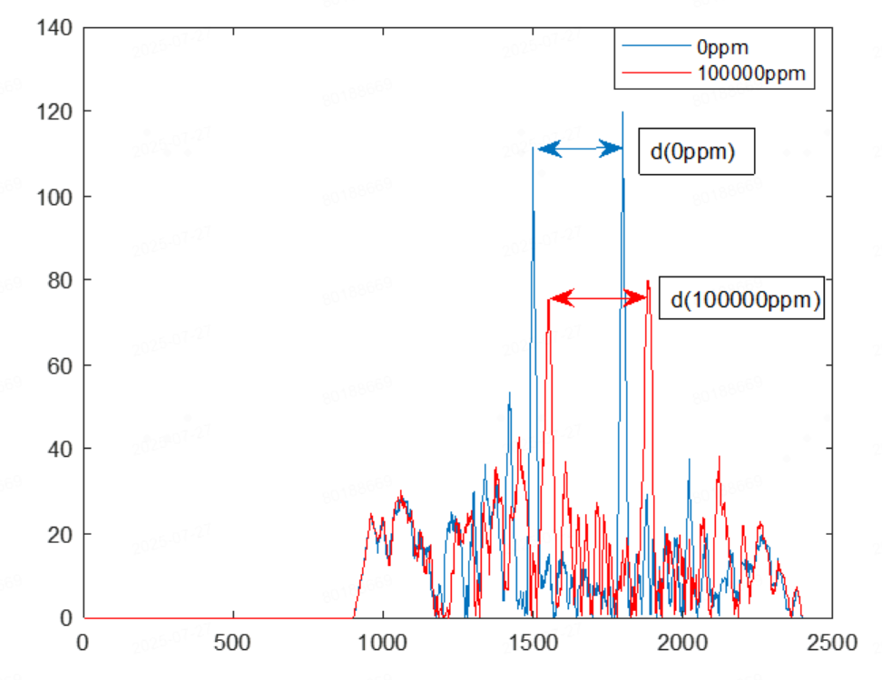
UL sync for backscatter AMP STA(1)
Doc.: IEEE 802.11-25/1265r0
Clock accuracy is 100000ppm. Besides providing UL synchronization, it will be beneficial if the UL sync can help to estimate the chip duration.
UL sync structure [S S] is proposed for backscatter AMP STA. The chip duration can be estimated using correlation:
  d(0ppm)/ d(100000ppm) = standard chip duration(0ppm)/actual chip duration(100000ppm)
    d(0 ppm) is the number of samplings between the correlation peaks in case of 0 ppm. d(100000 ppm) is the number of samplings between the correlation peaks in case of 100000 ppm

Slide 12
UL sync for backscatter AMP STA(2)
Doc.: IEEE 802.11-25/1265r0
  The length of S shall be as short as possible in order to have small accumulation of chip offset (from the 1st chip to the last chip of the UL sync sequence).
  An m sequence with length 15 is proposed.
  In Table 1, it show the performance for chip duration estimation.
Table 1: Residual estimation error of chip duration
SNR(dB) | 0.6 | 0.8 | 1.8 | 6.4
Residual estimation error of chip duration | 5% | 4% | 3% | 2%

Slide 13
Summary
Doc.: IEEE 802.11-25/1265r0
In summary, this submission
  Propose that DL sequence with length 16 and chip duration of 2us is used for non-backscatter AMP STA.
  Give analysis on implementation for differential decoders and the potential impact on sync performance
  Propose DL sync sequence for BC AMP STA
  Propose UL sync sequence for BC AMP STA
Wang Ke (OPPO)

Slide 14
Reference
July 2025
Doc.: IEEE 802.11-25/1265r0
IEEE 802.11-25/0705r0 An Analysis of SYNC Field for Downlink PPDU
Wang Ke (OPPO)

