Slide 1
Remaining Issues on WPT Protocols
July 2025
Doc.: IEEE 802.11-25/1263r0
Date: 2025-07-28
Authors:
Name | Affiliation | Address | Phone | Email
Yinan Qi | OPPO |  |  | v-qiyinan@oppo.com
Weijie Xu
Chuangfeng He
Ke Wang

Slide 2
Abstract
Doc.: IEEE 802.11-25/1263r0
In this contribution, we discuss the following issues:
  WPT protocol between AP and AMP device
  WPT protocol between AP and energizer
  Energizer channel access
  Correspondence between energizer and AMP devices

Slide 3
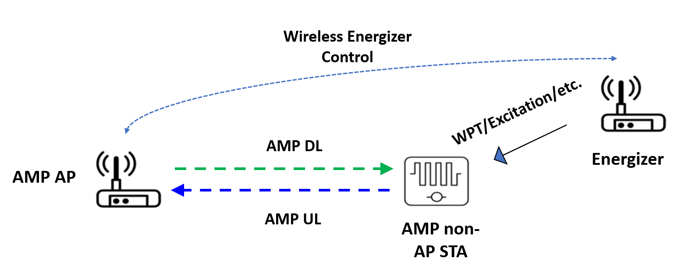
July 2025
Doc.: IEEE 802.11-25/1263r0
WPT Protocol: AMP non-AP STA Reporting
  Agreement: IEEE 802.11bp defines a mechanism that allows an AMP non-AP STA to report its energy harvesting and power related information to AMP AP STA. The parameters that are included in the report and how to report such information is TBD.
  Energizer harvest related information
    Long-term/non-periodic info
    Less frequent, sometimes only once → negligible energy consumption
  Power related information
    Short-term/periodic feedback info, more frequent, even real time
    More energy consumption
Slide 3
Yinan Qi (OPPO)

Slide 4
July 2025
Doc.: IEEE 802.11-25/1263r0
AMP non-AP STA Reporting: EH Parameters
  EH capability
    Power source(s)
      Power source type, e.g., RF, solar, vibration;
      Stability of the power source;
      Multiple power source support;
      EH efficiency.
  Energy storage capability
    Whether or not energy storage is supported;
    The amount of energy that can be stored;
    Energy storage draining rate;
  Others
    RF energy harvesting operation frequency.
  Joint reporting can be considered to reduce signalling overhead
Slide 4
Yinan Qi (OPPO)

Slide 5
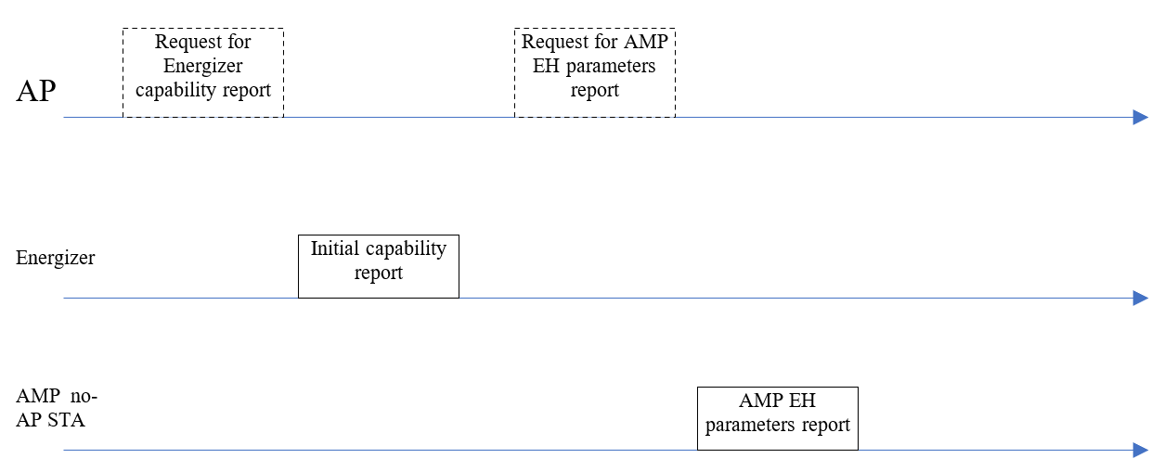
July 2025
Doc.: IEEE 802.11-25/1263r0
EH Parameters Reporting Procedure
  Long term parameters reporting
    AMP devices autonomously report;
    AMP devices report when requested by the AP.
  The reporting can happen during the initial procedures such as association, authentication, etc.
Optional
Slide 5
Yinan Qi (OPPO)

Slide 6
July 2025
Doc.: IEEE 802.11-25/0318r0
Wireless Energizer Control
  Energizer control parameters and capability report parameters have been agreed.
  Additional energizer control parameters
    It has been agreed that the energizer may perform LBT before transmitting WPT signals in S1G.
    AMP AP should indicate if LBT should be performed by the energizer
      If yes, LBT parameters, e.g., detection threshold, contention window, etc.
  The energizer control parameters can be divided into two parts:
    Static part, e.g., frequency related parameters. This part can be configured only once and rarely changes for a long time;
    Dynamic part, e.g., duration, transmit power, etc. This part may change from time to time and can be configured more frequently, e.g., every time when energizer is activated.
Slide 6
Yinan Qi (OPPO)

Slide 7
July 2025
Doc.: IEEE 802.11-25/0318r0
Wireless Energizer Control
  Energizer capability reporting
    Energizer autonomously reports;
    Energizer reports when requested by the AP.
  Energizer capability reporting can happen once an energizer is connected to an AMP AP.
Optional
Slide 7
Yinan Qi (OPPO)

Slide 8
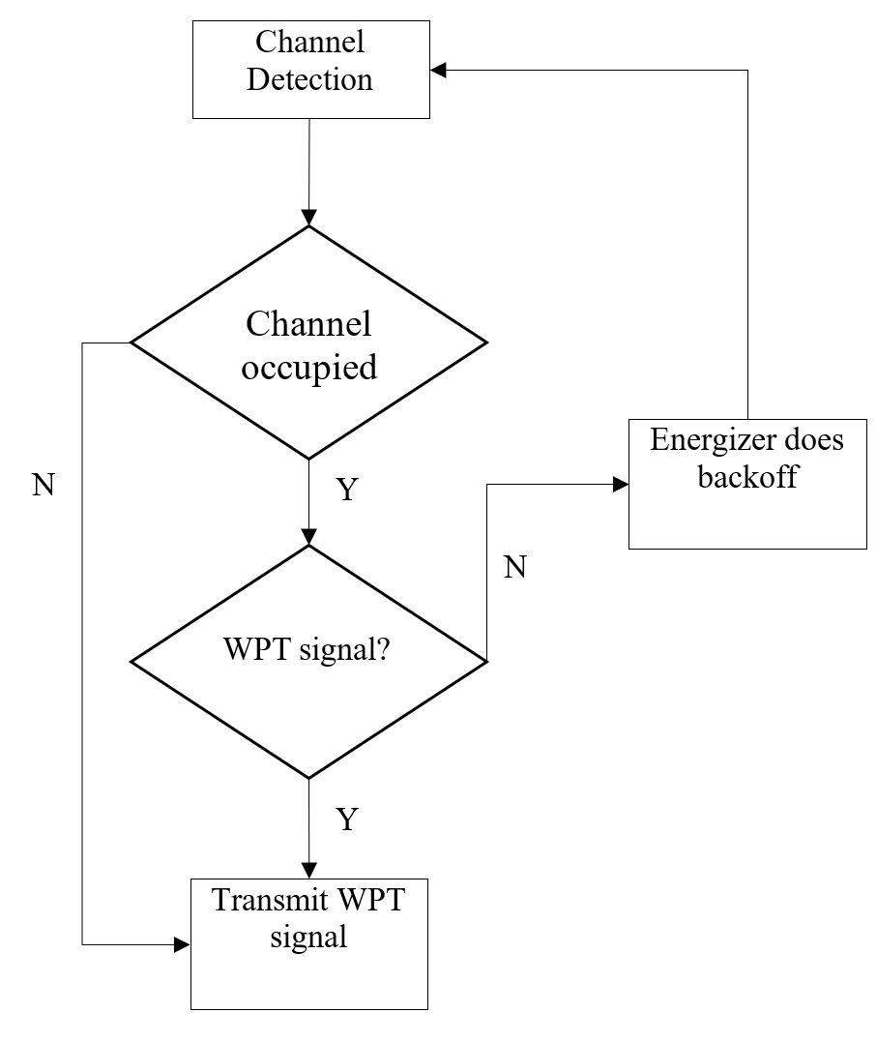
July 2025
Doc.: IEEE 802.11-25/0318r0
Energizer Channel Access
  It has been agreed that
    WPT signal can overlap in the same channel;
    Energizer can do LBT before transmitting WPT signal.
  The procedure of energizer LBT is different from non-AP STA
    AMP non-AP STA with data to transmit needs to do backoff once it detects the channel is occupied by another signal no matter it is WPT or data.
    Energizer does not need to do backoff if the channel is occupied by WPT signals since there is no interference issue.
Slide 8
Yinan Qi (OPPO)

Slide 9
July 2025
Doc.: IEEE 802.11-25/0318r0
Energizer Channel Access
  Channel detection
    Energy detection can be applied;
    Energy detection threshold needs to be configured;
    Such threshold is not necessarily to be the same as conventional ED detection threshold since the WPT signal strength is usually strong.
  WPT signal detection
    Can be done via WPT preamble.
  As aforementioned, LBT parameters, e.g., threshold, contention window, etc., can be configured by the AMP AP.
Slide 9
Yinan Qi (OPPO)

Slide 10
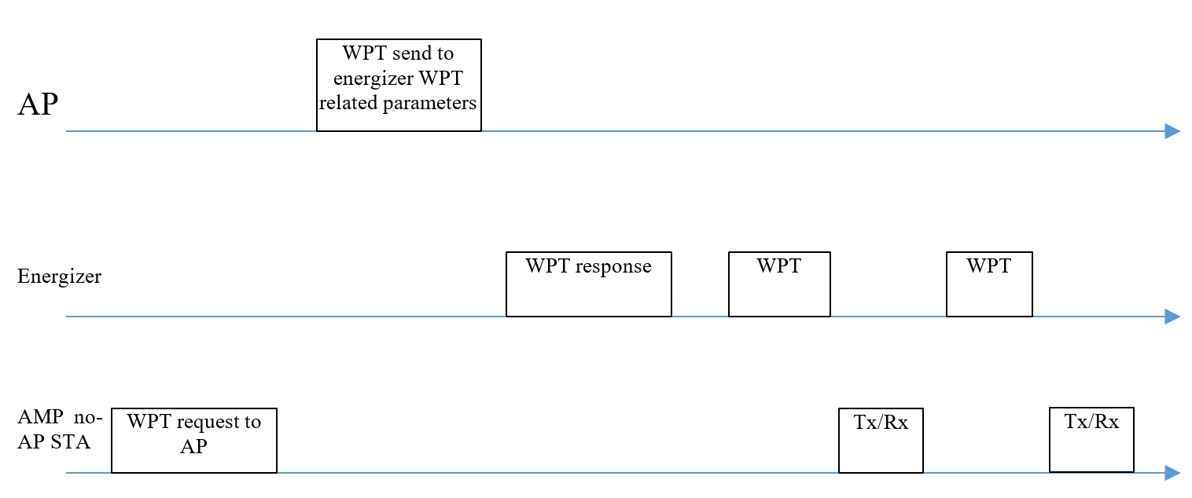
July 2025
Doc.: IEEE 802.11-25/0318r0
General WPT Procedure: Charging Procedure
  WPT procedure:
    Initialization
      AMP non-AP STA EH capability reporting;
      Energizer capability reporting.
    WPT
      AMP non-AP STA power parameters reporting (optional);
      AMP requests WPT (optional)
      AP send WPT related parameters to energizer
      Energizer acks AP request and initiate WPT
      WPT and Tx/Rx procedures can repeat
Slide 10
Yinan Qi (OPPO)

Slide 11
July 2025
Doc.: IEEE 802.11-25/0318r0
General WPT Procedure: Charging Procedure
  WPT duration:
    Longer than certain threshold to guarantee the AMP devices are sufficiently charged.
    It is a time window in which the energizer may need to do LBT → actual WPT Tx duration may be shorter than the WPT duration.
LBT
WPT Tx
Slide 11
Yinan Qi (OPPO)

Slide 12
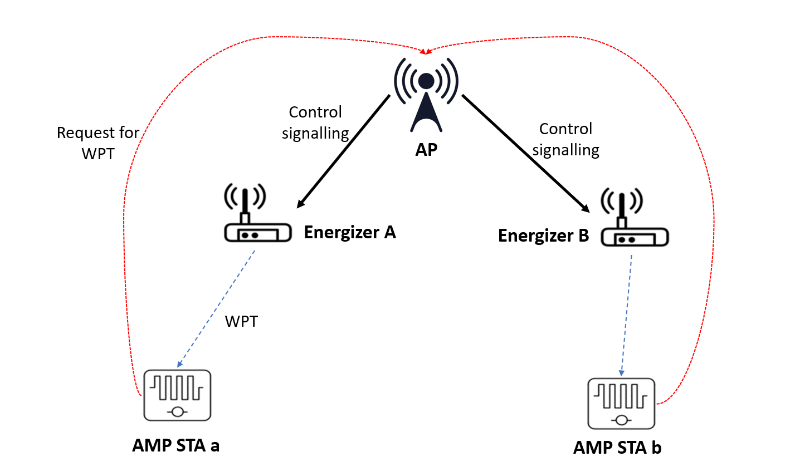
July 2025
Doc.: IEEE 802.11-25/0318r0
Correspondence Between Energizer and AMP non-AP STA
  Each energizer can correspond to one to multiple AMP non-AP STA [1].
    Excitation: essential to activate the correct energizer
    WPT: optimize the WPT and reduce the interference caused by the WPT signals
  How to establish correspondence
    Exchange of energizer ID between AP and energizer
    Report by the non-AP STA
 | Energizer A | Energizer B
AMP a | √ | X
AMP b | X | √
Slide 12
Yinan Qi (OPPO)

Slide 13
Reference
July 2025
Doc.: IEEE 802.11-25/1263r0
[1] “Follow up on Correspondence between Energizers and AMP non-AP STAs,” IEEE 802.11-25/0792r0, May 2025

Slide 14
July 2025
Doc.: IEEE 802.11-25/1263r0
SP1
  Do you agree to capture the following text to TGbp SFD?
    AMP devices shall support to reporting at least following energy harvesting related information
        Power source type, e.g., RF, solar, vibration;
        Whether or not energy storage is supported;
        The amount of energy that can be stored;
        RF energy harvesting operation frequency.
Slide 14
Yinan Qi (OPPO)

Slide 15
July 2025
Doc.: IEEE 802.11-25/1263r0
SP2
  Do you agree to capture the following text to TGbp SFD?
    AMP devices reporting is requested by the AP and the reporting procedure should happen during the initial connection procedures, e.g., association or authentication.
Slide 15
Yinan Qi (OPPO)

Slide 16
July 2025
Doc.: IEEE 802.11-25/1263r0
SP3
  Do you agree to capture the following text to TGbp SFD?
    Energizer capability reporting is requested by the AP and the reporting procedure should happen once the energizer is connected to the AMP AP.
Slide 16
Yinan Qi (OPPO)

Slide 17
July 2025
Doc.: IEEE 802.11-25/1263r0
SP4
  Do you agree to capture the following text to TGbp SFD?
    When the energizers perform LBT, the LBT parameters, e.g., threshold, channel sensing time, contention window, etc., should be configured by the AMP AP.
    The LBT parameters should be considered additionally as control information that is sent from the AMP AP to the AMP Energizer relating to the WPT waveform.
Slide 17
Yinan Qi (OPPO)

Slide 18
July 2025
Doc.: IEEE 802.11-25/1263r0
SP5
  Do you agree to capture the following text to TGbp SFD?
    The correspondence between energizer and AMP devices that determines which energizer to activate to charge target AMP devices should be supported.
Slide 18
Yinan Qi (OPPO)

