Slide 1
PHY Design for AMP in S1G
July 2025
Doc.: IEEE 802.11-25/1261r1
Date: 2025-07-30
Authors:
Name | Affiliation | Address | Phone | Email
Yinan Qi | OPPO |  |  | v-qiyinan@oppo.com
Weijie Xu
Chuanfeng He
Ke Wang

Slide 2
Abstract
Doc.: IEEE 802.11-25/1261r1
In this contribution, we discuss the PHY design for AMP in S1G covering issues including coverage, regulations, channelization, PPDU, Waveform and data rate.

Slide 3
July 2025
Doc.: IEEE 802.11-25/1261r1
Coverage Enhancement in S1G
  The coverage for mono-static backscattering AMP devices is expanded from few tens of centimetres in 2.4 GHz to a few meters in S1G [1].
    2.4GHz: limited coverage → one to one communication only, i.e., one reader triggers one AMP devices.
    S1G: enhanced coverage → potential one to many communication, i.e., one reader may trigger multiple AMP devices
      TDM: each AMP device is allocated with one slot;
      FDM: different frequency shift for each AMP device.
  Coexistence
    2.4GHz: negligible impact on other AMP devices and legacy devices due to limited coverage
    S1G: other AMP devices including energizers and legacy devices in coverage
      Interference to and from other devices
      Interference from WPT
Slide 3
Yinan Qi (OPPO)

Slide 4
July 2025
Doc.: IEEE 802.11-25/1261r1
Frequency Regulations on S1G
  USA [2]
    The frequency regulation in FCC 15.247 covers frequency bands 902-928MHz.
    Tx power
      The maximum electrical transmission power is 1W, i.e., 30dBm.
      Antennas with up to 6dBi gain
      EIRP at the AP of up to 36dBm.
    Frequency hopping
      More than 500kHz, no hopping, e.g., 11ah
      Less than 500kHz, with frequency hopping
  EU [2]
    ETSI Harmonised Standards cover the 863 to 870 MHz and 915 to 921 MHz band.
    Tx power: varies depending on the frequency band and bandwidth.
    Channel bandwidth: 200kHz, 250kHz, 400kHz, 800kHz and 1MHz depending on different system configurations
    Frequency hopping is needed in some cases.
Slide 4
Yinan Qi (OPPO)

Slide 5
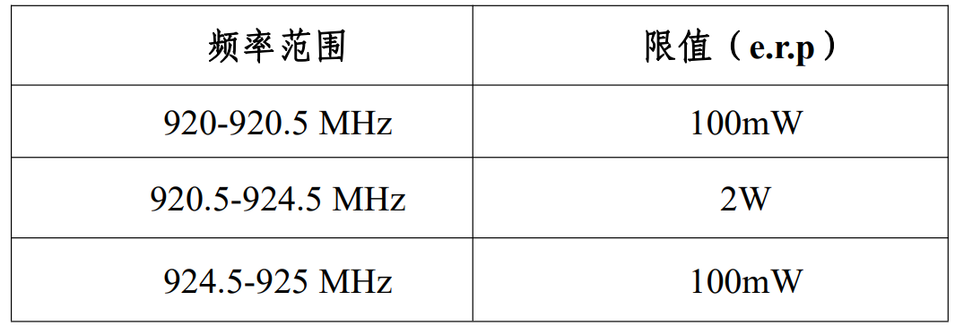
July 2025
Doc.: IEEE 802.11-25/1261r1
Frequency Regulations on S1G
  China [3]
    Frequency band: 920-925MHz.
    Tx power
    Channel bandwidth: maximum 250kHz
    Frequency hopping is mandatory with maximum dwelling time 2s.
  Major issues observed
    Channel bandwidth: how to unify the channel bandwidth across different regions/countries?
    Frequency hopping: mandatory in some regions/countries.
Frequency Band
e.r.p
Slide 5
Yinan Qi (OPPO)

Slide 6
July 2025
Doc.: IEEE 802.11-25/1261r1
Channelization
  How to determine channel BW?
    Dynamic bandwidth in different regions/countries
      For example, USA 1M/2MHz, EU 200k/400kHz, China 250kHz
      Pros: maximize the frequency band utilization, higher data rate
      Cons: impact on PPDU design, data rate, etc.
    Uniform bandwidth
      200kHz for all regions/countries
      Pros: simple PPDU design
      Cons: inefficient frequency band utilization, low data rate
    WUR like design
      1MHz for legacy preamble and 200kHz for AMP part
      Pros: support coexistence
      Cons: 1MHz legacy preamble is not supported in some regions/countries
Slide 6
Yinan Qi (OPPO)

Slide 7
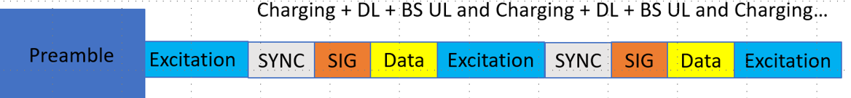
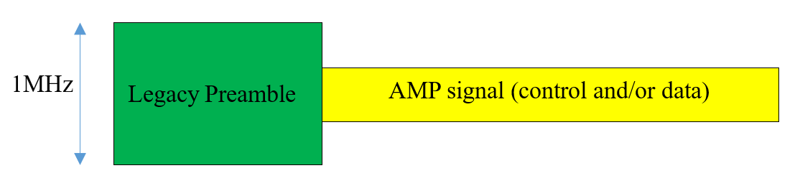
July 2025
Doc.: IEEE 802.11-25/1261r1
PPDU Design
  PPDU format
    2.4GHz PPDU format can be reused in S1G
  Non-AMP preamble
    Considering coexistence with existing S1G system, e.g., 802.11ah, legacy preamble is needed
      AMP part can be with narrower BW
      Legacy preamble can be used for coexistence when 802.11ah is deployed
      Legacy preamble can be removed when 802.11ah is not deployed
      Such PPDU format can work across different regions/countries.
Slide 7
Yinan Qi (OPPO)

Slide 8
July 2025
Doc.: IEEE 802.11-25/1261r1
Waveform
  Two waveforms can be considered
    OFDM
      Scale design from 2.4GHz
      SCS 31.25KHz
      Only 6 SC if the channel bandwidth is 200kHz
      Backward compatible with existing legacy devices
    Sine waveform
      No scaled design from 2.4GHz
      Simple implementation and suitable for narrow bandwidth
      Unified waveform for AMP PPDU and WPT
Slide 8
Yinan Qi (OPPO)

Slide 9
July 2025
Doc.: IEEE 802.11-25/1261r1
Modulation and Data Rates
  Modulation
    BPSK, OOK, FSK, etc.
    OOK modulation can be used due to simplicity
  Data rates
    Legacy 802.11ah data rates: 150kbps to more than 80Mbps
    AMP: lower data rates than 2.4GHz
      Data rate is limited by the narrower channel bandwidth
      No largely deployed legacy devices → longer channel occupancy is allowed
      Less or equal to 250kbps can be considered for both DL and UL, e.g., 125kbps and 250kbps
Slide 9
Yinan Qi (OPPO)

Slide 10
July 2025
Doc.: IEEE 802.11-25/1261r1
Coexistence
  Coexistence between WPT and other S1G systems has been considered in [4]
    Coexistence is crucial since WPT signal is usually with high Tx power
    WPT preamble can be designed to address the coexistence
  Coexistence between WPT and legacy 802.11 devices, i.e., 802.11ah
    Legacy preamble can be considered as aforementioned.
  With S1G AMP communication, coexistence should be further considered
    Coexistence between AMP communication and WPT
      Communication signal cannot overlap
      WPT can overlap with another WPT but not communication signal
      Some solutions have been proposed in companion contribution [5]
Slide 10
Yinan Qi (OPPO)

Slide 11

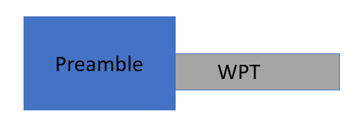
July 2025
Doc.: IEEE 802.11-25/1261r1
Coexistence
  With S1G AMP communication, coexistence should be further considered
    Excitation v.s. WPT
      Excitation field performs two tasks in 2.4GHz: charging and triggering AMP devices
      In S1G, charging is particularly done by WPT from energizer
      Excitation and WPT should be clearly differentiated.
    Consider additional WPT field in PPDU with multiple combinations
      Example 1: legacy preamble + WPT + AMP DL + AMP excitation for charging and data communication
      Example 2: legacy preamble + WPT for charging only
Slide 11
Yinan Qi (OPPO)

Slide 12
July 2025
Doc.: IEEE 802.11-25/1261r1
Summary
  The following issues are discussed and analysed in this contribution
    Coverage enhancement;
    Regulations on frequency bands;
    Channelization;
    PPDU design;
    Waveform
    Modulation and data rate
    Coexistence

Slide 13
Reference
July 2025
Doc.: IEEE 802.11-25/1261r1
[1] “Feasibility Study of Mono-static Backscatter in Sub-1 GHz,” IEEE 802.11-25/0816r0, May 2025
[2] “Updated Technical Report on support of AMP IoT devices in WLAN,” IEEE 802.11-23/2203r1, Feb. 2024
[3] “900MHz 频段射频识别（RFID）设备无线电管理规定”
[4] “Follow-up on WPT: Protocol, Waveform and PPDU,” IEEE 802.11-25/0320r1, Mar. 2025
[5] “PHY Design for AMP in S1G,” IEEE 802.11-25/1261r1, Jul. 2025.

Slide 14
SP 1
July 2025
Doc.: IEEE 802.11-25/1261r1
  IEEE 802.11bp will specify, in S1GHz, an AMP Downlink PPDU which can contain an 802.11 preamble field.
  • The details of the 802.11 preamble field are TBD.

Slide 15
SP 2
July 2025
Doc.: IEEE 802.11-25/1261r1
  IEEE 802.11bp will speficy at least one or more of the following channel bandwidth.
  200kHz
  250kHz
  1MHz
  Note: further down selection is TBD.

Slide 16
SP 3
July 2025
Doc.: IEEE 802.11-25/1261r1
  On-Off Keying (OOK) modulation is supported for AMP S1G.

Slide 17
SP 4
July 2025
Doc.: IEEE 802.11-25/1261r1
  IEEE 802.11bp will specify, in S1GHz, an AMP Downlink PPDU which can contain a WPT field.
  • The details of the WPT field are TBD.

