Slide 1
Enhanced Bi-Static Backscattering AMP STAs for Extended Ranges and Spatial Coverage
Date: 2025-07-28
Authors:

Slide 2
Abstract
In [1]-[2] it was proposed that AMP backscattering (BS) uplink (UL) range can be extended when BS gain is applied to the tag.
This discussion looks at potential AMP tag enhancements for achieving range extension and spatial coverage in bi-static operation modes.

Slide 3

Background: AMP Antenna Gains
This parameter can not be overlooked in AMP
Antennas can be designed with directional gain that indicates how well they focus the signal in a specific direction, compared to a theoretical isotropic antenna that radiates/receives identically in all directions.
Antenna gain is measured in decibels as compared with an isotropic antenna (dBi)
Antenna gain is typically maximized in a direction perpendicular to the antenna surface. It is dependent on the spatial deviation angle from this perpendicular line.
+ 6 dB
+ 3 dB
$$G=f({\text{φ}}_{XY})$$
0 dB
- 3 dB
φ
X
0 dBi
Antenna with Gain
Z
Y
Antenna with Gain
Isotropic Antenna
Antenna gain or directivity in AMP is not always a design choice and may be dependent on the object sensed and the environment

Slide 4
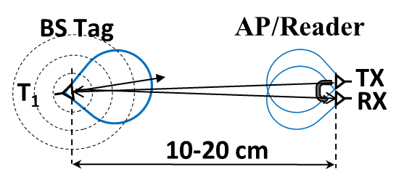
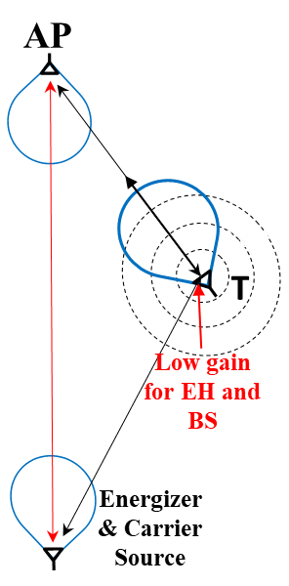
Range and Spatial Considerations with AMP Tags
All AMP tags are limited in range depending on their use case and with some fundamental differences
Mono-static BS:
  Mono-static is receiving and transmitting in the same antenna direction of the tag
  Mono-static at 2.4 GHz is very short range
Bi-static BS:
The energizer/exciter usually transmit from a different direction than the AP/receiver and the tag antenna is excited and backscatters from/to different directions
In [1]-[2] it was suggested that AMP BS range can be extended utilizing tag amplifiers
Active tags:
Propose longer ranges, enabled by S1G wireless power transfer (WPT) and on tag transmitters
Active tags are usually charged by the energizer from one location/direction and transmit to a different direction
Monostatic
Bistatic

Slide 5
Recap: AMP Spatial “Hidden Tag” Deployment Scenario
Assume an active or enhanced BS tag with a single antenna
AP
Tag T₁ can charge but can not communicate with the AP
Tag T₂ can communicate with the AP, yet cannot be charged/excited
Therefore, both T₁ and T₂ can be viewed as inactive “hidden tags”
Adding more energizers/exciters may activate T₂ but T₁ will always be inactive and hidden from the AP
Object Sensed
T₁
T₂
Energizer& Carrier Source
Positioning of the AP may dictate hidden positions for tags with a directed antenna

Slide 6
Challenges with Directional Antennas in Bi-Static BS Mode
Tag antenna gains are crucial for backscattering communications as well as important for EH
Nevertheless, respective antenna gains are highly dependent on the tag orientation and the deployment scenario, including propagation multi-path and obstacles
Achieving maximum antenna gains in the directions of both the AP and the exciter is very uncommon
It should be noted that while the term “backscattering” is used for bi-static communication, reflecting the modulated signal in 180˚ is rarely optimal.
AP
+ 6 dB
+ 6 dB
+ 3 dB
0 dB
+ 3 dB
- 3 dB
0 dB
T₁
T₂
- 3 dB
Very low tag gain for BS and EH
Energizer& Carrier Source
Antenna directivity is not always a design choice and may be dependent on the object sensed, orientation and the environment

Slide 7
Discussion: 2.4 GHz Monostatic BS vs. Extended Range Bistatic
Mono-static
  Antennas are well directed and hence total passive gain is high.
  Spatial considerations and interferences are negligible
  Low path loss
  EH is immediate as power available for harvesting is high and tag consumption is low
  Ad-hoc/instantaneous, EH, DL and UL operation rounds, which afterwards the tag may be drained out of energy
Enhanced Bi-static
  Antenna directions are usually misaligned and may result in a negative total passive gain for BS
  Prone to spatial propagation obstacles, multipath and possibly interferers
  High path loss
  EH is lengthy as power for harvesting is low and tag consumption is higher and ongoing over long periods
  Continuous cycles of EH, sleep, DL and UL operation rounds requiring energy management
Conclusions for extending the range of bistatic BS tags:
  Tag antenna spatial coverage/gain enhancement is essential
  Active gain on tag enhances the total BS gain [2]
  WPT and EH at S1G (P_{EX} > 30dBm and reduced path loss by 8.5 dB)
Slide 7

Slide 8
Increase Antennas Spatial Coverage with RX and TX Antennas
Assume a spatial deployment scenario for enhanced BS tag with 2 mutually isolated antennas
AP
The Tag may be able to receive the carrier signal through the 1st antenna and transmit to the AP via the 2nd
Positioning of the AP results in “less hidden positions” for tags with 2 antennas.
Reduced likelihood for “hidden tags”
Object Sensed
1
2
Tag with 2 Antennas
Energizer& Carrier Source

Slide 9
Example for an Enhanced AMP Tag with 2 Antennas
AMP tags with 2 antennas and an amplifier, enable functionality of a wireless repeater
Increase spatial coverage utilizing two isolated better directed antennas (passive gain)
Achieve active BS gain on tag
The amplifier direction needs to be controlled
Examples of AMP tags
with 2 isolated antennas
AP
H
UL
modulation
V
G
T₁
T₂
Horizontal & Vertical (H/V antenna)
Controlled
Amplifier
Ant₁
Ant₂
Optimizing performance may be enabled by STA configuration, either autonomous or by the AP
Better tag gain for carrier signal
Energizer
& Carrier Source
Orthogonal Antennas

Slide 10
Spatial Coverage of Enhanced AMP Tags with 2 Antennas
Enhanced AMP tags with 2 antennas and a BS amplifier, has higher total BS gain as compared with a standard single antenna tag with no gain.
Energizer
& Carrier Source
An enhanced tag is expected to achieve 6 dB or more of passive antenna gain as well as a maximum of 15 dB active amplifier gain.
Enhanced BS AMP STAs
AP
T₂
G₂
Energizer
& Carrier Source
T_{i}
Standard BS AMP STAs
G_{i}
T₁
G₁
AP
The total BS link budget gain of an enhanced versus standard tag may achieve a maximum of more than 20 dB and can result in 10 times extended UL range
T₂
T_{i}
T₁

Slide 11
Summary
Extended range bistatic BS, poses spatial requirements and constraints that increase the likelihood of “hidden tags”
Antennas spatial coverage/gain is crucial for EH, DL and UL. Needs to be enhanced for example by using multiple antennas
Active gain on tag further enhances UL range extension
Optimizing performance may be enabled by STA configuration, either autonomous or by the AP
WPT and EH at S1G is essential as well, in order to balance EH and BS ranges
Slide 11

Slide 12
Straw Poll #1
Do you agree to add the following content to TGbp SFD:
  802.11bp defines an "Enhanced Backscatter non-AP AMP STA” that is capable of 4-5 times longer transmission/reception range as compared with standard BS STA with no BS gain, and/or twice the spatial Tx/Rx coverage as compared with a standard single antenna BS STA, while utilizing S1G Energy harvesting

Slide 13
Straw Poll #2
Do you agree to add following content to TGbp SFD:
  An Enhanced Bi-static Backscatter non-AP AMP STAs may utilize two or more mutually isolated antennas

Slide 14
References
11-25-0307r0 “UL Monostatic and Bistatic Range Extension Considerations”; Dror Regev (Huawei)
11-25-1236r0 “AMP Enhanced Bi-Static Back Scattering Non AP STA with Gains”; Dror Regev (Huawei)
Slide 14

