Slide 1
WUR-based Trigger frame for AMP devices
Date: 2025-07-31
Authors:

Slide 2
Abstract
Consistency between UHF and Active TX-based AMP can be achieved by adapting the AMP trigger frame to indicate the type of communication being used explicitly.

Slide 3
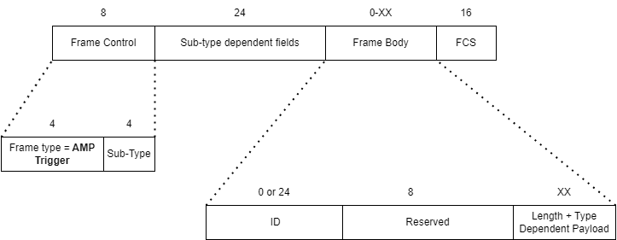
AMP Trigger Frame Format
Trigger Frame and its sub-types are already defined in the SDF[1]. We propose relocating the sub-type field for the Trigger Frame into the Frame Control field.
The Sub-Type field indicates the type of communication that will occur during the current TXOP. This early indication allows tags of other types to enter sleep mode immediately after receiving the Frame Control field, thereby conserving energy.
Additionally, Sub-Type Dependent fields can be used to carry supplementary data relevant to the specific communication type.
Notes:
This frame format is an AMP Trigger frame to indicate the start of the UHF or Active TX slots-based frame exchange.

Slide 4
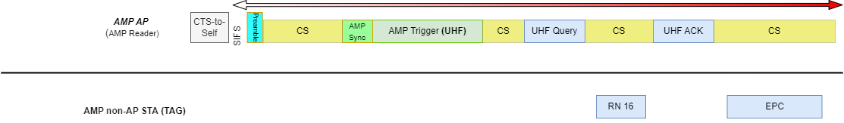
AMP UHF Trigger
Instead of attaching the frame type to every UHF frame in AMP [2], we define a Sub-Type within the AMP Trigger frame to signal the start of the UHF frame sequence to all AMP STAs.
The UHR trigger acts as a trigger for an instance of the EPC Gen2 protocol
STAs, such as dual-mode AMP tags, will begin listening for and responding to UHF RFID commands.
This approach simplifies the MAC layer and facilitates easier extension for supporting all EPC Gen2 commands.

Slide 5
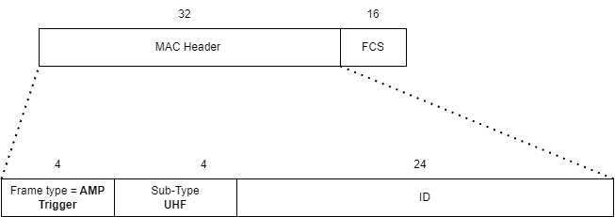
AMP Trigger Frame for UHF
This frame format is an AMP Trigger frame to indicate the start of the UHF frame exchange.
The Sub-Type field is to indicate that UHF commands and responses will be transmitted in this TXOP.
The ID field can carry the address of the reader.
There is no Frame Body.

Slide 6
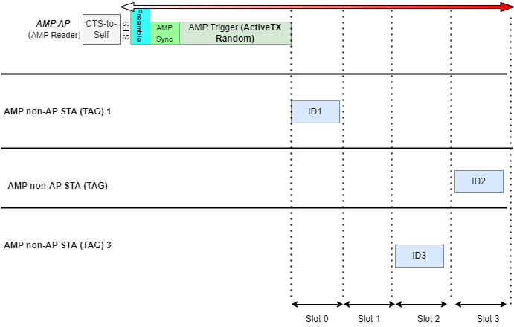
Active TX Time-slot based random access
One of the proposed modes for Active TX in AMP is random-access[3].
An example of random-access Active TX with ECW/ACW = 2:

Slide 7
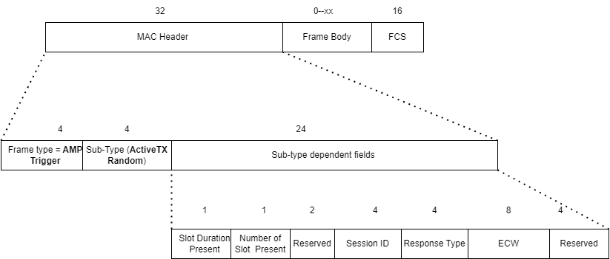
AMP Time-slot based random access
For random access Active TX the Sub-Type in the trigger frame will indicate that.
There are some Sub-type dependent fields in the MAC header; these fields determine the Frame body for this trigger frame.

Slide 8
AMP Time-slot based random access (2)
Sub-type dependent fields are as follows:
There are flags for Slot Duration present and Number of Slots Present
Then two bits Reserved field
Session ID identifies the random-access session
Response Type indicates the type of the solicited uplink response e.g., ID, Sensor Data, etc.
ECW represents total number of random-access slots = 2^{ECW} Allows up to 256 slots
Slot Duration is the time for each slot.
In the end, there is a reserved field.
Notes:
Update the image Reserved

Slide 9
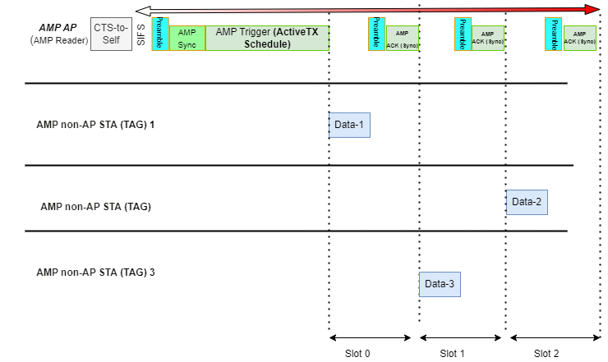
Time-slot based scheduled access example
An example of scheduled access Active TX [4] with ECW = 2:

Slide 10
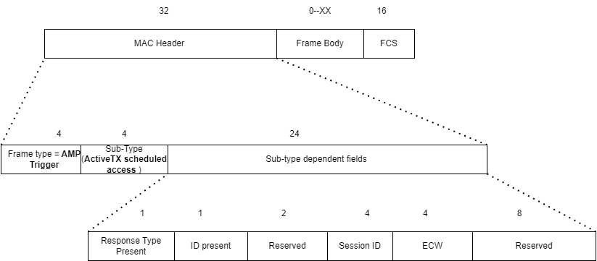
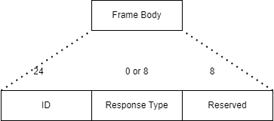
Active TX Time-slot based scheduled access
For scheduled access Active TX the Sub-Type in the trigger frame will indicate that.
There are some sub-type dependent fields as follows:
Response Type present = 1 Response type field is in the Frame body
ID present indicates if the is in the Frame Body
Session ID represents the scheduled access session
ECW represents total number of random-access slots = 2^{ECW} , allowing up to 16 slots
There are a couple of reserved bits for future use.
Notes:
Swap the order in the frame body and in the flags

Slide 11
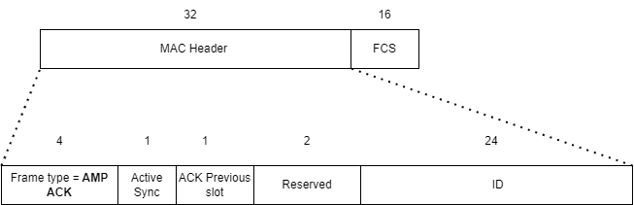
Active TX Time-slot based scheduled access (2)
For scheduled access in Active TX, the ACK frame [5] can be adjusted to simultaneously synchronize [6] the next slot while acknowledging the previous one.
Active Sync = 1 when it is an Active TX Sync as well
ACK previous Slot = 1 will acknowledge the previous slot frame.
The ID in the end is the ID of the AMP non-AP STA (AMP Tag) to transmit in the next slot.

Slide 12
Conclusion
We define a standardized WUR-based trigger frame format for AMP
The intent is to start both Backscatter and Active TX TXOP with a similar trigger frame, with the first 8 bits containing type and subtype.
This can be extended to other Active TX methods proposed by the group.

Slide 13
SP 1
July 2025
Do you agree that TGbp defines a common trigger frame format that can be used for multiple TGbp AMP transmission modes?
References: 11-25/1258

Slide 14
SP 2
July 2025
Do you agree that TGbp defines a control frame that the receiver can use as an acknowledgement as well as sync?
References: 11-25/1258

Slide 15
SP 3
July 2025
Do you agree that the UHF frames following a UHF-Trigger frame will follow the EPC Gen2 format with no additional 802.11 MAC fields?
References: 11-25/1258

Slide 16
References
[1] Proposed Specification Skeleton for TGbp D0.1, 11-25/0614r3
[2] Rojan et al., Channel access for Backscatter non-AP AMP STAs - way forward, 11-25/0818,
[3] Rojan et al., Random access for Active Tx non-AP AMP STAs, 11-25/0817r0
[4] Rojan et al., Channel access for Active Tx non-AP AMP STAs – follow up, 11-25/0334r0
[5] Chuanfeng He et al., AMP Ack frame, 11-250859
[6] Ugo Campiglio., ACK Message in Time-Slot Based Channel Access for Active AMP STAs, 11-25/1128

