Slide 1
WUR-based frame formats for AMP devices
Date: 2025-07-31
Authors:

Slide 2
Abstract
We need to fix the length of the MAC header to keep it consistent and easy to design tags.
We can keep inside the MAC header variable except the Frame Type.

Slide 3
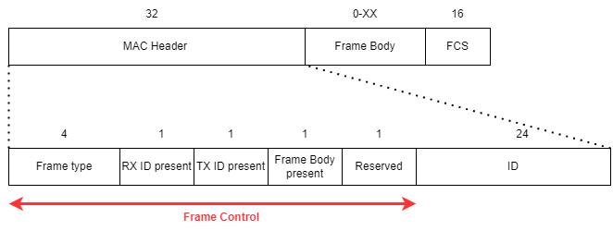
WUR inspired frame format
Frame type is 4 bits. The least significant bit of the frame type will be 1 only for protected type frames.
If the TX ID present = 1 [2], then ID will be at the start of the Frame Body.
A shorter 24-bit ID is suggested for AMP STAs
  a) There are fewer collisions of addressing
  b) 24 bits = half of a MAC address (minus the 24-bit OUI - you can map AMP addresses to MAC addresses).
  c) The Company ID part in the EPC is also 24 bits (can be used to filter tags in the trigger)
Notes:
RN16 is only unique for the tag contending for a particular slot orders in less number of tags

Slide 4
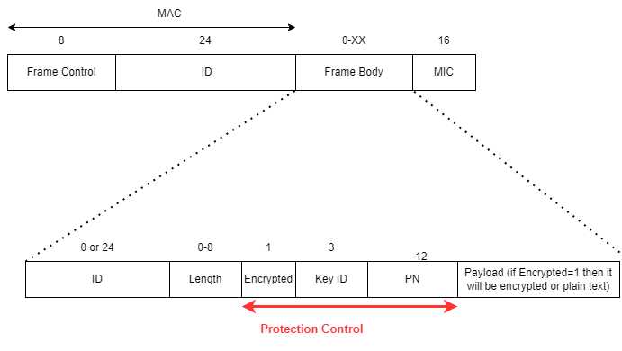
AMP Protected Frame[4]
July 2025
For frames protected by encryption the Frame type field will indicate that it is protected.
Protection Control header is added in the Frame Body before the payload
Payload will be encrypted if the Encrypted = 1 in the Protection Control

Slide 5
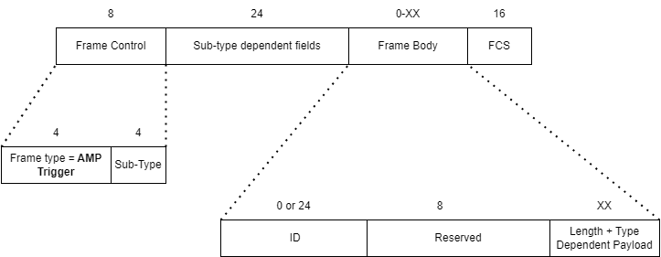
AMP Trigger Frame
  The MAC header will be the same for the Trigger Frames
  There are multiple subtypes for the AMP Trigger Frames

Slide 6
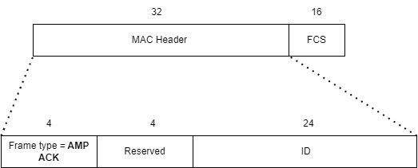
AMP ACK Frame Format
ACK frames[3] can be transmitted by an AMP STA in response to other AMP frames, like AMP trigger and data frames.
These frames have an ID that can be associated with a single STA or a group of STAs.
Some more information can be sent in the reserved fields.

Slide 7
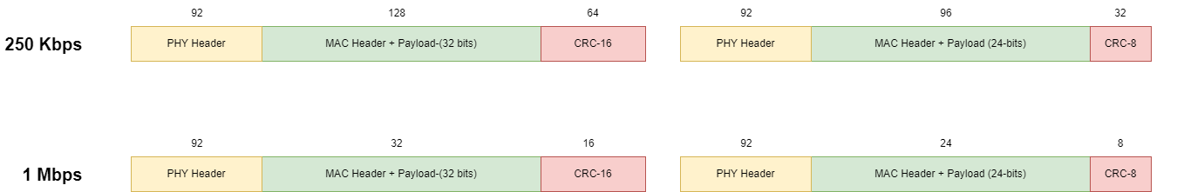
Overhead of a smaller CRC in ACK
EPC Gen2 has a 16-bit CRC in the standards
The savings in medium time are negligible
It makes hardware more costly and complex
The shorter CRC will give you less reliability
Data Rate | Total Transmission time (µsecs) | Saved by using CRC-8 (µsecs) | % saved
250 Kbps | 504 | 32 | 6.3%
1 Mbps | 264 | 8 | 3%

Slide 8
Conclusion
Keep the length of the MAC header, frame control, and FCS the same for all the frame types.
The intent is to be consistent and make the MAC protocol easier to implement.

Slide 9
SP 1
Do you agree to add to 11bp SFD:
Frame Control of 8 bits is present at the start of each AMP frame.
References: 11-25/1257

Slide 10
SP 2
Do you agree to add to 11bp SFD:
The size of the ID field in AMP frames is 24 bits each.
References: 11-25/1257

Slide 11
SP 3
Do you agree to add to 11bp SFD:
MAC header of 32 bits, including Frame Control, is present in all AMP frames.
References: 11-25/1257

Slide 12
References
[1] Proposed Specification Skeleton for TGbp D0.1, 11-25/0614r3
[2] Rojan et al., AMP Frame Format, 11-25/1102,
[3] Chuanfeng He et al., AMP Ack frame, 11-250859
[4] Rojan et al., AMP Security - follow up, 11-25/0819

