Slide 1
Coexistence of NPCA and DBE Mechanism
Date: 2024-07-xx
Authors:
Name | Affiliations | Address | Phone | Email
Shravan Kumar Kalyankar | Huawei | 9 N Buona Vista Dr, Singapore 138588 |  | kalyankar.shravan.kumar@huawei.com
Huang Lei
Rojan Chitrakar
Yunbo Li
Stephen McCann
Shi Zhenpeng

Slide 2
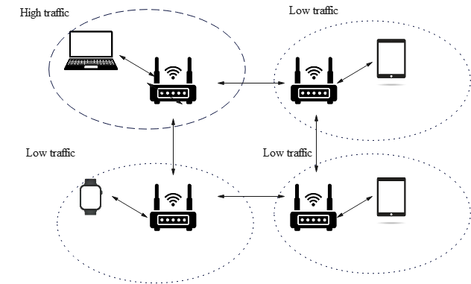
Background: DBE
Motivation: In a dense enterprise network, AP channel widths are typically 20 MHz or 40 MHz to minimize inter-BSS contention. In an coordinated AP scenario, to address high traffic demand at one of the APs, when the neighboring APs have low traffic, the AP experiencing the high traffic load may expand the operating bandwidth.
Fig. 1. Motivation for DBE.
References:
Maximizing channel bandwidth in dense AP deployments, Malcolm Smith, Cisco Systems, Jan 2024.
Dynamic Bandwidth Selection Signaling Details, Binita Gupta, Cisco Systems, Oct. 2024.
Dynamic Bandwidth Expansion (DBE) Operation and Signaling Details, Binita Gupta, Cisco Systems, Mar. 2025.

Slide 3
Background: DBE
37.x Dynamic bandwidth expansion (DBE)
Dynamic bandwidth expansion (DBE) is a mode of operation that allows a UHR AP to dynamically enable operation with an expanded bandwidth that is greater than its BSS bandwidth and up to the AP’s maximum supported DBE bandwidth, for UHR non-AP STAs that support DBE mode. When an AP is operating with an expanded operating bandwidth, the expanded bandwidth is referred to as the DBE bandwidth and DBE mode is enabled on the AP. When an AP is no longer operating with an expanded bandwidth greater than the BSS bandwidth, the DBE mode becomes disabled on the AP.
When DBE mode is enabled, the DBE bandwidth can be changed to a value that is greater than the BSS bandwidth. The BSS primary channel does not change when either: the DBE mode is enabled, the DBE bandwidth is changed or the DBE mode is disabled. When an AP has the DBE mode enabled, non-AP STAs that do not support DBE mode continue to operate with the BSS bandwidth.
Reference:
4. PDT-MAC-DBE

Slide 4
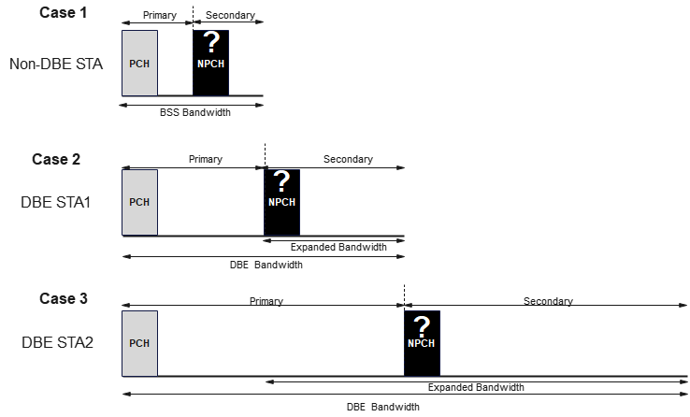
NPCA and DBE Co-existence Issue
The proposed method [2] restricts the legacy STAs (non-DBE STAs) from using an NPCA mechanism while AP DBE mode is enabled, resulting in the unfair treatment of STAs. Furthermore, one NPCH outside the E-BW would not effectively address the STA with a different DBE BW and the legacy STA’s.
In the case 1, the non-DBE STA can operate only in the BSS bandwidth, and the NPCH is located in the secondary channel. To support the non-DBE STA, the AP should fix the NPCH in the BSS bandwidth secondary channel. However, if the OBSS is wider than the entire BSS bandwidth, the DBE-AP and DBE-STAs loose the opportunity of using the NPCA mechanism to communicate without any interruption.
Similarly, in case 2, the DBE-AP assigns the NPCH in the expanded bandwidth. However, this new NPCH is outside the BSS bandwidth, restricting the non-DBE STA from using the NPCA mechanism. Furthermore, if the OBSS is wider than the primary channels of the expanded bandwidth of DBE-AP, the DBE-AP fails to utilize the NPCA mechanism, limiting the efficiency of the NPCA mechanism.
In case 3, if we assume that the DBE-AP shifts the NPCH to the secondary channels of the DBE-AP expanded bandwidth; the non-DBE-STA and DBE-STA1 fail to access the NPCH in the case of an OBSS, as the NPCH is outside their maximum bandwidth. Therefore, identifying a single NPCH that supports a non-DBE-STA and DBE-STA1/DBE-STA2 (i.e. a DBE-STA with varying max. BW) is highly complicated and results in misalignment issues.
Fig. 2. Challenges in using one NPCH with varying bandwidths.

Slide 5
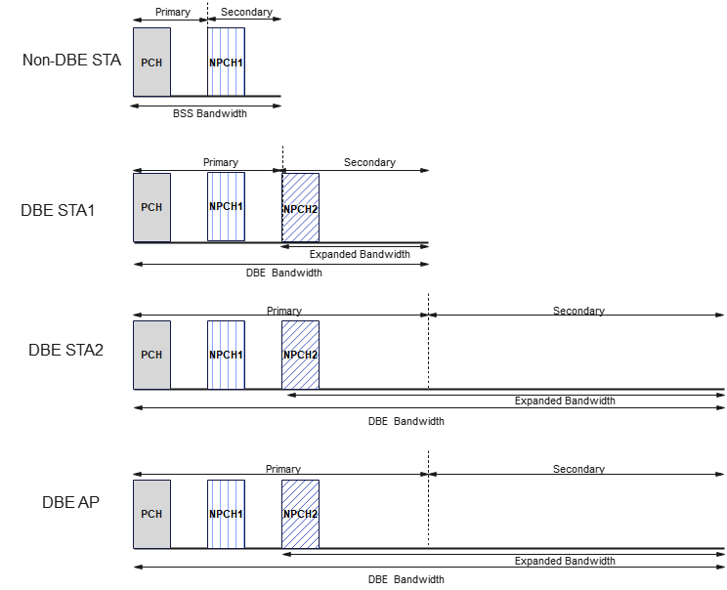
Recommended Solutions
DBE AP Disables NPCA mode:
Option 1. The DBE AP disables NPCA mode, so that all the STAs will disable the NPCA mode. A simple solution, to avoid ambiguity among STAs in the case of OBSS and treats all the STAs with fairness.
DBE AP Enables NPCA mode:
Option 2. The DBE AP announces two NPCHs, one in the BSS bandwidth and the other outside the BSS bandwidth.
If the OBSS occurs on the PCH, all the STAs will switch to the NPCH (in the BSS bandwidth).
If the OBSS occupies the entire BSS bandwidth, the STAs with expanded bandwidth switch to the NPCH channel (outside the BSS bandwidth).
Note: One NPCH is used at a time.
Fig. 3. Two NPCH approach.

Slide 6
Summary
In this contribution, we explored potential co-existence challenges of the NPCA and DBE mechanisms.

Slide 7
References
Maximizing channel bandwidth in dense AP deployments, Malcolm Smith, Cisco Systems, Jan 2024.
Dynamic Bandwidth Selection Signaling Details, Binita Gupta, Cisco Systems, Oct. 2024.
Dynamic Bandwidth Expansion (DBE) Operation and Signaling Details, Binita Gupta, Cisco Systems, Mar. 2025.
PDT-MAC-DBE

Slide 8
Straw Poll 1
Do you support the AP Disables the NPCA mode before Enabling the DBE mode?
Y/N/A

Slide 9
Straw Poll 2
Do you support that the AP announces two or more NPCHs, one within the BSS bandwidth and the other outside of the BSS bandwidth?
Y/N/A

