Slide 1
Further details of Duty-cycle operation for AMP
July 2025
Doc.: IEEE 802.11-25/1252r0
Date: 2025-07-22
Authors:
Name | Affiliation | Address | Phone | Email
Chuanfeng He | OPPO |  |  | hechuanfeng@oppo.com
Weijie Xu |  |  |  | xuweijie@oppo.com
Yinan Qi |  |  |  | v-qiyinan@oppo.com

Slide 2
July 2025
Doc.: IEEE 802.11-25/1252r0
Background
  For AMP communication, power storage is necessary for AMP STA to supply the operation power when simultaneously harvested power only is not enough to cover the consumed power[1].
  Power saving from duty cycle
    It is challenging for AMP STA to perform consistent monitoring for potential AMP trigger for uplink transmission due to limited power storage.
    Duty-cycle operation can reduce the time duration of AMP STAs Rx, which are the main contributors of power consumption during awake time.
  The motions related to duty cycle operation were agreed [2].
  MM-1: If AMP device is able to support AMP TSF, the maximum timing offset is ±10⁴ ppm.
  MM-2: 11bp defines a mechanism to allow an AP to solicit AMP uplink PPDU(s) from one or more 802.11bp clients.
  MM-4: If an AMP device is able to support TSF, it can monitor AMP DL Frame in a duty-cycle manner.
Slide 2
Chuanfeng He (OPPO)

Slide 3
July 2025
Doc.: IEEE 802.11-25/1252r0
Duty cycle operation for use cases
  Logistics like use cases: short term detection and identification
    Short latency is required for quick trigger detection and uplink transmission for AMP STA identification.
    Small form factor is required. Capacitor is used for energy storage from RF power harvesting.
    Short duty cycle is assumed to address low latency and limited awake duration. Typical duty cycle may be several or dozens of milliseconds.
  Sensor like use cases: long term monitoring and reporting
    The reporting frequency of sensor data is low. Short awake duration for reporting and long idle duration for power save can be assumed.
    Capacitor or solid-state battery can be equipped for energy storage. Ambient power other than RF can be supported, e.g. solar.
    Long duty cycle can be used to allow power save. Typical duty cycle may be several minutes or hours.
  This submission focuses on the logistics like use cases, which addresses one shot and quick UL access. Time-slot based random access mechanism is applicable for the use cases. [3]
Slide 3
Chuanfeng He (OPPO)

Slide 4
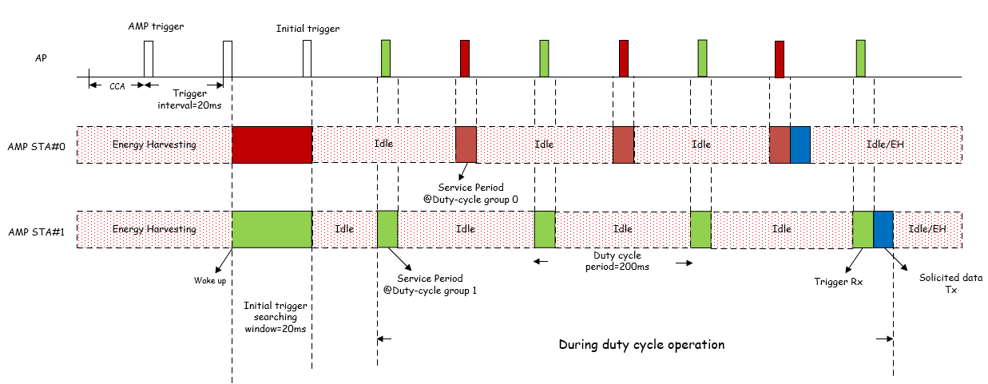
July 2025
Doc.: IEEE 802.11-25/1252r0
Duty-cycle operation procedure
  AMP STA monitors AMP trigger during initial trigger searching window to obtain
    Timestamp[4]
    Duty-cycle configuration, e.g. Duty-cycle period, Service Period length
    Duty-cycle Grouping Information to determine specific duty cycle period and service periods
  AMP STA derives its specific Duty-cycle group
    Determine Duty-cycle group based on Duty-cycle Grouping Information in AMP trigger
    Derive its specific duty cycle period and service periods corresponding to the Duty-cycle group
  AMP STA detects AMP trigger based on its specific Duty-cycle group and local TSF timer.
Slide 4
Chuanfeng He (OPPO)

Slide 5
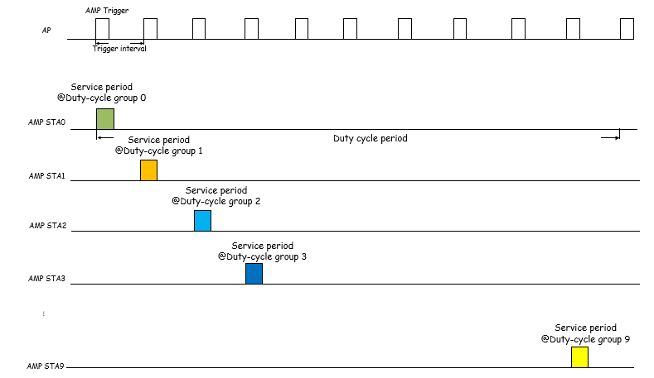
July 2025
Doc.: IEEE 802.11-25/1252r0
Duty-cycle Grouping
  Motivation of Duty-cycle Grouping
    Reduce power consumption through less trigger monitoring
    Distribute AMP STAs to different service period time to reduce collision
  Example of Duty-cycle Grouping procedure
    From AP side, it may transmit AMP trigger with a shorter trigger interval, e.g. 20ms.
    From AMP STA side, it detects AMP trigger with a longer Duty cycle period, e.g. 200ms.
    AMP STA detects an initial trigger after wake up, and receives the Duty-cycle group ID and total number of groups.
    AMP STA determines its Duty-cycle group through e.g. randomly selecting.
    AMP STA derives service periods corresponding to the selected Duty-cycle group.
      The time offset between service periods of adjacent Duty-cycle group ID is one trigger interval.
      Trigger interval and offset between selected and detected Duty-cycle group ID are used to derive service periods.
Slide 5
Chuanfeng He (OPPO)

Slide 6
July 2025
Doc.: IEEE 802.11-25/1252r0
Duty-cycle configuration delivery
  Duty cycle configuration
    Duty-cycle period
    Service period duration
    Trigger interval
    Duty-cycle Group ID (e.g. 0-9)
    Parameter for Duty-cycle grouping (e.g. number of Duty-cycle Group=10)
  Duty-cycle configuration in AMP trigger
    The main contribution of Duty-cycle configuration is to allow Duty-cycle operation for trigger monitoring.
    The main behavior of AMP STAs is the monitoring of AMP trigger after wakeup.
    The trigger interval should be short in logistics like use cases, due to energy constraints and low latency requirement. It means AMP trigger is transmitted more frequently, which leads to easier detection for AMP STA after wakeup with less energy consumption.
  Proposal:
    AMP STA can obtain Duty-cycle configuration through AMP trigger.
Slide 6
Chuanfeng He (OPPO)

Slide 7
July 2025
Doc.: IEEE 802.11-25/1252r0
Summary and proposals
  In this submission, further details of Duty-cycle operation for AMP are discussed.
    Duty-cycle operation procedure.
    Duty-cycle grouping procedure.
  To support Duty-cycle operation, it is proposed:
    AMP STA or STA group specific Duty-cycle operation is supported
    Duty-cycle configuration is indicated through AMP trigger frame
      Duty-cycle configuration includes Duty-cycle parameters, which include
        Duty-cycle period
        Service period duration
        Trigger interval
        Duty-cycle Group ID (e.g. 0-9)
        Parameter for Duty-cycle grouping
Slide 7
Chuanfeng He (OPPO)

Slide 8
July 2025
Doc.: IEEE 802.11-25/1252r0
Straw Poll #1
Do you agree with the following text:
  Duty-cycle configuration is carried in AMP trigger.
    Duty-cycle configuration includes duty cycle parameters, e.g. duty-cycle period, service period duration. Other information are TBD.
Yes
No
Abstain
Slide 8
Chuanfeng He (OPPO)

Slide 9
July 2025
Doc.: IEEE 802.11-25/1252r0
Straw Poll #2
Do you agree with the following text:
  AMP STA or STA group specific Duty-cycle operation is supported in 11bp.
Yes
No
Abstain
Slide 9
Chuanfeng He (OPPO)

Slide 10
Reference
July 2025
Doc.: IEEE 802.11-25/1252r0
IEEE 11-24/1500r0, Duty-cycle-amp-operation, OPPO
IEEE 11-24/1613r10, Specification framework for tgbp
IEEE 11-25/1253r0, Trigger based UL access for Active Tx AMP STAs, OPPO
IEEE 11-25/1251r0, Follow up on TSF for trigger based AMP communication, OPPO

