Slide 1
Follow up on TSF for trigger based AMP communication
July 2025
Doc.: IEEE 802.11-25/1251r0
Date: 2025-07-25
Authors:
Name | Affiliation | Address | Phone | Email
Chuanfeng He | OPPO |  |  | hechuanfeng@oppo.com
Weijie Xu |  |  |  | xuweijie@oppo.com
Yinan Qi |  |  |  | v-qiyinan@oppo.com

Slide 2
Background
Doc.: IEEE 802.11-25/1251r0
The motion about the support of AMP TSF, duty cycle operation and the trigger based AMP uplink PPDU transmission were agreed.[1]
  MM-1: If AMP device is able to support AMP TSF, the maximum timing offset is ±10⁴ ppm.
  MM-2: 11bp defines a mechanism to allow an AP to solicit AMP uplink PPDU(s) from one or more 802.11bp clients.
  MM-4: If an AMP device is able to support TSF, it can monitor AMP DL Frame in a duty-cycle manner.
  MM-23: 802.11bp defines short timestamp to enable AMP NON-AP STA to monitor DL frames in duty-cycle operation.
    The length of short timestamp is TBD..
Chuanfeng He (OPPO)

Slide 3
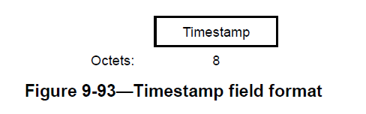
July 2025
Doc.: IEEE 802.11-25/1251r0
Recap: Timestamp
  Timestamp in legacy 802.11 standards
    Timestamp is used to synchronize the TSF timer of non-AP STAs in BSS.
    TSF timer is used for STAs to derive the time of TBTT, TWT, SP, and so on.
    Each STA shall maintain a TSF timer which is able to span 2⁶⁴ microseconds.
    The size of timestamp is 8 Octets, which is carried in Beacon or Probe Response frame.
Slide 3
Chuanfeng He (OPPO)

Slide 4
July 2025
Doc.: IEEE 802.11-25/1251r0
Timestamp size for AMP TSF
  Factors to determine timestamp size for AMP TSF
    The timing granularity of AMP TSF
      Significantly relax the timing granularity requirement for AMP, e.g. to 1024us, is acceptable
        Since the TSF clock accuracy is 10^4 ppm, for a 200ms duty cycle period, 2ms drifting will happen. It is not necessary to maintain fine timing granularity(i.e. 1us).
    The range of AMP TSF timer
      The range of AMP TSF timer can be determined to cover the duration of whole operation duration (e.g., time spending for the whole inventory procedure).
        In [2], we raised the assumption on energy storage and the procedure of success UL PPDU transmission. One practical maximum operation duration is about 2.02s.
        During the operation duration, TSF timer is used to determine the service periods based on the Duty-cycle configuration and finish the solicited UL data Tx.
      If we assume timestamp is available for each service period of Duty-cycle operation, period, the range of AMP TSF timer can be determined to cover the duration of Duty-cycle period.
Slide 4
Chuanfeng He (OPPO)

Slide 5
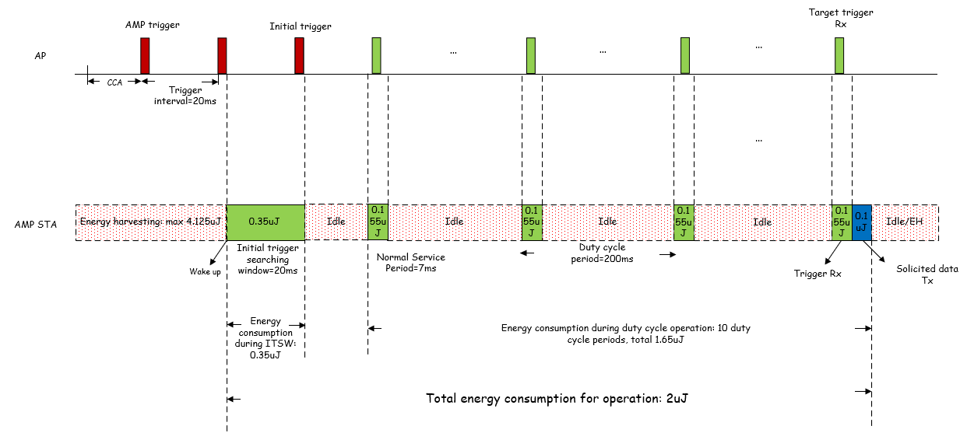
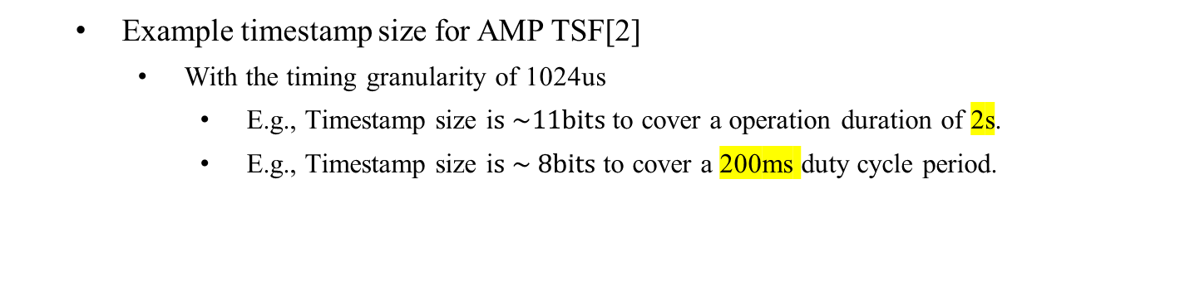
July 2025
Doc.: IEEE 802.11-25/1251r0
Timestamp size for AMP TSF
    Example timestamp size for AMP TSF[2]
      With the timing granularity of 1024us
        E.g., Timestamp size i$s \sim 11bits$to cover a operation duration of 2s.
        E.g., Timestamp size i$s \sim 8bits$to cover a 200ms duty cycle period.
Slide 5
Chuanfeng He (OPPO)

Slide 6
July 2025
Doc.: IEEE 802.11-25/1251r0
Short timestamp for AMP TSF
  Observations[3]:
    The total operation duration after wake up may be short due to limited energy storage and low latency for logistics like use cases. The TSF timer can only need to cover operation duration to make AMP STA timing synchronized before success UL PPDU transmission.
    Based on the assumption on energy storage and the procedure of success UL PPDU transmission, one practical maximum operation duration is 2.02s, which leads to 11 bits timestamp to cover it, with timing granularity of 1024us.
    Consider the low latency for logistics like use cases, maximum duty cycle period, e.g. 200ms, can be assumed, which leads to only 8 bits timestamp to cover it, with timing granularity of 1024us.
  Proposals:
    802.11bp defines short timestamp with coarse timing granularity.
    802.11bp defines short timestamp to cover a short time span.
Slide 6
Chuanfeng He (OPPO)

Slide 7
July 2025
Doc.: IEEE 802.11-25/1251r0
Short timestamp delivery
  Why deliver timestamp in AMP trigger:
    The main contribution of timestamp is to enable Duty-cycle operation for trigger monitoring.
    The main behavior of AMP STAs is the monitoring of AMP trigger after wakeup. At least for logistics like use cases, AMP trigger may be the only frame AMP STA will monitor in order for solicited UL PPDU Tx.
    The trigger interval should be short in logistics like use cases, due to energy constraints and low latency requirement. It means AMP trigger is transmitted more frequently, which leads to easier detection for AMP STA after wakeup with less energy consumption.
  Proposal:
    AMP STA can obtain a short timestamp through AMP trigger.
Slide 7
Chuanfeng He (OPPO)

Slide 8
July 2025
Doc.: IEEE 802.11-25/1251r0
Proposal
  802.11bp defines short timestamp with coarse timing granularity.
  802.11bp defines short timestamp to cover a short time span.
  AMP STA can obtain a short timestamp through AMP trigger frame.
Slide 8
Chuanfeng He (OPPO)

Slide 9
July 2025
Doc.: IEEE 802.11-25/1251r0
Straw Poll #1
Do you agree with the following text:
  802.11bp defines short timestamp with coarse timing granularity and short time spanning.
Yes
No
Abstain
Slide 9
Chuanfeng He (OPPO)

Slide 10
July 2025
Doc.: IEEE 802.11-25/1251r0
Straw Poll #2
Do you agree with the following text:
  802.11bp supports short timestamp indication through AMP trigger frame.
Yes
No
Abstain
Slide 10
Chuanfeng He (OPPO)

Slide 11
Reference
July 2025
Doc.: IEEE 802.11-25/1251r0
IEEE 802.11-24/1613r10, Specification framework for tgbp
IEEE 802.11-25/0813r0, Follow up on Duty-cycle operation for AMP, OPPO
IEEE 802.11-25/0814r0, Follow up on TSF for trigger based AMP, OPPO

