Slide 1
Discussions on DL Sync Field for Non-Backscatter STAs: Part II
July 2025
Date: 2025-07-28
Authors:
Name | Affiliations | Address | Phone | Email
Bin Qian | Huawei | Shenzhen, China |  | qianbin14@huawei.com
Lumin Liu |  | Singapore
Lei Huang |  | Singapore
Panpan Li |  | Singapore
Notes:
September 2012

Slide 2
Introduction
July 2025
Two types of Sync field detectors are considered based on STA capabilities
This part introduces a unified Sync field that works with both detector types
Feature | Correlation-Based Detector [1] | Differential Decoder [2]
Hardware Complexity | High: requires multi-bit correlator and AGC | Low: uses 1-bit correlator, no AGC
Energy Measurement | Absolute energy used, different from data processing | Only relative energy used, same as data processing
Sequence Requirement | Good auto-correlation property | Must be Manchester-encoded
Robustness | High: can suppress noise and interference via correlation thresholding | Low: may falsely trigger on noise or interference
Applicable STA Types | High-end active transmitters AMP Enabled non-AP STAs | Low-end active transmitters

Slide 3
Recap: PSLR Degradation from Manchester Encoding
July 2025
An example of a well-optimized sequence with optimal PSLR (peak-to-sidelobe ratio) of 4
  Original: s = 0 0 1 0 1 1 0 1 1 1 0 0 0 1 1 0
After applying full Manchester encoding
  Modified: s’ = 0 1 1 0 1 0 0 1 1 0 0 1 0 1 1 0
Observation: Significant degradation in PSLR after encoding
  Full Manchester encoding negatively impacts correlation-based detector performance

Slide 4
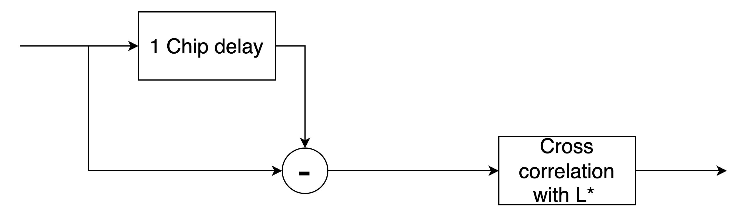
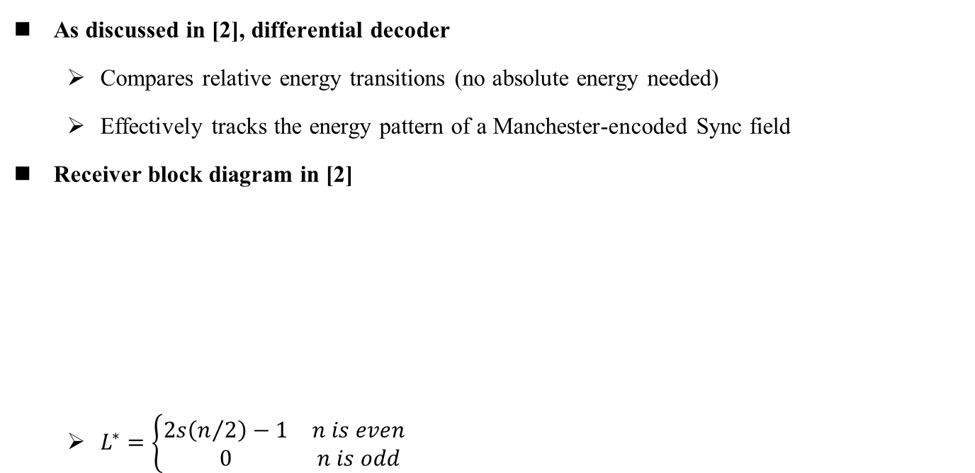
How Differential Decoder Works
July 2025
As discussed in [2], differential decoder
  Compares relative energy transitions (no absolute energy needed)
  Effectively tracks the energy pattern of a Manchester-encoded Sync field
Receiver block diagram in [2]
  $L^{∗}=\left\{\begin{matrix}2s\left(n/2\right)−1 & n is even \\ 0 & n is odd\end{matrix}\right.$

Slide 5
Unified Sync Field: Hybrid Sequence
July 2025
Full Manchester encoding compromises correlation performance
Proposal: Use a hybrid sequence including Manchester-encoded bits and some chip exceptions
Outcome:
  Maintains Manchester decoding compatibility for differential decoder
  Retains high auto-correlation performance for correlation-based detection
Sequence Length | # Manchester-Encoded Bits | # Chip Exceptions
16 | 7 | 2
24 | 10 | 4
32 | 13 | 6

Slide 6
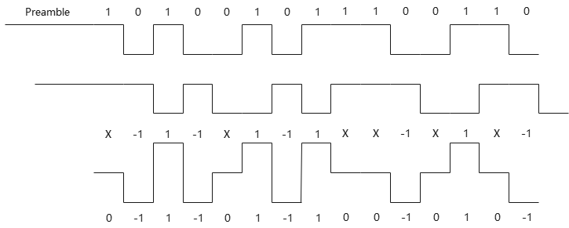
Hybrid Sequence Example
July 2025
Example hybrid sequence
  s = 1 0 1 0 0 1 0 1 1 1 0 0 1 1 0 0
  In the figure, ‘x’ denotes an uncertain bit, which may randomly take the value 1 or 0 due to noise
  The local reference sequence is modified to match the Sync field and ensure proper detection despite chip exceptions and different from [2]
Received signals without noise
Received signals with 1 chip delay
Received signals minus delayed signals
Local reference sequence

Slide 7
Hybrid Sequence Example (cont.)
July 2025
Length-24 sequence example: 0 1 0 1 1 0 1 0 0 0 1 0 1 1 0 0 1 1 1 0 1 1 0 0
Length-32 sequence example: 0 1 0 1 1 0 1 0 0 1 1 1 0 0 0 1 1 0 1 0 0 0 1 0 1 1 1 0 1 1 0 0

Slide 8
False Alarm Issue of Differential Decoder
July 2025
Differential decoder is highly sensitive to noise
  Noise may be interpreted as chip ‘0’ or ‘1’ randomly
To achieve a false alarm rate < 1%, two enhancements can be applied
  Increase the number of known bits of the output of the differential decoder, i.e., the absolution peak value after correlation
  Extend the special segment length
Sequence Length | Positive Peak Value | Negative Peak Value
16 | 9 | -10
24 | 15 | -14
32 | 19 | -18
2x16 | 19 | -20

Slide 9
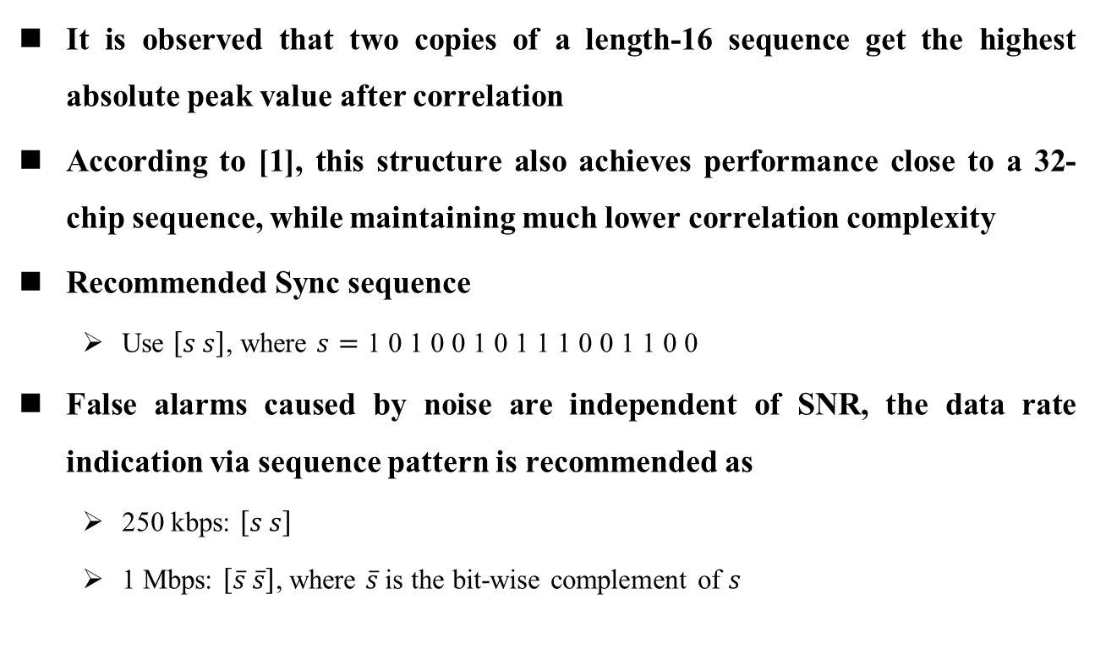
Recommended Sync Sequence
July 2025
It is observed that two copies of a length-16 sequence get the highest absolute peak value after correlation
According to [1], this structure also achieves performance close to a 32-chip sequence, while maintaining much lower correlation complexity
Recommended Sync sequence
  Use $\left[s s\right]$, where $s=\text{1 0 1 0 0 1 0 1 1 1 0 0 1 1 0 0}$
False alarms caused by noise are independent of SNR, the data rate indication via sequence pattern is recommended as
  250 kbps: $\left[s s\right]$
  1 Mbps: $\left[\overline{s} \overline{s}\right]$, where $\overline{s}$is the bit-wise complement of $s$

Slide 10
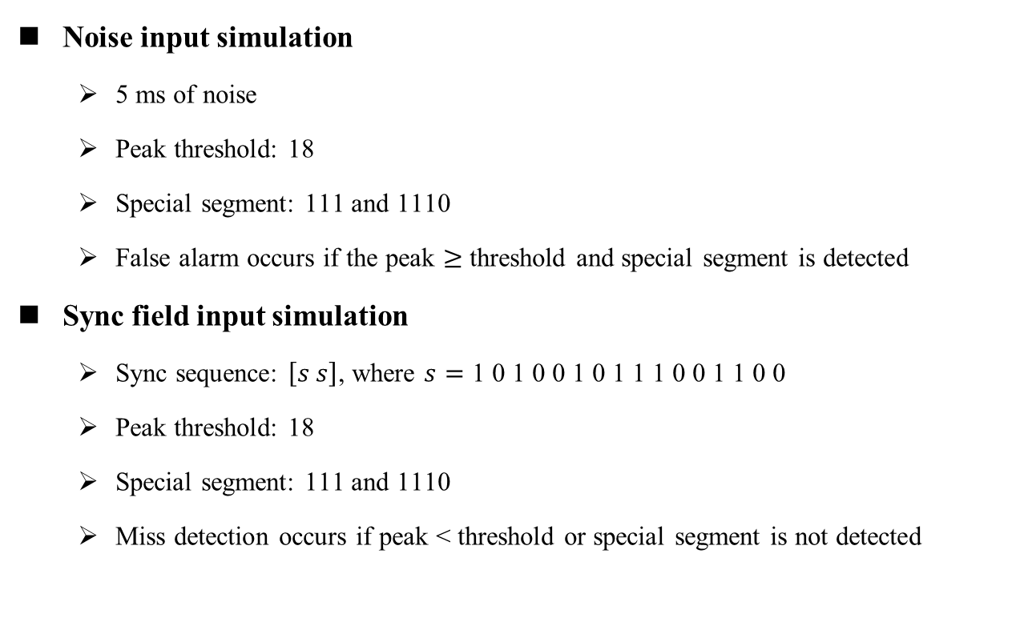
Simulation Settings
July 2025
Noise input simulation
  5 ms of noise
  Peak threshold: 18
  Special segment: 111 and 1110
  False alarm occurs if the peak $≥$ threshold and special segment is detected
Sync field input simulation
  Sync sequence: $\left[s s\right]$, where $s=\text{1 0 1 0 0 1 0 1 1 1 0 0 1 1 0 0}$
  Peak threshold: 18
  Special segment: 111 and 1110
  Miss detection occurs if peak < threshold or special segment is not detected

Slide 11
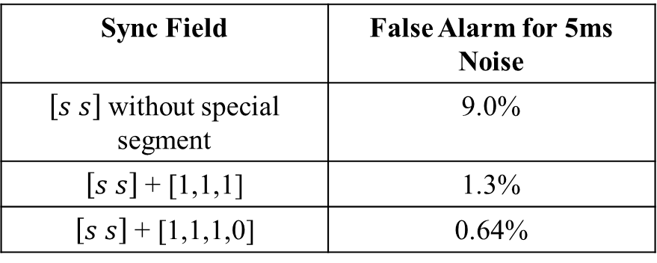

Simulation Results
July 2025
False alarm rate due to noise
Once the Sync sequence is detected, half of its average chip energy is used as the reference to detect the special segment
The combination of $\left[s s\right]$ and a 4-chip special segment achieves a false alarm rate below 1%
Sync Field | False Alarm for 5ms Noise
$\left[s s\right]$ without special segment | 9.0%
$\left[s s\right]$ + [1,1,1] | 1.3%
$\left[s s\right]$ + [1,1,1,0] | 0.64%

Slide 12
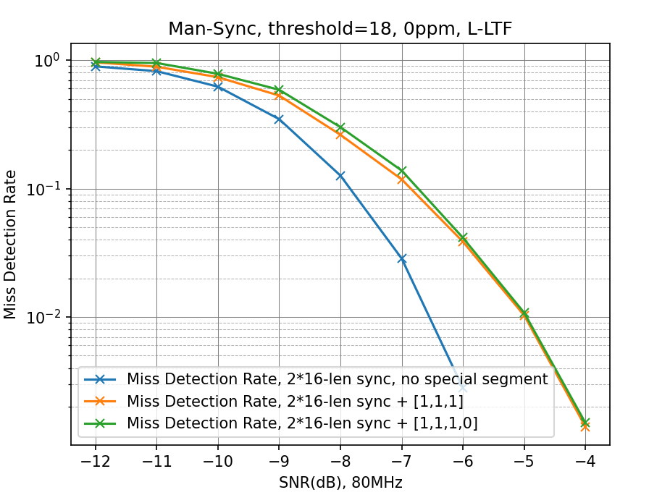
Simulation Results
July 2025
Miss detection rate when Sync field is the input
  Assuming perfect timing
The addition of a special segment results in approximately 1 dB degradation in miss detection performance, while the impact of adding one more chip to the segment is negligible

Slide 13
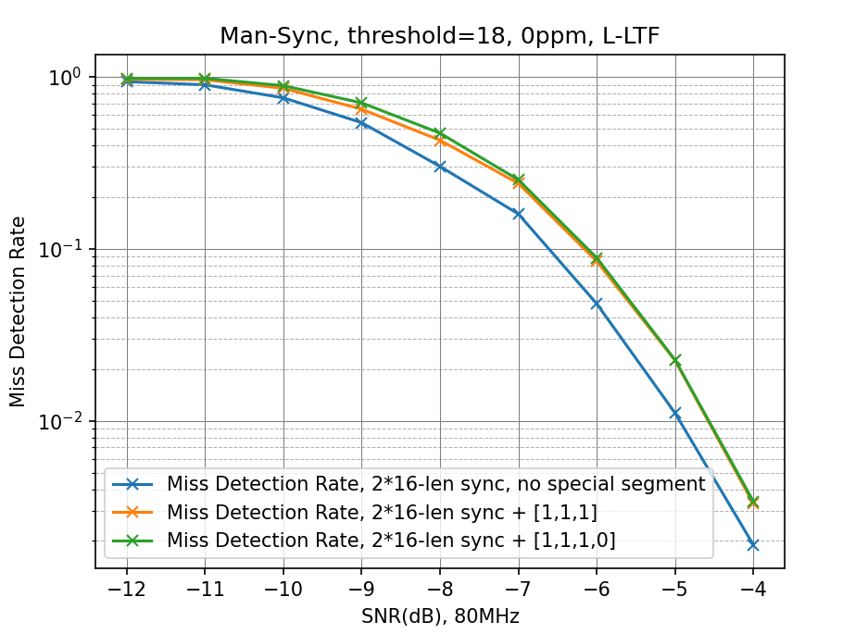
Simulation Results
July 2025
Miss detection rate when Sync field is the input
  Detection is performed using two timing hypotheses, spaced 50% of a chip duration apart
Results show a 1.2 dB performance loss compared to the perfect timing case without the special segment, and a 0.6 dB loss compared to the perfect timing case with the special segment

Slide 14
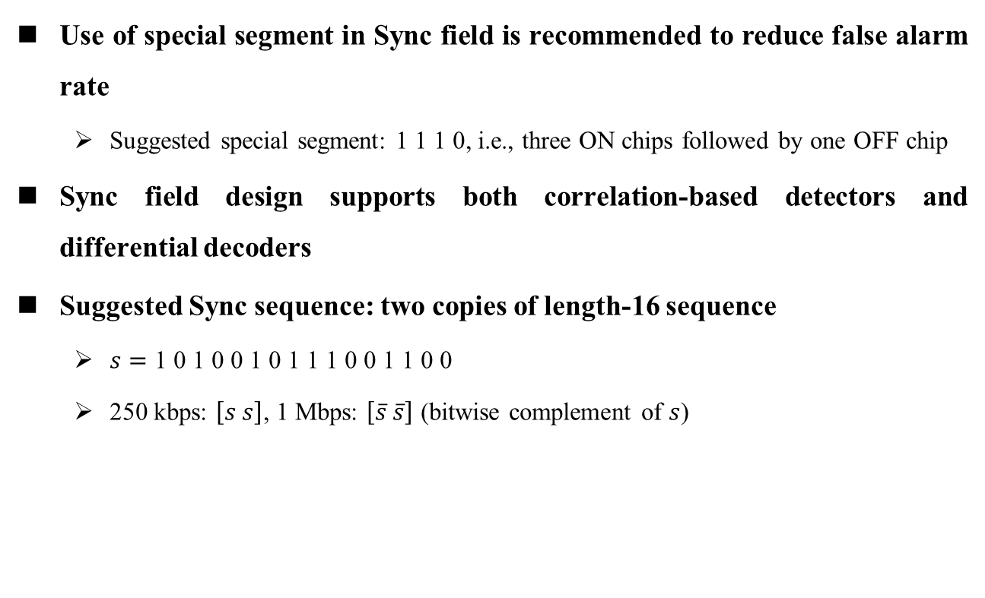
Summary
July 2025
Use of special segment in Sync field is recommended to reduce false alarm rate
  Suggested special segment: 1 1 1 0, i.e., three ON chips followed by one OFF chip
Sync field design supports both correlation-based detectors and differential decoders
Suggested Sync sequence: two copies of length-16 sequence
  $s=\text{1 0 1 0 0 1 0 1 1 1 0 0 1 1 0 0}$
  250 kbps: $\left[s s\right]$, 1 Mbps: $\left[\overline{s} \overline{s}\right]$ (bitwise complement of $s$)

Slide 15
Straw Poll #1
July 2025
Do you agree to add following content to TGbp SFD:
  The AMP-Sync field of the AMP DL PPDU for non-backscatter STAs in 2.4 GHz supports both the correlation-based detector and the differential decoder

Slide 16
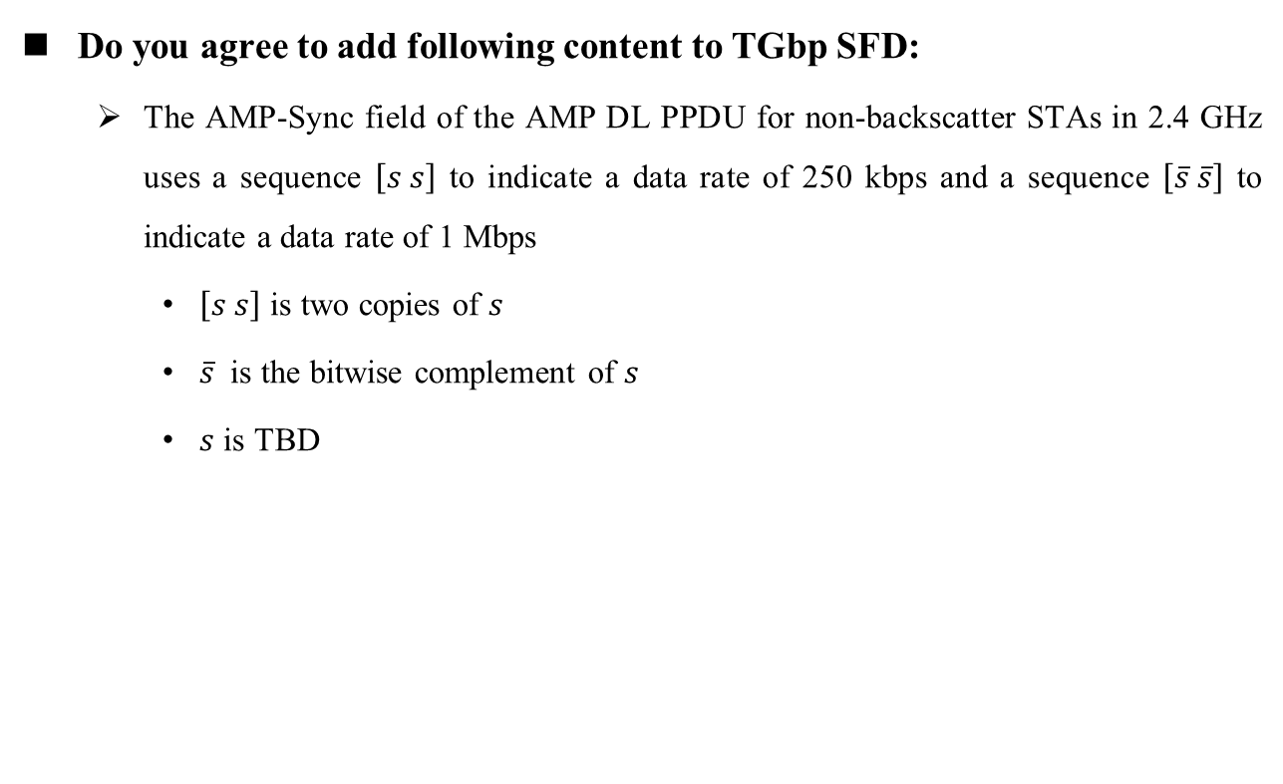
Straw Poll #2
July 2025
Do you agree to add following content to TGbp SFD:
  The AMP-Sync field of the AMP DL PPDU for non-backscatter STAs in 2.4 GHz uses a sequence $\left[s s\right]$ to indicate a data rate of 250 kbps and a sequence $\left[\overline{s} \overline{s}\right]$ to indicate a data rate of 1 Mbps
    $\left[s s\right]$ is two copies of $s$
    $\overline{s}$ is the bitwise complement of $s$
    $s$ is TBD

Slide 17
Straw Poll #3
July 2025
Do you agree to add following content to TGbp SFD:
  The AMP-Sync field of the AMP DL PPDU for non-backscatter STAs in 2.4 GHz includes a segment consisting of three ON chips followed by one OFF chip

Slide 18
References
July 2025
[1] Steve Shellhammer, et. al., 11-25-0794-00bp-initial-thoughts-on-amp-downlink-sync-field-design
[2] Amichai Sanderovich, et. al., 11-25-0705-00bp-an-analysis-of-sync-field-for-downlink-ppdu
[3] Bin Qian, et.al., 11-25-1248-00bp-discussions-on-dl-sync-field-for-non-backscatter-stas-part-1

Slide 19
Appendix
July 2025

Slide 20

Simulation Settings: Lenth-12 Sequence
July 2025
Noise input simulation
  5 ms of noise
  Peak threshold: 16
  Special segment: 111 and 1110
  Sync sequence: $\left[s s\right]$, where $s=\text{0 1 0 1 0 1 1 0 0 1 1 0}$
  False alarm occurs if the peak $≥$ threshold and special segment is detected

Slide 21
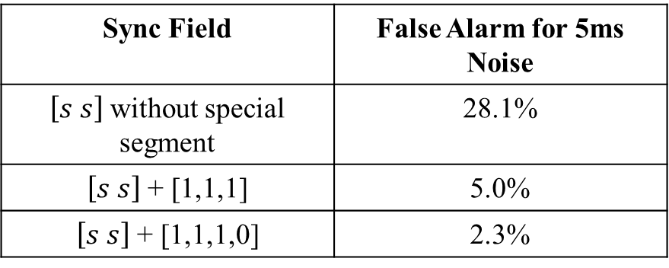
Simulation Results
July 2025
False alarm rate due to noise
Two copies of a length-12 sequence combined with a 4-chip special segment fail to achieve a false alarm rate below 1%
Sync Field | False Alarm for 5ms Noise
$\left[s s\right]$ without special segment | 28.1%
$\left[s s\right]$ + [1,1,1] | 5.0%
$\left[s s\right]$ + [1,1,1,0] | 2.3%

