Slide 1
Discussions on DL Sync Field for Non-Backscatter STAs: Part I
July 2025
Date: 2025-07-28
Authors:
Name | Affiliations | Address | Phone | Email
Bin Qian | Huawei | Shenzhen, China |  | qianbin14@huawei.com
Lumin Liu |  | Singapore
Lei Huang |  | Singapore
Panpan Li |  | Singapore
Notes:
September 2012

Slide 2
Introduction
July 2025
Two types of Sync field detectors are considered based on STA capabilities
  Correlation-based detector [1]
  Differential decoder [2] based on differential Manchester decoding
This work is divided into two parts
  Part I focuses on the correlation-based detector, with emphasis on complexity considerations
  Part II focuses on the differential decoder and unified Sync field design compatible with both detector types

Slide 3
Key Factors Driving Receiver Complexity and Power Consumption
July 2025
Non-backscatter STAs, especially active transmitters, are assumed to be low power consumption, and minimal hardware complexity
Key factors dominate receiver complexity and power
  Local reference sequence length
  Buffer size
  Correlation duration
    Continuous correlation over long detection window (e.g., 5ms) leads to high energy consumption
  Sampling rate
    Higher sampling rate = more samples per chip = higher buffer load

Slide 4
Local Reference Sequence and Correlation Complexity
July 2025
Local reference sequence length
  Longer local reference sequence requires more multiply-accumulate (MAC) operation, increasing power consumption per correlation
  Longer local reference sequence leads to higher processing load, greater hardware resource usage, and increased overall implementation complexity
Considering the long correlation duration, optimizing the sequence length is critical for minimizing computation overhead

Slide 5
Buffer Size and Sync Uncertainty Margin
July 2025
Buffer size is another key driver of receiver complexity and power. Larger buffers lead to increased memory demand, higher system-level complexity and greater energy consumption
  Buffer must store both the correlation window and the sync uncertainty margin
The sync uncertainty margin depends on threshold selection
  Threshold 1: Low threshold, e.g., the threshold is selected under noise-only consideration
    Trigger may occur at sidelobes, far from the main peak
    Sync position uncertainty may span the entire sequence length
  Threshold 2: High threshold, e.g., the threshold is selected to consider sidelobes
    Trigger occurs only near the main peak, sidelobes suppressed
    Sync position uncertainty is limited to a few chips

Slide 6
Buffer Size and Sync Uncertainty Margin (cont.)
July 2025
Sync position uncertainty for Threshold 2
Threshold 2
Threshold 1
Sync position uncertainty for Threshold 1

Slide 7
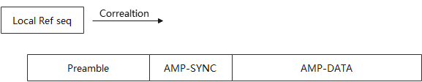
Buffer Size and Sync Uncertainty Margin (cont.)
July 2025
Conclusion
  Threshold 1 increases Sync uncertainty and forces worst case buffer allocation
  Threshold 2 enables tight Sync alignment and reduces buffer need
Data stored for TP1
We consider two trigger cases of Threshold 1
TP: trigger position
Data stored for TP2
Trigger position 2
Trigger position 1

Slide 8
Normalized Correlation
July 2025
The normalized correlation results are computed following the method described in [3]
Based on the CCDF analysis (shown in the next three slides)
  As SNR increases, the normalized correlation between noise and the local reference sequence remains stable
  However, the normalized sidelobe levels increase with SNR
  Extreme case: In the absence of noise, if the last chip of the reference sequence is ‘1’, this chip and the leading part of preamble can produce a sidelobe as strong as the correlation peak
It becomes difficult to select a fixed threshold that reliably suppresses sidelobes across a wide SNR range

Slide 9
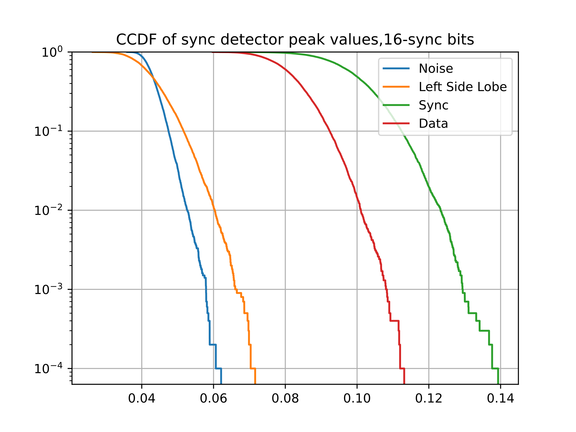
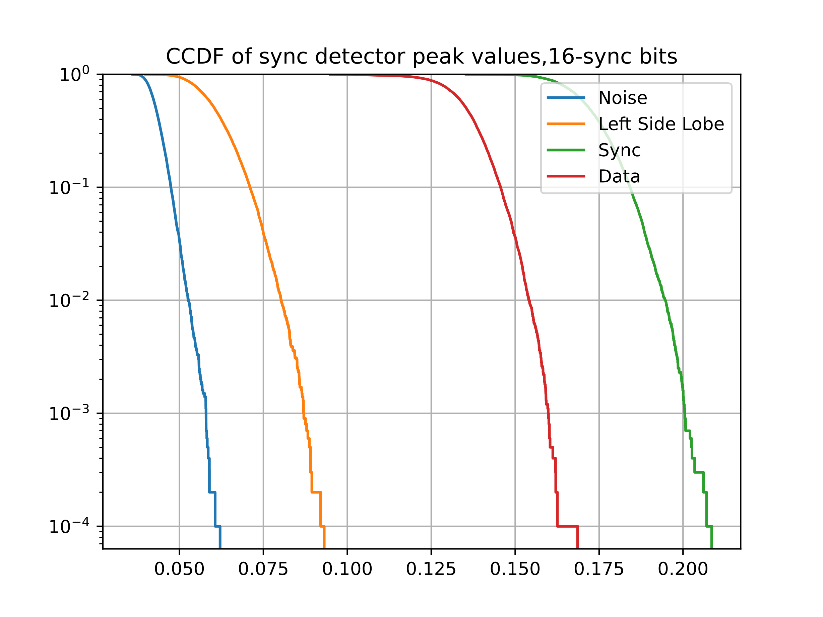
CCDF: Length-16
July 2025
When computing the correlation with noise, a 5ms noise is used as described in [4]
INR: interference to noise ratio
Normalized correlation results when SNR = INR = -6 dB
Normalized correlation results when SNR = INR = -3 dB

Slide 10
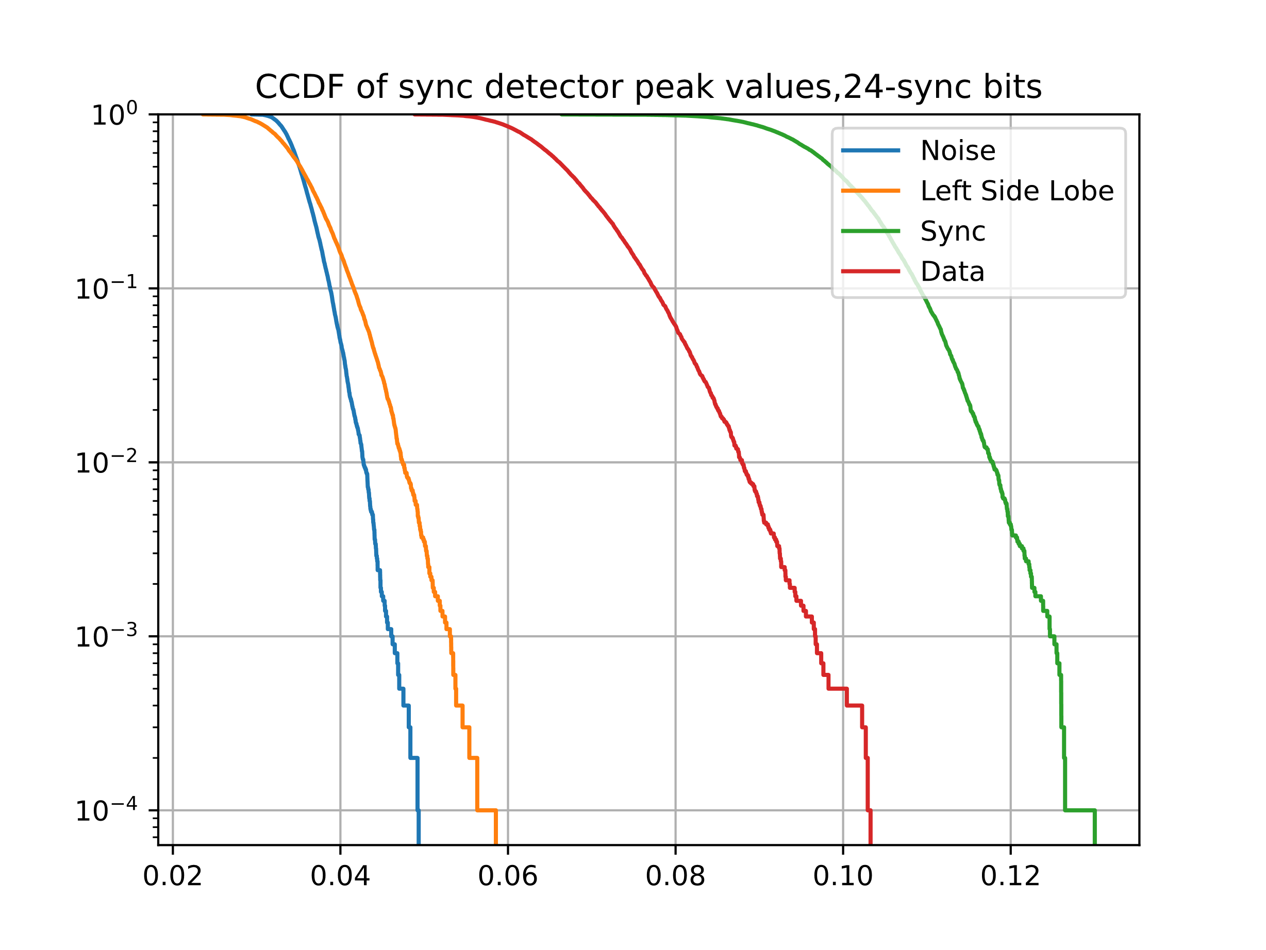
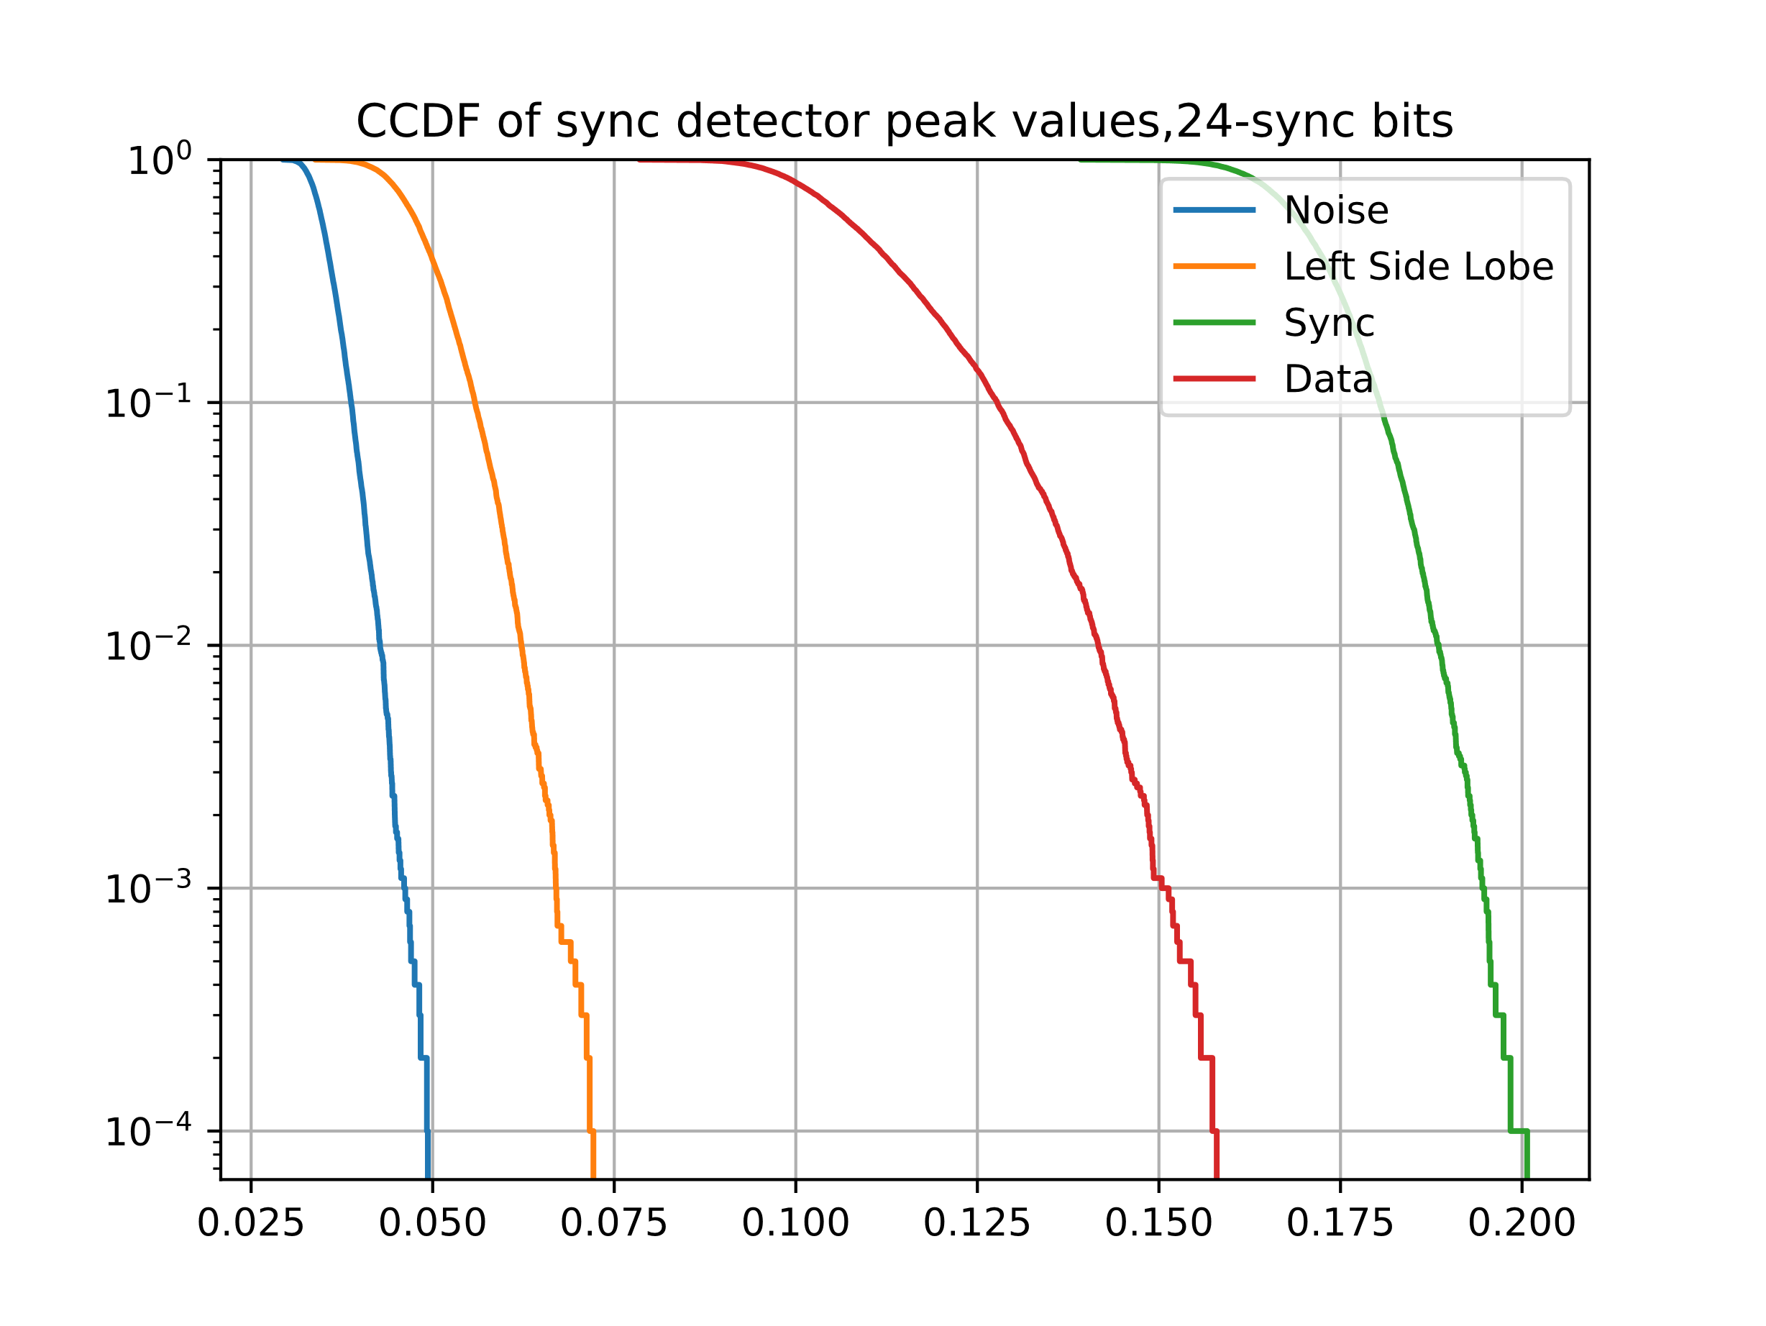
CCDF: Length-24
July 2025
Normalized correlation results when SNR = INR = -6 dB
Normalized correlation results when SNR = INR = -3 dB

Slide 11
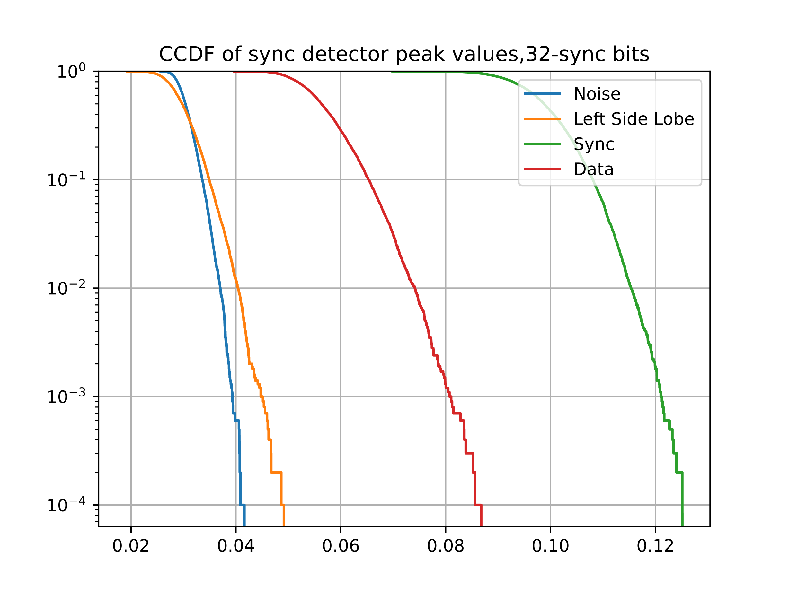
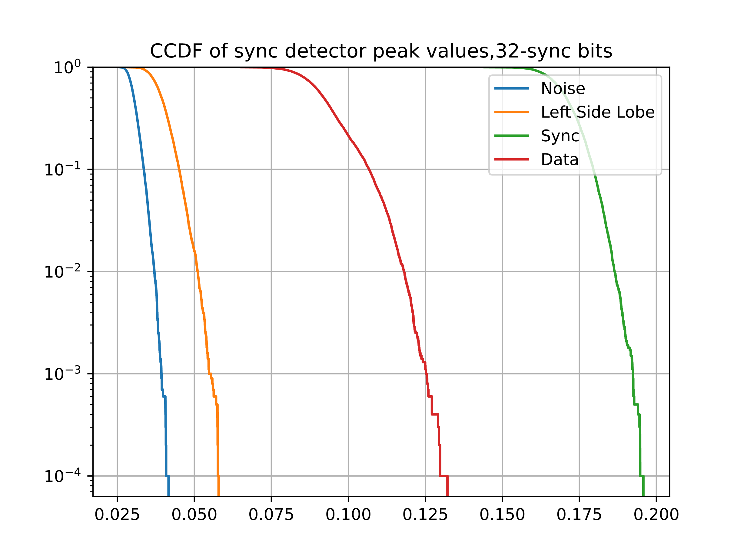
CCDF: Length-32
July 2025
Normalized correlation results when SNR = INR = -6 dB
Normalized correlation results when SNR = INR = -3 dB

Slide 12
Sync Detection Failure Rate Simulation
July 2025
Sync detection performance across different sequence lengths
Scenario | DL Sync
Timing assumption | Ideal timing
Channel | AWGN
Clock offset | 0 ppm
Sync sequence length | 16, 24, 32, 2x16
Threshold | 0.063, 0.049, 0.042, 0.042
Maximum offset between the detected peak position and the actual sync position | ±25% of a chip
Sync position uncertainty | Preamble duration + Sync duration

Slide 13


Sync Detection Failure Rate Simulation
July 2025
The Sync sequence used
  Length-16: 1 0 1 0 0 1 0 1 1 1 0 0 1 1 0 0
  Length-24: 0 1 0 1 1 0 1 0 0 0 1 0 1 1 0 0 1 1 1 0 1 1 0 0
  Length-32: 0 1 0 1 1 0 1 0 0 1 1 1 0 0 0 1 1 0 1 0 0 0 1 0 1 1 1 0 1 1 0 0
  2x16: 1 0 1 0 0 1 0 1 1 1 0 0 1 1 0 0 1 0 1 0 0 1 0 1 1 1 0 0 1 1 0 0
$\left[s s\right]$: Correlation with Reference Sequence
$\left[\overline{s} \overline{s}\right]$: Correlation with Reference Sequence
Correlation results of 2x16 sequence

Slide 14
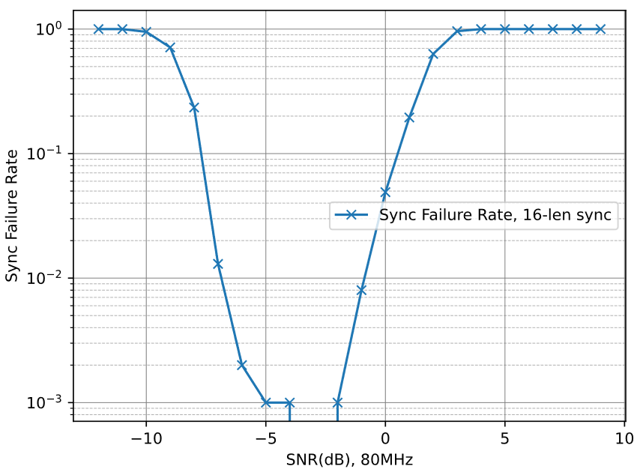
Sync Detection Failure Rate Simulation
July 2025
When the correlation result exceeds the threshold, and correlation continues for half the sync position uncertainty, a significant sync error rate can occur at SNRs above 0dB

Slide 15
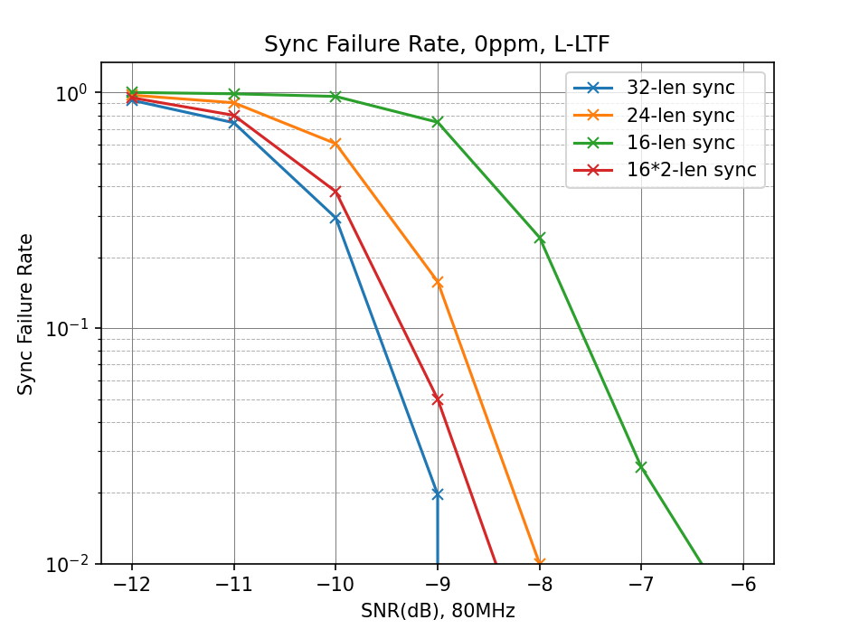
Sync Detection Failure Rate Simulation
July 2025
When the correlation result exceeds the threshold and correlation continue over the full sync position uncertainty window, no increase in Sync error rate is observed
The performance difference between the length-32 sequence and two concatenated length-16 sequences is 0.3 dB

Slide 16
Comparison of Sync Sequence Options
July 2025
Sync Sequence | Correlation Complexity | Buffer Size for Correlation | Sync Uncertainty | Performance | Remarks
Length-16 | Lowest | 16 chips | 32-chip duration | Poor | Not suitable for reliable detection
Length-24 | Moderate | 24 chips | 40-chip duration | Moderate | Tradeoff between complexity and robustness
Length-32 | Highest | 32 chips | 48-chip duration | Best | Strongest detection, but highest power and complexity
[16 16] (two copies) | Same as length-16 | 32 chips | 48-chip duration | Very good – 0.3 dB worse than length-32 | Optimal balance: low correlation complexity, near best performance

Slide 17
Special Segment
July 2025
CCDF analysis shows that the correlation between the Sync sequence and random Manchester-encoded data can frequently exceed sidelobes, especially under high interference-to-noise ratio conditions
This interference effect is strong particularly in 2.4 GHz environments with multiple overlapping tags
It becomes impractical to set a very high threshold to reject all possible Manchester-like interference
A special segment following the Sync sequence, using a non-Manchester pattern, provides a robust mechanism to reject Manchester-encoded interference that thresholding alone is difficult to handle

Slide 18
Part I Summary: Correlation-Based Detectors
July 2025
Correlation complexity is the main driver of the power consumption during the long detection window
Buffer size contributes less to power consumption than correlation operation
Two copies of length-16 sequence is recommended since it achieves performance close to length-32 with much lower correlation complexity

Slide 19
References
July 2025
[1] Steve Shellhammer, et. al., 11-25-0794-00bp-initial-thoughts-on-amp-downlink-sync-field-design
[2] Amichai Sanderovich, et. al., 11-25-0705-00bp-an-analysis-of-sync-field-for-downlink-ppdu
[3] Steve Shellhammer, et. al., 11-18-1201-00-00ba-concerns-about-sync-detector-false-alarms
[4] Rui Cao, et. al., 11-25-0798-00bp-amp-ook-simulation-methodology-and-baseline-results
[5] Shengquan Hu, et. al., 11-25-1223-00bp-sync-field-design-discussion

Slide 20
Appendix
July 2025

Slide 21
Baseline Simulations: DL Data
July 2025
The baseline simulation methodology and settings follow the approach described in [4]
Key assumptions and configurations
Scenario | DL non-backscatter
Data rate | 250 kbps, 1 Mbps
Waveforms | Square pulse, OFDM with L-LTF
detector | Non-coherent
Timing assumption | Ideal timing
Channel | AWGN
Clock offset | 0 ppm
Payload size | 100 bits

Slide 22
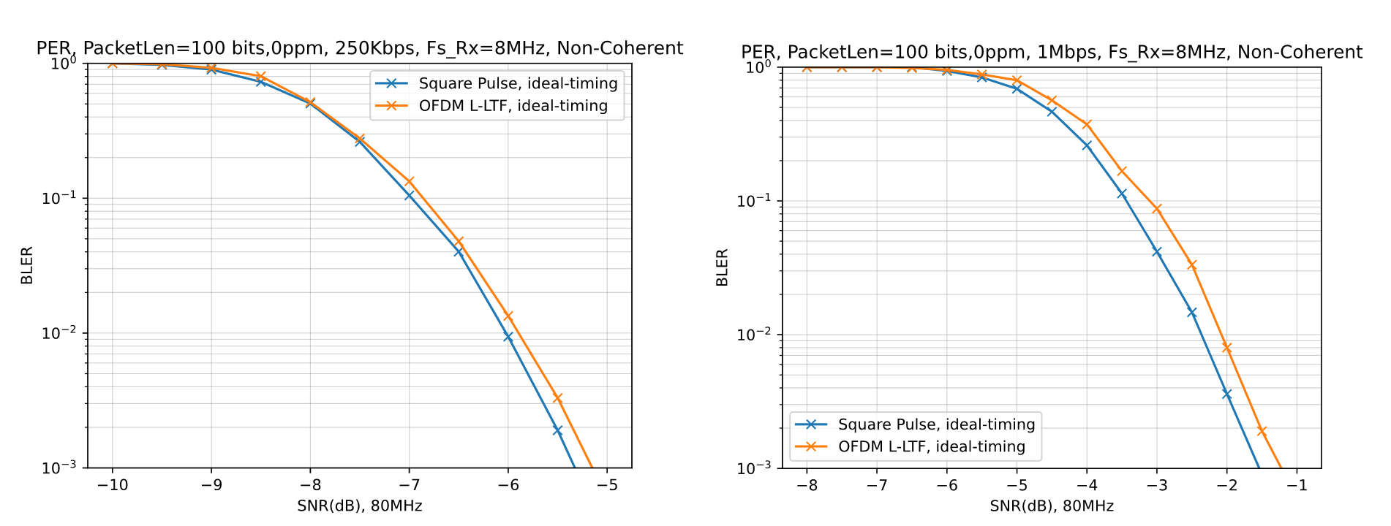
Baseline Simulations: DL Data (cont.)
July 2025
waveform | platform | 250kbps | 1Mbps
Square Pulse | [4] | -7.00 dB | -3.47 dB
 | HW | -6.98 dB | -3.44 dB
OFDM | [4] | -6.90 dB | -3.00 dB
 | HW | -6.85 dB | -3.10 dB

Slide 23
Correlation-Based Detector: Sync Detection Failure Rate
July 2025
The Sync detection failure rate for the correlation-based detector is reproduced based on the methodology in baseline simulation methodology and settings follow the approach described in [5]
Simulation parameters
Sync sequence lengths | 16, 24, 32
Chip duration | 2 us
Threshold | 0.058, 0.048, 0.042

Slide 24
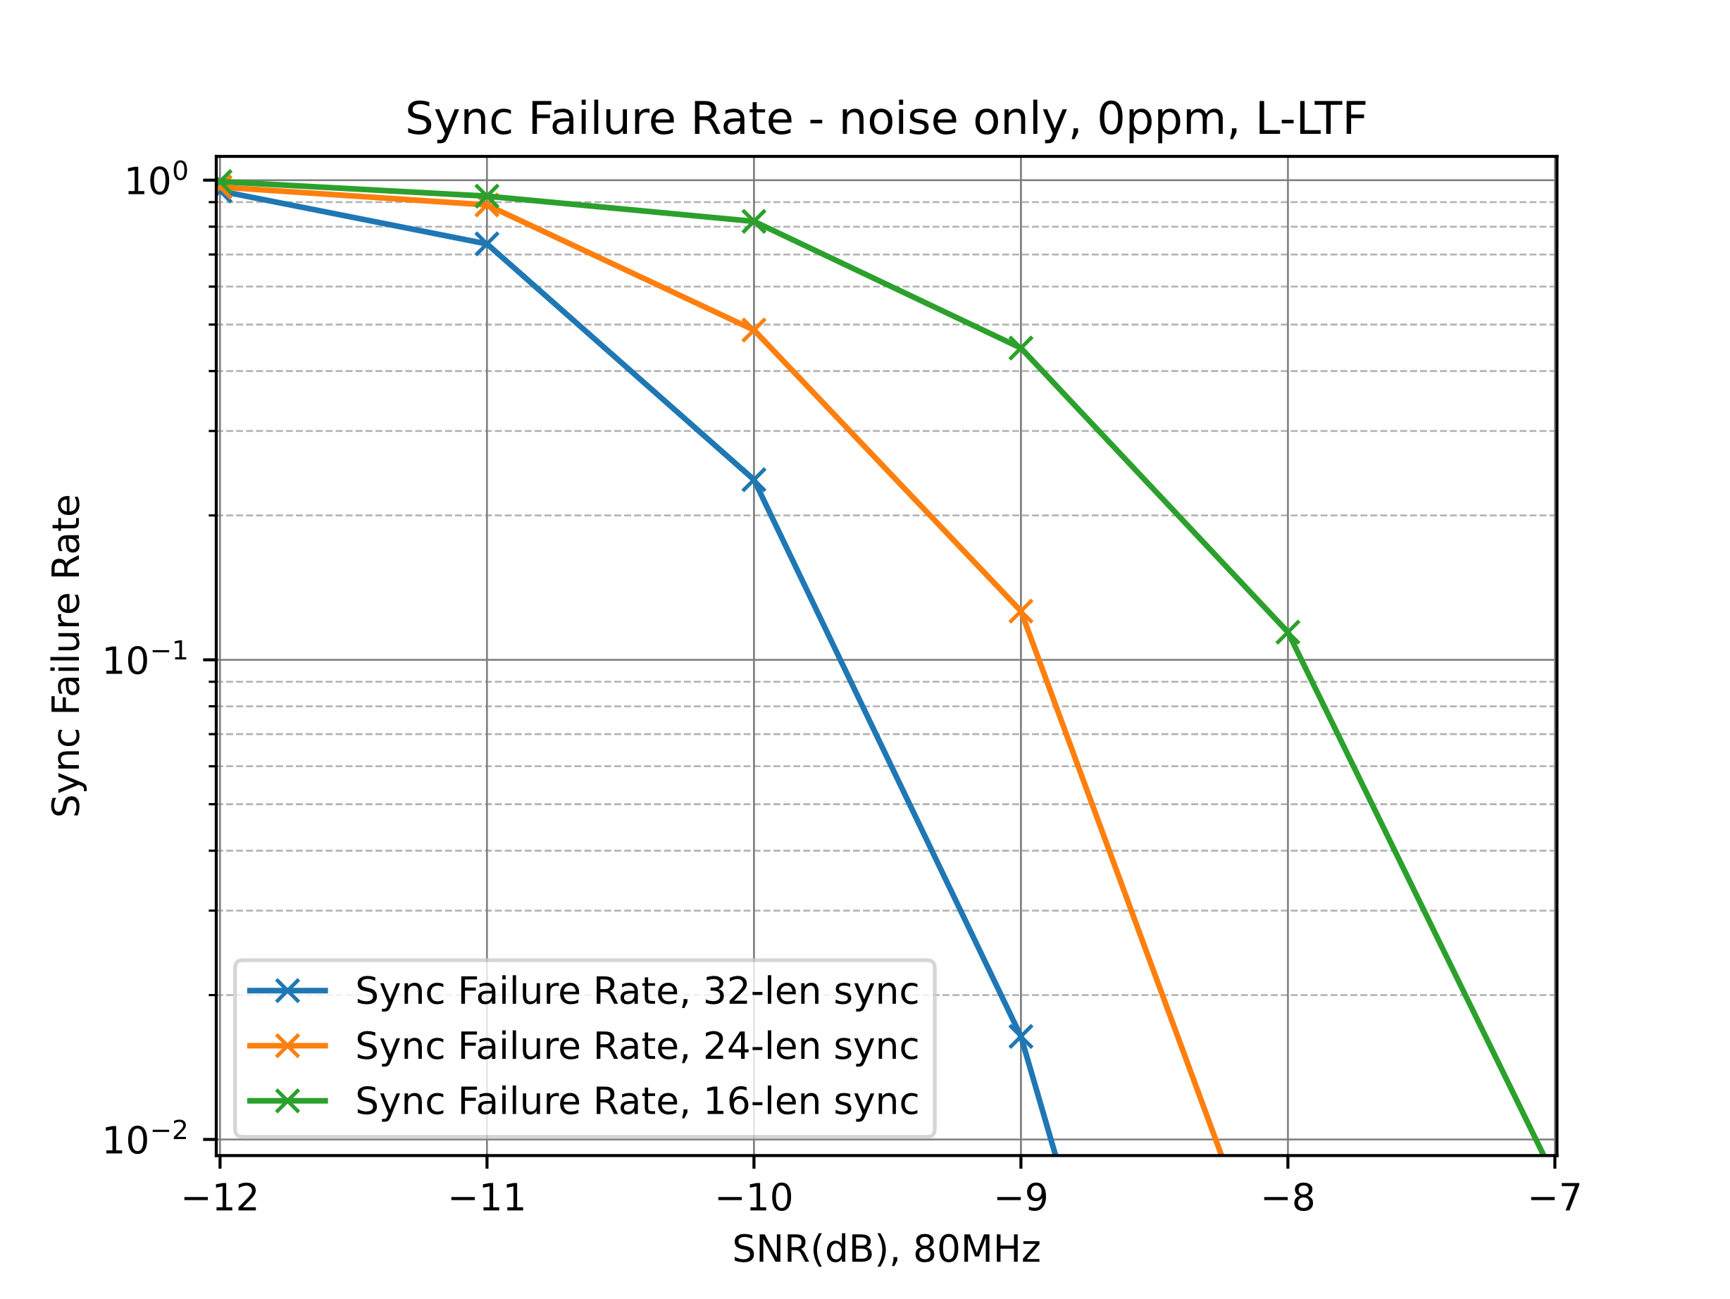
July 2025
Correlation-Based Detector: Sync Detection Failure Rate (cont.)
Sync Sequence Length | platform | Required SNR for 10% Sync Detection Failure Rate (dB)
16 | [5] | -7.8
 | HW | -7.9
24 | [5] | -8.8
 | HW | -8.9
32 | [5] | -9.6
 | HW | -9.7

