Slide 1
AMP Beacon
Date: July 2025
Name | Affiliation | Address | Phone | Email
Ian Bajaj | Huawei | Singapore |  | ian.bajaj@huawei.com
Lei Huang
Rojan Chitrakar
Notes:
Jul 12, 2010
Page 1

Slide 2
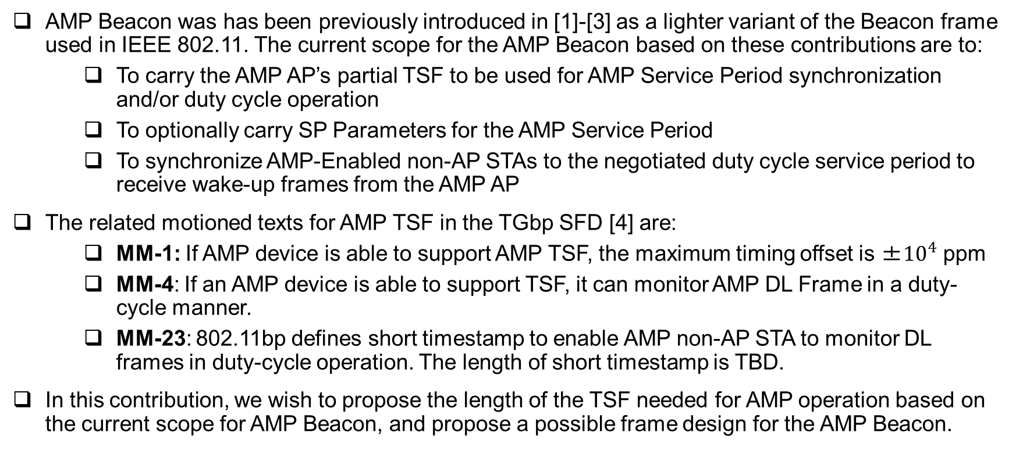
Background
AMP Beacon was has been previously introduced in [1]-[3] as a lighter variant of the Beacon frame used in IEEE 802.11. The current scope for the AMP Beacon based on these contributions are to:
  To carry the AMP AP’s partial TSF to be used for AMP Service Period synchronization and/or duty cycle operation
  To optionally carry SP Parameters for the AMP Service Period
  To synchronize AMP-Enabled non-AP STAs to the negotiated duty cycle service period to receive wake-up frames from the AMP AP
The related motioned texts for AMP TSF in the TGbp SFD [4] are:
  MM-1: If AMP device is able to support AMP TSF, the maximum timing offset is ±${10}^{4}$ ppm
  MM-4: If an AMP device is able to support TSF, it can monitor AMP DL Frame in a duty-cycle manner.
  MM-23: 802.11bp defines short timestamp to enable AMP non-AP STA to monitor DL frames in duty-cycle operation. The length of short timestamp is TBD.
In this contribution, we wish to propose the length of the TSF needed for AMP operation based on the current scope for AMP Beacon, and propose a possible frame design for the AMP Beacon.

Slide 3
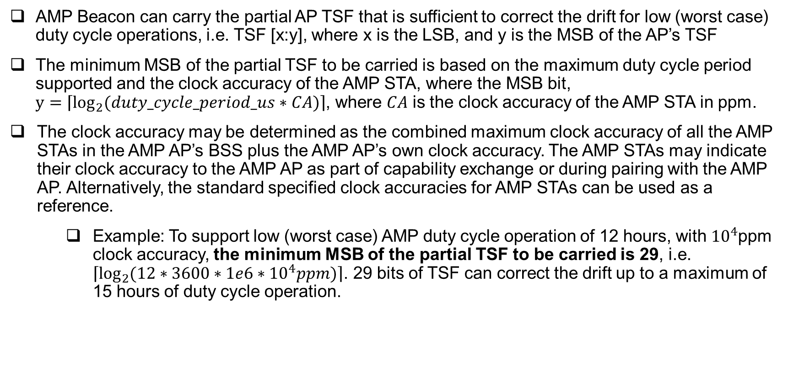
AMP Beacon (1/2)
AMP Beacon can carry the partial AP TSF that is sufficient to correct the drift for low (worst case) duty cycle operations, i.e. TSF [x:y], where x is the LSB, and y is the MSB of the AP’s TSF
The minimum MSB of the partial TSF to be carried is based on the maximum duty cycle period supported and the clock accuracy of the AMP STA, where the MSB bit, $y=\left\lceil \log_{2}{(duty_cycle_period_us∗CA)}\right\rceil$, where $CA$ is the clock accuracy of the AMP STA in ppm.
The clock accuracy may be determined as the combined maximum clock accuracy of all the AMP STAs in the AMP AP’s BSS plus the AMP AP’s own clock accuracy. The AMP STAs may indicate their clock accuracy to the AMP AP as part of capability exchange or during pairing with the AMP AP. Alternatively, the standard specified clock accuracies for AMP STAs can be used as a reference.
  Example: To support low (worst case) AMP duty cycle operation of 12 hours, with ${10}^{4}$ppm clock accuracy, the minimum MSB of the partial TSF to be carried is 29, i.e. $\left\lceil \log_{2}{(12∗3600∗1e6∗{10}^{4}ppm)}\right\rceil$. 29 bits of TSF can correct the drift up to a maximum of 15 hours of duty cycle operation.

Slide 4
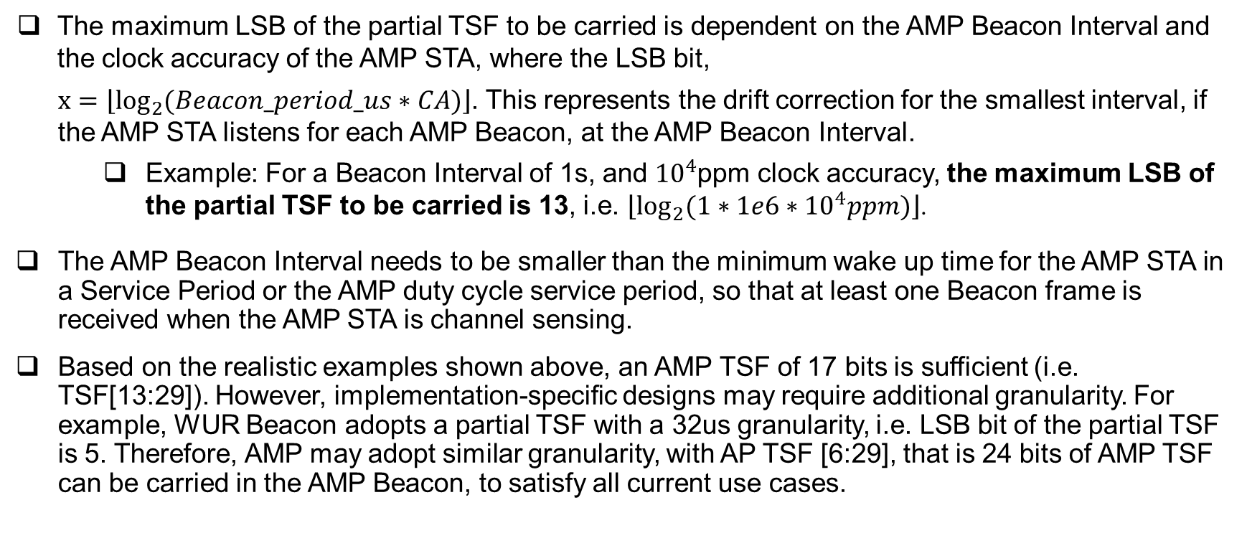
AMP Beacon (2/2)
The maximum LSB of the partial TSF to be carried is dependent on the AMP Beacon Interval and the clock accuracy of the AMP STA, where the LSB bit,
$x=\left\lfloor \log_{2}{(Beacon_period_us∗CA)}\right\rfloor$. This represents the drift correction for the smallest interval, if the AMP STA listens for each AMP Beacon, at the AMP Beacon Interval.
  Example: For a Beacon Interval of 1s, and $10^{4}$ppm clock accuracy, the maximum LSB of the partial TSF to be carried is 13, i.e. $\left\lfloor \log_{2}{(1∗1e6∗{10}^{4}ppm)}\right\rfloor$.
The AMP Beacon Interval needs to be smaller than the minimum wake up time for the AMP STA in a Service Period or the AMP duty cycle service period, so that at least one Beacon frame is received when the AMP STA is channel sensing.
Based on the realistic examples shown above, an AMP TSF of 17 bits is sufficient (i.e. TSF[13:29]). However, implementation-specific designs may require additional granularity. For example, WUR Beacon adopts a partial TSF with a 32us granularity, i.e. LSB bit of the partial TSF is 5. Therefore, AMP may adopt similar granularity, with AP TSF [6:29], that is 24 bits of AMP TSF can be carried in the AMP Beacon, to satisfy all current use cases.

Slide 5
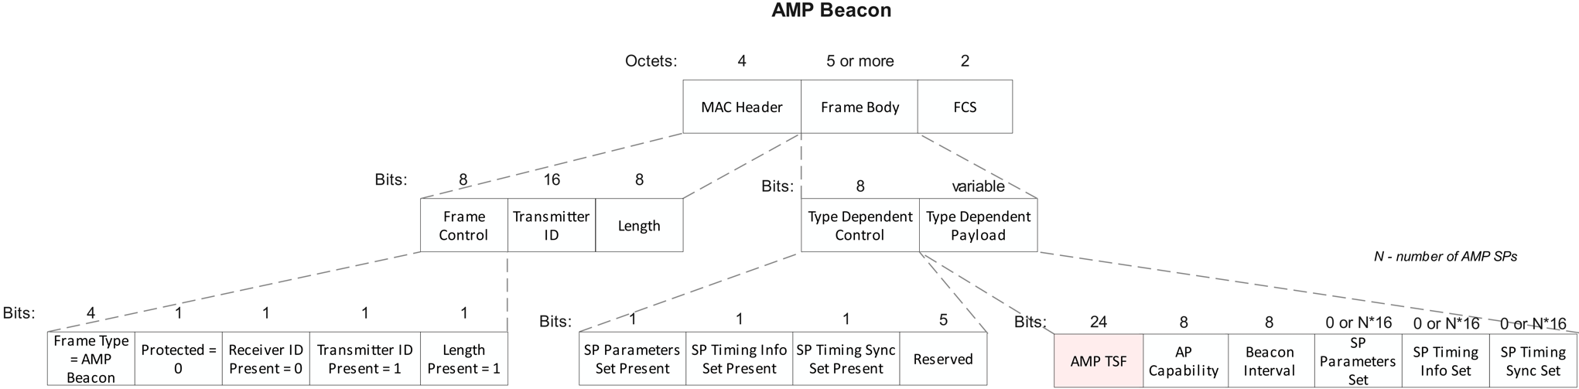
Proposed AMP Beacon Frame Format
Based on the general AMP frame design presented in [5], when the Frame Type is AMP Beacon (indicated by the Frame Control field), the transmitter ID and Length fields can be carried in the MAC header.
The Type Dependent Control field includes presence bits to indicate the presence of fields carried in the variable Type Dependent Payload.
The Type Dependent Payload carries:
  AMP TSF (24 bits) – The AMP AP’s partial TSF [6:29]
  AP capability (8 bits) – PHY/MAC/Security related capability [1]
  Beacon Interval (8 bits) – To indicate the interval of the AMP Beacon (in ms)
  SP Parameter Set (0 or N*16 bits) – Each set carries SP ID (4 bits), SP Interval (8 bits), and SP Minimum Wake Duration (4 bits, expressed as a multiple of TUs) [1]
  SP Timing Info Set (0 or N*16 bits) – Each set carries SP ID (4 bits), SP Start Time (12 bits)
  SP Timing Sync Set (0 or N*16 bits) – Each set carries SP ID (4 bits), SP Advert Count (10 bits), and Reserved field (2 bits)

Slide 6
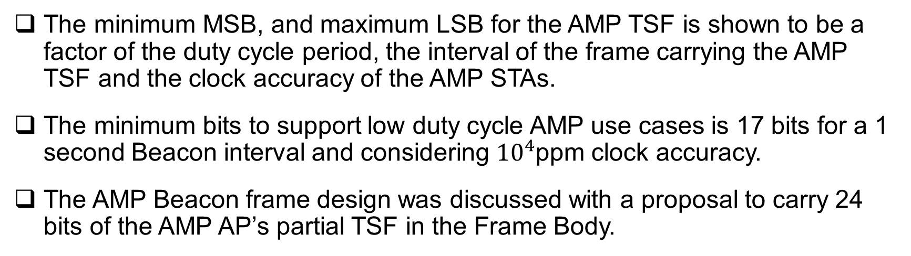
Summary
The minimum MSB, and maximum LSB for the AMP TSF is shown to be a factor of the duty cycle period, the interval of the frame carrying the AMP TSF and the clock accuracy of the AMP STAs.
The minimum bits to support low duty cycle AMP use cases is 17 bits for a 1 second Beacon interval and considering ${10}^{4}$ppm clock accuracy.
The AMP Beacon frame design was discussed with a proposal to carry 24 bits of the AMP AP’s partial TSF in the Frame Body.

Slide 7
SP1
Do you agree to add the following text to TGbp SFD?
IEEE 802.11bp defines AMP Beacon frame as one type of AMP frame to carry AMP TSF in the Frame Body.
The other fields carried in the AMP Beacon are TBD.
[Reference: 11-25/0039r0, 11-25/0285r1, 11-25/0787r0, 11-25/1247r0]

Slide 8
SP2
Do you agree to add the following text to TGbp SFD?
The length of the AMP TSF field carried in the AMP Beacon is 24 bits. The AMP TSF field carries the partial TSF of the AMP AP’s TSF.
[Reference: 11-25/0039r0, 11-25/0285r1, 11-25/0787r0, 11-25/1247r0]

Slide 9
SP3
Do you agree to add the following text to TGbp SFD?
The AMP AP’s TSF bits [6:29] is carried in the AMP TSF field in the AMP Beacon Frame.
[Reference: 11-25/0039r0, 11-25/0285r1, 11-25/0787r0, 11-25/1247r0]

Slide 10
References
[1] 11-25/0285r1, SP Timing Synchronization with AMP Beacon
[2] 11-25/0094r0, AMP Device Management
[3] 11-25/0779r0, E2E Operation of AMP-enabled Non-AP STAs
[4] 11-24/1613r9, Specification Framework for TGbp
[5] 11-25/1102r0, AMP Frame Format

