Slide 1
AMP WUR Frame Format
Date: July 2025
Name | Affiliation | Address | Phone | Email
Ian Bajaj | Huawei | Singapore |  | ian.bajaj@huawei.com
Lei Huang
Rojan Chitrakar
Notes:
Jul 12, 2010
Page 1

Slide 2
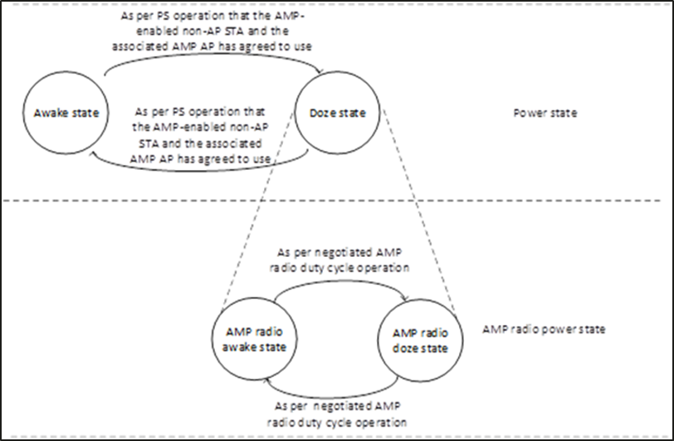
Background
Current motioned texts for Section 3.7 Power management for AMP-enabled non-AP STA in the AMP SFD [1]:
As indicated in the related contribution [2], the expectation for the AMP-enabled non-AP STA to operate in legacy WLAN network is to reuse much of the protocol and signaling for WUR operation, i.e. reuse the WUR frame format, with modifications specific to the AMP characteristics, and to carry it in an AMP PPDU.
In this contribution, we wish to highlight possible modifications specific to AMP implementation, and suggest two frame design options for AMP WUR (AWUR) frames, namely:
Modification of existing WUR frames to enable AMP use cases
Encapsulation of the WUR frames in AMP PPDU, with flexible frame control to enable AMP use cases
MM-11: 802.11bp defines an AMP duty cycle operation for an AMP-enabled non-AP STA, which follows the state transition diagram shown in the figure. AMP duty cycle operation follows the negotiation procedure defined for WUR in the baseline
MM-12: If an AMP-enabled non-AP STA successfully receives an AMP Wake-Up frame from the associated AMP AP, the non-AP STA should transition to the Awake State and transmit a PS-Poll/UL frame to the AP to indicate that it is in the Awake State (PS/Active mode).

Slide 3
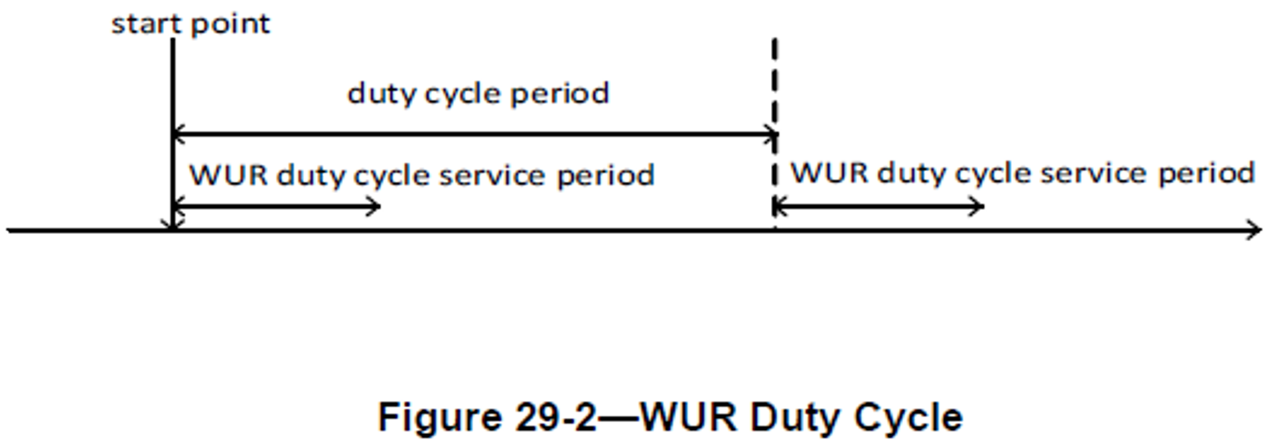
Recap on WUR
WUR STAs operate in WUR duty cycle period, by maintaining the WUR awake state for a WUR duty cycle service period and switch to WUR doze state till the end of the WUR duty cycle period.
In the WUR duty cycle service period, a WUR STA expects to receive a WUR Beacon frame and/or a WUR wake-up frame (or WUR short wake-up frame), if the WUR STA has requested for keep-alive WUR frames to be transmitted by the WUR AP in a successful WUR mode setup.
The AP’s Partial TSF [5:16] is carried in the Type Dependent Control field for WUR Beacon to allow the WUR STA to update its timer (adjusting for local delays).
16 bits TSF can correct the drift @100ppm (WUR clock accuracy) up to 10 minutes of duty cycle period (i.e. $\left\lceil \log_{2}{(10∗60∗{10}^{6}∗{10}^{−4}}\right\rceil =16$)

Slide 4
Adapting WUR for AMP
The clock accuracy we expect for AMP-enabled non-AP STAs is similar to the Receiver clock for the Active Tx non-AP AMP STA, which may be ${10}^{4}$ppm (not currently motioned by the task group).
16 bits of TSF @${10}^{4}$ppm, can correct the drift for only 6 seconds of duty cycle period (i.e. $\left\lceil \log_{2}{(6∗{10}^{6}∗{10}^{−2}}\right\rceil =16$).
As a consequence, the AMP STA will consume more power cycling their receivers very often to channel sense for Beacons.
This cannot support potentially lower duty cycle use-cases in AMP, or at the very least match the maximum duty cycle supported with keep-alive frames in WUR Beacon (i.e. 10mins)
Without the AMP (WUR) Beacon synchronization, the AMP STAs may not wake up at the negotiated AMP (WUR) service period, start to accumulate drift, and may miss receiving AMP (WUR) wake-up frames from the AMP AP.
Procedurally, if the WUR operation is followed, the AMP (WUR) STAs that do not receive AMP (WUR) Beacon frames for a time period, should perform AMP (WUR) scanning or transition to awake state – which will end up consuming significant amount of energy.
The simplest modification to enable synchronization for AMP use cases, would be to extend the TSF bits carried in AMP WUR (AWUR) frames.

Slide 5
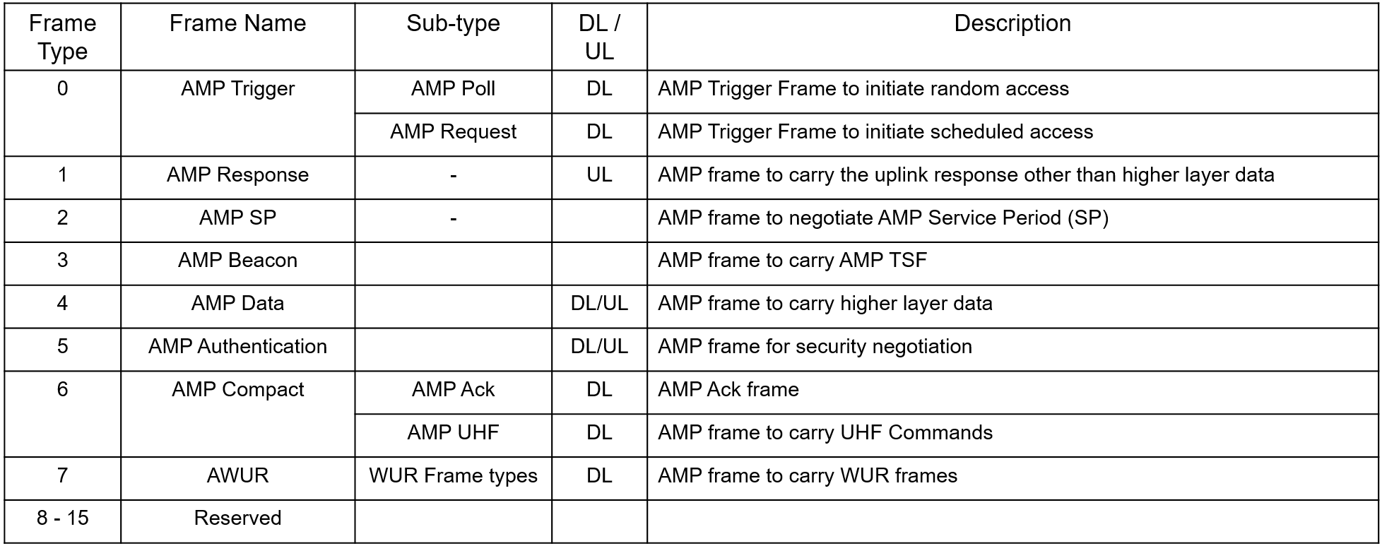
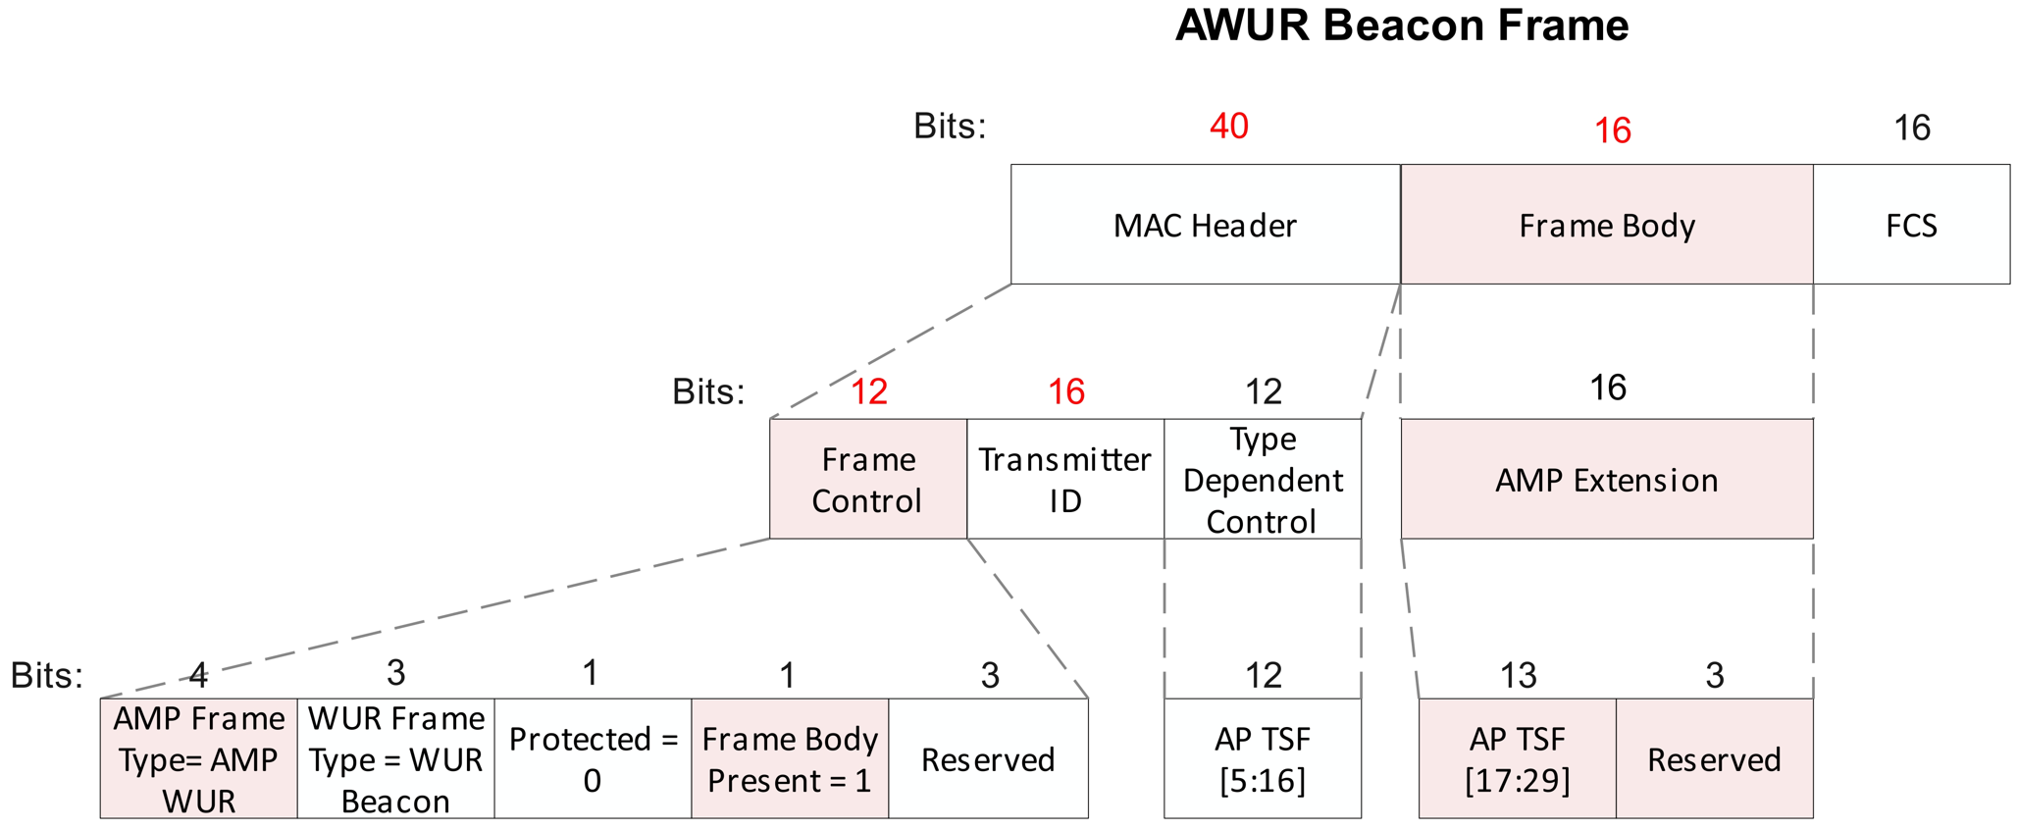
Frame Format Option 1 – Modifying existing WUR frames
The AMP WUR Beacon can modify elements of the WUR Beacon to accommodate more partial TSF bits.
To match the duty cycle supported in WUR, at the very least 23 bits of TSF would be needed to support 10mins of drift at ${10}^{4}$ppm.
For very low duty cycle AMP applications, the TSF may need to be extended to 29 bits to support up to 15 hours of duty cycle operation.
The Frame control includes an additional 4 bits for the AMP Frame Type to indicate AMP WUR frames [3].
The Transmitter ID space is increased to 16 bits.
The Frame Body is present and carries the AMP Extension which can be 8/16 bits depending on the use case to be supported.

Slide 6
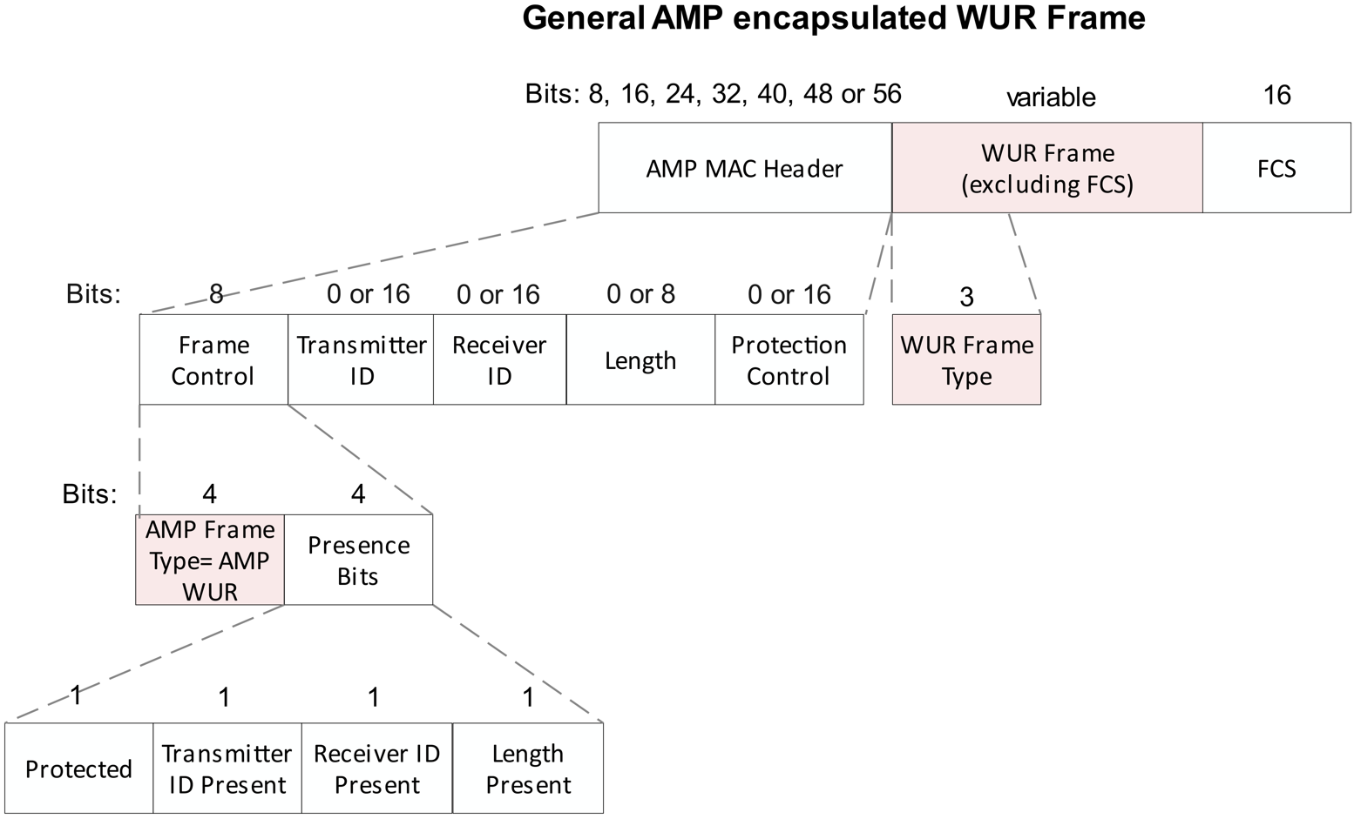
Frame Format Option 2 – Encapsulating WUR frames in AMP PPDU (1/3)
The general design principle here is to carry the WUR frames as is (without modification), in an AMP PPDU. In [3], the possible flexible design of the AMP MAC Header could be 1 to 7 octets in length preceding the WUR Frame and the FCS of 16 bits following the WUR Frame.
The AMP MAC header contains the Frame control, which carries 4 bits of the AMP Frame Type set to AMP WUR, to indicate the encapsulation of the WUR frame excluding the FCS in the Frame Body.
The original presence bits field in the frame control shown in [3], determine the presence of the TX ID, RX ID, Length, and Protection Control fields in the AMP MAC header. However, this may be optimized based on the WUR operation.

Slide 7
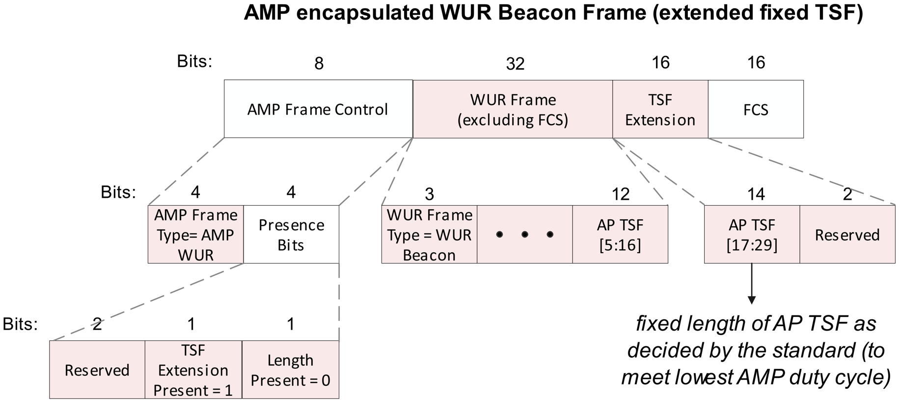
Frame Format Option 2 – Encapsulating WUR frames in AMP PPDU (2/3)
For example, when the WUR Frame Type = WUR Beacon, the Presence Bits field carried in the AMP Control Frame can be modified to a Reserved field of 2 bits, TSF Extension Present field of 1 bit, and Length Present bit of 1 bit. The corresponding fields in the AMP MAC Header following the Frame Control are dropped.
To support synchronization for AMP use cases, an extended TSF can be carried by setting TSF Extension Present bit to 1, and carrying 14 bits of TSF, namely TSF [17:29], and 2 bits of Reserved field, after the WUR Frame.
The length of the TSF extension here is fixed and decided based on standard development to meet the lowest duty cycle operation and clock accuracies of AMP STAs.

Slide 8
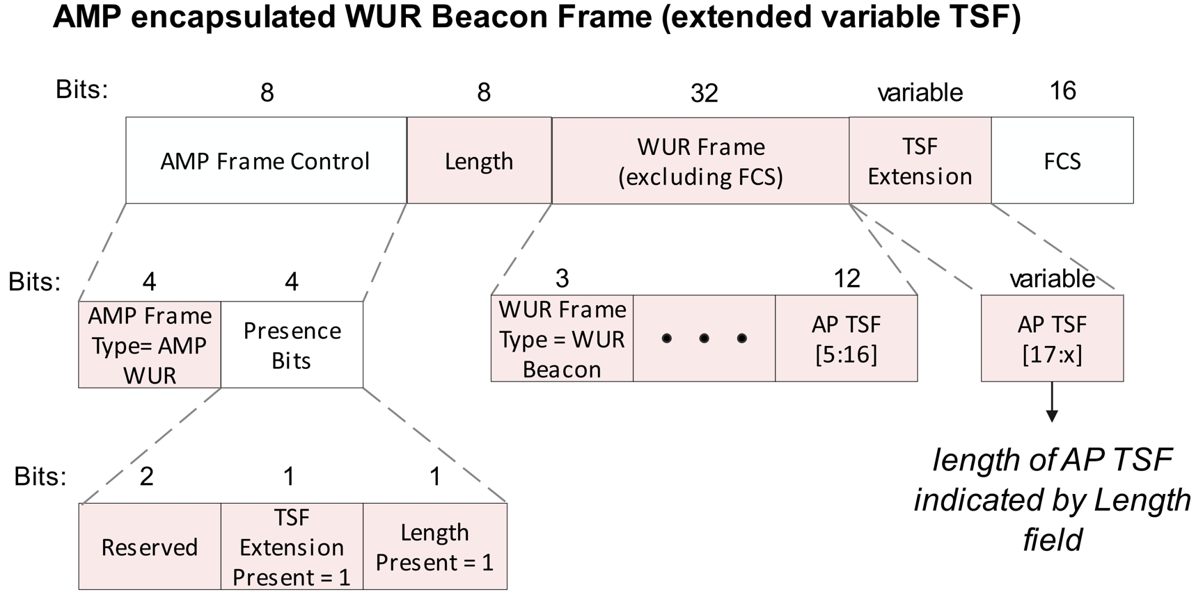
Frame Format Option 2 – Encapsulating WUR frames in AMP PPDU (3/3)
The length of the TSF extension may also be variable and dynamically decided by the AP based on the specific implementation and to support various use cases.
The AMP AP can set the TSF Extension Present bit to 1, and Length Present bit to 1, where the length field preceding the WUR frame, indicates the length of the AMP PPDU minus the FCS field.
The variable AP TSF, namely TSF[17:x] is carried in the TSF Extension field after the WUR Frame, where ‘x’ may be determined by the length field.

Slide 9
Summary
Two proposals for AMP WUR frames were discussed:
Option 1: Modification of the existing WUR frames
Option 2 (preferred): Encapsulation of the WUR frame in AMP PPDU
For AMP encapsulated WUR frames, the presence bits may be flexibly designed to support modifications required for the WUR operation in AMP implementation.
Given the clock accuracies expected for AMP STAs, the need for TSF extension was addressed, and options for both fixed and variable TSF extension were shown to be possible through the frame control field.

Slide 10
SP
Do you agree to add the following text to TGbp SFD?
IEEE 802.11bp defines AWUR frame as one type of AMP frame with the Frame Body including WUR Frame (excluding FCS).
Note: AWUR means Ambient Wake-up Radio
[Reference: 11-25/1246r0]

Slide 11
References
[1] 11-24/1613r9, Specification Framework for TGbp
[2] 11-25/0779r0, E2E Operation of AMP-enabled Non-AP STAs
[3] 11-25/1102r0, AMP Frame Format

