Slide 1
AMP SP Timing Synchronization for Positive Clock Drift
Date: July 2025
Name | Affiliation | Address | Phone | Email
Ian Bajaj | Huawei | Singapore |  | ian.bajaj@huawei.com
Lei Huang
Rojan Chitrakar
Notes:
Jul 12, 2010
Page 1

Slide 2
Background
Current motioned text for AMP Service Period in AMP SFD [1]:
MM-22: IEEE 802.11bp defines an AMP Service Period, that allows an Active Tx non-AP AMP STA to enter doze state after a minimum wake up time since the start of the AMP Service Period, if the Active Tx non-AP AMP STA does not receive any AMP DL PPDU from the AMP AP.
In [2], the AMP Service Period defines an SP interval, that allows the non-AP AMP STA to sleep and conserve its harvested energy, and wake up for transmission opportunities during a service period window. SP Advert Frames are proposed to carry a decremental counter to allow the AMP STAs that experience clock drift to correct/reset their timers to wake up at the start of the service period window.
In this contribution, we wish to discuss the impact of positive clock drift and provide further details on the synchronization process to ensure that no non-AP AMP STA misses the start of the AMP Service Period.

Slide 3
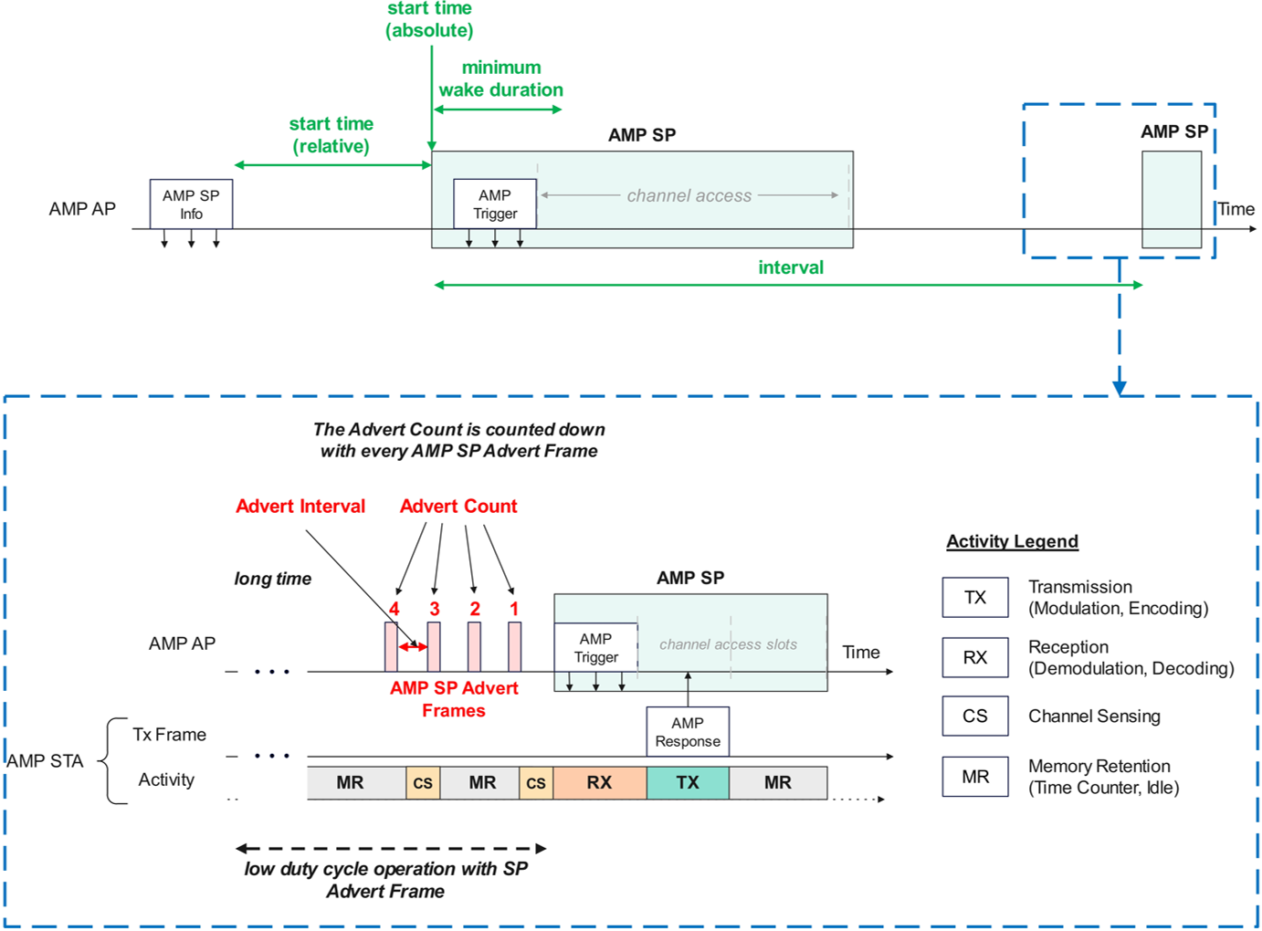
Recap on AMP Service Period in [2]
In [2], AMP Service Period refers to a window where the AMP AP may schedule DL PPDU and/or solicit UL PPDUs from AMP STAs in its BSS.
The minimum wake duration refers to the minimum time the AMP STAs remain in channel sensing state at the start of the SP.
The AMP STAs sleep for the duration of the SP interval and wake up at the start of the subsequent SP.
The SP Advert frames are transmitted prior to the start of the SP to cover the clock drift margin of the AMP STAs and reset their counters/timer to point them to the start of the SP.

Slide 4
Issue with Positive Clock Drift
AMP STAs that experience positive clock drift (slower clock than AMP AP) may miss the start of the AMP SP, and consequently the opportunity for channel access
Based on the definition of AMP SP in MM-22 [1], the AMP STA that does not receive a DL PPDU from the AP within a minimum wake duration from waking up, will sleep for another SP interval
As a consequence, the AMP STAs may lose synchronization and accumulate drift, never being able to communicate with the AMP AP
The AMP STA may have to revert to random channel sensing to search for AP DL triggers, which can consume significant energy.

Slide 5
Timing Synchronization for Positive Clock Drift (1/2)
The AMP AP needs to indicate a start time for the SP that accounts for the worst case clock drift
This implies that an AMP STA that has the worst positive clock drift will still wake up at the start of the AMP SP
The indicated start given by the SP interval parameter, is carried in the AMP SP Info frame by the AMP AP as:
$SP_{interval_indicated}=SP_{interval_true}∗(1−CA)$, where $CA$ is the maximum clock accuracy of the AMP STAs in the AMP AP’s BSS plus the AMP AP’s clock accuracy. The clock accuracy of the AMP STA can be measured by the manufacturer during production testing.
The AMP STA can share its clock accuracy (in ppm) as part of capability sharing with the AMP AP. The AP Trigger frame can indicate a response type to solicit clock accuracy information.
Alternatively, the AMP AP can use the maximum standard-specified clock accuracy.

Slide 6
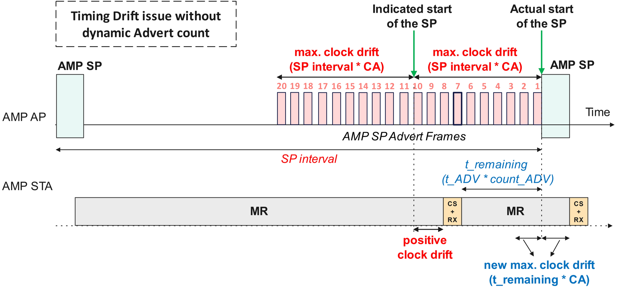
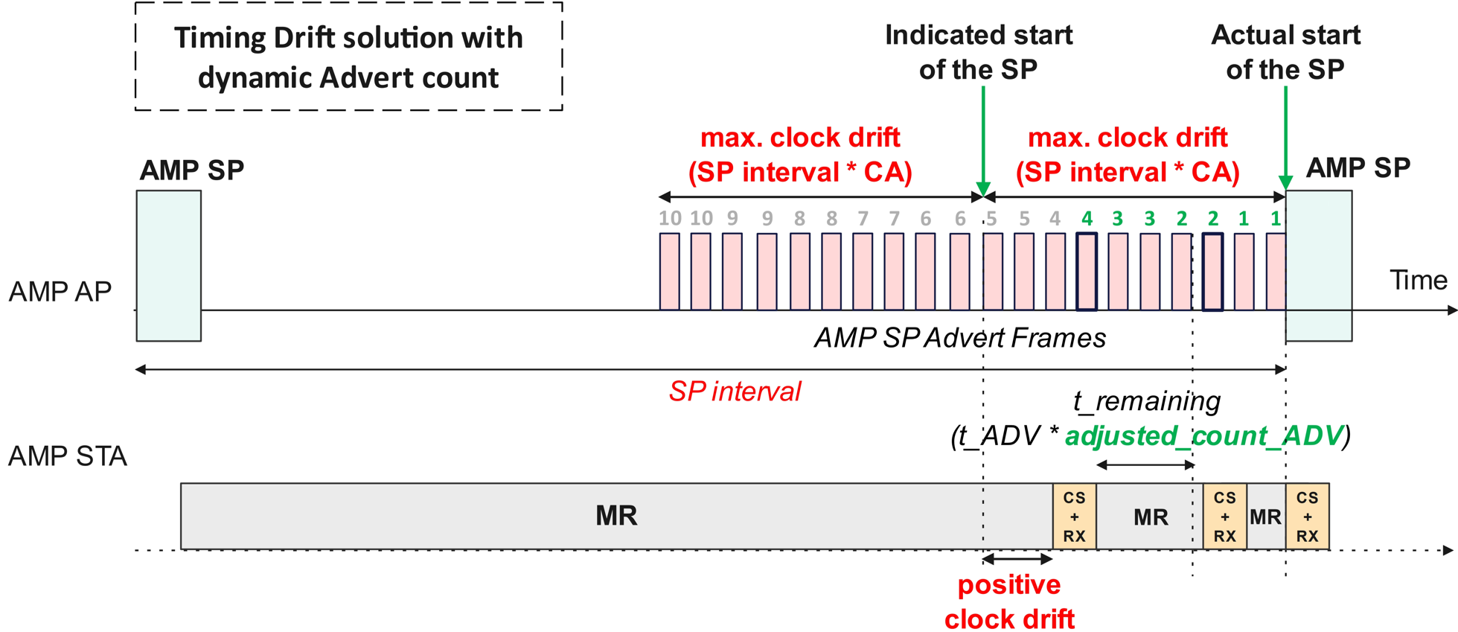
Timing Synchronization for Positive Clock Drift (2/2)
When the AMP STA wakes up within the clock drift margin based on the indicated start, it will receive at least one SP Advert frame that points it to the start of the SP. The AMP STA sleeps for the remaining time, $t_{remaining}=t_{ADV}∗{count}_{ADV}$ , where $t_{ADV}$ is the Advert frame interval, and ${count}_{ADV}$ is the Advert count. However this remaining time may incur positive clock drift that causes the AMP STA to miss the AMP SP.
The Advert count must similarly be adjusted based on the remaining time as, ${adjusted_count}_{ADV}=\frac{\left(\frac{t_{remaining}}{2}\right)}{t_{ADV}}$, allowing
the AMP STA to approach the start of the SP but never exceed it.

Slide 7
Summary
The issue of positive clock drift was highlighted for AMP STAs causing them to miss the start of the AMP Service Period. As a consequence, AMP STAs may:
Lose synchronization with the AMP AP, and accumulate drift
Miss transmission opportunities during the SP window
Revert to random channel sensing and consume significant energy
A timing adjustment to the SP start time and a dynamically updated SP Advert count allows AMP STAs to approach the start of the AMP SP without ever exceeding it.

Slide 8
SP
Do you agree to add the following text to TGbp SFD?
IEEE 802.11bp allows a non-AP AMP STA to report its clock accuracy to the AMP AP.
[Reference: 11-25/0039r0, 11-25/0285r1, 11-25/0787r0, 11-25/1244r0, 11-25/1245r0]

Slide 9
References
[1] 11-24/1613r9, Specification Framework for TGbp
[2] 11-25/0787r0, Follow-up on AMP Open Service Period

