Slide 1
Power Savings with AMP Service Period
Date: July 2025
Name | Affiliation | Address | Phone | Email
Ian Bajaj | Huawei | Singapore |  | ian.bajaj@huawei.com
Lei Huang
Rojan Chitrakar
Notes:
Jul 12, 2010
Page 1

Slide 2
Background
Current motioned texts for Section 3.4 Duty Cycle Operation in AMP SFD [1]:
MM-4: If an AMP device is able to support TSF, it can monitor AMP DL Frame in a duty-cycle manner.
MM-22: IEEE 802.11bp defines an AMP Service Period, that allows an Active Tx non-AP AMP STA to enter doze state after a minimum wake up time since the start of the AMP Service Period, if the Active Tx non-AP AMP STA does not receive any AMP DL PPDU from the AMP AP.
As discussed in related contributions [2, 3], the two motioned texts discuss two power management schemes that differ in both AMP AP and AMP STA behavior.
In this contribution, we wish to compare the general protocol, channel utilization, frame signaling and overall power savings for the motioned AMP Power Management Schemes.

Slide 3
Recap on AMP Service Period in [3] (1/2)
In [3], AMP Service Period (OSP) was defined as a window that the AMP AP will gain a TXOP for any non-AP AMP STAs in its BSS, regardless of association.
At the start of the OSP, within the SP minimum wake duration, the AMP AP will send for example, an AMP Poll to enable channel access for the non-AP AMP STAs. If the non-AP AMP STAs do not receive any AMP DL PPDU from the AP, the non-AP AMP STA will return to idle mode for the SP interval duration (wake up at the start of the following OSP).
The OSP parameters, namely, SP start time, SP interval and SP minimum wake duration may be carried in an SP Info frame sent periodically by the AMP AP. The SP start time maybe expressed as an absolute TSF time or a relative time from the end of frame carrying this field.

Slide 4
Recap on AMP Service Period in [3] (2/2)
To provide a timing reference, the AMP AP can transmit SP Advert Frames that indicate the Advert interval and Advert count (no. of remaining Advert frames to the start of the OSP). An OSP ID can be used to identify the OSP that the SP Advert Frame is pointing to.
The Advert Interval must be less than the SP minimum wake duration.
The SP Advert Frame will only need to be transmitted closer to the start of the OSP (to cover clock drift), thus avoiding channel congestion.
The AMP non-AP STA can reset its counter based on the remaining time to the start of the SP, given by Advert_interval * Advert_count

Slide 5
Recap on duty cycle operation in [2]
AMP STAs cycle their receiver to wake up for each AMP Trigger every duty cycle period (200ms) (referred to as the Normal Service Period), until the target trigger is received that solicits its UL PPDU (referred to as the Target service period). That is to say, each AMP Trigger is decoded to determine some filtering condition for the AMP STA to transmit or not.
The interval of the AMP DL frame carrying TSF (here AMP Trigger) determines the clock drift that the AMP STA would experience. The AMP STA keeps waking up to correct its clock at this frame interval.
For the sake of clarity, we will refer to this scheme as “Receiver Duty Cycling”

Slide 6
Protocol Comparison
Power Management Scheme | AMP Service Period | Receiver Duty Cycling
Sleep Duration | SP interval (off period) | TSF Frame interval
AMP AP DL Frame | SP Advert (or any AMP PPDU carrying SP timing parameters) | AMP Trigger (or AMP Beacon)
DL PPDU Frequency | Expected 5ms ($≤$minimum wake duration) for clock drift period preceding the AMP SP | Expected every 100ms to 1s (TSF Frame interval)
AMP STA Number of Frames Decoded | Subset of SP Advert Frames, $fn\left(\frac{\log\left(\frac{1}{SP_{int}}\right)}{\log\left(CA\right)}\right)$ | Every DL Frame (carrying TSF)

Slide 7
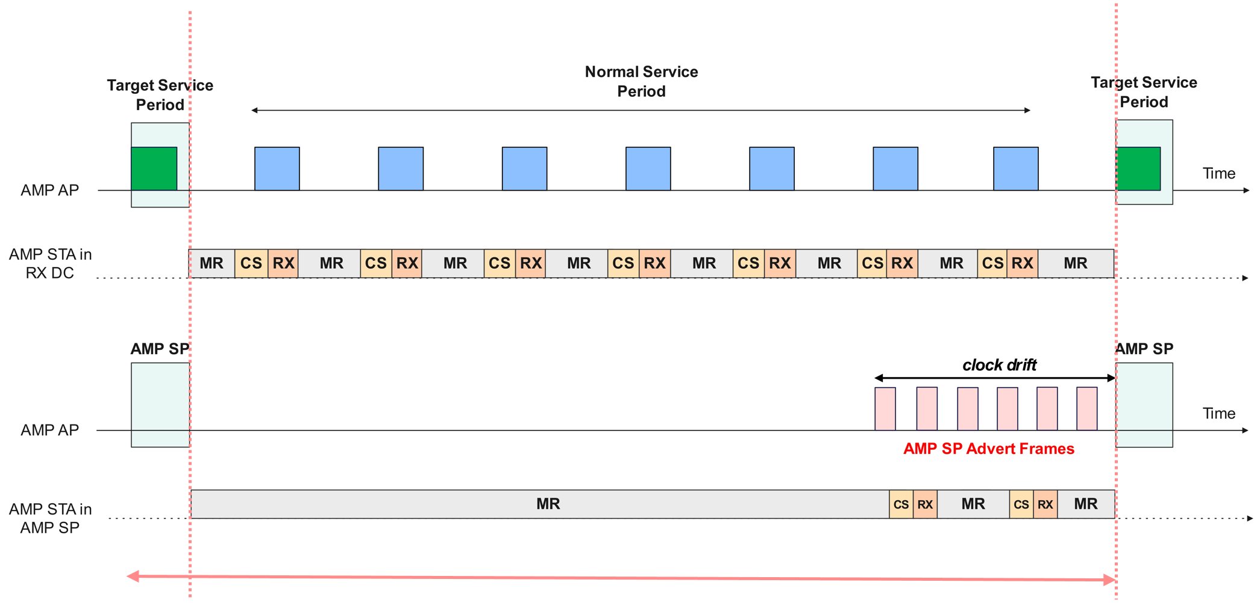
Power Saving Comparison (1/2)
Simulation Parameters:
AMP STA RX Clock accuracy: ${10}^{4}$ppm
MR state:
Clock power consumption: 510pW^{[4]}
Idle Power consumption: 0.01uW
CS state:
Channel sensing (CS) power consumption: 0.1uW
Channel sensing duration/minimum wake duration: 5ms
RX state:
RX power consumption: 1uW
DL PPDU RX time: 100us (100bits @1Mbps)
DL PPDU transmission frequency: 5ms (AMP SP), 100ms or 1s (RX DC)
$$P_{clk}$$
$$P_{idle}$$
$$P_{CS}$$
$$t_{CS}$$
$$P_{RX}$$
$$t_{RX}$$
$SP_{int}$, Varying Service Period Interval Lengths (100ms to 1 hour)
$$t_{wake}$$
$${TSF}_{int}$$

Slide 8
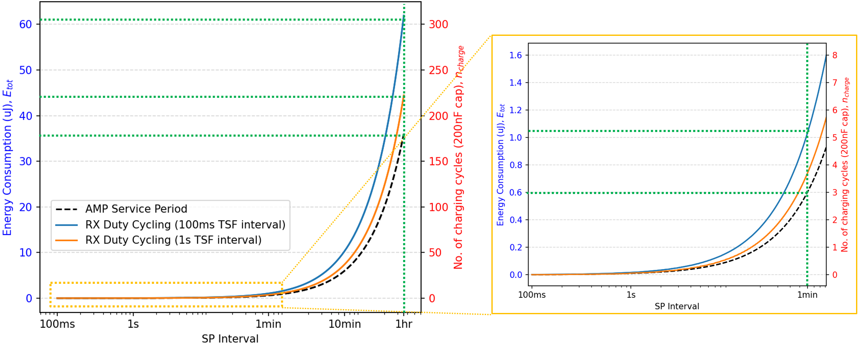
Power Saving Comparison (2/2)
Number of advert frames decoded for AMP SP,
$$n_{RX}=\left\lfloor \log\left(\frac{t_{wake}}{SP_{int}}\right)/\log\left(CA\right)\right\rfloor$$
Number of DL PPDU frames decoded for RX DC,
$$n_{RX}=\left\lfloor \frac{SP_{int}}{TSF_{int}}\right\rfloor$$
$$E_{RX}=n_{RX}∗t_{RX}∗P_{RX}$$
$$E_{CS}=n_{RX}∗t_{CS}∗P_{CS}$$
$$t_{idle}=SP_{int}−n_{RX}∗\left(t_{CS}+t_{RX}\right)$$
$$E_{idle}=t_{idle}∗\left(P_{idle}+P_{clk}\right)$$
Total energy consumption, $E_{tot}=E_{CS}+E_{RX}+E_{idle}$
No. of full charge cycles, $n_{charge}=E_{tot}/E_{cap}$
$E_{cap}$ = 200nJ (200nF cap., $V_{H}=1.5V, V_{L}=0.5V)$
Simulation Results
Significant power savings with AMP SP compared to receiver duty cycling (150 fewer capacitor charge cycles at 1 hour SP Interval).
Lower channel utilization for SP Advert synchronization compared to 100ms-1s DL PPDU transmissions for receiver duty cycling.

Slide 9
Summary
The current motioned text supporting AMP Power Management was recapped, with discussion on:
The protocol: AMP AP, AMP STA behavior
DL channel utilization for synchronization frames provided by the AP
The overall power savings comparison
The power savings for an AMP STA in an AMP Service Period, are almost double compared to receiver duty cycle for AMP DL PPDU interval of 100ms (frame carrying TSF).

Slide 10
SP1
Do you agree to add the following text to TGbp SFD?
IEEE 802.11bp defines an AMP SP frame as one type of AMP Frame to carry AMP Service Period information.
[Reference: 11-25/0039r0, 11-25/0285r1, 11-25/0787r0, 11-25/1244r0]

Slide 11
SP2
Do you agree to add the following text to TGbp SFD?
IEEE 802.11bp defines an AMP SP Info frame as a Sub-Type of AMP SP Frame to carry the SP ID, SP Start Time, SP Interval, and SP Minimum Wake Duration. The SP ID serves to uniquely identify the AMP Service Period.
[Reference: 11-25/0039r0, 11-25/0285r1, 11-25/0787r0, 11-25/1244r0]

Slide 12
SP3
Do you agree to add the following text to TGbp SFD?
IEEE 802.11bp defines an AMP SP Advert frame as a Sub-Type of AMP SP Frame to carry the SP Advert Interval, and SP Advert count.
The SP Advert Interval is the periodicity of the AMP SP Advert frame.
The SP Advert Count is a decremental counter, that is counted down in each subsequent AMP SP Advert frame, to assist AMP STAs to wake up at the start of the service period.
[Reference: 11-25/0039r0, 11-25/0285r1, 11-25/0787r0, 11-25/1244r0]

Slide 13
SP4
Do you agree to add the following text to TGbp SFD?
AMP Service Period allows a Backscatter non-AP AMP STA to enter doze state after a minimum wake up time since the start of the AMP Service Period, if the Backscatter non-AP AMP STA does not receive any AMP DL PPDU from the AMP AP, and can support duty-cycle operation.
[Reference: 11-25/0039r0, 11-25/0285r1, 11-25/0787r0, 11-25/1244r0]

Slide 14
References
[1] 11-24/1613r9, Specification Framework for TGbp
[2] 11-25/0813r0, Follow up on Duty-cycle operation for AMP
[3] 11-25/0787r0, Follow-up on AMP Open Service Period
[4] 11-24/1475r2, Discussion on ultra-low power timing clock

Slide 15
Appendix - AMP SP Info Frame Body Details
The AMP SP Info Frame Body can have a Type Dependent Control (sub-type field, presence bitmap) and Type Dependent Payload.
The Type Dependent Payload may contain:
OSP ID (4 bits) – To uniquely identify the OSP
SP Parameters (0 or 12 bits) – To carry the SP Interval (8 bits) [2], and SP Minimum Wake Duration (4 bits, expressed as a multiple of TUs)
SP Start Time (0 or 12 bits) – To indicate the start of the OSP
SP Timing Sync (24 bits) – To carry the SP Advert Interval (12 bits), SP Advert Count (10 bits), and Reserved field (2 bits). With 12 bits, the SP Advert Interval can support a duration up to 130ms with a 32us granularity (based on expectation that minimum wake duration for channel sensing <=100ms)
The typical overhead from the SP Info Frame Body is 5 octets (40us @ 1Mbps) to serve the following purposes:
Advertising the ongoing OSP, by transmitting the SP Parameters and SP Start Time fields (Low periodicity announcement)
Provide timing synchronization for the OSP, by transmitting the SP Timing Sync field (Medium periodicity burst with low channel utilization)
At any point, either the SP Start Time or the SP Timing Sync fields will be present, but not both.

