Slide 1
Follow-up on AMP Operation Status Reporting
Date: July 2025
Name | Affiliation | Address | Phone | Email
Ian Bajaj | Huawei | Singapore |  | ian.bajaj@huawei.com
Lei Huang
Rojan Chitrakar
Yaron Ben-Arie |  | Israel
Notes:
Jul 12, 2010
Page 1

Slide 2
Introduction
Motion WM-2 [1] states “IEEE 802.11bp defines a mechanism that allows an AMP non-AP STA to report its energy harvesting and power related information to AMP AP STA. The parameters that are included in the report and how to report such information is TBD.”
In contribution [2], we introduced the Operation Status report parameter that indicates the time remaining in a mode of operation for an AMP STA. The benefits are seen in the AMP AP determination of:
The required duration and time for WPT/excitation signal transmission (or its control)
Scheduling or prioritizing of non-AP AMP STAs for channel access
In this contribution, we wish to:
Recap the proposed Operation Status Reporting procedure
Discuss implementation feasibility at the non-AP AMP STA for this reporting method
Provide details on the encoding of time remaining in a mode of operation

Slide 3
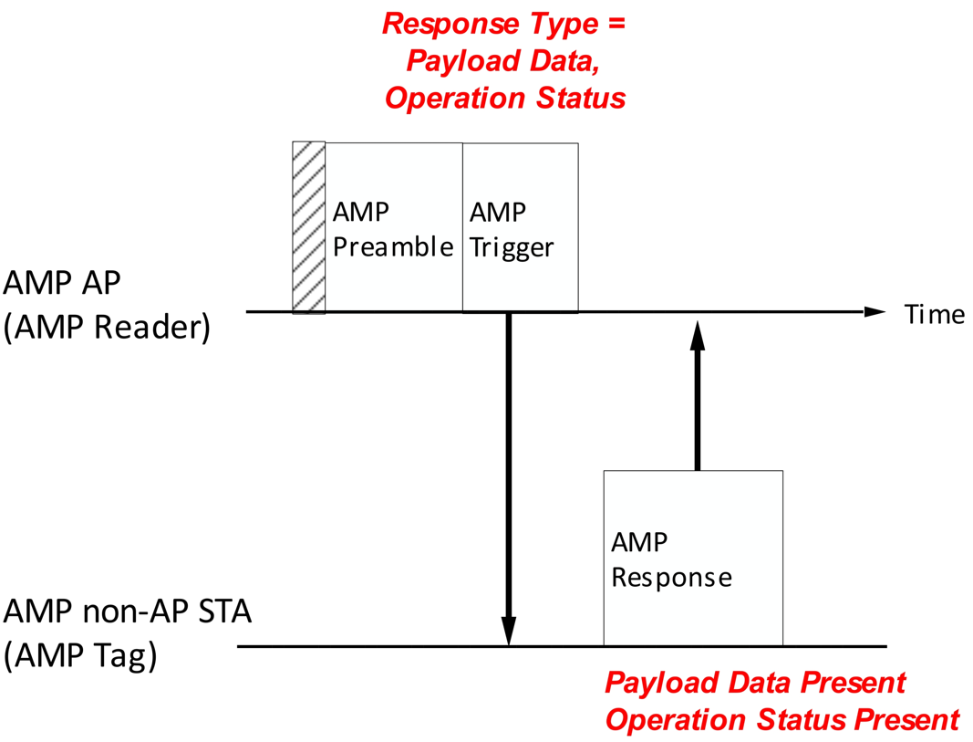
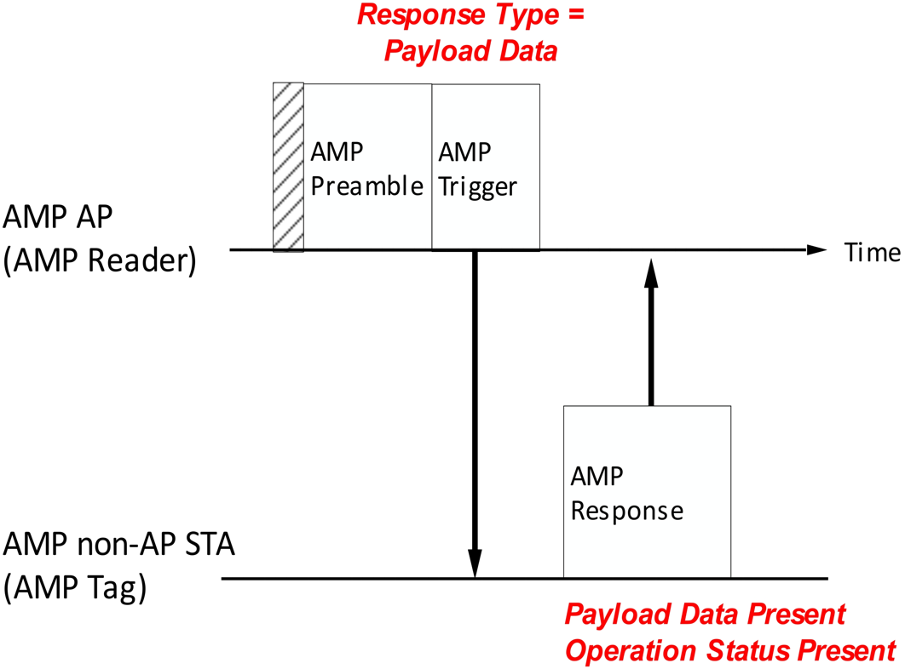
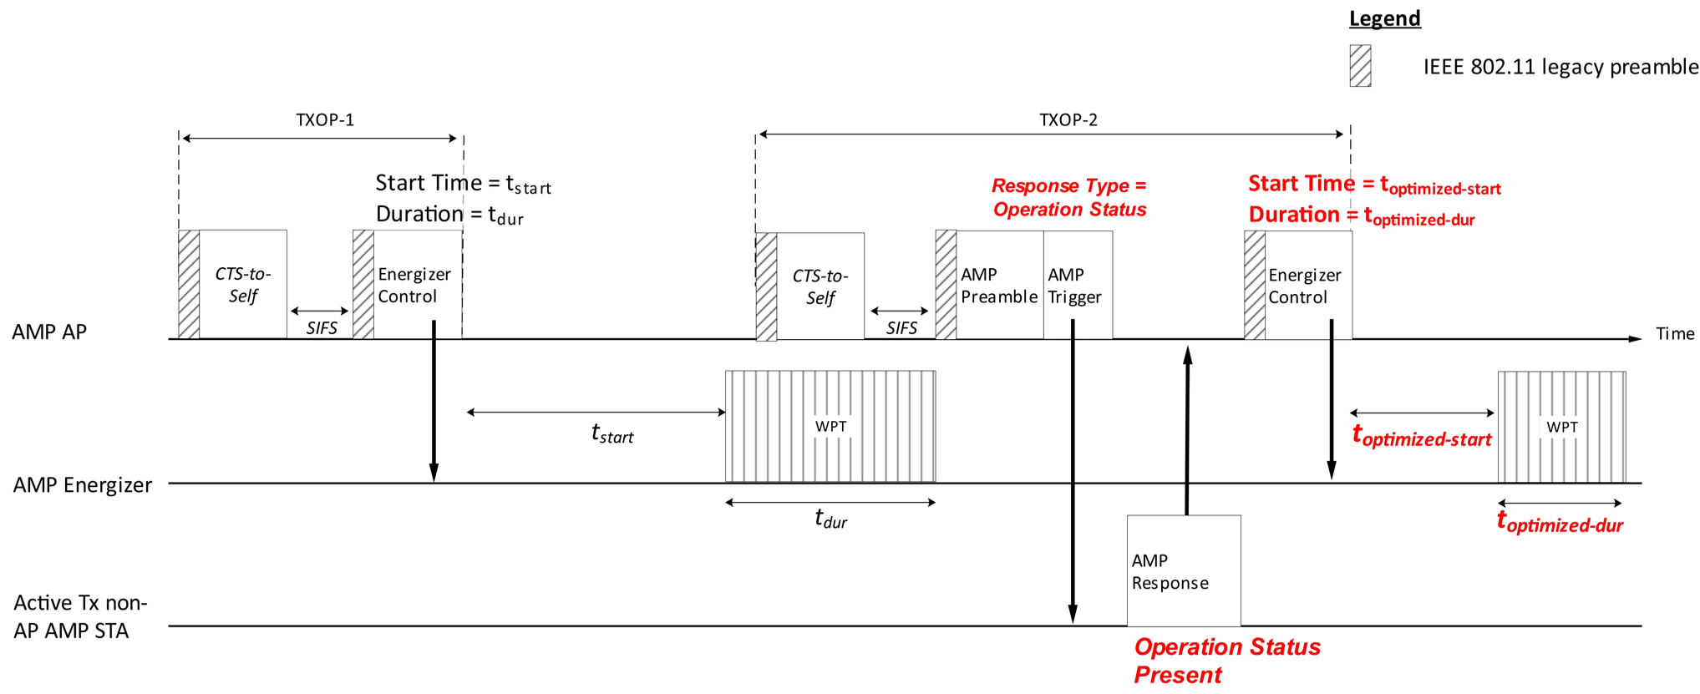
AMP Operation Status – Recap
Procedure:
The Operation status report can be explicitly solicited by the AMP AP in an AMP Trigger frame, or piggybacked in an UL AMP Response frame.
The AMP AP may optionally transmit WPT/excitation signal immediately preceding the request for Operation status to gauge the AMP STA’s energy charging/discharging rate.
Computation:
The AMP STA can measure its current voltage on chip, to determine its available energy, $E=\frac{1}{2}C\left(V_{current}^{2}−V_{min}^{2}\right)$, and based on power consumption in a mode of operation, determine the time it can sustain the mode of operation (TX, RX, CS, idle), $t_{MODE}=\frac{E}{P_{MODE}}$.
Solicited by AMP AP
Piggybacked by AMP STA

Slide 4
AMP Operation Status – Implementation
Active Tx non-AP AMP STA should have an 8-bit ADC, that we can utilize to get the voltage reading on the capacitor, say, every minute or so, or when triggered by the AMP AP. Several references [3, 4] show extremely low energy consumption (65-nm CMOS process, 3.19 fJ/conversion-step).
Backscatter non-AP AMP STAs may be fitted with a 3-bit ADC to enable operation status reporting.
Extra circuitry is necessary to convert the voltage on capacitor to time in a mode of operation, namely, $V_{min}$ is the minimum voltage level that can support a mode of operation, and $P_{MODE}$ is the power consumption in that mode of operation. Both can be measured by the vendor during production testing or simulation for each AMP tag, based on a default data rate (say 1Mbps). For other data rates (250kbps, 4Mbps), the power consumption is assumed linear (0.25x, 4x)
The time in a mode of operation can then be encoded to a few bits to indicate to the AMP AP.
The x-bit ADC, and y-bit encoding determine the granularity of the timing report.

Slide 5
AMP Operation Status – Encoding
The encoding for the time in a mode of operation needs to consider a range of capacitor values, and power consumptions for these modes of operation.
The communication overhead for the operation status report can be 6 bits, where the time in transmission mode, $t_{TX}$, is encoded as 5 bits, and a 1 bit indicator can be used to indicate a fixed multiplicative factor to account for the time difference in other operation modes relative to $t_{TX}$ (e.g. $t_{RX}=RX_{multiple}∗t_{TX}$).
Operation Status Report
Indicator 1 bit | Unit (microsecond) 2 bits | Value (+1) 3 bits (bxxx000-bxxx111)
b0xxxxx: $t_{TX}$ | bx00xxx: ${10}^{1}$ | 10us to 80us
 | bx01xxx: ${10}^{2}$ | 100us to 800us
 | bx10xxx: ${10}^{3}$ | 1ms to 8ms
 | bx11xxx: ${10}^{4}$ | 10ms to 80ms
b1xxxxx: Multiple | Mode 2 bits | Value (+1) 3 bits (bxxx000-bxxx111)
 | bx00xxx: RX multiple | $$2∗bit value$$
 | bx01xxx: CS multiple | $$20∗bit value$$
 | bx10xxx: idle multiple | $$200∗bit value$$
 | bx11xxx: Reserved | -
C = [100pF, 1uF]; $V_{max}$=1.5V; $V_{min}$= 0.5V $E_{mode}$ = [100pJ, 1uJ]
Operation Mode | $$P_{mode}$$ | $$t_{mode}$$
Transmission | 10uW | [10us, 0.1s] : $t_{TX}$
Reception | 1uW | [100us, 1s] : $t_{RX}$
Channel Sensing | 0.1uW | [1ms, 10s] : $t_{CS}$
Idle | 0.01uW | [10ms, 100s] : $t_{idle}$
*Based on standard development to support general purpose implementation

Slide 6
Summary
The Operation Status report serves as an indication of the time remaining in a mode of operation for an AMP STA, that allows the AMP AP to optimize the charging and possibly channel access for the AMP STAs in its BSS.
Implementation design principle and references were provided to demonstrate on-tag computation feasibility.
A minimalistic encoding scheme of 6 bits to encode the time in transmission mode, and expressing the time in other modes of operation as a multiplicative factor of the transmission time was shown.

Slide 7
SP
Do you agree to add the following text to TGbp SFD?
IEEE 802.11bp allows a non-AP AMP STA to report the transmission time it can sustain, and a fixed multiplicative factor of the transmission time, to indicate the time it can sustain other modes of operation. How the non-AP AMP STA may determine these times is TBD.
Note:
Other modes of operation may include reception, channel sensing, and idle.
Idle mode refers to a mode of operation with no RF activity, i.e. the non-AP AMP STA cannot transmit or receive any frames in this mode.
[Reference: 11-25/0788r0, 11-25/1243r0]

Slide 8
References
[1] 11-24/1613r9, Specification Framework for TGbp
[2] 11-25/0788r0, AMP Operation Status Reporting
[3] P. Harikumar, et. al., “A 0.4-V Subnanowatt 8-Bit 1-kS/s SAR ADC in 65-nm CMOS for Wireless Sensor Applications,” IEEE Transactions on Circuits and Systems, vol. 63, no. 8, Aug. 2016.
[4] W. Hu, et. al., “An 8-Bit Single-Ended Ultra-Low-Power SAR ADC With a Novel DAC Switching Method and a Counter-Based Digital Control Circuitry,” IEEE Transactions on Circuits and Systems, vol. 60, no. 7, Jul. 2013.

