Slide 1
AMP Acknowledgments
Date: 25 July 2025
Name | Affiliation | Address | Phone | Email
Rojan Chitrakar | Huawei | Singapore |  | rojan.chitrakar@huawei.com
Lei Huang
Ian Bajaj
Mahmoud Hasabelnaby
Notes:
Jul 12, 2010
Page 1

Slide 2
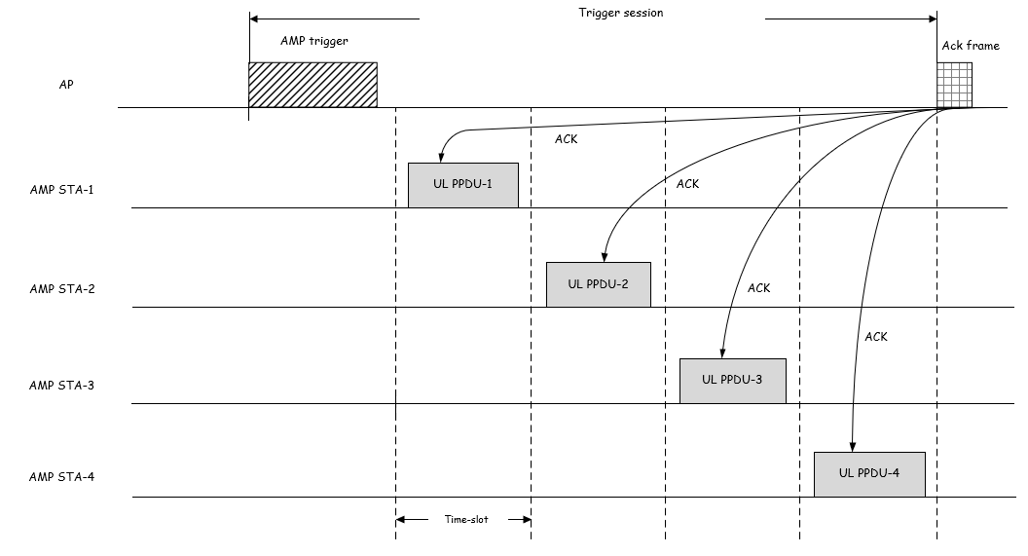
Background
FM-4: 802.11bp defines an AMP Ack frame that an AMP AP transmits to acknowledge the received UL AMP frame(s). [1]
AMP AP transmits an block ACK frame after all time-slots indicated by the AMP trigger, to acknowledge the received UL PPDUs in the time-slots. [2]

Slide 3
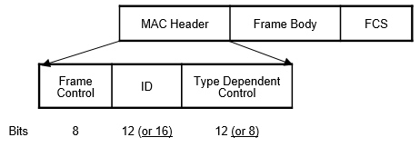

Immediate Ack
A potential Ack frame format [4]: Proposal for AMP Ack frame (e.g., 6 octets@250kbps~192us of PSDU airtime, i.e., 284uS PPDU Duration):
Another potential Ack frame format [5] (32 bits PSDU = 220µS @ 250 Kbps):
The airtime for AMP Ack frame may be similar or even higher than the solicited uplink response. E.g., a 6 octet AMP Ack frame@ 250 kbps consumes similar airtime as an uplink frame of size: 8 octet @250 kbps, or 32 octets @ 1 Mbps, or 128 octets @ 4 Mbps.
Notes:
DL Assumptions:
AMP-Sync: 32x2us for 250 kbps; 16x2uS for 1000 kbps
AMP Preamble = L-Preamble (28 uS) + AMP-Sync: : 92us for 250 kbps, 60us for 1000 kbps
UL Assumptions:
AMP-Sync: 16x2uS for all data rates (250 kbps, 1 Mbps, 4 Mbps)
AMP Preamble: 32us for all data rates

Slide 4
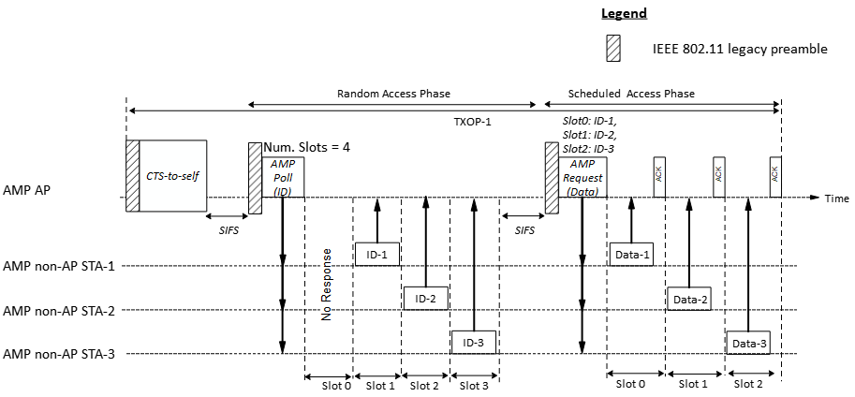
No/Implicit Acknowledgment
In a two-phase channel access (e.g., obtaining a short ID in the random access phase, and subsequently soliciting actual uplink data in a scheduled access), explicit Ack frame is not required in the random access phase. The AMP Trigger frame for the scheduled access phase can act as implicit acks.
Explicit Ack frames may be useful in the scheduled access phase (e.g., to help STAs clear their buffer), or in a single phase random access (e.g., soliciting actual uplink data in the random access phase itself). However, if the solicited data is static (e.g., EPC), Ack may not be necessary even for scheduled access, since the AMP AP can solicit the data again if the previous attempt failed.

Slide 5
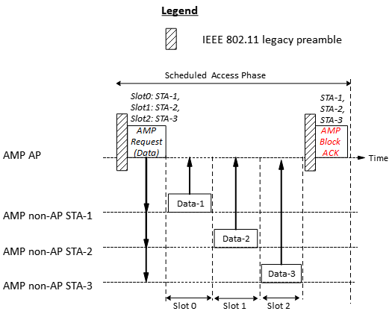
Delayed Acknowledgment
If Ack is required, the airtime efficiency can be improved by delaying the individual acks and transmitting a consolidated acknowledgement (e.g., in an AMP BlockAck frame).
@ 250 Kbps:
1 BA = 476 µS
3 Acks = 3*220 µS = 660 µS
Airtime savings of 1 BA vs 3 Acks = ~28%
Notes:
3 Ack frames = 220 * 3 = 660 uS
1 BA = 284 + N*16*4 = 476 uS

Slide 6
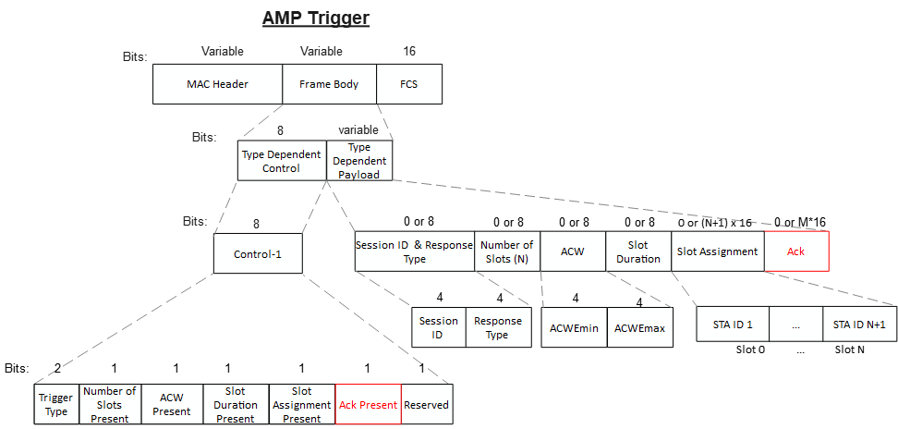
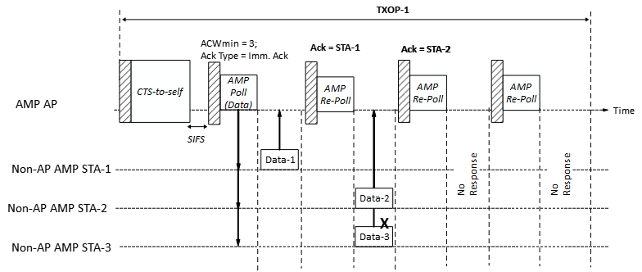
Ack field
For either immediate or delayed acknowledgments, instead of transmitting dedicated Ack (or BlockAck) frame, the AMP AP may also include an Ack field in a downlink AMP frame to acknowledge uplink transmissions. Saves the high air-time overhead associated with the PHY and MAC headers for a separate Ack/BA frame.
AMP Trigger frame also acknowledges STA-2’s uplink transmission.
Notes:
3 Ack frames = 220 * 3 = 660 uS
1 BA = 284 + N*16 = 476 uS

Slide 7
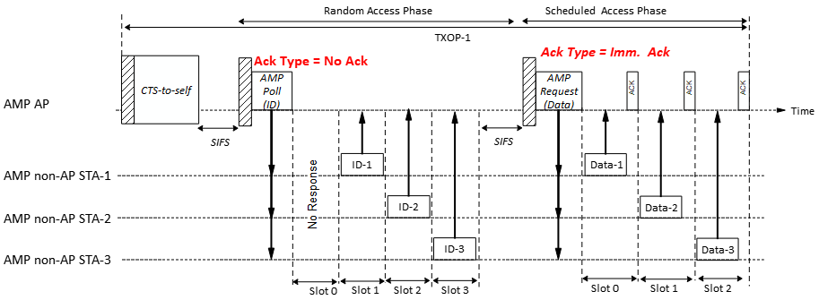
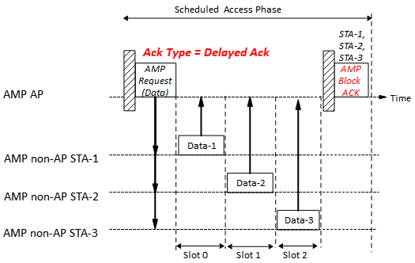
Proposal
In the AMP Trigger frame, the AMP AP indicates the type of acknowledgment that it intends to use for uplink access, e.g., using a 2 bits Ack Type field:
Ack Type field
Value | Name | Description
0 | No Ack | AMP AP will not transmit Ack frame after uplink transmissions
1 | Immediate Ack | AMP AP will transmit an Ack frame after each successful uplink transmission
2 | Delayed Ack | AMP AP will transmit a Block Ack frame in delayed manner to acknowledge one or more successful uplink transmissions.
3 | Reserved

Slide 8
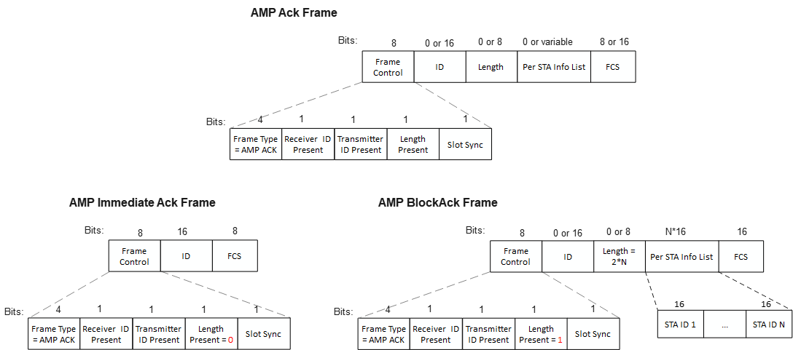
Ack frame format
The same frame type (e.g., AMP Ack) can be used for both Immediate Ack and Block Ack. The Length field can be used to indicate an AMP BlockAck frame:
  If Length field is not present => Immediate Ack
  If Length field is present => AMP BlockAck

Slide 9
Summary
The need and format of downlink AMP Ack frame may be situation dependent.
In the AMP Trigger frame, the AMP AP indicates the type of acknowledgment that it intends to use in the slots allocated for uplink access, e.g., using a 2 bits Ack Type field.
Ack Type field
Value | Name | Description
0 | No Ack | AMP AP will not transmit Ack frame after uplink transmissions
1 | Immediate Ack | AMP AP will transmit an Ack frame after each successful uplink transmission
2 | Delayed Ack | AMP AP will transmit a Block Ack frame in delayed manner to acknowledge one or more successful uplink transmissions.
3 | Reserved
The same frame type (e.g., AMP Ack) can be used for both Immediate Ack and Block Ack, the Length field differentiate the two Ack types.

Slide 10
SP 1
Do you agree to add to 11bp SFD:
In the AMP Trigger frame, the AMP AP indicates the type of acknowledgment that it intends to use in the slots allocated for uplink access.

Slide 11
SP 2
Do you agree to add to 11bp SFD:
In the AMP Trigger frame, the AMP AP indicates the following types of acknowledgments that it intends to use in the slots allocated for uplink access:
  No Ack
  Immediate Ack
  Delayed Ack

Slide 12
SP 3
Do you agree to add to 11bp SFD:
802.11bp defines an AMP BlockAck frame that is used to acknowledge the uplink transmissions from two or more non-AP AMP STAs.

Slide 13
SP 4
Do you agree to add to 11bp SFD:
AMP AP may include an Ack field in a downlink AMP frame to acknowledge uplink transmissions.

Slide 14
References
[1] IEEE 802.11-24/1613r7, Specification framework for tgbp
[2] 11-25/0398r0, AMP frames (Alfred Asterjadhi et. al)
[3] 11-25/0859r0, AMP Ack frame (Chuanfeng He)
[4] 11-25-0776r1, AMP Frames - follow up (Alfred Asterjadhi et. al)
[5] 11-25-1102, AMP Frame format (Rojan Chitrakar)

