Slide 1
AMP Pairing and ID Assignment
Date: 25 July 2025
Name | Affiliation | Address | Phone | Email
Rojan Chitrakar | Huawei | Singapore |  | rojan.chitrakar@huawei.com
Lei Huang
Ian Bajaj
Notes:
Jul 12, 2010
Page 1

Slide 2
Background
MM-21: 11bp uses short local addresses for AMP non-AP STAs in secure AMP communications. [1]
FM-2: 802.11bp defines an AMP Trigger frame that an AP transmits to solicit UL AMP PPDU(s) from one or more 802.11bp clients and may carry the following content
  Transmitter ID
  Receiver ID(s)
  FCS
  Other parameters TBD.
Several contributions have proposed assigning a short ID to non-AP AMP STAs. [2], [3], [4]
Several contributions also implicitly assume some form of “relationship” or “shared information” between AMP AP and non-AP AMP STAs:
  For duty cycle or service period (SP) operations. [8], [9]
  Security related: shared secret for security key generation etc. [5], [6], [7]

Slide 3
Discussion
Simple forms of non-AP AMP STAs (e.g., tag form backscatter non-AP AMP STAs, or even Active Tx non-AP AMP STA) may not have capability (e.g., Persistent memory) to save assigned IDs, or “association information.” But some, especially Active Tx non-AP AMP STA may have such capability.
Some use cases or deployment scenarios may work well without assigned IDs or “association”. E.g., RFID like transient retail, or logistic use cases.
However, some use cases or deployment scenarios may benefit from assigned IDs and/or “association”. E.g., warehouse inventory applications, or sensor data networks etc.

Slide 4
AMP Pairing
We propose the following definitions:
AMP Pairing: A bonding relationship between an AMP AP and a non-AP AMP STA.
AMP AP ID (APID): A short ID, e.g., 16-bits, that identifies the AMP AP. APID may be derived from the AMP AP’s MAC address. e.g., as the 16 LSBs of the 32-bit CRC calculated over the AMP AP’s MAC address.
Paired ID (PID): A short ID, that is assigned by an AMP AP to a paired non-AP AMP STA.
Group ID (GID): A short ID representing a group of non-AP AMP STAs.
Paired communication: Unicast communication between an AMP AP and a paired non-AP AMP STA using the PID.
Upon a successful AMP Pairing between an AMP AP and a non-AP AMP STA :
  A PID (and optionally one or more GID) is assigned by the AMP AP to the non-AP AMP STA.
  The AMP AP saves relevant information of the non-AP AMP STA, e.g., permanent ID (MAC Address, EPC, TID etc.), PID, GID, the non-AP AMP STA’s capabilities etc.
  The paired non-AP AMP STA saves the assigned PID, GID and relevant information of the AMP AP: Paired AP Address (e.g., MAC Address of the AMP AP).
  When security is negotiated, security materials (Key, Key ID etc.) are also saved by both devices.

Slide 5
AMP Pairing
Two levels (or types) of AMP Pairing may be considered:
Open pairing (Allows paired communication without security):
  Applicable for non-AP AMP STAs that do not support MAC level security.
  Dedicated frame exchange is performed to establish AMP pairing and exchange pairing related information.
  No security guarantees can be assumed at the MAC level.
Secure pairing (Allows paired communication with security):
  Establishment of a secured relationship between an AMP AP and a non-AP AMP STA also leads to the establishment of the secure pairing relationship.
  Pairing AMP AP and the paired non-AP AMP STA successfully authenticate each other and generate security keys.
  If not already exchanged, pairing related information is also exchanged during the security establishment.

Slide 6
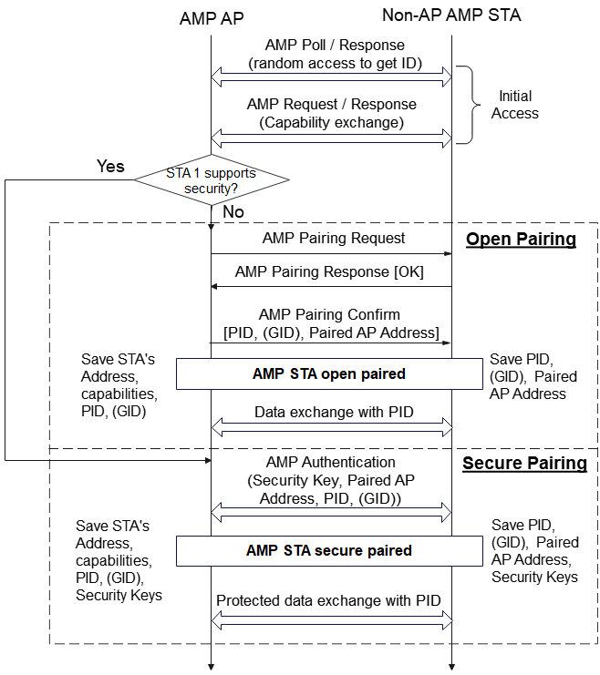
AMP Pairing setup

Slide 7
Summary
We proposed to define an AMP Pairing procedure to form a bonding relationship between an AMP AP and a non-AP AMP STA.
Upon a successful AMP Pairing between an AMP AP and a non-AP AMP STA, a Paired ID (PID), and optionally one or more Group ID (GID), are assigned by the AMP AP to the non-AP AMP STA.
An AMP AP ID (APID) identifies the AMP AP. APID may be derived from the AMP AP’s MAC address.
Once AMP Pairing is established, an AMP AP and a paired non-AP AMP STA may engage in paired communication using the APID, PID and optionally GID.
AMP Pairing may be either Open or Secure.

Slide 8
SP 1
Do you agree to add to 11bp SFD:
An AMP AP may assign a Short ID to a non-AP AMP STA.
  The size of the Short ID is TBD.
  The method to derive the Short ID is TBD.

Slide 9
SP 2
Do you agree to add to 11bp SFD:
An AMP AP may be identified by a Short ID.
  The size of the Short ID is TBD.
  The method to derive the Short ID is TBD.

Slide 10
SP 3
Do you agree to add to 11bp SFD:
An AMP AP may assign one or more Group IDs to a non-AP AMP STA.
  The size of the Group ID is TBD.
  The method to derive the Group ID is TBD.

Slide 11
References
[1] IEEE 802.11-24/1613r7, Specification framework for tgbp
[2] 11-25/0785r2, .11bp Frame Formats for Active TX AMP STA (Solomon Trainin)
[3] 11-25/0041, Follow up on AMP identification (Zhanjing Bao)
[4] 11-25/0263, Provisioning Protocol for long range AMP IoT devices (Guy-Armand Kamendje)
[5] 11-25/0779, E2E Operation of AMP-enabled Non-AP STAs (Sanket Kalamkar)
[6] Low-Complexity Provisioning Methods for Low-Complexity Secure AMP Communications (Hui Luo)
[7] 11-25/0819, AMP Security – follow up (Rojan Chitrakar )
[8] 11-25/0813, Follow up on Duty-cycle operation for AMP (Chuanfeng He)
[9] 11-25/0787r0, Follow-up on AMP Open Service Period (Ian Baja)

